Slide 1
Discrete Growth And Compounding
Time Interval

Slide 2
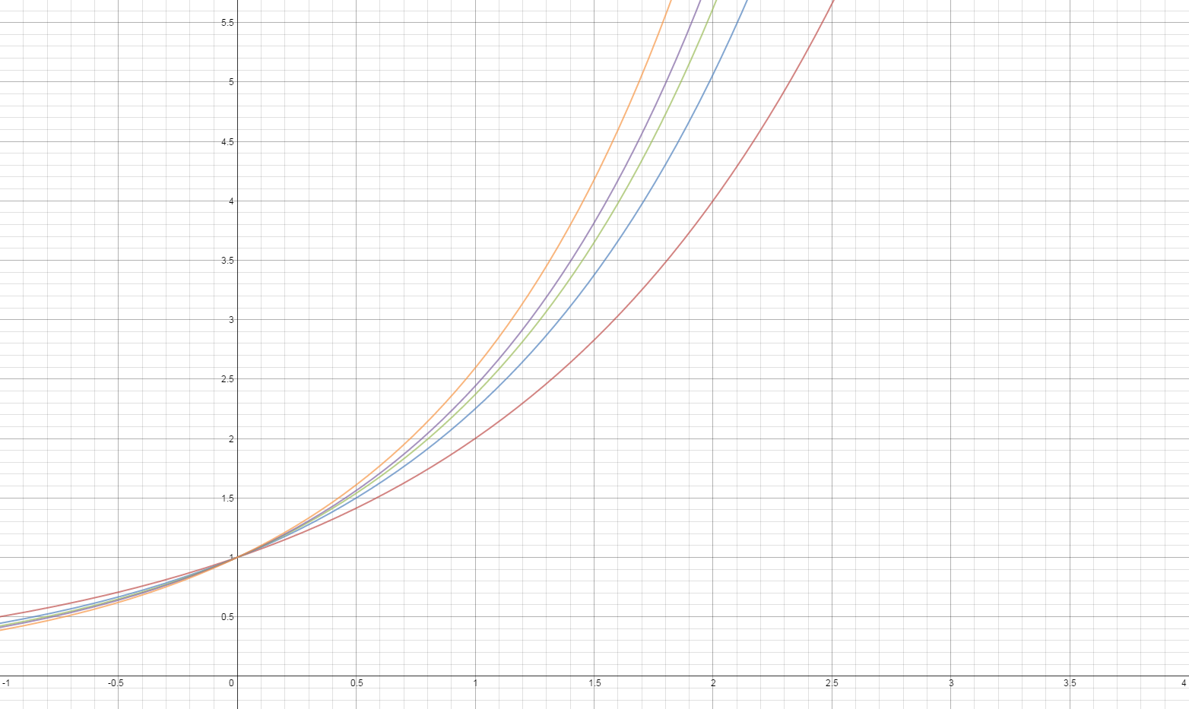
Continuous Growth And Discrete Compounding
With Increased Compounding Frequency
This shows g(x) = 2^{x} at progressively increasing compounding values: 1, 2, 3, 4, 10.
At each increased compounding there is more growth.

Slide 3
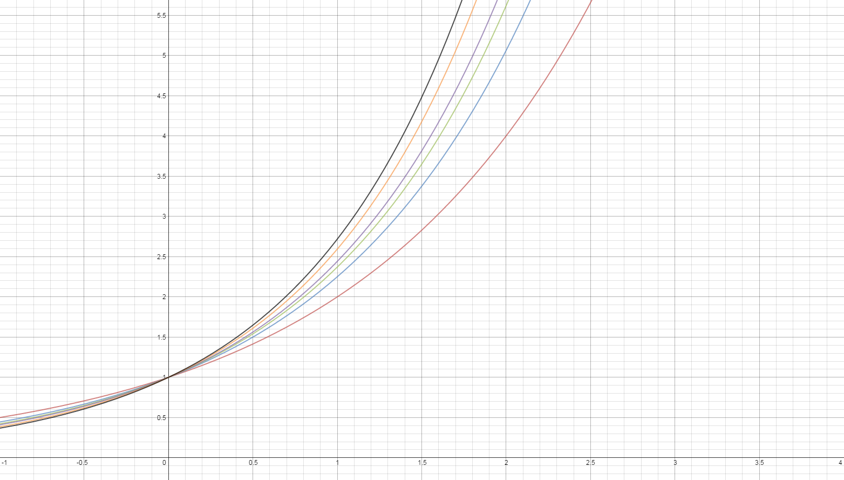
Continuous Growth And Compounding
This shows g(x) = 2^{x} with the same compounding frequencies as before, but also
With continuous compounding, which dominates all the other discrete compounding
Frequencies!

