Slide 1

Why Are Nullable Types Introduced in Kotlin?
by Anton Zaviyalov
info@skill-centric.com
© Skill Centric

Slide 2


Download:
https://github.com/skill-centric/objectbox/tree/queries

Slide 3
public class Demo { public static void main(String[] args) { String name = null; name.toUpperCase(); } }

Slide 4
Create
public class Demo { public static void main(String[] args) { String name = null; name.toUpperCase(); } }

Slide 5

Java 8 default methods
Steep learning curve
Alternatives: CVS, Subversion...

Slide 6

String
String
null
“Mike”
“Jake”
“”
“John”
null

Slide 7
if (firstName != null) { firstName.count() } else { null }
firstName?.count()

Slide 8
name != null
name.count()
name?.count()
null
name == null

Slide 9

public
public
protected
internal
package-private
protected
private
private
Visibility

Slide 10



protected
Subclass
Not Subclass
Same package
Different package

Slide 11


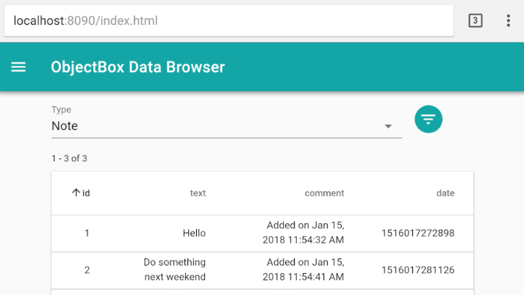

adb forward tcp:8090 tcp:8090

Slide 12
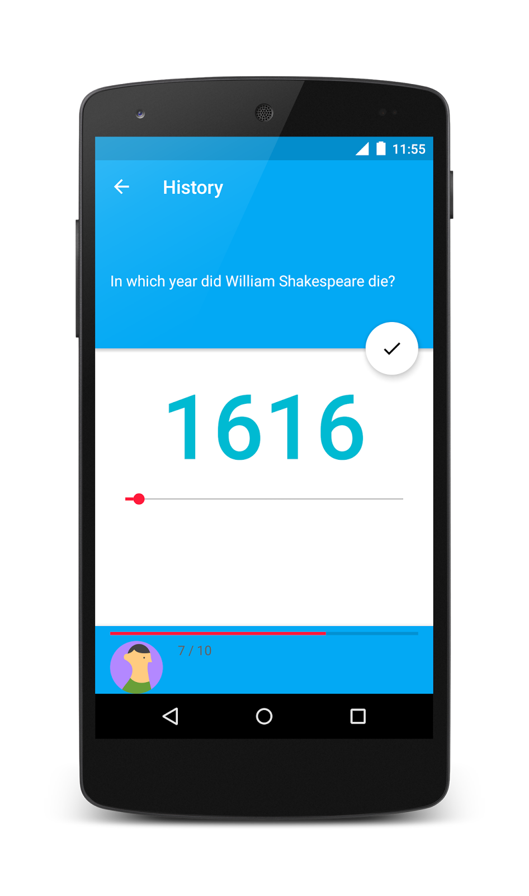


Slide 13
Hotfix
V 1.0
V 1.1
Master
Release
Develop
Feature 1
Feature 2

Slide 14
View
ViewState
Presenter
Model

