Slide 2
Nope
Team 1
Tony Hart
Jim Bowen
Scott Bergler
Powell Quiring
Adam Davis
Notes:
Tony:

Slide 3

DESCRIBE YOUR SOLUTION
Notes:
Tony:

Slide 4
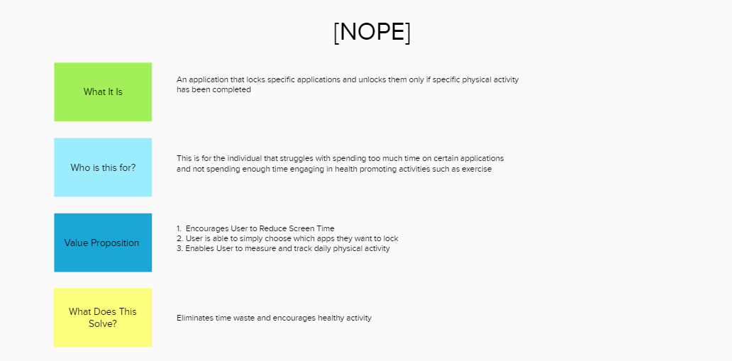
Notes:
Jim: talks to the sequence demo
And then back to Tony

Slide 5
THE PATH FORWARD
How does this make things better?
How can this be deployed?
What’s next?
Notes:
Tony to do strategy

Slide 6
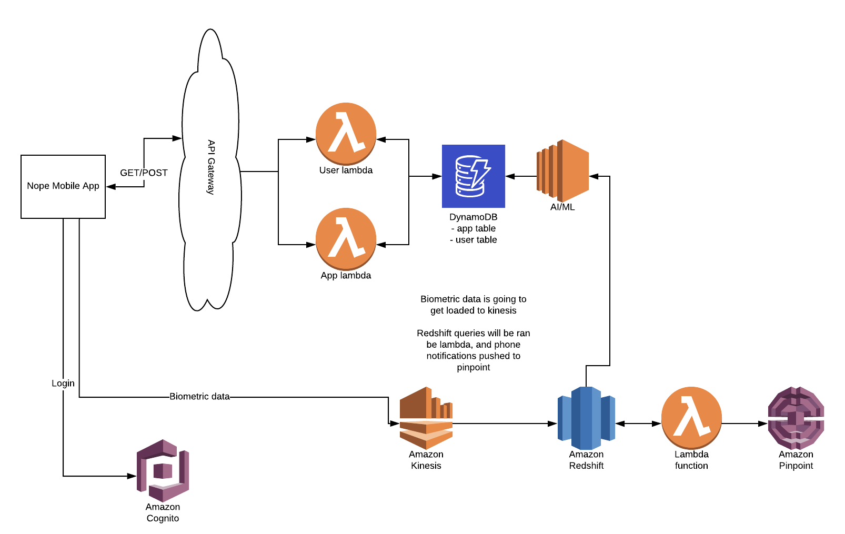
HOW DID YOU CREATE IT?

