Slide 1
Next Best Action - Bank Marketing
Goal: estimate which customers are likely to subscribe before the current campaign.
Prediction: customer propensity to subscribe to a term deposit.
NBA decision: use that propensity to support TARGET vs. DO NOT TARGET
Dataset: UCI Bank Marketing dataset; Historical bank-customer data with customer context and previous interactions. Relevant to NBA because historical information can support a future marketing decision.

Slide 2
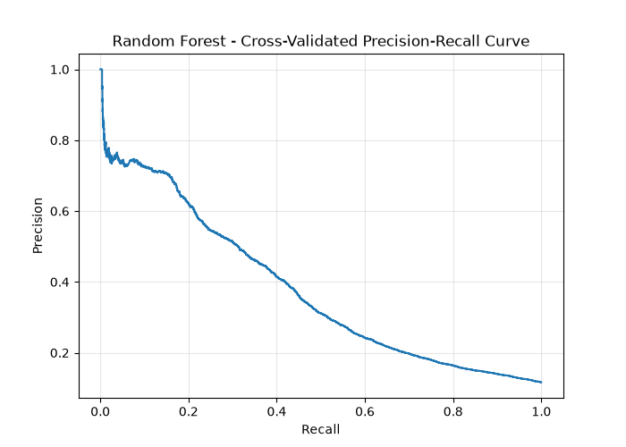
Design, Challenges and Results
Main repository design:
1. EDA and define prediction time.
2. Exclude current-campaign features unavailable before the campaign.
3. Preprocess numerical and categorical features in a scikit-learn Pipeline.
4. Compare Logistic Regression, Decision Tree and Random Forest.
5. Select by 5-fold stratified CV Average Precision.
6. Select threshold from out-of-fold predictions; evaluate once on the held-out test set.
Key challenges and their resolutions:
1. Class imbalance - AP for model selection, Precision/Recall/F1 score for proper model evaluation
2. Leaky features - Removed these features in the training pipeline
3. Special, skewed features - Introduced standard and robust scaling
4. No defined FN/FP business costs - Used the F1 score to have balance between precision and recall
5. Reproducibility - Next to .ipynb I introduced a modular training pipeline with fixed seed.
OOF threshold selection:
Selected model: random_forest
Threshold: 0.1815
Precision: 0.4039
Recall: 0.4164
F1: 0.41
Final test set evaluation:
Threshold: 0.1815
Average Precision: 0.3905
Precision: 0.4095
Recall: 0.4149
F1: 0.4122

