Slide 1
Comparing Company Stock Growth 2020-2023 and forecasting for 2024-2025
Group Members:
Raymond Conley
Sunny Kiluvia
Richard Ravos
Lane Melton

Slide 2
Executive Summary
The purpose of the project was to identify eight (8) companies' stock who had an AI focus and review their performance during the 2020 - 2023 performance years influenced by the Covid pandemic.
This information provided historical data to make a prediction using Prophet and determine year end closing prices for 2025.
For 2024 year end closing, prices were also identified for all companies to determine an endpoint reference.

Slide 3
Executive Summary(con’t)
It should be noted all companies maintained original business objectives which included a focus on non-AI factors as well as pre-pandemic product lines. These factors may influence a higher comparative stock price for companies with broader business objectives than others.
The research concluded NVDA not only had the highest closing stock price but the highest future closing price for 2025 while INTC had the lowest closing stock price and lowest future price for 2025.

Slide 4
Scope/project overview
An agile project was set up using GitHub Projects to get the group started and establish a proper focus.
The focus resulted in an analysis of the financial stock market.
The group chose 8 companies who had an Artificial Intelligence focus during the primary Covid years 2020-2023.
The company's stock was analyzed to see how they perform during this time and forecast using Prophet to determine performance through 2024-2025.
Historical data was used to predict how the companies may perform in the future.
Companies chosen were NVidia, Intel, Microsoft, Tesla, Amazon, Alphabet Inc, Arista Networks Inc, Meta
The group met regularly during class hours as well as worked individually during off hours to ensure all milestones were met and a timeline maintained.

Slide 5
Research Questions
What were the closing prices of identified company stock?
Using the historical data of closing prices, what are the forecasted closing prices at the end of 2025?

Slide 6
approach
The group approached its objective by obtaining a clean and functional dataset. This was found on Yahoo Finance.
Data was obtained by accessing the dataset for each company with an AI focus and establishing a date and time stamp.

Slide 7
Approach (con’t)
All record sets contained identical formatting which was used to incorporate data into analysis and determine closing price.
Data was then plotted for visual determination.

Slide 8
Data collection
Data Collection was obtained from https://finance.yahoo.com.
Reference research was obtained from various web sites specifically listed in Appendices of Readme.md.

Slide 9
Data Cleanup
Cleanup was achieved by originally plotting all companies together and then plotting individually to determine if each company contained sufficient data to include in the analysis.
For Future Analysis it should be noted NVDA does not contain the equivalent historical data as the other companies and could skew the statistical findings.

Slide 10
Analysis and conclusion
Analysis shows the listed companies indicated the highest closing prices during 2020-2023 time periods in the following order.
- NVDA $450 Projected - $700
- MSFT $375 Projected - $500
- META $350 Projected - $500
- TSLA $250 Projected - $350
- ANET $240 Projected - $340
- AMZN $155 Projected - $205
- GOOG $140 Projected - $190
- INTC $50 Projected - $75
*Scrubbed Data

Slide 11
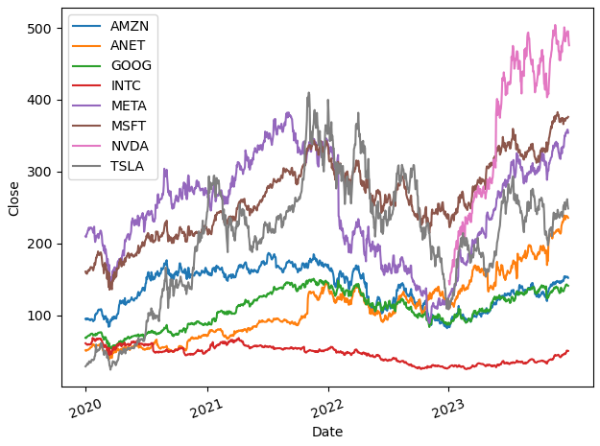
All companies' Historical data

Slide 12
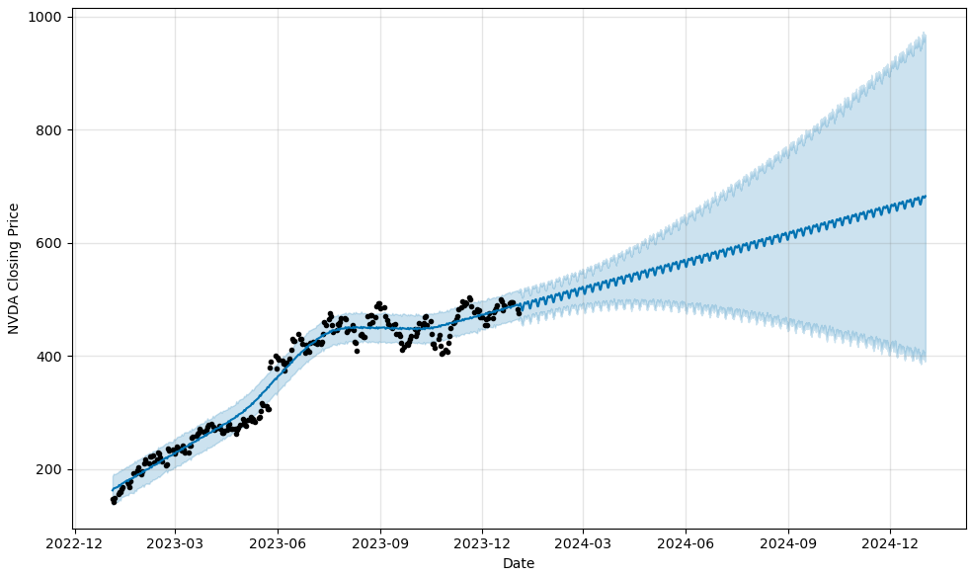
Nvda projection

Slide 13
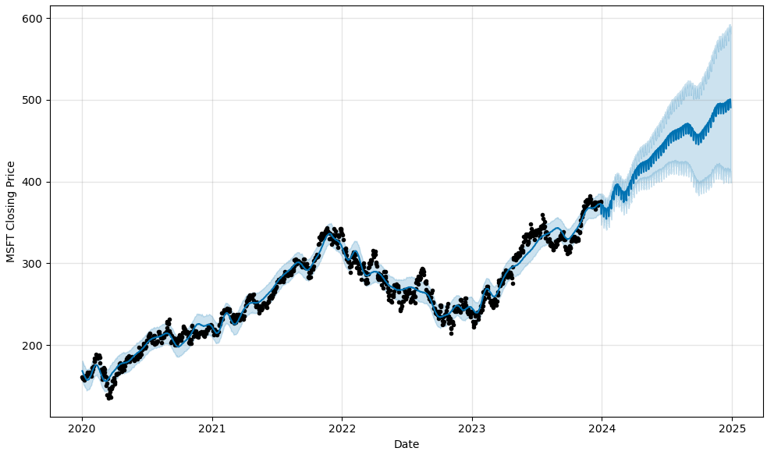
Msft projection

Slide 14
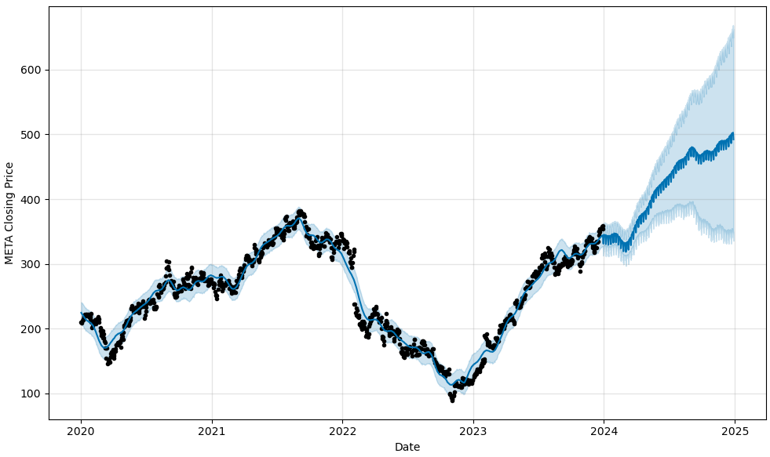
Meta projection

Slide 15
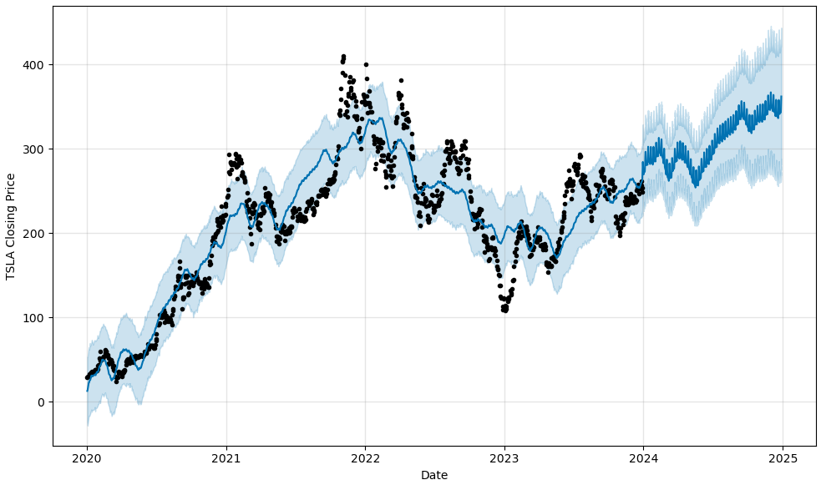
Tsla projection

Slide 16
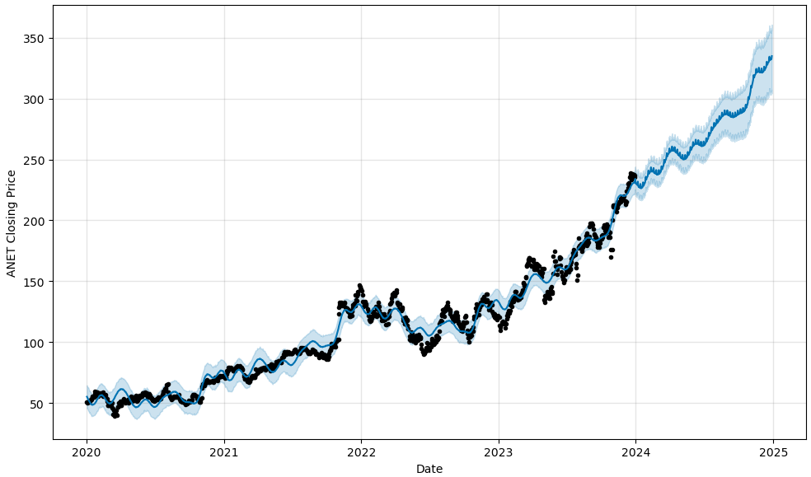
ANET PROJECTION

Slide 17
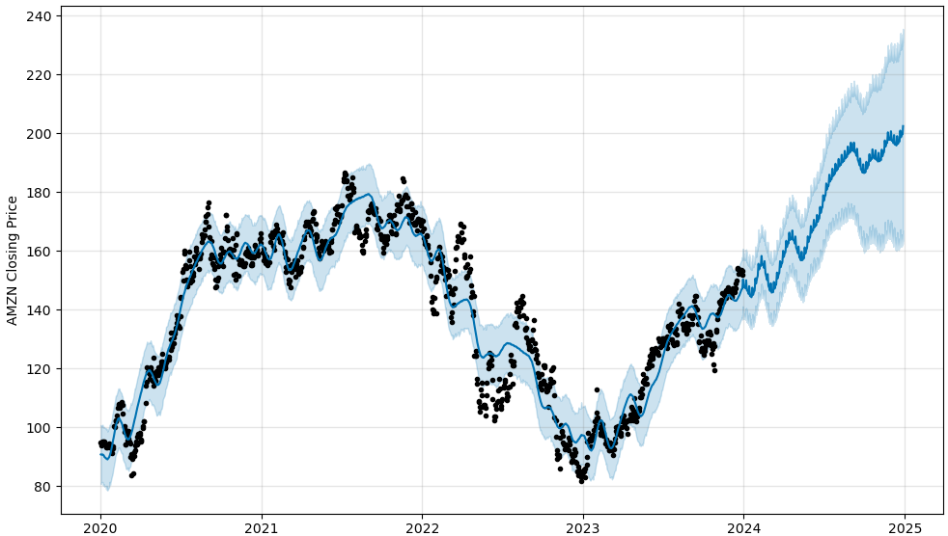
AMZN PROJECTION

Slide 18
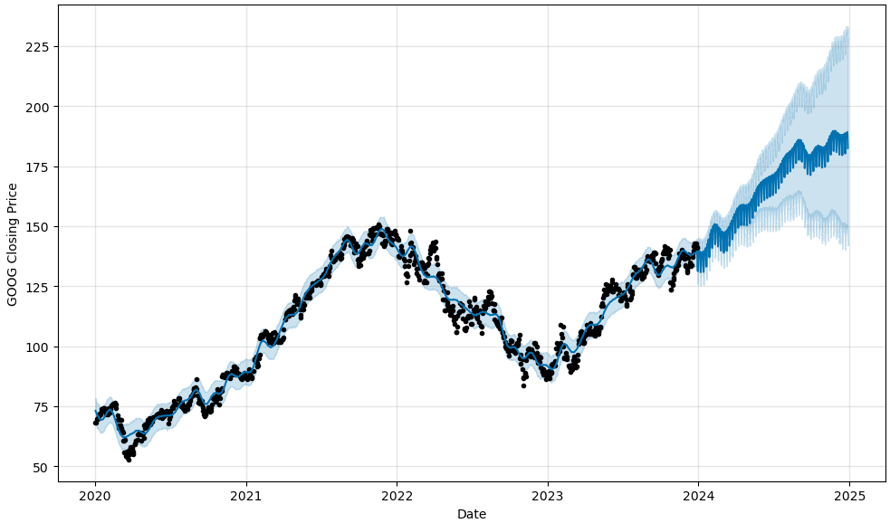
Goog projection

Slide 19
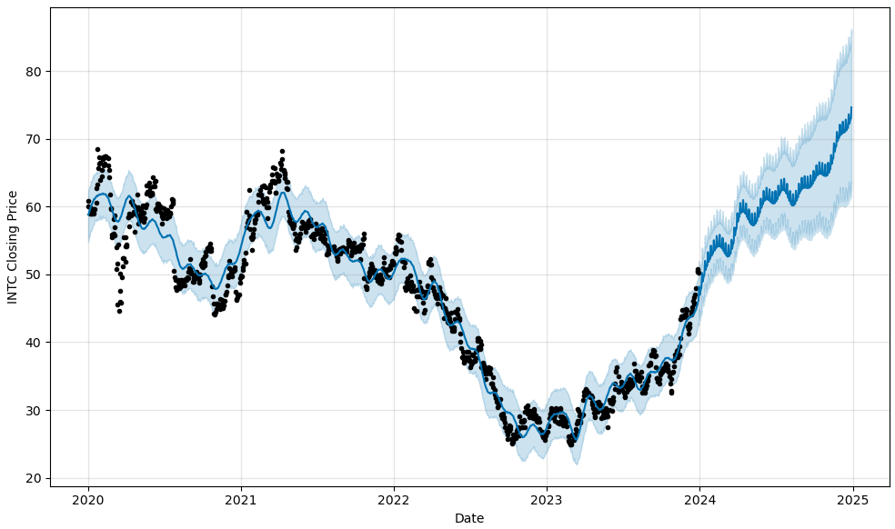
Intc projection

Slide 20
Findings and implications
The findings indicate NVDA had the highest closing prices with the largest growth in closing dollar amount for 2025.
The findings indicate INTC had the lowest closing prices with the smallest growth in closing dollar amount for 2025.
All companies had an Artificial Intelligence focus while still maintaining pre-AI and pre-Covid business objectives.

Slide 21
Software version control
A GitHub repository was created - all group members contributed to repository.
Each GitHub commit was annotated to ensure proper communication between group members.
Supporting files were also uploaded and evaluated by the group.

Slide 22
documentation
Relevant notes have been included with all code as well as the Readme.md.
There are no installation requirements.
The Readme.md file contains graphical representation of the research findings.

Slide 23
Future development
Future development includes the identification of price range during the 2020 - 2024 timeframe and the average fluctuation of stock prices.
Highest percentage gains should be determined from initial 2020 price to closing of 2025.
Recommendations should be made to determine which stock to purchase for maximum profit in 2025.
For Future Analysis it should be noted NVDA does not contain the equivalent historical data as the other companies and could skew the statistical findings.

Slide 24
THANK YOU

