Slide 1

Painless Live Userspace Patching
Stanislav Kinsburskiy
stanislav.kinsburskiy@gmail.com
https://github.com/skinsbursky/presentations/blob/master/lup-devconf.odp

Slide 2
Summary
What is “Live Patching”?
Why it's needed?
Types of binary code
Process state
What can be patched?
Binary patch creation
When binary patch can be applied?
Where to place new code?
Userspace live patching in pictures
Why is it called “painless”?

Slide 3

What is “Live Patching”?
Change a piece of code in a process
Preserve process state
Do it safe

Slide 4
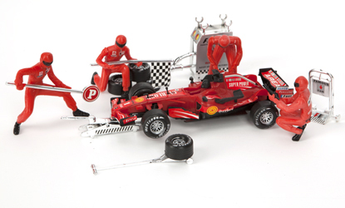
Why it's needed?
Get rid of heavy services restart
Reduce service downtime in case of critical vulnerabilities, because of:
  No need in application restart
  No need in migration

Slide 5

Types of binary code
Statically-linked
Dynamically-linked
  Load-time relocation
  Position independent code (PIC)

Slide 6
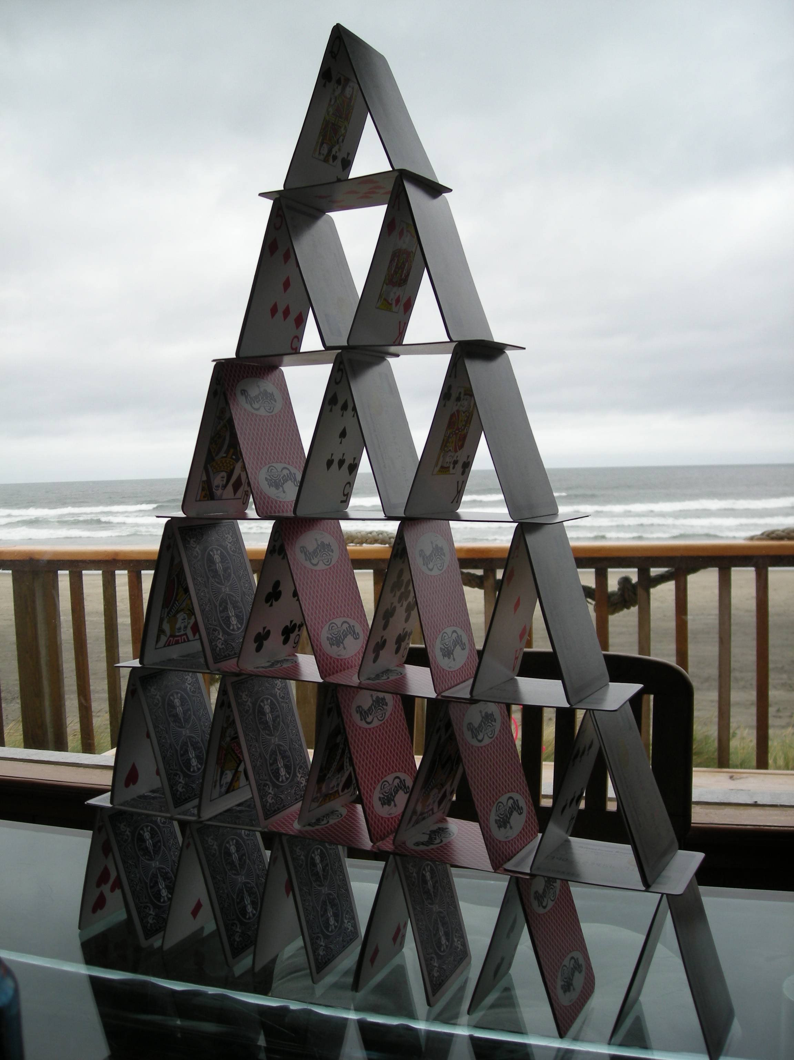
Process state
Process state is like a cards castle:
    strongly associated
    accurately verified
Contains of:
    statically allocated variables
    dynamically allocated variables
    stack content
Is changing during runtime

Slide 7

What can be patched?
Not any binary patch can be applied
Fundamental Limitations:
  Static data of different size
  Dynamically allocated objects of different size
Source code review is required :(

Slide 8

Binary patch creation
Information about binary is required
Patch code on function basis:
  Reliable
  Relatively simple
Information about symbols required:
  Name
  Size
  Address

Slide 9

When binary patch can be applied?
Process external stop/resume is essential
Not at any moment of time:
    Process can execute the code to patch
    Code to patch can be referenced in the call stack
Stack unwinding is essential:
    Need to catch the process outside old code
    Or at least outside functions to patch

Slide 10

Where to place new code?
Has to be placed into process address space:
    Either as binary blob
    Or as a file mapping
Static code has to be “fixed” in place
PIC code can be mapped as is, but:
    Initialization required: external and global symbols
    Corresponding data has to be copied
Need to redirect execution to the new code

Slide 11
Userspace live patching in pictures
Patching — via address replace
Before patching
Patching — via jump
Inserting code
Process
Function address
Map
Call
Call
Original
function
Op
Jump
Replacement
function

Slide 12

Why is it called “painless”?
Live patching can't be painless :)
No kernel changes required!
Binary patch creation can be based on ELF parsing
Libcompel can be used for:
  Task stop
  Task resume
  Code insertion
  Source: https://github.com/xemul/criu/tree/criu-dev
Libunwind can be used for stack unwinding
  Source: http://git.savannah.gnu.org/cgit/libunwind.git

Slide 13
Thanks for your attention.
Q&A.
Stanislav Kinsburskiy
stanislav.kinsburskiy@gmail.com
https://github.com/skinsbursky/presentations/blob/master/lup-devconf.odp

