Slide 2
Overview of Bottom-Up Euphony
Goal: change Euphony to use Bottom-\Up enumeration with a pruning heuristic to quickly find a solution in SyGuS problem.
Challenges:
Bottom-Up Euphony cannot naively reuse the A* search implemented in the original Top-Down Euphony.
How to determine the cost ”efficiently” for a massive program bank
How to determine the right value for the cost threshold for a given iteration

Slide 3
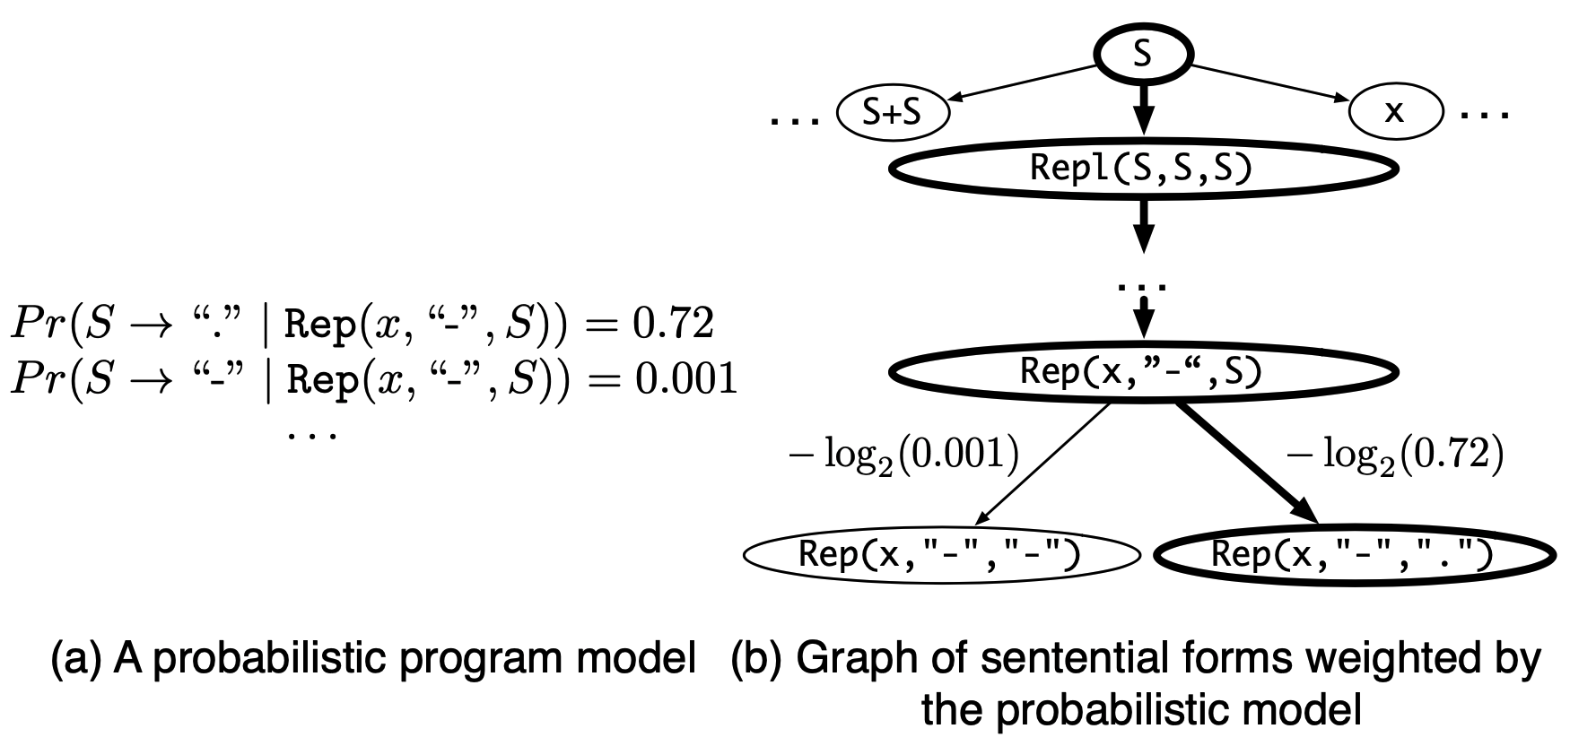
Recap: Top-Down Euphony
Main ideas:
Using A* search to traverse the PCFG efficiently
Using PHOG to guide the search (Probabilistic Enumeration)

Slide 4
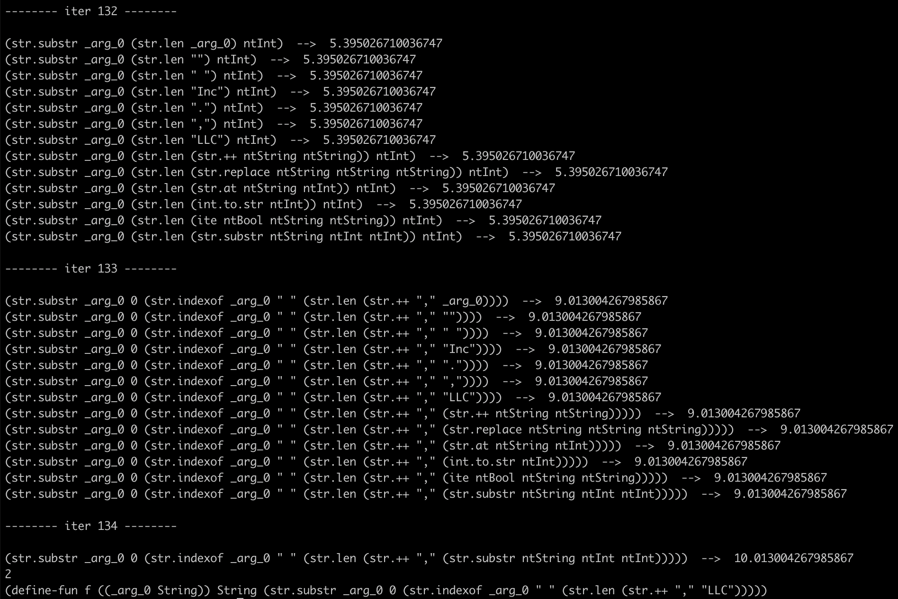
Recap: Top-Down Euphony

Slide 5
Implementing Bottom-Up Euphony
We used a Probabilistic Context Free Grammar (PCFG) with Bottom-Up enumeration
To mitigate the issue of massive program banks, prune the search space using a cost threshold

Slide 6
Efficiently Computing the Cost
We modified the way the cost for sub-programs are stored and reused

