Slide 1
USIP OSP Facilitator Training

Slide 2
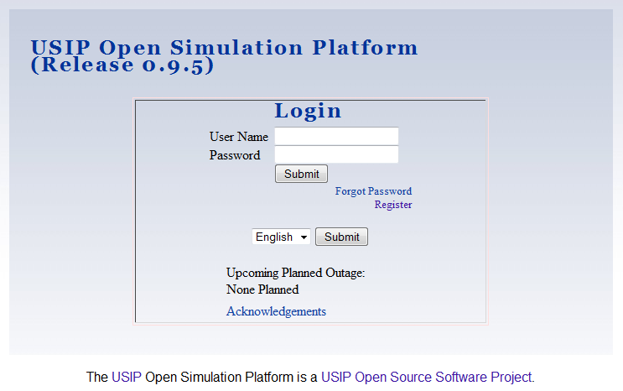
Notes:
"This video will acquaint you with the features of the USIP OSP needed to launch and monitor a running simulation. No prior background knowledge, or special coding skills are required."
"Watching this video you will learn how to
1.) Browse your online library for simulations.
2.) Select a simulation for your players to participate in
3.) Assign your players to the various roles in the simulation
4.) Notify your players of the simulation - emailing them a link to where they can log on.
5.) Monitor a simulation to verify that all of the players have entered into it and contact them to see if they need any help.
This presentation has been created for USIP OSP version 0.9.5. If your version differs it, some of the screen shots may look different, but the same work flow will probably be preserved.

Slide 3
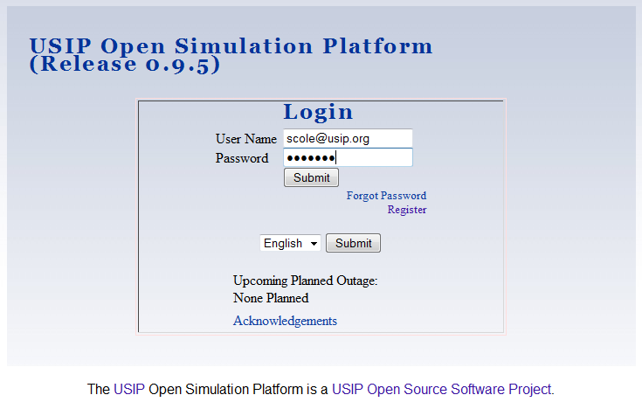
Notes:
"First we login to an OSP system were we have been given an account."

Slide 4
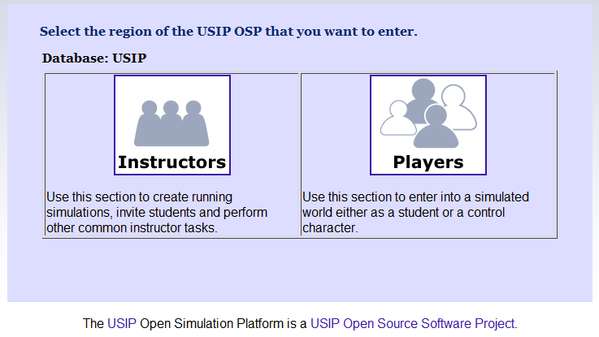
Notes:
Select the 'Instructor' icon to enter the system as an instructor. Please note that you may, as an instructor, later select the 'Player' icon to participate (moderate or facilitate) in a live simulation. But the 'Instructor' section of this program gives you the tools the perform the tasks that we are discussing today. We select the ‘Instructor’ icon to move on.

Slide 5
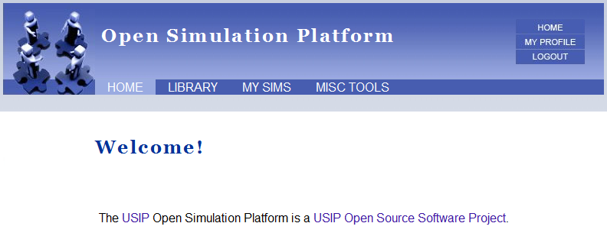
Notes:
We now see the instructor landing page. It has four major sections labeled across the top: "Home", "Library", "My Sims", and "Miscellaneous Tools." We are currently on the ‘Home’ page. Later, this page will contain a dashboard containing information regarding your players. We do not see it now since this instructor has not initiated any simulations. When we have done that this page will look different. So now we select the ‘Library’ tab to take us to the Library.

Slide 6
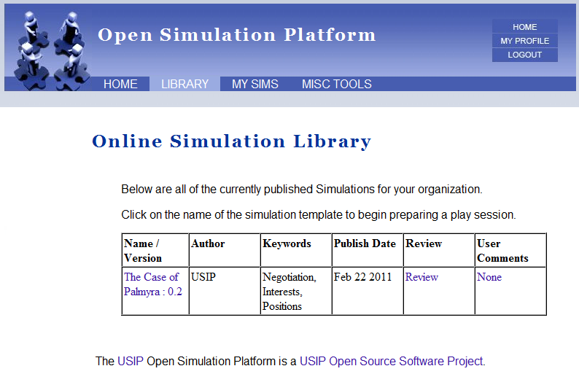
Notes:
On this page we will see all of the simulations that have been loaded onto this system or written locally here. Simulations created by the USIP OSP are exportable as a single file (an XML file) that can then be imported onto other people’s systems. We want empower people to created ‘user generated content’ and share simulations with each other.
On this system we see only one simulation available, ‘The Case of Palmyra.’ We will be looking closer at it later on.
We will return to this tab section to queue up a game after our look at all four of the top tab headings (Home, Library, My Sims and Miscellaneous Tools) is complete.

Slide 7
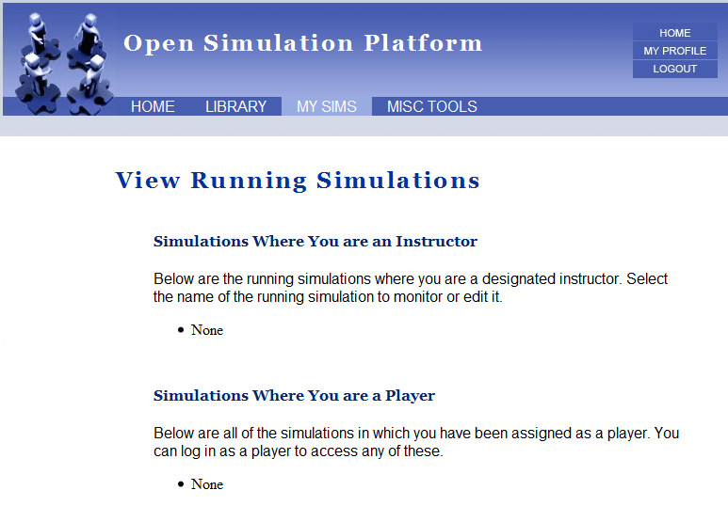
Notes:
The next section, ‘My Sims,’ is where you will be able to your simulations to make changes to them if necessary. This section has two parts: In the top part, you will see listed all of the simulations in which you have been designated as an instructor. An instructor in this sense can go in and do the types of things we are discussing here today. There is nothing here since this instructor has not created any simulations yet.
Below this is a section which lists all of the simulations where this instructor has been included as a player. (Again, one can be a player in a simulation - even a player whose job it is is to facilitate the other players through their simulated world - and not be a designated ‘Instructor’ of that simulation. And vice-versa, being a designated instructor does not necessarily make one a player in a simulation.)

Slide 8
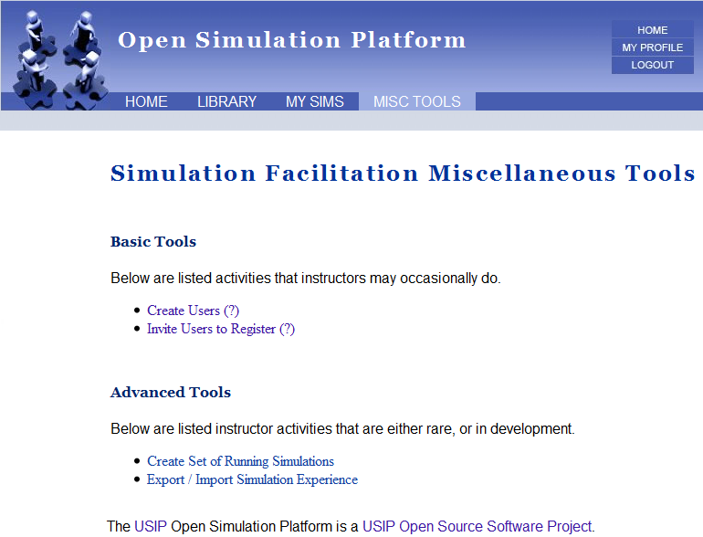
Notes:
The final tab across the top are the Miscellaneous Tools that an instructor may need. Since these are not normally required, we will not cover them today. But you may want to check here on your system to see if anything here may be of value to you.
Any new instructor features that our community generates will normally show up here first.

Slide 9
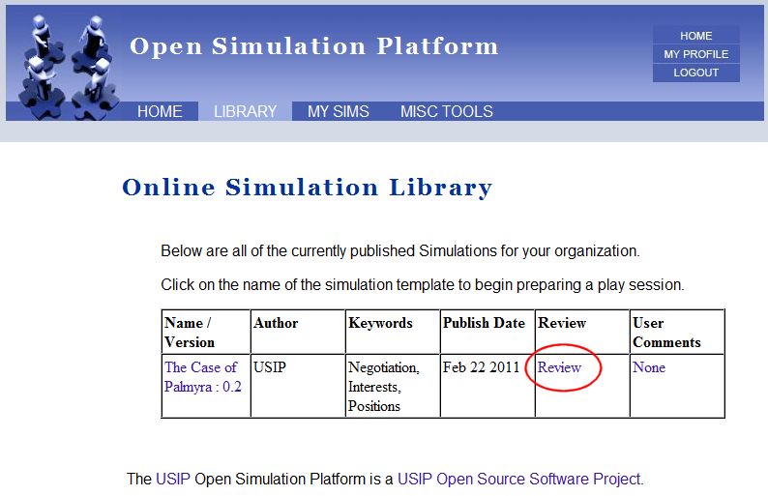
Notes:
We return to the ‘Library’ section of the program to look at a simulation and then launch it as a live training experience for our students.
In this library we only have one simulation, The Case of Palmyra. We select the review section to see more about it.

Slide 10
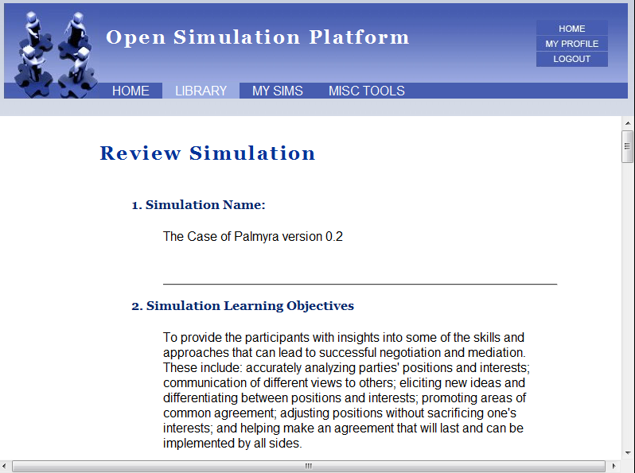
Notes:
On this page an instructor can review an entire simulation. You will be able to read all of the character information and see any other information that the author or authors have created. As you can seen from the scroll bar on the right hand side, the entire text for a simulation can be quite long.

Slide 11
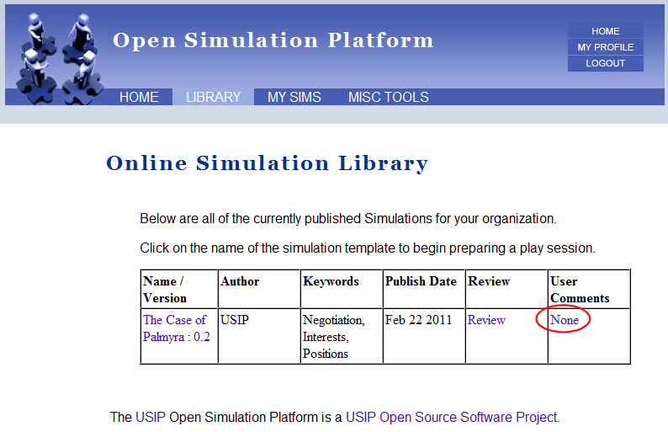
Notes:
Our ‘user comments’ section is in development. This will be an important part of the platform - allowing people to leave suggestions and advice for each other.

Slide 12
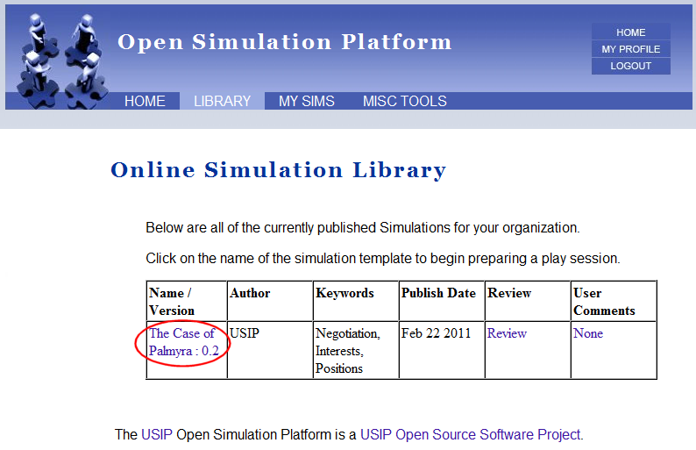
Notes:
Select the name of the simulation. This takes one immediately to the ‘Launch’ page. This page will walk one through the process of beginning the simulation.

Slide 13
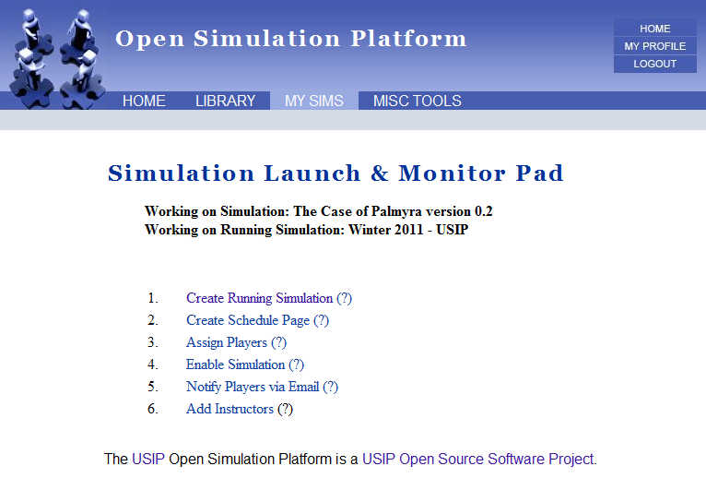
Notes:
This page shows all of the steps you will need to go through to successfully launch a simulation. Also, once you begin the process, the pages themselves will guide you, one leading onto the next. As you can see from this page, the basic steps are pretty minimal: give your play session a name, write your schedule for it, assign your players, enable the simulation and then contact your players. All information that you enter here can be edited later, but of course, invitation emails, once sent out, cannot be ‘unsent’. We select the first link ‘Create Running Simulation’ to move to the first step.

Slide 14
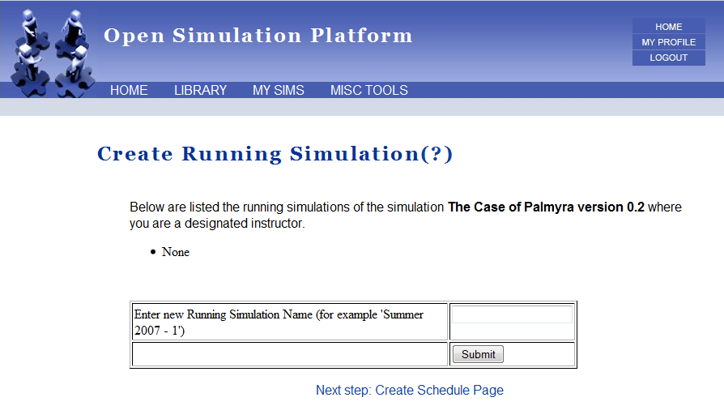
Notes:
On this page you will be able to create a new instance of a game. We call these ‘Running Simulations’ since it is a game in play with a real set of players assigned.

Slide 15
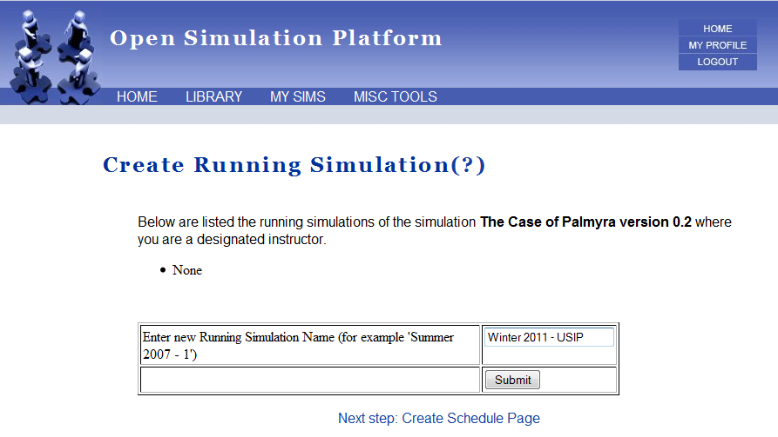
Notes:
To create one, one has to enter in the name desired, frequently this will be the name of the class for which it is being used.

Slide 16
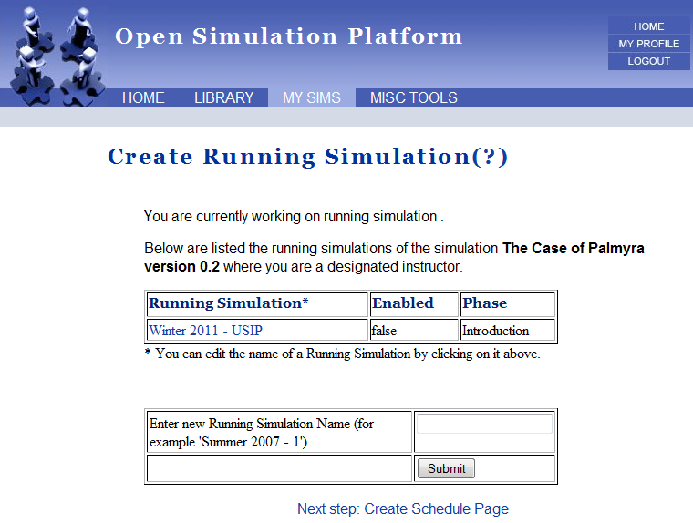
Notes:
At the bottom of the page you can see the link to move onto creating the schedule for this simulation.

Slide 17
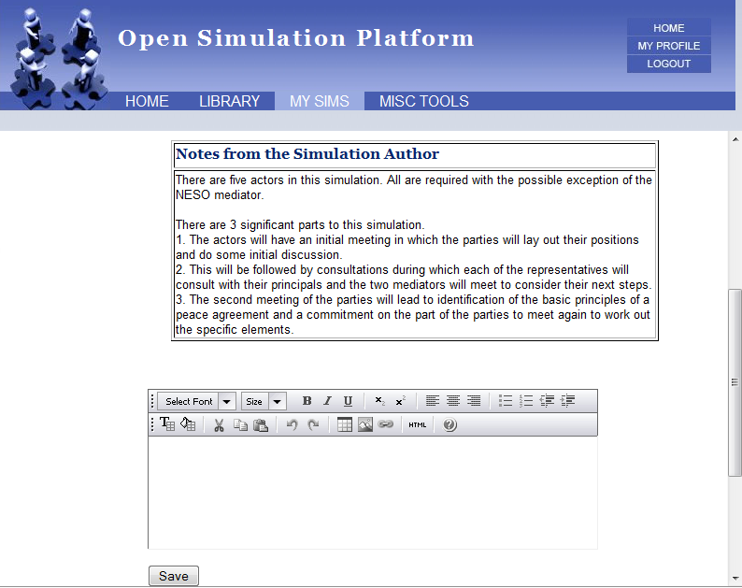
Notes:
Your players will need to know when they expected to enter into the simulation. In addition to any emails you send them, or mentions in class, the ‘Schedule’ page provides a place they can get to to find that out.
When a simulation is created, the authors have in mind how long a typical play session will take. This information is displayed for you to aid in your scheduling.

Slide 18
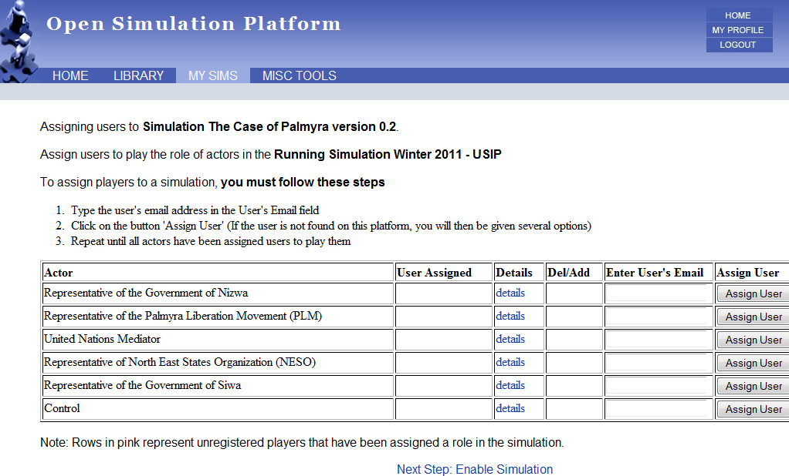

Slide 19
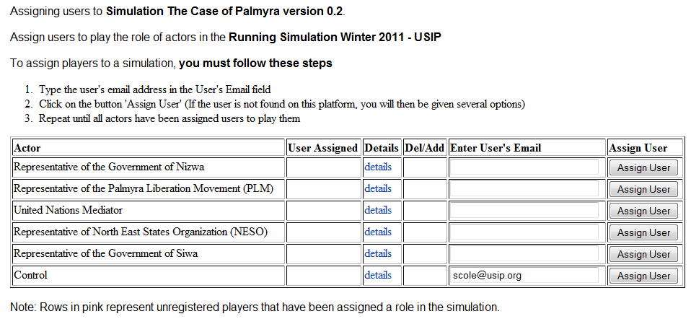
Notes:
Type the players email address in the column labled ‘Enter User’s Email’ and then click the ‘Assign User’ button.

Slide 20
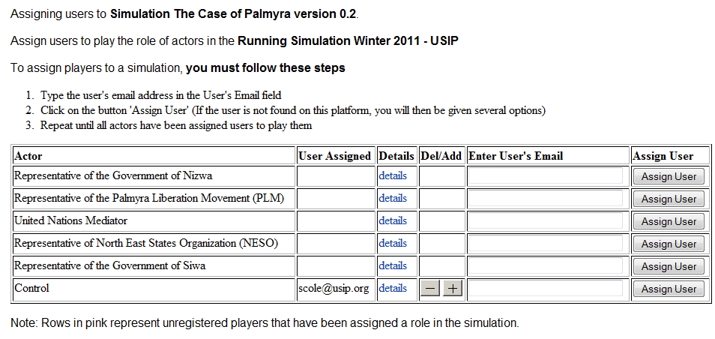

Slide 21
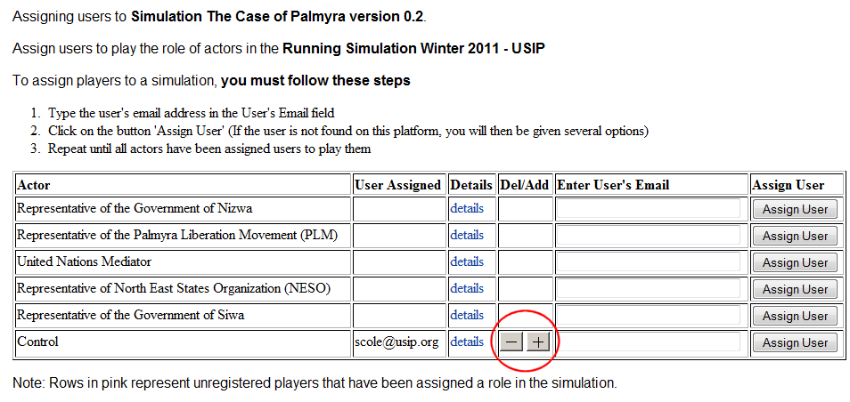
Notes:
Now that we have assigned a user to an actor role, we see ‘+’ and ‘-’ icons on the same line. The minus symbol is to remove the assignment we just added. The plus symbol is to assign and additional player to this role. There is no theoretical limit to the number of people you can assign to one role, and in large simulations you may want to assign several instructors to one position.
We will click on the plus symbol to add another player assignment.

Slide 22
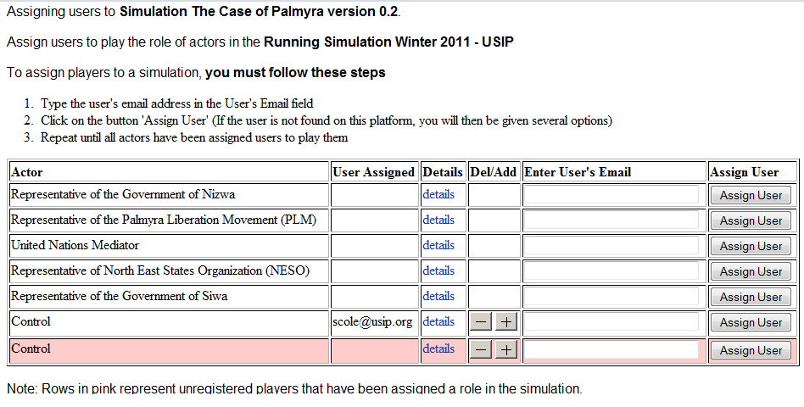
Notes:
We can see another assignment line has been added. We will type in the name of another player.

Slide 23
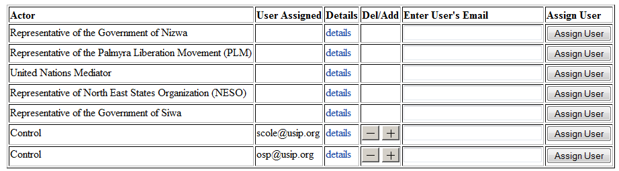
Notes:
Two players are now assigned to the role ‘Control.’ They will be able to log on at the same time if they desire, but they should coordinate their activities.

Slide 24
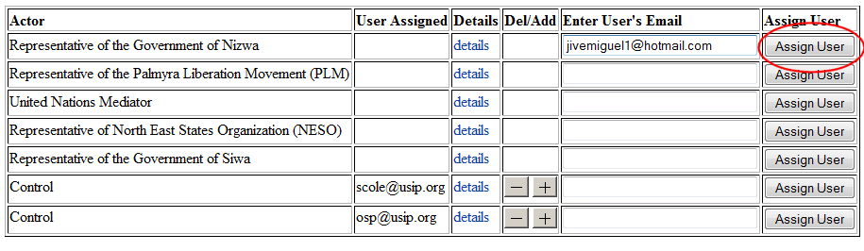
Notes:
We will next add a player who has not registered on the system yet. You will do this by typing in (or better still copying and pasting in their email address to avoid typos) and then hitting the ‘assign user’ button.

Slide 25
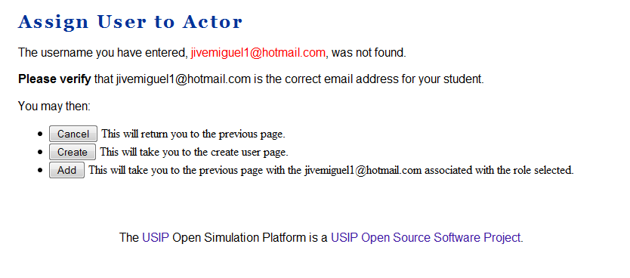
Notes:
This will take us immediately to this page. The user was not found registered on this system (which is often the case.)
Here you have three choices. The ‘Cancel’ button will take you back to the previous page and do nothing.
The ‘Create’ button will take you to a page where you will be able to register this user yourself. We will cover this in more detail later.
The ‘Add’ button will register this player’s email address to the role you have assigned them. When they respond to your invitation to enter they simulation they will then have to enter in their own information (password, full name, etc.)
For the purposes of this demonstration, we hit the ‘add’ button.

Slide 26
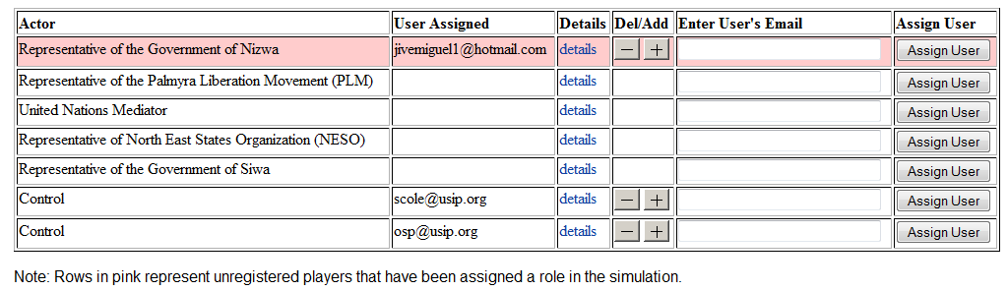

Slide 29
Notes here on future screen shots.
Notes:
Screen Shot : Assign Player (create user completed)
After you have created the user, you will be immediately taken to the page where you can email them informing them of their username and password via email. Since this is via email, and it is never a good idea to send any password via email, the player will need to change the temporary password that you assigned them the first time they log in.
Screen Shot : Assign Player (unregistered user)
The most common scenario, when you assign users to your simulations, is that you will want to just enter their email address, and leave to them the other details such as entering their phone number and time zone.
Screen Shot : Assign Player (multiple users per role)
Screen Shot : Enable
V: Once a simulation has been enabled, your players will be able to log into it. You take care of enabling a simulation here.
Screen Shot : Email Notifications (composing email)
Screen Shot : Email Notifications (email sent)
V:
After you have completed sending an email notification you receive confirmation on the screen that this step, and a link back to your ‘Home’ page. Clicking on the link will take you back to your Home page, but it will look a bit different than before.
Screen Shot : Home Page (showing student dashboard)
V: As you can see, your home page now has a Dashboard on it where you can see the student’s status on it. What you want to see is that everyone is ‘green,’ that is, that all students have received their invites and logged onto the simulation. Frequently this will not be the case. Emails get blocked by spam filters, email boxes get full, people change accounts and do not inform you, etc. For these
Screen Shot : My Sims
V: We look now at the ‘My Sims’ tab and see the simulation we just created in our list. Clicking on its name we enter into where we can modify various aspects of it.
Screen Shot : View Running Simulation
V:
Screen Shot : Time Passes, Listen ...
V: We log off as the instructor and come back in a day or so later. We can immediately see that several of our players have found the simulation, but not all have.
Screen Shot : Home tab
V: After logging in we immediately see which of our students have logged and entered into their simulated experience. Due to modern spam filters, it is possible that some of the students did not receive their invitation emails.
Screen Shot : Student Profile
V: Clicking on a Student’s name will show us their profile. We can then send them another email, or contact them via another means that a teacher uses these days to reach their students (phone, blackboard, face to face, etc.)

