Slide 1
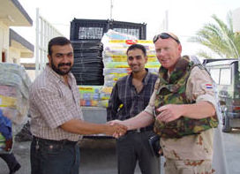
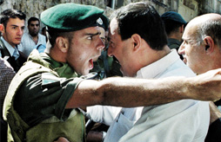
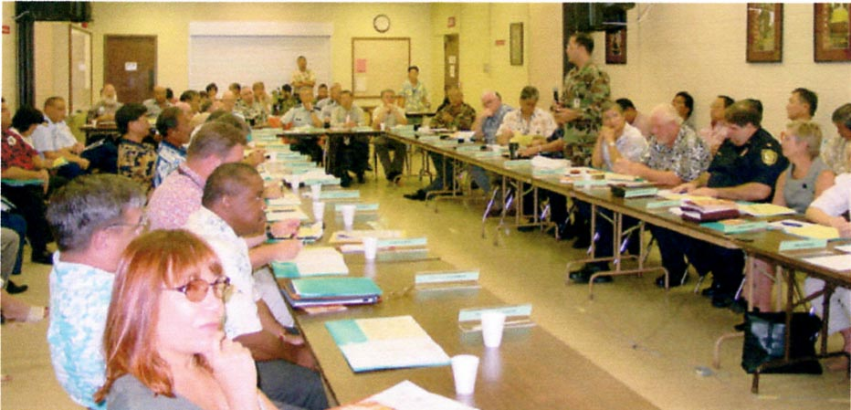
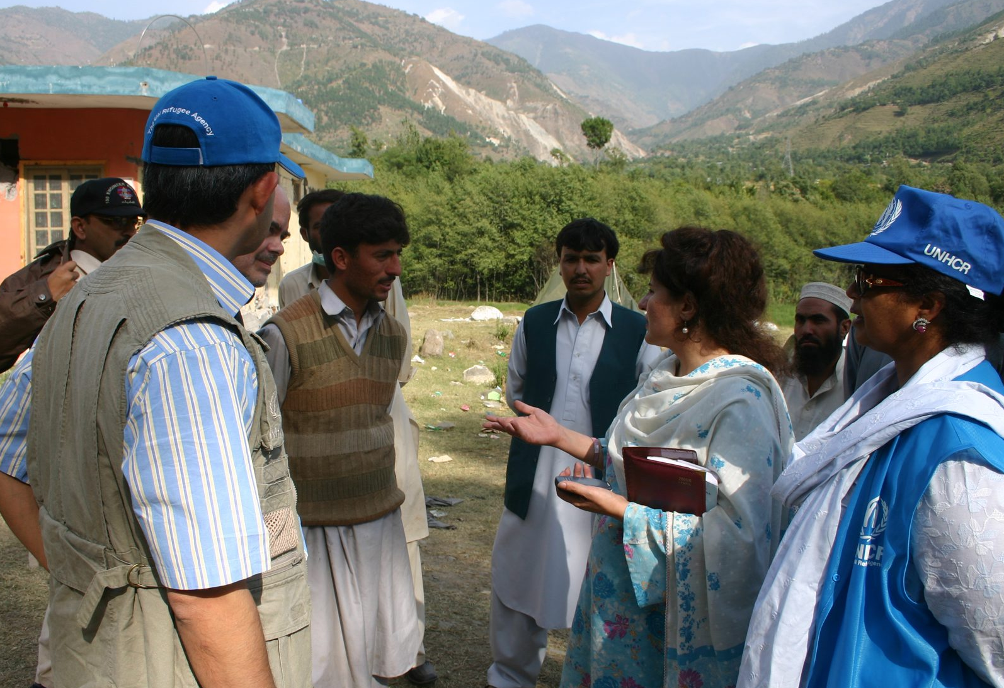


Coordination in the Field
U N H C R e C e n t r e a n d U n i v e r s i t y o f H i r o s h i m a

Slide 2
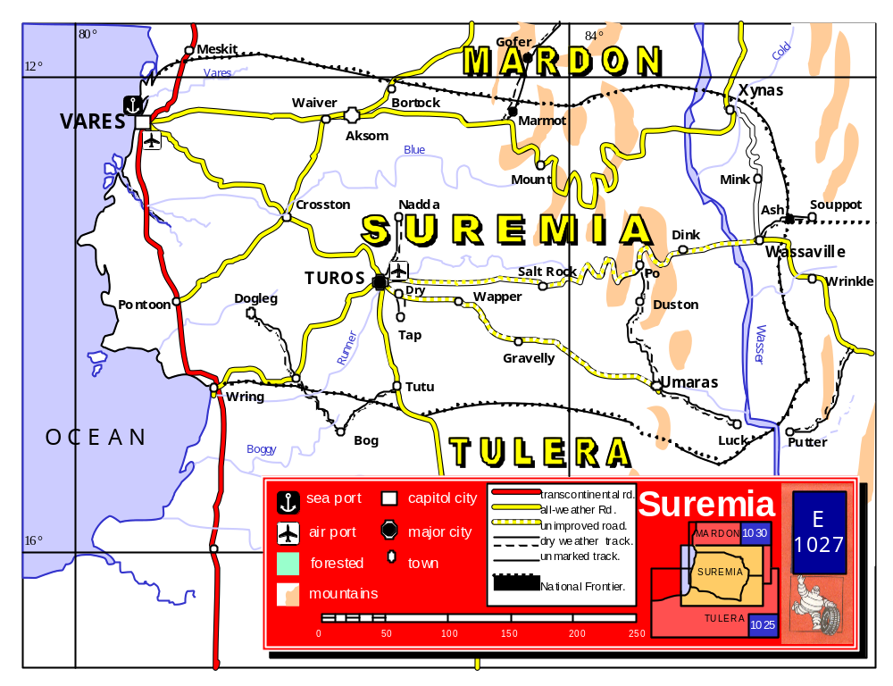
Building Peace in Suremia

Slide 3
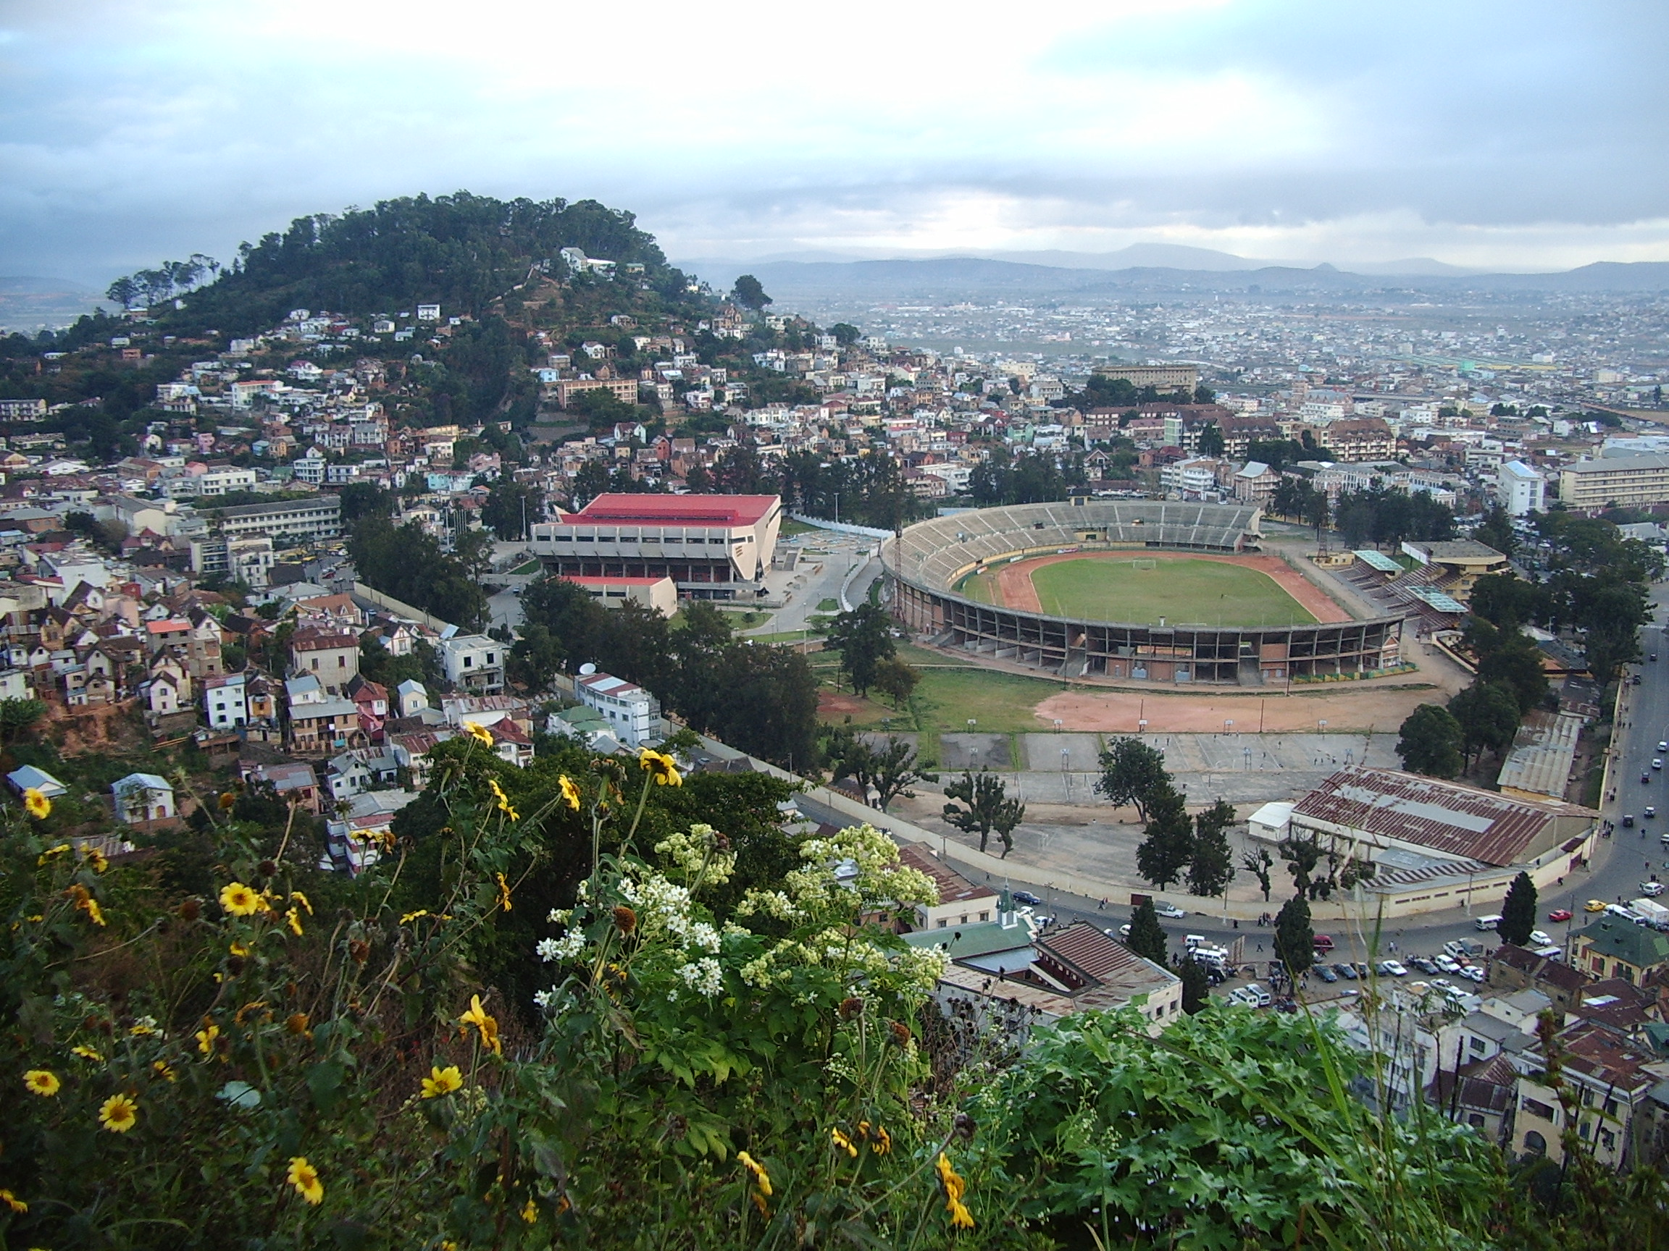
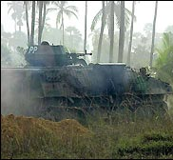
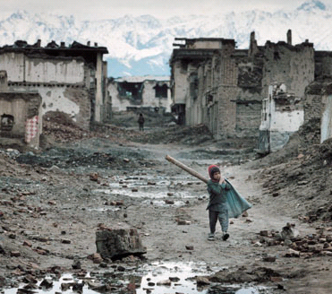
Building Peace in Suremia
Small developing country
Emerging from destructive civil war
Trying to re-establish peace, stability and social justice

Slide 4
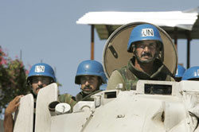
Building Peace in Suremia
Through UNSCR 1780, International Community has created United Nations Mission in Suremia (UNMISU)
Mission to assist Suremia in re-establishing peace, stability and social justice

Slide 5
Problems in Suremia
1: Security

Slide 7
AKSOM
MARMOT
XYNAS
VARES/
CAPITAL
TUROS
SALT ROCK
WASSAVILLE
PONTOON
GRAVELLY
UMARAS

Slide 8

Suremia: Security
VARES
AKSOM
HR
Returnees
MARMOT
XYNAS
IDPs
HR
Returnees
TUROS
IDPs
IDPs
SALT ROCK
WASSAVILLE
PONTOON
HR
Returnees
=Safe
GRAVELLY
=Precautionary
=Warring faction
UMARAS
=Elevated
HR
=Human Rights Violation
=Dangerous
=Critical

Slide 9
Problems in Suremia
2: Displacement
Internally Displaced Persons (IDPs)
Refugees

Slide 10
Suremia: Displacement
VARES
AKSOM
5000
Return-
ees
45,000
Refugees
MARMOT
XYNAS
5000
IDPs
5000
IDPs
5000
IDPs
5000
IDPs
5000
Return-
ees
TUROS
5000
IDPs
5000
IDPs
5000
IDPs
40,000
Refugees
5000
IDPs
5000
IDPs
5000
Return-
ees
5000
IDPs
5000
IDPs
SALT ROCK
WASSAVILLE
PONTOON
45,000
Refugees
5000
Return-
ees
UMARAS

Slide 11
Problems in Suremia
3: Health
Suremia Sickness

Slide 12
Suremia: Health
SS
VARES
AKSOM
MARMOT
XYNAS
SS
SS
SS
TUROS
SS
SS
SS
SS
SALT ROCK
WASSAVILLE
PONTOON
SS
GRAVELLY
SS
SS
=Outbreak of Suremian Sickness
(5,000 severe cases)
UMARAS
SS
=Outbreak of Suremian Sickness
(5,000 critical cases)
SS
=Suremian Sickness--
5,000 dead

Slide 13
Problems in Suremia
4: Human Rights Violations

Slide 14
Suremia Week 1 Map
VARES
AKSOM
HR
XYNAS
HR
TUROS
SALT ROCK
WASSAVILLE
PONTOON
HR
GRAVELLY
UMARAS
HR
=Human Rights Violation

Slide 15
Suremia Week 1 Map
SS
HR
VARES
AKSOM
5000
Return-
ees
45,000
Refugees
MARMOT
5000
IDPs
5000
IDPs
XYNAS
SS
5000
IDPs
5000
IDPs
5000
IDPs
5000
IDPs
HR
5000
IDPs
5000
Return-
ees
TUROS
5000
IDPs
5000
IDPs
40,000
Refugees
5000
IDPs
5000
Return-
ees
5000
IDPs
SS
SS
SS
SALT ROCK
WASSAVILLE
PONTOON
HR
SS
45,000
Refugees
5000
Return-
ees
=Safe
GRAVELLY
SS
=Precautionary
=Warring faction
UMARAS
=Elevated
HR
=Human Rights Violation
=Dangerous
=Critical
SS
=Outbreak of Suremian Sickness
(5,000 severe cases)

Slide 16
The current situation
Your agency will be one of the initial responders on the ground in Suremia
Your agency has a specific mandate and responsibility—see first paragraph of colored sheet
Your agency has limited resources- see small envelope
Those resources can be deployed in any of Suremia’s nine provinces or the capital
Where you deploy your resources will have an impact on the situation
Now read your instruction sheet

Slide 17
Your task:
Consider your mandate, your resources and the needs on the ground
Decide where you will deploy your resources for the first week in Suremia
  Each resource must be deployed in one of Suremia’s nine provinces or the capital
Deploy resources by inserting them in the Resource Allocation Map Sheet
Submit Resource Allocation Sheet to facilitator upon end of week 1
  If not received by end of week 1, no resources will be deployed by your agency for that week!

Slide 18
Your Task (ctd)
There is intense pressure from the international community: why has it taken so long to respond?
Your agency must respond quickly by deploying resources where they are most needed without delay—time is of the essence!

Slide 19
Your Task (ctd):
Week one will last for five (5) minutes…
Questions…
Week one begins now!

Slide 20
Suremia Week 1 Map
SS
HR
VARES
AKSOM
5000
Return-
ees
45,000
Refugees
MARMOT
5000
IDPs
5000
IDPs
XYNAS
SS
5000
IDPs
5000
IDPs
5000
IDPs
5000
IDPs
HR
5000
IDPs
5000
Return-
ees
TUROS
5000
IDPs
5000
IDPs
40,000
Refugees
5000
IDPs
5000
Return-
ees
5000
IDPs
SS
SS
SS
SALT ROCK
WASSAVILLE
PONTOON
HR
SS
45,000
Refugees
5000
Return-
ees
=Safe
GRAVELLY
SS
=Precautionary
=Warring faction
UMARAS
=Elevated
HR
=Human Rights Violation
=Dangerous
=Critical
SS
=Outbreak of Suremian Sickness
(5,000 severe cases)

Slide 21
Week One is over!
Hand your Resource Allocation Sheets to the Facilitator
Let’s take a look at the situation on the ground…

Slide 22
Week Two
For week two you will have twenty (20) minutes to plan and decide your resource allocation
For this week and all hereafter you will receive a weekly budget
Needed items can be purchased on through the international market
Some new items on the International Market list: those parties who may have an interest will receive additional instructions about how to buy/use
Questions….
Week Two begins now!

Slide 23
Suremia Week 2 Map
SS
HR
VARES
AKSOM
5000
Return-
ees
45,000
Refugees
MARMOT
5000
IDPs
5000
IDPs
XYNAS
SS
5000
IDPs
5000
IDPs
5000
IDPs
5000
IDPs
HR
5000
IDPs
5000
Return-
ees
TUROS
5000
IDPs
5000
IDPs
40,000
Refugees
5000
IDPs
5000
Return-
ees
5000
IDPs
SS
SS
SS
SALT ROCK
WASSAVILLE
PONTOON
HR
SS
45,000
Refugees
5000
Return-
ees
=Safe
GRAVELLY
SS
=Precautionary
=Warring faction
UMARAS
=Elevated
HR
=Human Rights Violation
=Dangerous
=Critical
SS
=Outbreak of Suremian Sickness
(5,000 severe cases)

Slide 24
Week Two is over!
Hand your Resource Allocation Sheets to the Facilitator
Let’s take a look at the situation on the ground…

Slide 25
Week Three
Crisis—a 7.3 richter earthquake has struck in the Province of Pontoon

Slide 26
Suremia
MARDON
Epicenter of 7.3 Richter Quake in Pontoon
Xynas
Vares
SUREMIA
Wasaville
Turos
Umaras
TULERA
kilometers
River Wasser
0
50
100
150
EARTHQUAKE!

Slide 27

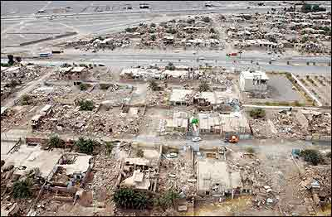
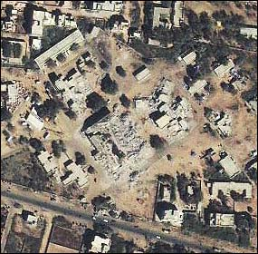
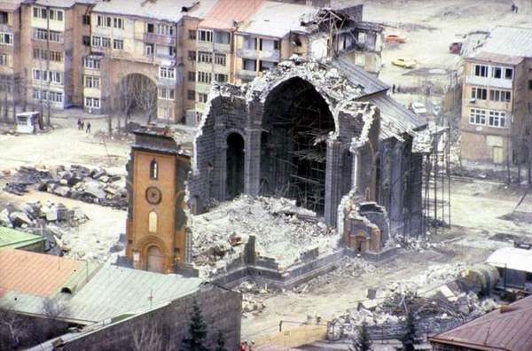

Slide 28
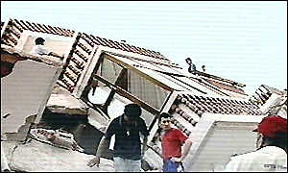
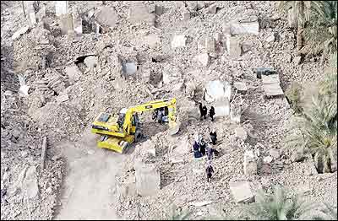
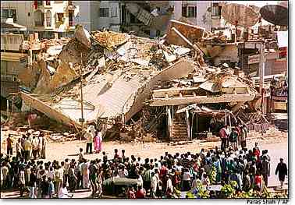

Slide 29
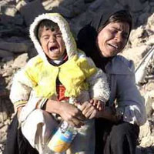
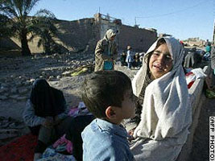

Slide 30
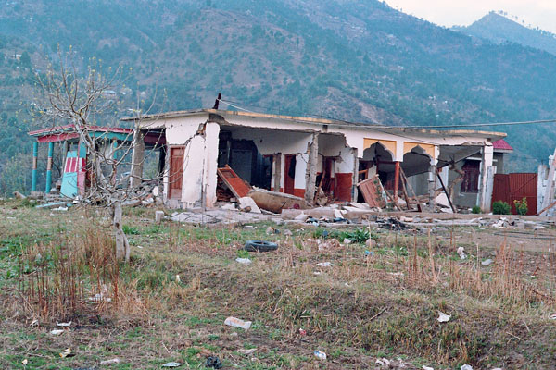
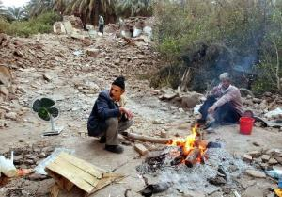

Slide 31
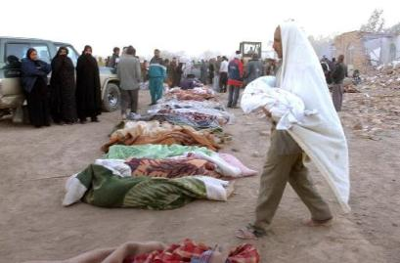

Slide 32
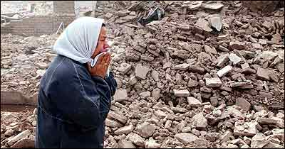
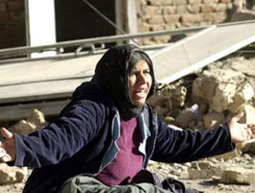

Slide 33
Week Three
Week Three will last for fifteen (15) minutes
Questions….
Week Three begins now!

Slide 34
Suremia Week 3 Map
SS
HR
VARES
AKSOM
5000
Return-
ees
45,000
Refugees
MARMOT
5000
IDPs
5000
IDPs
XYNAS
SS
5000
IDPs
5000
IDPs
5000
IDPs
5000
IDPs
HR
5000
IDPs
5000
Return-
ees
TUROS
5000
IDPs
5000
IDPs
40,000
Refugees
5000
IDPs
5000
Return-
ees
5000
IDPs
SS
SS
SS
SALT ROCK
WASSAVILLE
PONTOON
HR
SS
45,000
Refugees
5000
Return-
ees
=Safe
GRAVELLY
SS
=Precautionary
=Warring faction
UMARAS
=Elevated
HR
=Human Rights Violation
=Dangerous
=Critical
SS
=Outbreak of Suremian Sickness
(5,000 severe cases)

Slide 35
Week Three is over!
Hand your Resource Allocation Sheets to the Facilitator
Let’s take a look at the situation on the ground…

Slide 36
Week Four
Consolidated Appeal
The international donor community, recognizing the significant efforts being made on the ground in Suremia, is prepared to make an additional contribution of $150,000 to aid the actors on the ground
They have only one precondition…

Slide 37
Week Four
The Country Team must prepare an itemized list detailing exactly what resources they are requesting
The list can only include those items currently available on the international market
The list must total no more than $150,000
The list must have the agreement of all parties—signatures from all
If these conditions are met, donors will provide the listed items
If not, no additional resources will be provided

Slide 38
Week Four
Week for will last for twenty (20 minutes)
Questions…
Week 4 begins now!

Slide 39
Suremia Week 4 Map
SS
HR
VARES
AKSOM
5000
Return-
ees
45,000
Refugees
MARMOT
5000
IDPs
5000
IDPs
XYNAS
SS
5000
IDPs
5000
IDPs
5000
IDPs
5000
IDPs
HR
5000
IDPs
5000
Return-
ees
TUROS
5000
IDPs
5000
IDPs
40,000
Refugees
5000
IDPs
5000
Return-
ees
5000
IDPs
SS
SS
SS
SALT ROCK
WASSAVILLE
PONTOON
HR
SS
45,000
Refugees
5000
Return-
ees
=Safe
GRAVELLY
SS
=Precautionary
=Warring faction
UMARAS
=Elevated
HR
=Human Rights Violation
=Dangerous
=Critical
SS
=Outbreak of Suremian Sickness
(5,000 severe cases)

Slide 40
Week Four
Resources delivered…
Week four will last for 10 more minutes to allow for deployment of resources
Week four begins now

Slide 41
Suremia Week 4 Map
SS
HR
VARES
AKSOM
5000
Return-
ees
45,000
Refugees
MARMOT
5000
IDPs
5000
IDPs
XYNAS
SS
5000
IDPs
5000
IDPs
5000
IDPs
5000
IDPs
HR
5000
IDPs
5000
Return-
ees
TUROS
5000
IDPs
5000
IDPs
40,000
Refugees
5000
IDPs
5000
Return-
ees
5000
IDPs
SS
SS
SS
SALT ROCK
WASSAVILLE
PONTOON
HR
SS
45,000
Refugees
5000
Return-
ees
=Safe
GRAVELLY
SS
=Precautionary
=Warring faction
UMARAS
=Elevated
HR
=Human Rights Violation
=Dangerous
=Critical
SS
=Outbreak of Suremian Sickness
(5,000 severe cases)

Slide 42
Coordination in the Field
U N H C R e C e n t r e a n d U n i v e r s i t y o f H i r o s h i m a

