Slide 1
USIP OSP Facilitator Training

Slide 2
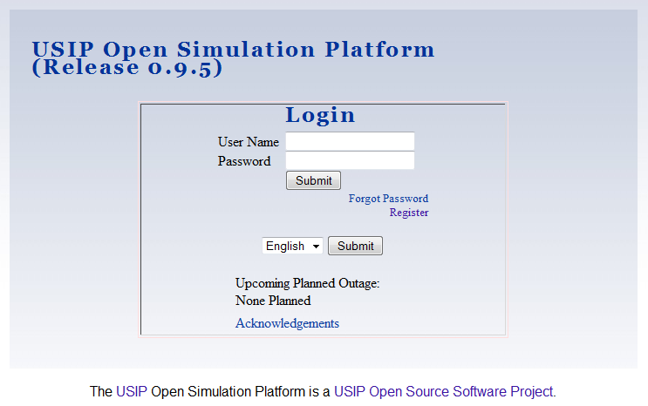
Notes:
"This video will acquaint you with the features of the USIP OSP needed to launch and monitor a running simulation. No prior background knowledge, or special coding skills are required."
"Watching this video you will learn how to
1.) Browse your online library for simulations.
2.) Select a simulation for your players to participate in
3.) Assign your players to the various roles in the simulation
4.) Notify your players of the simulation - emailing them a link to where they can log on.
5.) Monitor a simulation to verify that all of the players have entered into it and contact them to see if they need any help.
This presentation has been created for USIP OSP version 0.9.5. If your version differs it, some of the screen shots may look different, but the same work flow will probably be preserved.

Slide 3
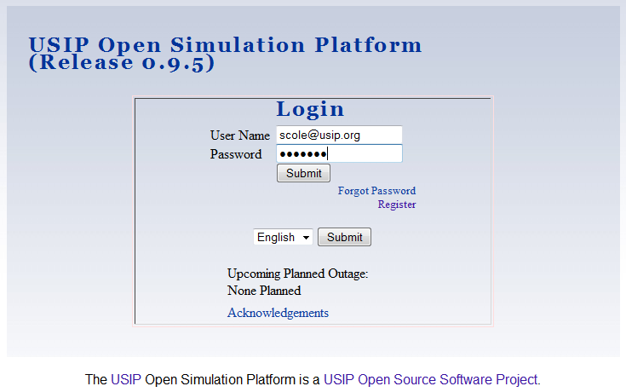

Slide 4
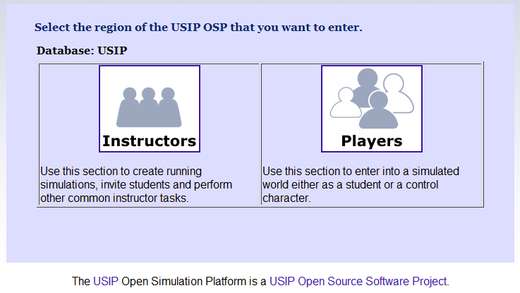

Slide 5
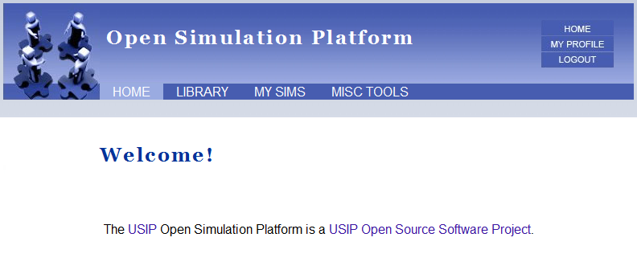

Slide 6
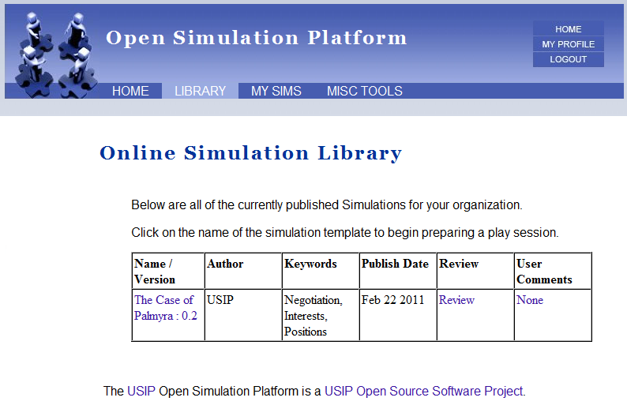

Slide 7
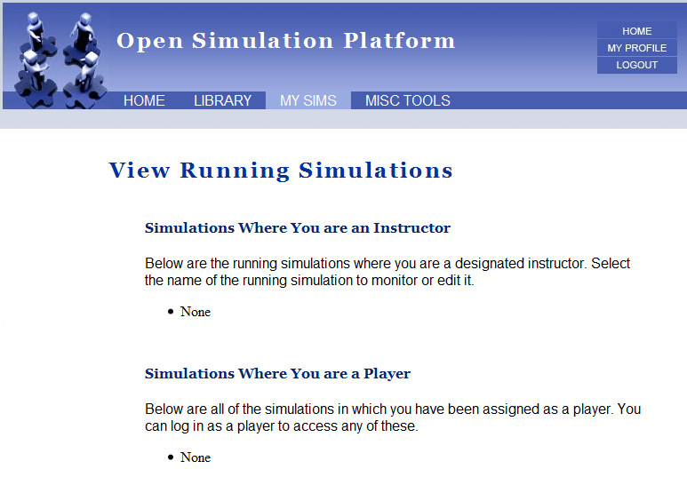

Slide 8
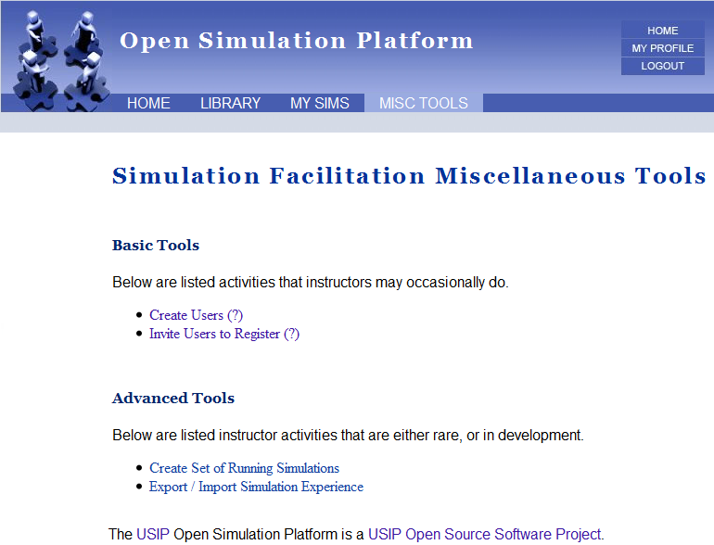

Slide 9
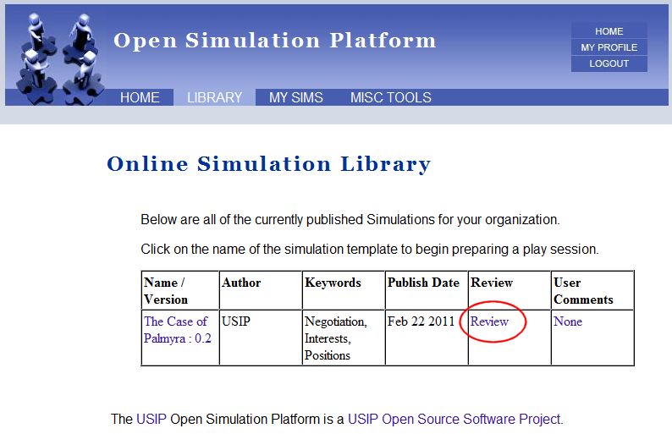

Slide 10
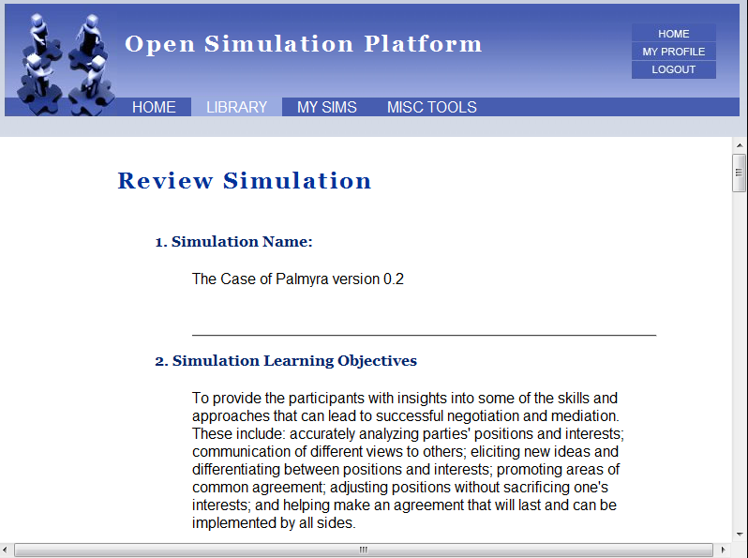

Slide 11
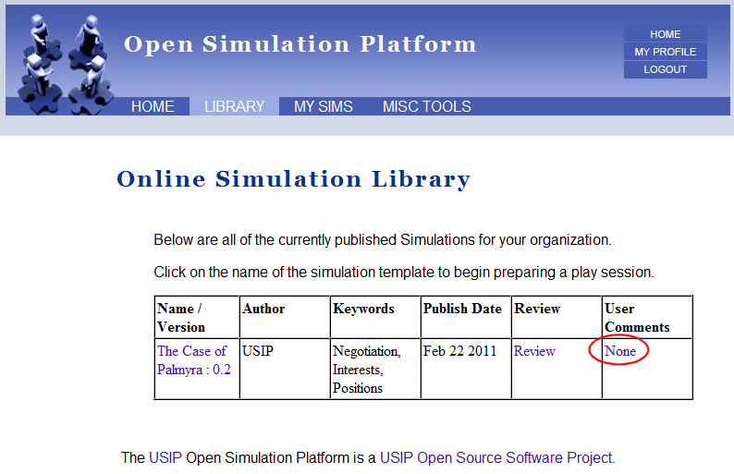

Slide 12
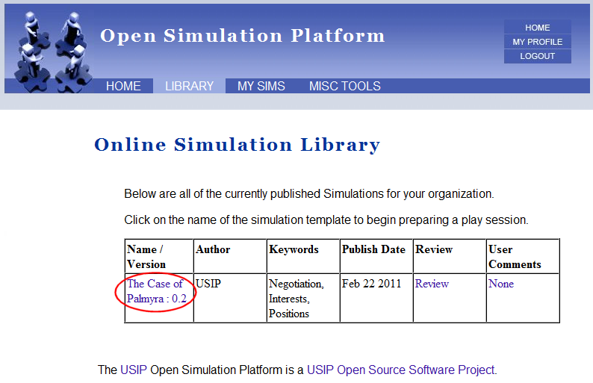

Slide 13
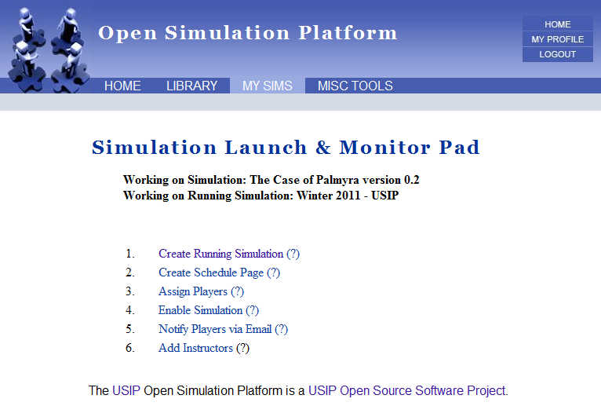

Slide 14
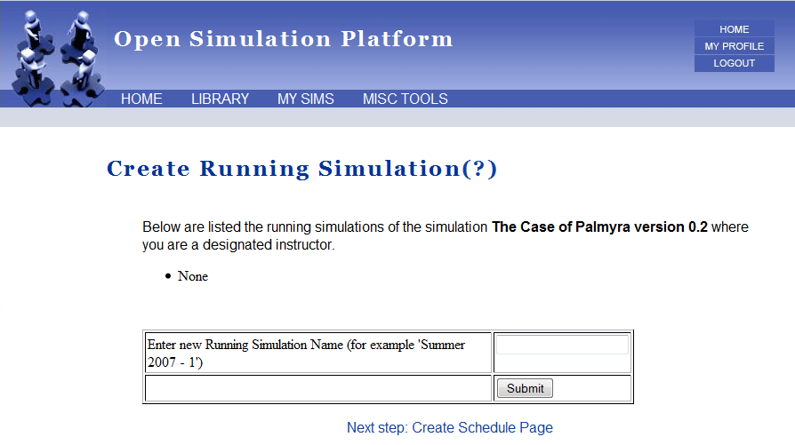

Slide 15
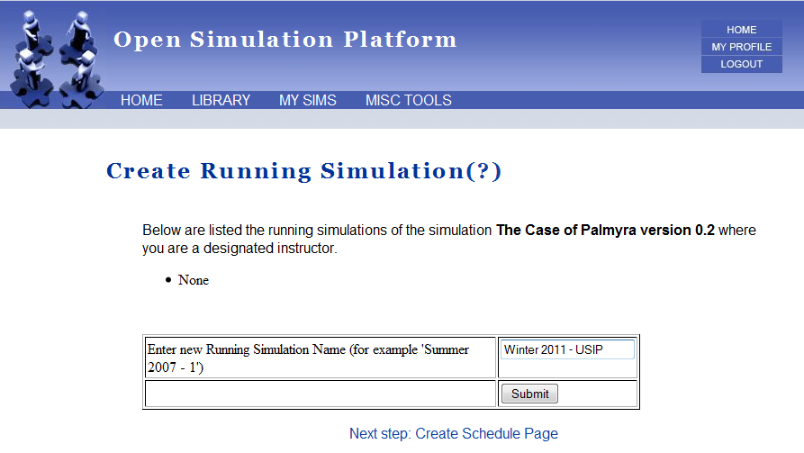

Slide 16
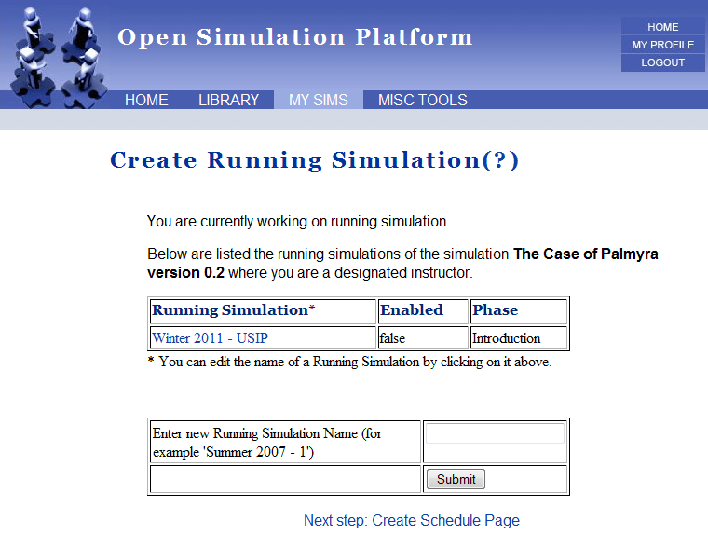

Slide 17
