Slide 1
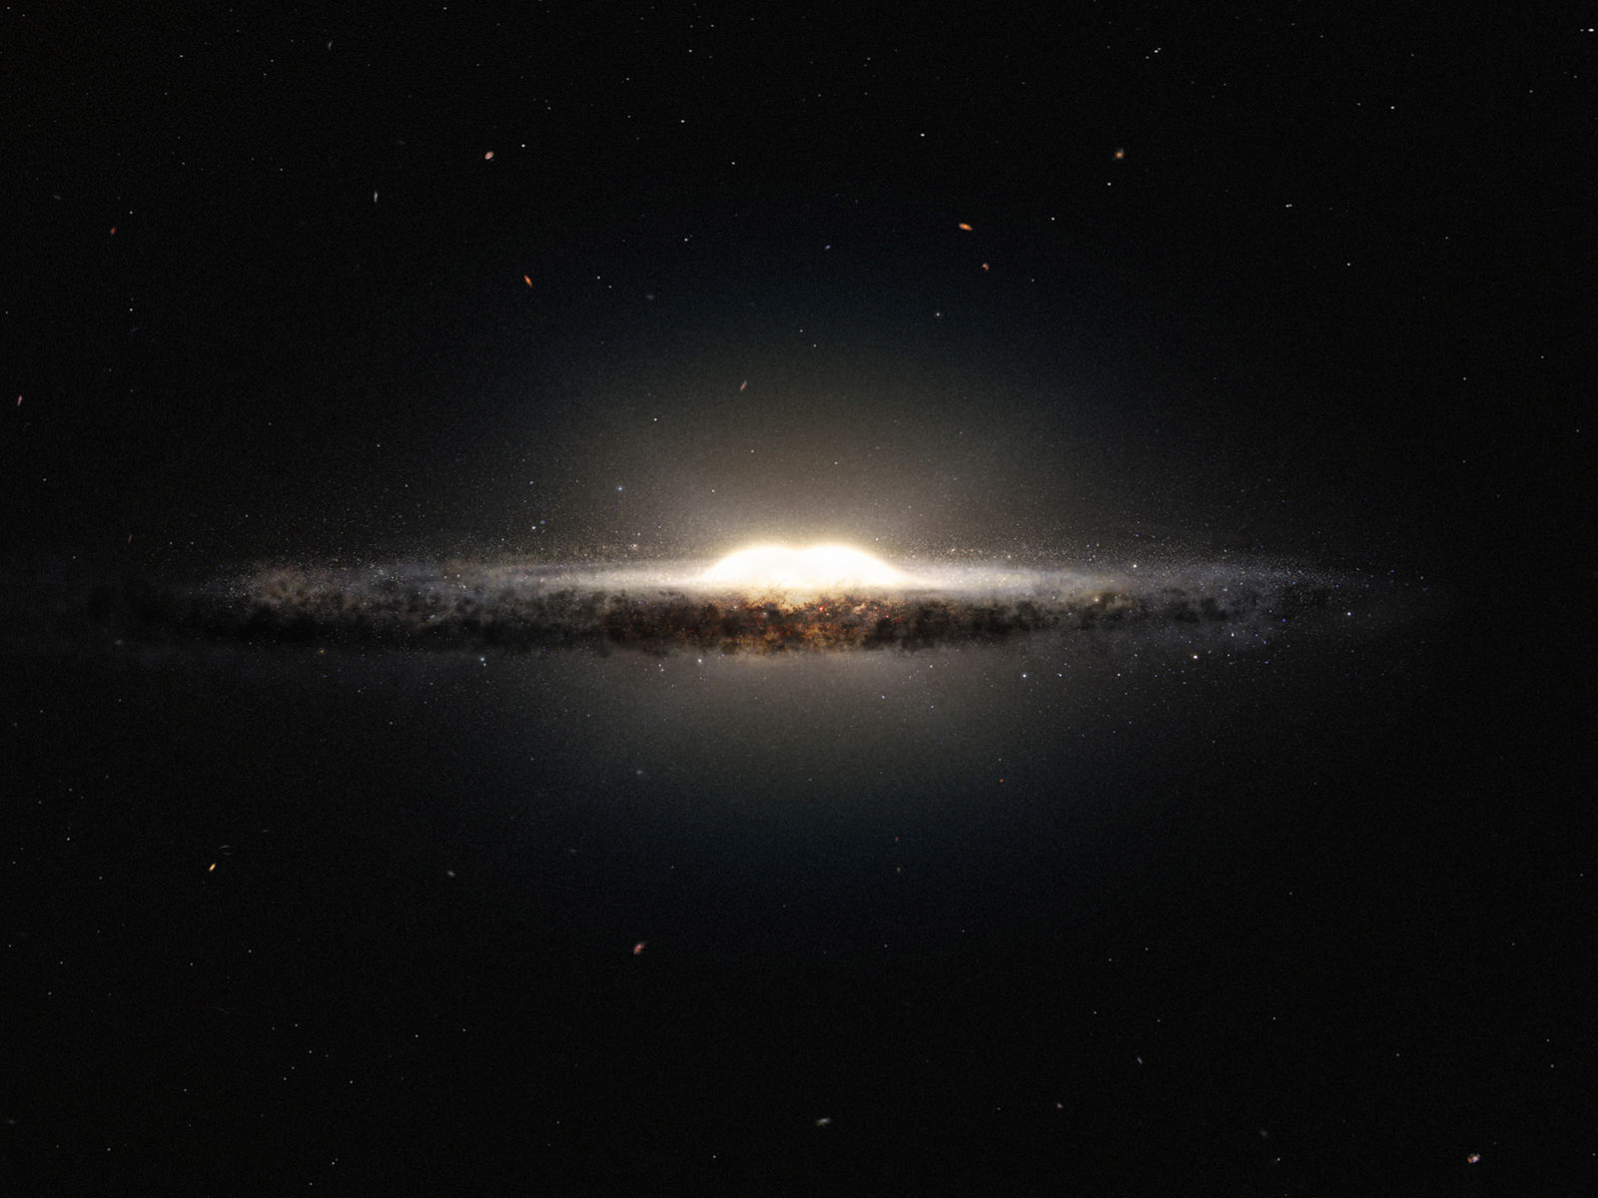
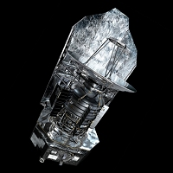
Mining Herschel Space Telescope data
Identifying areas of galactic interest based on variance between long-wavelength infrared intensities

Slide 2
Mining Herschel Space Telescope data
Team:
Jon Allured (4502)
Jacob C. Levine (4502)
Problem:
Identifying specific characteristics of star-forming regions based on variance between long-wave infrared wavelength intensities

Slide 3
Mining Herschel Space Telescope data
Prior Work:
There has been prior work in this area, such as S. Cichowolski et al’s The infrared and molecular environment surrounding WR 130. They were able to identify structure and chemical composition characteristics of four main molecular cloud regions within the area they analyzed.

Slide 4
Mining Herschel Space Telescope data
Proposed Work:
By analyzing the differences in intensity across 5 different wavelengths (70, 160, 250, 350, and 500 microns), we hope to be able to identify the characteristics of various molecular gas clouds within the galactic plane.

Slide 5
Mining Herschel Space Telescope data
Data:
Hi-GAL dataset from the Herschel Space Telescope
.fits file format, 13 GB of data, approx. one billion data points
Attributes: galactic latitude, galactic longitude, intensity, wavelength
Tools:
Python: for preprocessing and data analysis
AstroPy: for working with FITS headers and FITS data arrays
Montage: for mosaicking and producing images from FITS files

Slide 6
Mining Herschel Space Telescope data
Evaluation:
Compare our findings and methods with those used in previous research of this type
Apply our analysis techniques to an area with known gas cloud characteristics to determine validity of techniques
Other options…?

Slide 7
Mining Herschel Space Telescope data
Project Checkpoint
Review of proposed work:
We plan on extracting data from the Herschel Hi-GAL dataset in order to make a temperature map of the galactic plane. We want to match each data point to a corresponding black body radiation curve. The black body radiation curve will give us a peak wavelength, which can then be converted to a temperature value to be used for map generation. Our subtasks are to: mosaic the existing data, determine our method of pattern matching, and develop code to convert the data into their corresponding temperature values. Our final task will be to use the temperature values to create the temperature map.

Slide 8

Mining Herschel Space Telescope data
Project Checkpoint
Accomplishments so far:
Mosaicked existing data: We have mosaicked the data using Caltech’s Montage software for all 5 wavelengths.
Determined method of pattern matching: We are going to use SciPy’s curve_fit function to match the data points (wavelengths and intensities) to a blackbody radiation curve. The curve_fit function will output a corresponding temperature value based on the data. The black body radiation function we will be using is:
Where h is Planck’s constant, c is the speed of light, k is Boltzmann’s constant, E(λ, T) is the intensity as a function of wavelength λ and temperature T. The intensity and wavelength values will be obtained from the data set and fed into the curve_fit function to generate a corresponding temperature.
Started writing code for the pattern matching: We have started writing the code for pattern matching using the curve_fit function as described above.

Slide 9
Mining Herschel Space Telescope data
Project Checkpoint
Key results, lessons, any changes:
One result of mosaicking the data is that we found the 160 band contains one flawed image. The Montage package includes a module that we should be able to use to fix the data, however at the time of discovery the module was not working properly. We’ve been in touch with Montage’s senior software engineer and he has made changes to the module and believes it to be working properly now.
We’ve also become aware of a potential hurdle in working with our data. The data has different resolutions for each the different wavelengths, making it more difficult to make sure we are comparing the same galactic coordinates across the dataset. We have come up with a few methods of dealing with this issue, and we are currently deciding which will be the best to use in our situation.
Another lesson learned is that we might not be able to use data points that don’t contain a peak wavelength inside of our wavelength range. We are still working on this issue, and may be able to still fit the data using the SciPy curve_fit function, but it will come down to how accurate the results are. If needed, we may need to throw away data points that don’t contain a peak wavelength.

Slide 10
Mining Herschel Space Telescope data
Project Checkpoint
Remaining tasks:
Fix the 160 micron mosaic
Choose and implement method for dealing with the different resolutions to achieve galactic coordinate consistency across the dataset
Finish the code for the pattern matching
Test our method with small medium dataset first
Generate the temperature map based on the temperature values obtained

