Slide 1
THE BIG IDEA · IN PLAIN WORDS
A quantum shortcut
for factoring numbers
3
3
21
A step-by-step walkthrough of Shor's algorithm using N = 21
7
21 = 3 × 7
SHOR'S ALGORITHM · INTERACTIVE WALKTHROUGH
Notes:
Open with the destination: we will not ask the quantum computer for 3 and 7 directly. We will ask it for a period.
[Sources]
- User-provided Shor walkthrough and visual reference.
- Peter W. Shor, “Algorithms for quantum computation: discrete logarithms and factoring,” FOCS 1994.

Slide 2
THE CHALLENGE
02
Small numbers are easy. Large numbers are not.
A familiar number
A cryptographic-scale number
15 = 3 × 5
N = ? × ?
We can recognize the factors almost immediately.
The arithmetic is the same—but searching for the factors becomes the bottleneck.
Shor's insight: solve a different problem that exposes the factors.
SHOR'S ALGORITHM · FACTORING N = 21
Notes:
The point is not that multiplication changes. The difficulty lies in reversing multiplication when the factors are hidden inside a very large N.
[Sources]
- User-provided reference slide and Shor walkthrough.
- Peter W. Shor, FOCS 1994.

Slide 3
THE REFRAME
03
Shor turns factoring into period finding.
Find the period of aˣ mod N
CLASSICAL
QUANTUM
CLASSICAL
Choose a
→
Find r
→
Calculate gcd
The quantum computer accelerates the hard middle step—not the final gcd arithmetic.
SHOR'S ALGORITHM · FACTORING N = 21
Notes:
Keep the division of labor explicit. The quantum routine estimates the period. The factor extraction before and after it is classical.
[Sources]
- User-provided Shor walkthrough.
- Peter W. Shor, FOCS 1994.

Slide 4
STEP 1
04
Choose a base; run the first gcd check.
N = 21 a = 2
1 < 2 < 21 ✓
1
Check the required range
gcd(2, 21) = 1
2
Look for an immediate shared factor
2 and 21 are coprime. No factor has been found yet, so period finding is needed.
SHOR'S ALGORITHM · FACTORING N = 21
Notes:
If the initial gcd were greater than 1, we would already have a factor. Because gcd(2,21)=1, this is a genuine period-finding example.
[Sources]
- User-provided Shor walkthrough.

Slide 5
STEP 2 · BUILD 1
05
Modulo keeps only the remainder.
f(x) = 2ˣ mod 21
“mod 21” means: calculate the power, divide by 21, and keep only the remainder.
2⁵ = 32
→
32 = 1 × 21 + 11
→
f(5) = 11
power
division with remainder
keep the remainder
SHOR'S ALGORITHM · FACTORING N = 21
Notes:
Read the example from left to right. The quotient is 1 and the remainder is 11, so f(5)=11.
[Sources]
- User-provided Shor walkthrough.

Slide 6
STEP 2 · BUILD 2
06
Evaluate every power until the pattern repeats.
x | Calculate 2ˣ | Divide by 21 | Keep remainder
0 | 2⁰ = 1 | 1 = 0 × 21 + 1 | f(0) = 1
1 | 2¹ = 2 | 2 = 0 × 21 + 2 | f(1) = 2
2 | 2² = 4 | 4 = 0 × 21 + 4 | f(2) = 4
3 | 2³ = 8 | 8 = 0 × 21 + 8 | f(3) = 8
4 | 2⁴ = 16 | 16 = 0 × 21 + 16 | f(4) = 16
5 | 2⁵ = 32 | 32 = 1 × 21 + 11 | f(5) = 11
6 | 2⁶ = 64 | 64 = 3 × 21 + 1 | f(6) = 1
7 | 2⁷ = 128 | 128 = 6 × 21 + 2 | f(7) = 2
8 | 2⁸ = 256 | 256 = 12 × 21 + 4 | f(8) = 4
At x = 6, the remainder 1 returns—and the sequence starts again.
SHOR'S ALGORITHM · FACTORING N = 21
Notes:
Walk down the table. Rows 6 through 8 repeat rows 0 through 2. The repetition begins when f(6)=1.
[Sources]
- User-provided Shor walkthrough.

Slide 7
STEP 2 · BUILD 3
07
The repeated residues expose the period r = 6.
One complete cycle
1
→
2
→
4
→
8
→
16
→
11
then
1
6 steps
r = 6
SHOR'S ALGORITHM · FACTORING N = 21
Notes:
The values repeat after six inputs: f(0)=f(6), f(1)=f(7), and f(2)=f(8). Therefore the period is six.
[Sources]
- User-provided Shor walkthrough.

Slide 8
STEP 3
08
The QFT turns repetition into measurable peaks.
|0⟩|1⟩ + |1⟩|2⟩ + |2⟩|4⟩ + |3⟩|8⟩ + …
SUPERPOSITION
QFT
MEASUREMENT
→
→
r = 6
many x-values
six frequency peaks
The QFT reveals the hidden frequency structure; classical post-processing reconstructs r.
SHOR'S ALGORITHM · FACTORING N = 21
Notes:
This is a conceptual view. The quantum Fourier transform concentrates probability at frequencies related to the hidden period. The classical part reconstructs r=6 from a measurement.
[Sources]
- User-provided Shor walkthrough.
- Peter W. Shor, FOCS 1994.

Slide 9
STEP 4
09
The period passes both checks.
r = 6 is even ✓
1
The period must be even
y = 2^(6/2) = 2³ = 8
2
Calculate the half-period power
8 = 0 × 21 + 8
3
Check y modulo N
8 mod 21 = 8
8 is neither +1 nor −1 modulo 21, so this period is usable.
SHOR'S ALGORITHM · FACTORING N = 21
Notes:
A usable period must be even, and the half-period power must not collapse to plus or minus one modulo N. Both conditions hold.
[Sources]
- User-provided Shor walkthrough.

Slide 10
STEP 5
10
One number now has two useful factorizations.
2⁶ mod 21 = 1
64 = 3 × 21 + 1
63 = 21 × 3
because
subtract 1
Multiple of N
Difference of squares
63 = 21 × 3
63 = (8 − 1)(8 + 1)
= 7 × 9
The candidates 7 and 9 are not yet the final factor pair. The gcd step extracts what each shares with 21.
SHOR'S ALGORITHM · FACTORING N = 21
Notes:
Emphasize the equality after modulo: 2^6 mod 21 equals 1. Since 64=3×21+1, subtracting the remainder gives 63=21×3. The difference-of-squares identity writes that same 63 as 7×9.
[Sources]
- User-provided Shor walkthrough.

Slide 11
STEP 6
11
Two gcd calculations reveal 3 and 7.
First candidate
Second candidate
gcd(7, 21) = 7
gcd(9, 21) = 3
↓
21 = 3 × 7
The quantum period has become a classical factorization.
SHOR'S ALGORITHM · FACTORING N = 21
Notes:
The candidates are 7 and 9. The shared divisor of 7 and 21 is 7. The shared divisor of 9 and 21 is 3. Those are the two prime factors.
[Sources]
- User-provided Shor walkthrough.

Slide 12
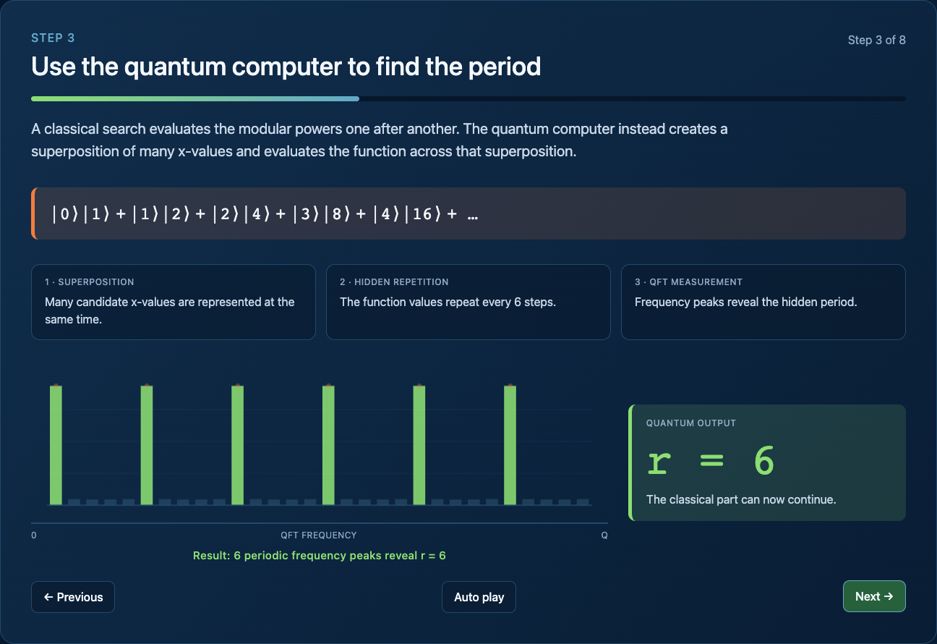
THE KEY IDEA
12
Quantum finds the period—not the factors.
QUANTUM
Find r for aˣ mod N
CLASSICAL
Use gcd to extract factors
21 = 3 × 7
Continue with the interactive walkthrough →
SHOR'S ALGORITHM · OPEN THE LIVE WALKTHROUGH
Notes:
Close the conceptual explanation, then open the live walkthrough at /Users/spreuss/Documents/skipp-algo/docs/demos/shor-factoring/index.html.
[Sources]
- User-provided Shor walkthrough.
- Local interactive demo screenshot captured from /Users/spreuss/Documents/skipp-algo/docs/demos/shor-factoring/index.html.

