Slide 5
PPD RFR RECESSION/DRAWDOWN

Slide 8
CEO RECESSION/DRAWDOWN

Slide 11
SAA RECESSION/DRAWDOWN

Slide 18
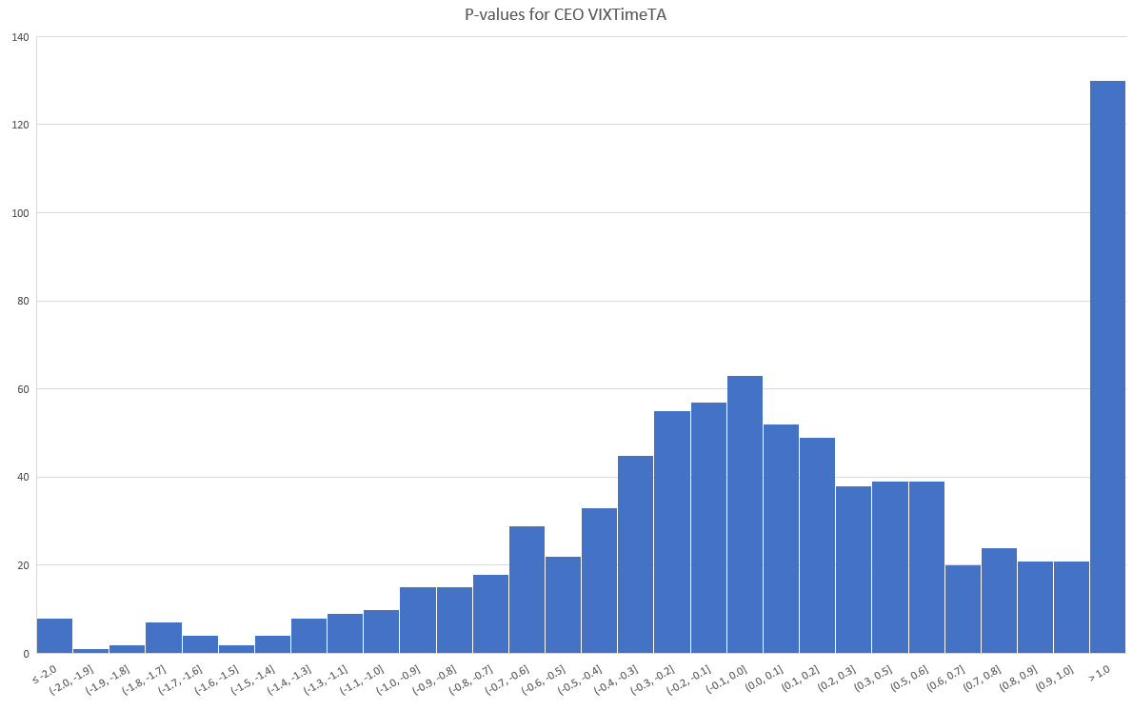

Slide 19
