Slide 1

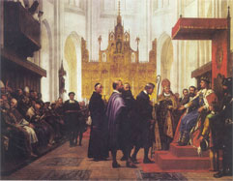
Robustness in Production Planning
Uffe Gram Christensen and Pimin Konstantin Balić Kefaloukos

Slide 2
Elevator pitch
Problem
Integer problems with stochastic parameters in production planning
Lack of specialized algorithms that handle arbitrary stochastic parameters and arbitrary problems.
Solution
Search for solutions using a metaheuristic
Use fast simulation to determine robustness of solutions on the fly

Slide 3
Agenda
Purpose
Robustness and uncertainty
Knapsack and Lot-sizing
Metaheuristics
Seeding
Simulation and statistics
Results

Slide 4
Purpose
Problem
Usual optimization problems assume constant parameters.
In real life, parameters may vary over time.
To overcome this fact in the model the parameters are assigned constant values. Two approaches are generally used:
The parameters are assigned a value that is the highest possible outcome of the parameter.
The parameters are assigned some average value of the outcomes.
The first approach will usually yield a sub-optimal solution, while the second approach will lead to solutions that are not always feasible in real life (have a low robustness).

Slide 5
Purpose
Our solution
We try to find solutions that have a high probability of being feasible while still having good solution values.
We do this using a metaheuristic.
We generate inital solutions and try to search for better solutions from the initial solutions.

Slide 6
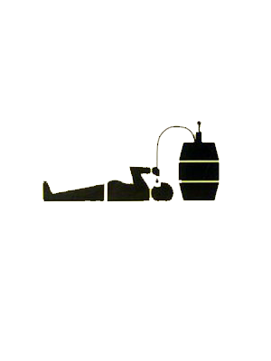



Purpose
Illustrative example – Planning a reception
Accept small probability of running out of beverages.
Stochastic parameters:
Number of people
Amount each person drinks
Number of people
Amount of beverage/person
or
or

Slide 7
Robustness and uncertainty
Uncertainty
Uncertainty means a model with stochastic parameters.
Normal, Gamma, Weibul, binomial, multinomial distributions… etc
Robustness
Complete robustness: Solution feasible no matter outcome.
Bounded uncertainty.
Classic definition of robustness
Partial robustness: (High) probability of solution being feasible.
Unbounded uncertainty
Our definition of robustness

Slide 8
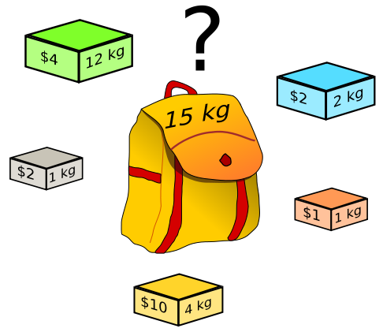
Knapsack and Lot-sizing
Knapsack
Maximizing the profit of items in a knapsack.
The knapsack has a capacity and the items each have a weight or size and an associated profit.

Slide 9
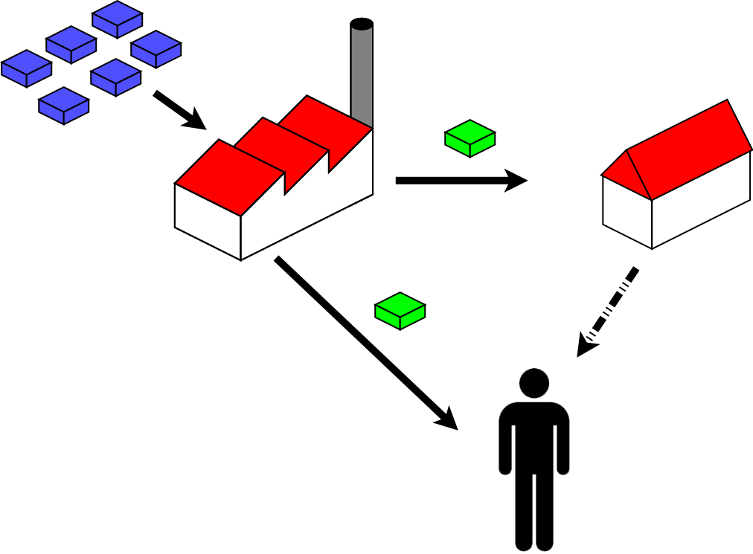
Knapsack and Lot-sizing
Lot-sizing
Objective: Minimize cost
Elements of the problem:
Production costs
Holding costs
Limited production capacity
External demand
Finite amount of time periods

Slide 10
Next: Method
Both problems are NP-hard
Algorithms exist for solving the problems, but not many discuss solving the problems with stochastic parameters.
We will now turn to our method of finding robust solutions

Slide 11
Metaheuristics
Hill climbing
Simulated annealing
Tabu search
Genetic algorithms
General idea of a metaheuristic
General applicability
Limited knowledge of the problem
Only measures by results

Slide 12
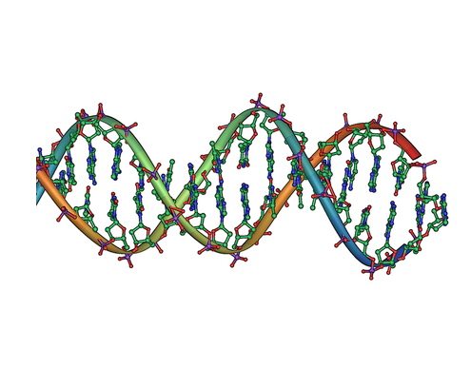
Metaheuristics
Why have we chosen a metaheuristic?
We have chosen genetic algorithms.

Slide 13
Metaheuristics: Seeding
Choosing initial solutions for metaheuristics
Scenario sampling
Solve scenario to near optimality
Test robustness
Search for better solution among neighbours
Sampling has high likelihood of generating a ”typical” scenario.
Repeated sampling gives good scatter of typical scenarios.

Slide 14
Scenario optimization
Metaheuristics
Search for solutions
Scenario optimization
Search for ”well hedged” scenario
Solve by conventional deterministic solver

Slide 15
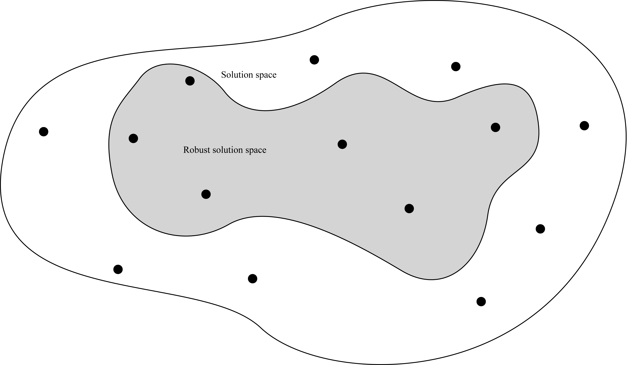
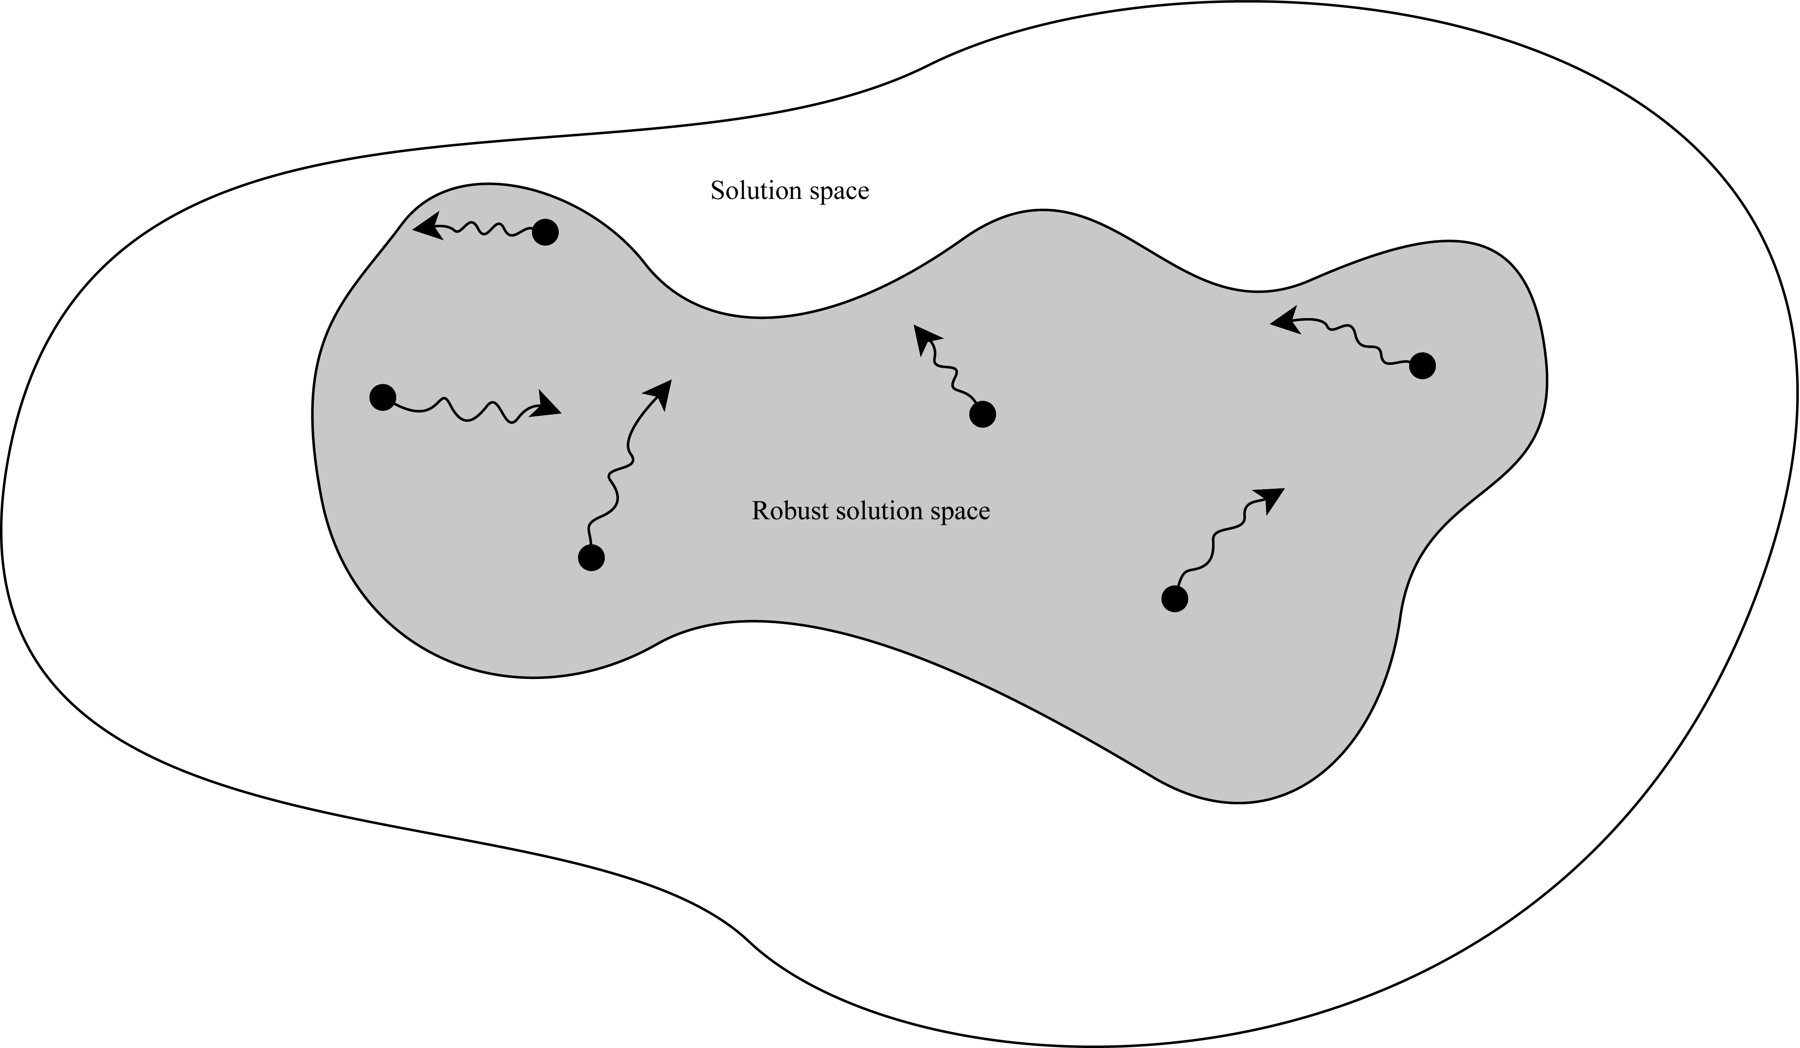
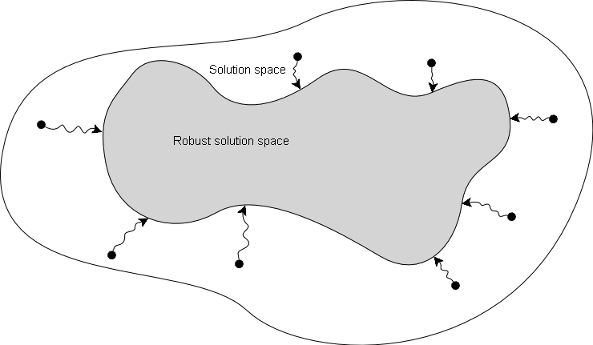
Metaheuristics: Seeding

Slide 16
Next: Statistics
Algorithms find solutions
Two properties of solutions are interesting
Solution value
Robustness
We use simulation to determine robustness.

Slide 17

Simulation and statistics
Testing robustness using simulation as opposed to analytical methods.
Observation:
Generate a scenario (sample distributions)
Is solution feasible in this scenario?
Conclude on robustness using simulation:
Generate many observations!
Number of positives used to estimate robustness
We want to limit the number of observations needed!

Slide 18
Simulation and statistics
Naive way
Make 100.000 observations
Observed 98.000 positive results
98% likelihood of positive result
Positive result could be number of scenarios where a solution is feasible.

Slide 19
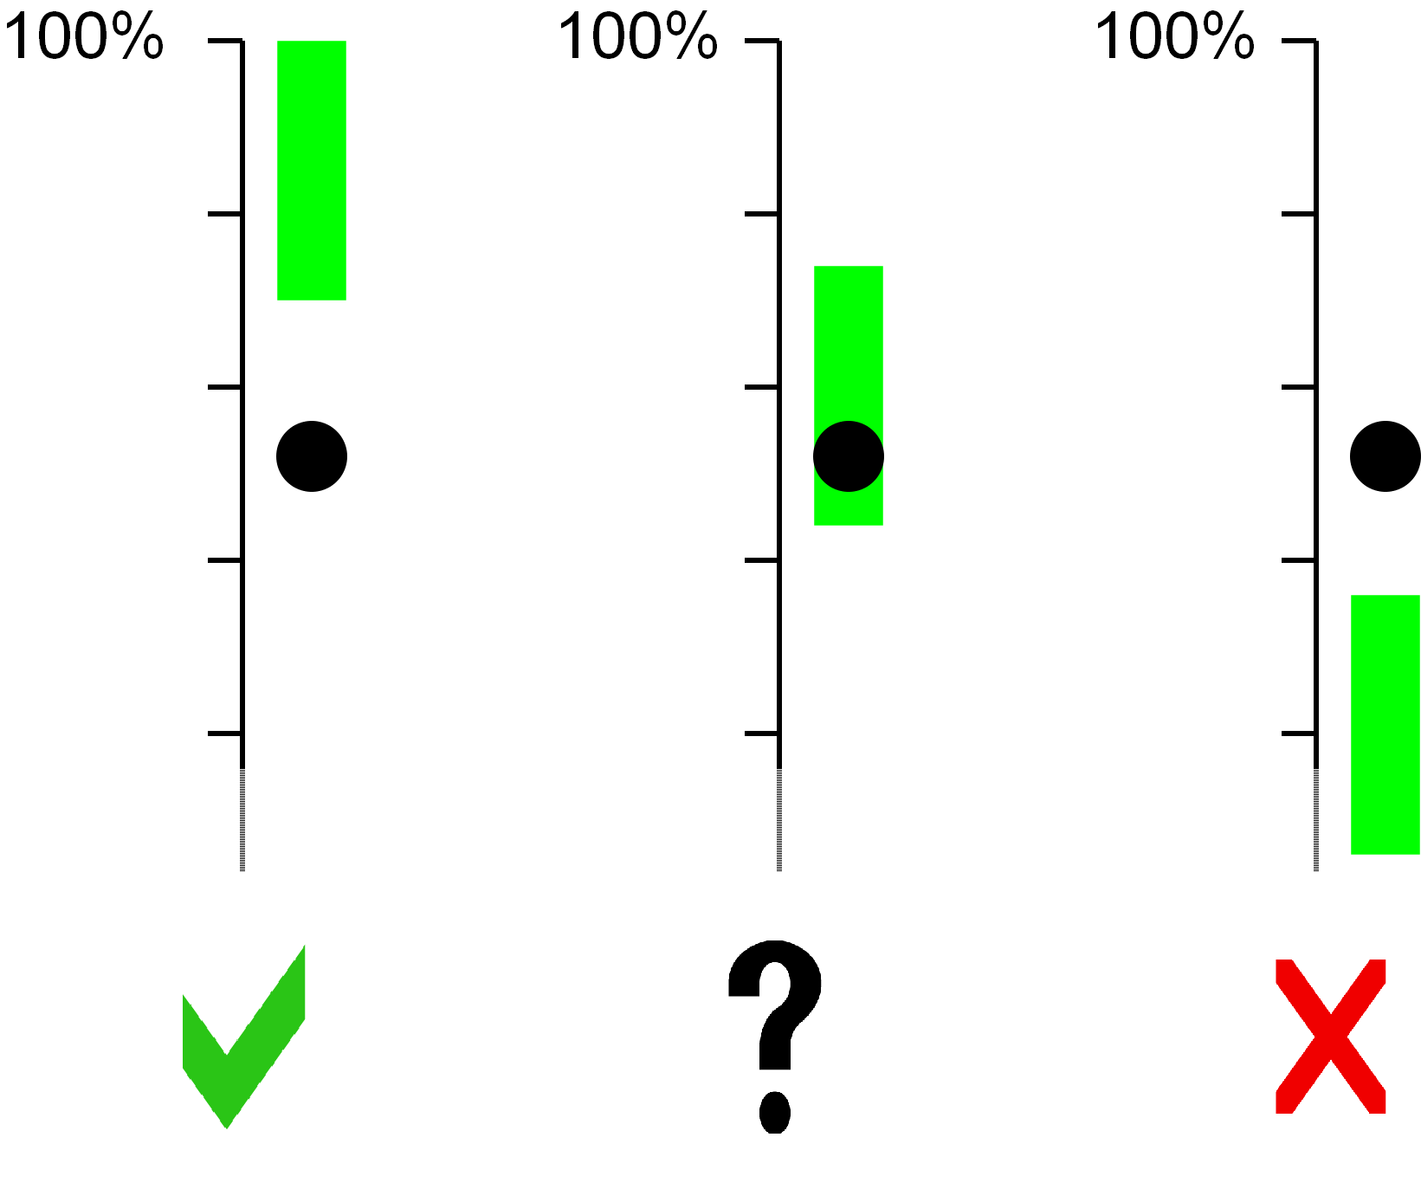
Simulation and statistics
From statistics
Hypothesis test
Acceptance area
Clever way to simulate robustness
Make 1000 observations
Calculate acceptance area
Is desired robustness lower than acceptance area?

Slide 20
Simulation and statistics
Exploit
Width of acceptance area decreases with number of observations
Fast to calculate acceptance area
Very clever way
Calculate acceptance area on the fly
Discard solution immediately if acceptance area lower than desired robustness
Accept solution immediately if acceptance area higher than desired robustness
Very clever way reduces number of generated scenarios by roughly 2/3 compared to clever way.

Slide 21
Results
Knapsack
Improvement over fat solution by 2-31%.
Best improvements are achieved, when the stochastic parameters have high deviation.
Robust solutions lose 0.4-32.5% compared to deterministic solution.

Slide 22
Results
Lot-sizing
Good:
Simulation fast way to evaluate robustness.
Scenario optimization finds well-hedged scenarios.
Going from low to high robustness without adding initial stock
Bad:
Most instances too hard to solve even using specialized solver.
Hard to generalize results with so few solvable instances.

Slide 23
Conclusion
Metaheuristics:
Genetic algorithms works well for the knapsack problem
Genetic algorithms did not work for the lot-sizing problem
Simulation:
Works well with our approach, for both problems
We can determine robustness fast
Scenario optimization:
Worked well for lot-sizing problem
What have we learned:
No free lunch in search and optimization!

Slide 24
Thank you for listening
Thank
you
for
listening
liste
ning

