Slide 1

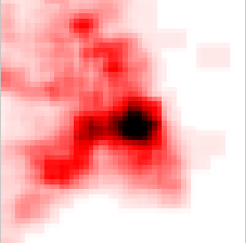


TileHeat
Department of Computer Science (DIKU)
A Framework for Tile Selection
Pimin K. Kefaloukos
Marcos Vaz Salles
Martin Zachariasen
DIKU, University of Copenhagen
ACM SIGSPATIAL GIS 2012 - Rendondo Beach
Notes:
Thank you -- TODAY I will present TileHeat, a Framework for Tile Selection. This is joint work with Marcos Vaz Salles and Martin Zachariasen at the University of Copenhagen.

Slide 2
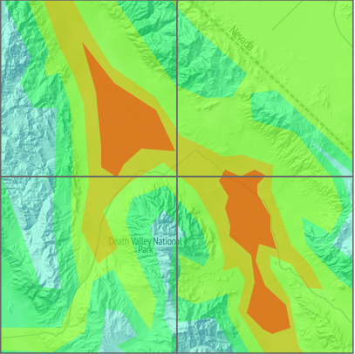
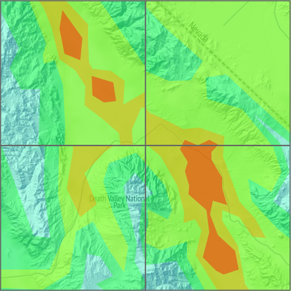
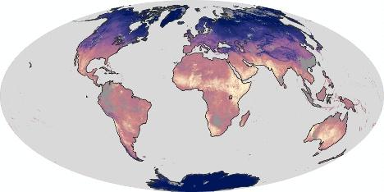


Motivation by example
Department of Computer Science (DIKU)
Consider for a minute that you are publishing a tiled geographical map online
A global temperature map...
stale tile
Data updated daily
Fast, consistent and up-to-date tiles!
What would your users demand?
Source: earthobservatory.nasa.gov
Notes:
Temperatures change daily. This is reflected by the data, which is updated daily. This means that tiles change all over.

Slide 3
Why would you use tiles?
Department of Computer Science (DIKU)
If data is updated daily, why not compute map images on-the-fly from the base data?
“Fast” in “Fast, consistent and up-to-date”
Hardware and server software is not free ($$$)
A “peaky” load would mean adding a lot of computing power to meet demand
Serving cached tiles lets you meet demand with fewer resources
Notes:
Here we’ll compare two scenarios, where a map service is subjected to two different workloads

Slide 4
Problem: Big invalidations
Department of Computer Science (DIKU)
map service
Tile Cache
Render Service
DB
Scenario 1: Small data update
map service
Tile Cache
Render Service
DB
Scenario 2: Big data update
Notes:
One way to produce many simultaneous cache misses:
- Big invalidations

Slide 5
Problem: Big invalidations
Department of Computer Science (DIKU)
Fast, consistent and up-to-date tiles!
Best case: Small invalidation
Small update
Tile Cache
Render Service
DB
Scenario 1: Small data update
Initially all tiles stored in cache
Best case: Big invalidation
Big update
Tile Cache
Render Service
DB
Scenario 2: Big data update
Notes:
Let’s assume that all tiles are cached in the beginning of each scenario

Slide 6
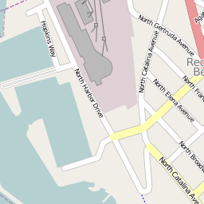
Problem: Here comes peak load!
Department of Computer Science (DIKU)
Map Client
Map Client
Tile Cache
Render Service
DB
Map Client
Map Client
Tile Cache
Tile Cache
Render Service
Render Service
DB
DB
Map Client
Map Client
High latency
High level of concurrency
Notes:
Here comes the peak load!
In scenario 2: We are torn apart on the backend!

Slide 7
Problem: Big invalidations
Department of Computer Science (DIKU)
I'm not happy. Some of those tiles were slow!
Tile Cache
Render Service
DB
Map Client
High latency
High level of concurrency
Notes:
So here is the problem. Our user is not happy, because she experienced bad performance (high latency for the map tile responses)

Slide 8
Case study: KMS
Department of Computer Science (DIKU)
National Survey and Cadastre (KMS)
National mapping agency of Denmark
Provide geospatial services to the public
Issues:
Overload results in high latency
Large data updates cause bad cache utilization leading to overload
Data we have analyzed
Request log last 5 years: ~1B requests total
Results in paper produced from Q4 2011 log
Patterns in requests for the most popular map service @KMS: ~1.4M requests per day
Notes:
If you are wondering if this really happens in practice, I can assure you it does. …
Rendering: mostly because of high degree of concurrency, but also because of the quality of the rendering.

Slide 9
Ideal situation
Department of Computer Science (DIKU)
queries/second
Massive data update and invalidation
Precompute missing tiles
Serve tiles from cache
midnight
noon
midnight
Schedule massive data updates during low load
Time to refresh cache with new tiles before peak load
Serve tiles from cache during peak load
Source: National Survey and Cadastre
Notes:
Given the scenario from before (the bottom one) big data updates + big invalidations + many simultaneous tile requests.
WHAT would be an ideal way to serve the tiles?
BLUE curve represents queries per second, which relates to the number of simultaneous requests

Slide 10
Problem
Department of Computer Science (DIKU)
queries/sec
Massive data update and invalidation
Time needed to precompute all tiles
midnight
noon
midnight
It takes a long time to precompute all tiles
~4^{m} tiles for m zoom-levels
2.5 days for 12 zoom-levels @KMS
Source: National Survey and Cadastre
Notes:
Exponentially many
Idea: Prioritize which tiles to precompute
Precompute the tiles that will ACTUALLY be requested

Slide 11
Sketch of solution
Department of Computer Science (DIKU)
queries/sec
Predict and precompute popular tiles
midnight
noon
midnight
Only precompute tiles that are actually requested during next 24 hours
We need a prediction algorithm!
Source: National Survey and Cadastre
Notes:
Exponentially many
Idea: Prioritize which tiles to precompute
Move the first hit on the cache to the low load period
Precompute the tiles that will ACTUALLY be requested

Slide 12
Overview of this presentation
Department of Computer Science (DIKU)
Problem statement
Sketch of TileHeat
Algorithms in detail
Experimental results
Conclusion
Notes:
What we are after is a method to predict tile requests

Slide 13

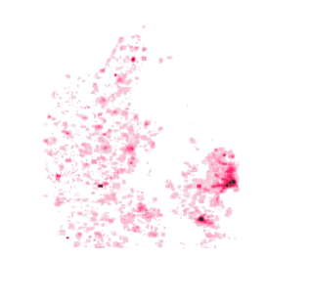
Exploited workload properties
Department of Computer Science (DIKU)
queries/second
Mon Tue Wed Thu Fri Sat Sun
Spatial skew in tile requests
Seasonal variation in QPS (24-hour, week)
Strong skew in requested tiles
# requested tiles < # total tiles
Source: National Survey and Cadastre

Slide 14
TileHeat at a glance
Department of Computer Science (DIKU)
For the production service we have studied:
Using TileHeat, we can select a subset of tiles, that covers 95% of requested tiles (next 24 hours)
~7% of total number of tiles
These tiles can be computed in 8 hours
Computation time fits in low load period

Slide 15
TileHeat at a glance
Department of Computer Science (DIKU)
Normal processing
TileHeat
Tile request
Cache miss
Invalidate stale tiles
Low load
Tile in cache
Compute/cache tile
+
Compute ranking of tiles
Tile response
Pre-compute tiles in order
Normal processing
Tile request
Cache miss
High load
Tile in cache
Compute/cache tile
Tile response

Slide 16
TileHeat at a glance
Department of Computer Science (DIKU)
Normal processing
TileHeat
Tile request
Cache miss
Invalidate stale tiles
Low load
Tile in cache
Compute/cache tile
+
Compute ranking of tiles
Tile response
Pre-compute tiles in order
Normal processing
Tile request
Cache miss
High load
Tile in cache
Compute/cache tile
Tile response

Slide 17
Overview of this presentation
Department of Computer Science (DIKU)
Problem statement
Sketch of TileHeat
Algorithms in detail
Experimental results
Conclusion

Slide 18
What the algorithm computes
Department of Computer Science (DIKU)
Input: Log of accesses, tile pyramid
Output: A ranking of the tiles (rank by predicted popularity for next 24 hours)
Process: Order tiles by decreasing rank
1
3
2
5
4
9
8
13
7
12
17
6
11
16
21
10
15
20
14
19
18
29
28
27
26
25
24
23
...
22
31
30

Slide 19
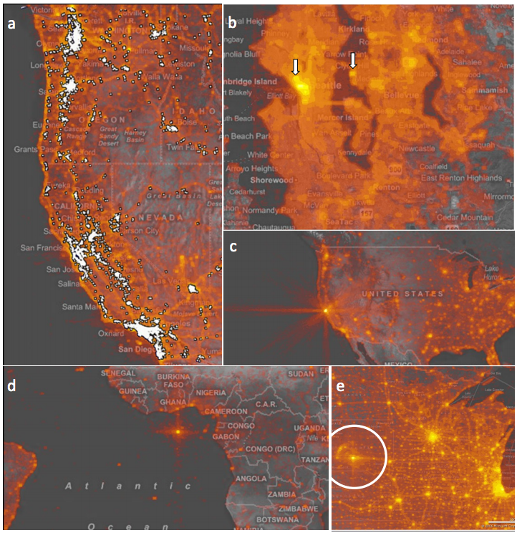
Heatmap of past tile requests
Department of Computer Science (DIKU)
Similar idea to:“Hotmap: Looking at Geographic Attention”, Danyel Fisher, Microsoft Research (2007)
Hot cells correspond to tiles with many requests

Slide 20
Are static heatmaps enough?
Department of Computer Science (DIKU)
We need ability to capture:
Local variation in space
Predict requests for previously unrequested tiles
Local variation in time
React to rising and falling trends in requests

Slide 21
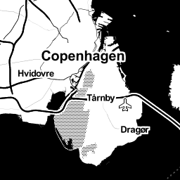

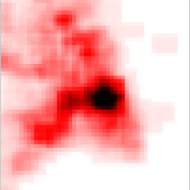
Local variation in space
Department of Computer Science (DIKU)
Tobler's first law of geography
“Everything is related to everything else, but near things are more related than distant things”

Slide 22
Heat dissipation
Department of Computer Science (DIKU)
Rank unrequested tiles near requested tiles
Model likelihood of future requests
Tile requested tomorrow (but not today)
Tile requested today
heat in model
no heat in model
Neighboring tiles
Notes:
WE PROPOSE to capture local variation in time by transferring some of the heat from popular tiles to nearby tiles.

Slide 23
Heat dissipation
Department of Computer Science (DIKU)
Dissipate heat to neighbors cells
Neighboring tiles

Slide 24
Heat dissipation
Department of Computer Science (DIKU)
Tiles close to requested tiles get heat
Tile now has heat, i.e. it gets a higher rank
Neighboring tiles

Slide 25
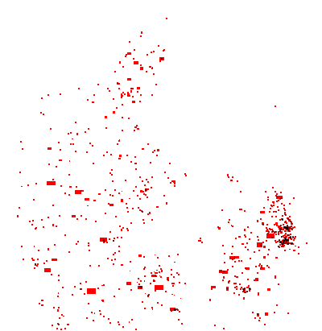
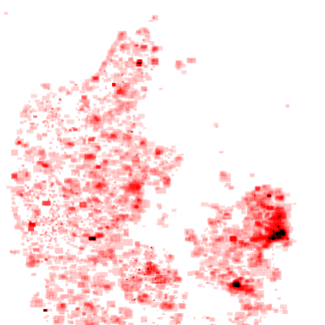
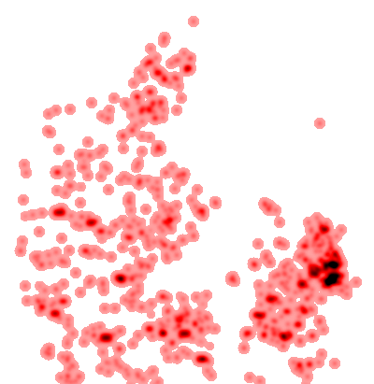
Heat dissipation: A real example
Department of Computer Science (DIKU)
After dissipation
Heatmap based on a small sample of requests (real data)
Real heatmap

Slide 26
Local variation in time
Department of Computer Science (DIKU)
Hypothetical example
Request/sec
Current time
Current time
Popular area A
B mentioned in the news
B becomes more popular than A
Non-popular area B
Time
We want to know before it happens!
Notes:
So that was local variation in space.
Let’s see how we handle local variation in time.

Slide 27
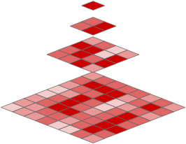
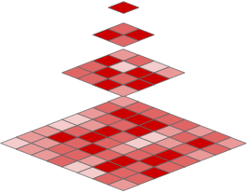
Exponential smoothing
Department of Computer Science (DIKU)
Use exponential smoothing to predict the next heatmap
,
,
,
?
Weighted average of past k heatmaps
We use Holt-Winter double exponential smoothing
Standard prediction technique
Captures trends in the data
Details in the paper

Slide 28
Overview of this presentation
Department of Computer Science (DIKU)
Problem statement
Sketch of TileHeat
Algorithms in detail
Experimental results
Conclusion

Slide 29
Experimental setup
Department of Computer Science (DIKU)
K heatmaps for training, one for validation
K=3, averaged over multiple days
Algorithms tested with production data
KMS request log: 1M+ request/day
Measured
Hit ratio for pre-computed tiles
Compare four algorithms
Optimal algorithm (OPT)
KMS's current algorithm (GEOM)
TileHeat without heat dissipation (HEAT-HW)
TileHeat with heat dissipation (HEAT-D)
Notes:
NOT SHOWN: max # simultaneous cache misses.
SHOWN: Hit ratio for # precomputed tiles
WHY is this good enough? Uncached popular tiles have higher likelyhood of producing simultaneous cache misses than uncached less popular tiles. If we precompute the popular tiles, we reduce the likelyhood of many simultaneous cache misses.

Slide 30
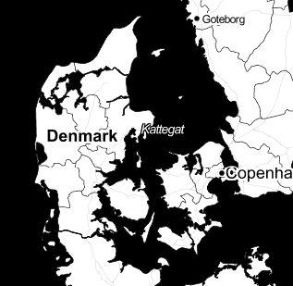
Experimental results
Department of Computer Science (DIKU)
Hit ratio
95% of requested tiles
OPT
100%
HEAT-D
HEAT-HW
GEOM
50%
< 500K tiles needed for 100 % hit ratio
# tiles computable during low load
# tiles cached
0
1M
2M
3M
7% of tiles
Notes:
OPT: An oracle has told us the actual number of accesses to each tile next 24 hours.
Only 500K out of 22M possible tiles are requested within next 24 hours.
Easily precomputable during low load time window
Let’s see how close we can get to OPT using various prediction algorithms

Slide 31
Conclusion
Department of Computer Science (DIKU)
TileHeat
Method for ranking tiles in geospatial web service
Based on heatmaps
Handles local variation in space and time
Predict set of tiles that accounts for 95% of requests
Computing 7% of total tiles
25% improvement over state-of-the-art
Future work
TileHeat for data mining and user modeling
Explore other scalable geospatial data solutions
Thank you! Questions?

