Slide 1


How To Maximize Your Career Direction Results
Using the Student CDII Scanform
Collecting Student Information
Mailing Scanforms to CTC
New For RRNCOs: Refined Student Lead Report
Counselor’s Report
Updated 15 AUG 2007
Notes:
The unique thing about Career Direction is the way it positions the RRNCO to talk face to face with students about their future plans. It is not a “soft sell” but a “smooth sell” approach.

Slide 2
Message From NGB
With Career Direction you are able to help students while identifying valuable NPS leads.
By using your RRNCO Scanning Report, your follow-up conversations will be
        informed
        targeted to the student,
        relevant to their plans
        and therefore, more successful.
– Michael Jones, COL, GS
Chief, ARNG Strength Maintenance Division
Notes:
NGB wants you owning your high schools by positioning yourself as a “Partner in Education.”

Slide 3
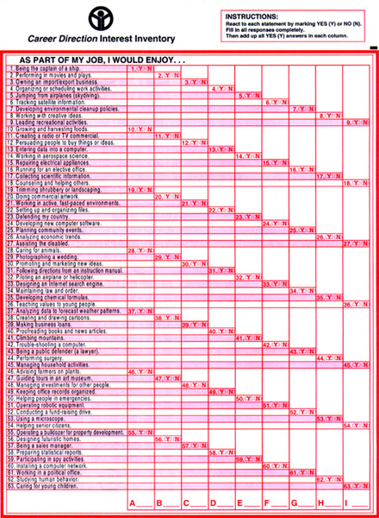
Using The CDII Scanform
Administering the Career Direction Interest Inventory (CDII) scanform is easy and takes only 10 – 15 minutes.
The CDII scanform consists of 63 scientifically-validated statements divided into 9 career categories.
Students simply bubble (Y) Yes or (N) No for each statement.
Scanform
Notes:
Notice: answers go across the page. Be sure students enter their answers in the correct numbered space. Students can easily keep their place by using a blank piece of paper to line up the items.
The average student can complete the Interest Inventory in about seven to nine minutes.

Slide 4
Using The CDII Scanform
Students easily self-score by counting the number of “YES” answers for each column.
Students use their school’s password online to generate their personal CDII Report.
However, student data is NOT saved online and is NOT accessible online to you or to the educator.
3
5
0
7
3
6
1
2
1
Scanform
Notes:
Interest Inventory
Be sure that students transfer the category letters of their three highest scores to page 9.

Slide 5
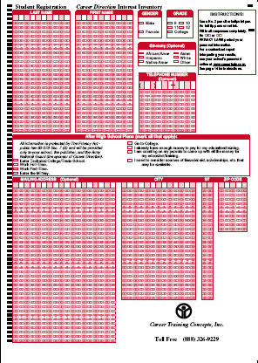
Student Information
Have students complete reverse side of scanform to record their:
Student Contact Info
Gender
Grade
Future Plans
Note: student info is privacy protected. It will only be provided to the ARNG and to the school.
Scanform
Notes:
Privacy laws protect students’ personal information. Interest Inventory results are not accessible on the Internet. Student information WILL NOT be sold to any outside companies. It WILL be provided to counselors, to you as a representative of the Army National Guard, and also to the publisher of the Career Direction program for research purposes.
If a counselor or student asks, be up-front and explain that yes, you will use the contact information to get in touch with those students whose answers indicate they could benefit by joining the Army National Guard. You may even want to tell them why you joined the Guard and how it has helped you!

Slide 6
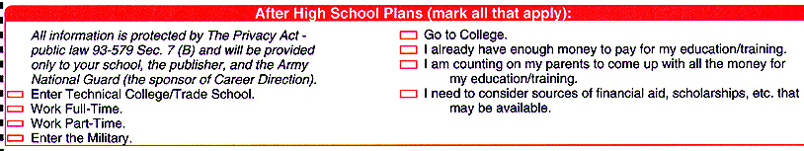
Future Plans Section
Encourage students to indicate all future plans they are considering after high school.
Remember: incomplete scanforms will give you incomplete follow-up reports.
Scanform
Notes:
Interest Inventory future plans section
Be sure students indicate ALL options they are considering. This will make the report we email you more accurate for your follow-up contact planning.

Slide 7
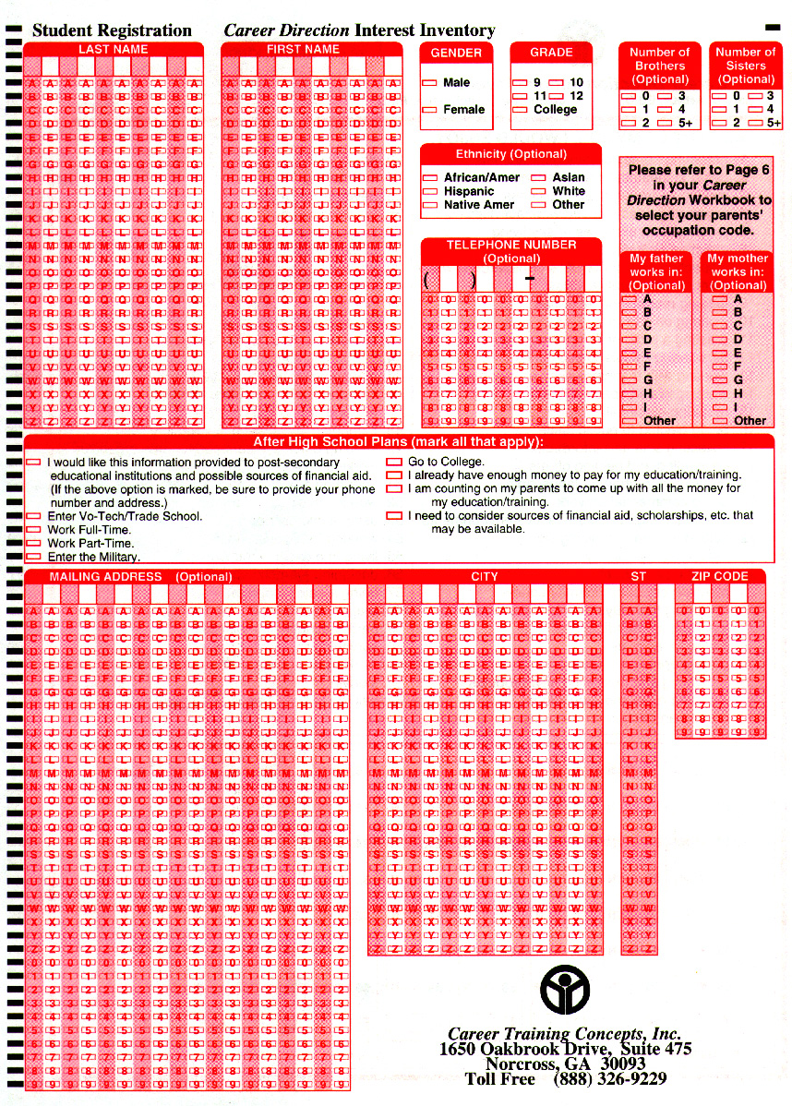
Check Scanforms For Completeness
Write within the blocks
D
O
E
J
O
H
N
Before mailing the forms to CTC, double-check to ensure students have completely bubbled in the appropriate letters.
Scanform
Notes:
Be sure students stay within the blocks. Writing across a line or bubbling outside the grid causes the report to be incorrect.

Slide 8
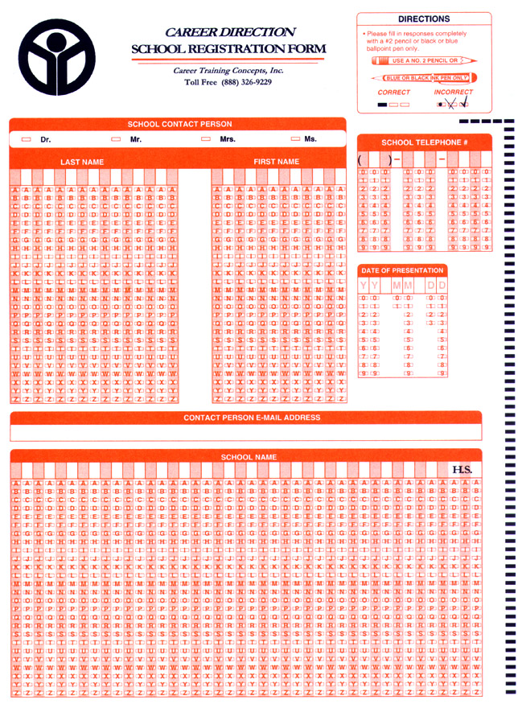
Mail Scanforms To CTC
Complete both sides of Orange Cover Sheet for each batch of CDII scanforms you mail.
Mail to Career Training Concepts (CTC) for processing – See address on Orange form.
Be sure to include your last 4 SSN for Mission Zone Points!
Separate Reports will be emailed to both the RRNCO and the school POC within 3 days after CTC receives the scanforms.
Orange Scanform Cover Sheet
Notes:
CTC moved to a new office in March of 2003. If RRNCOs use envelopes included in older versions of Career Direction, they will go to the wrong address. The correct address is in Snellville, GA.
Make a copy of the scanforms for your records (in case they are lost or destroyed by the post office)
Orient the original scanforms the same direction.
Complete the orange “Scanform Cover Sheet”
BE SURE TO INCLUDE PROPER EMAIL ADDRESSES FOR YOURSELF AND YOUR SCHOOL POC
Place in a sturdy envelope and seal with strong tape and mail to us at:
Career Training Concepts, Inc.
3640 Hewatt Court
Snellville, GA 30039
If you have any questions, call us at 770 326-9229.

Slide 9
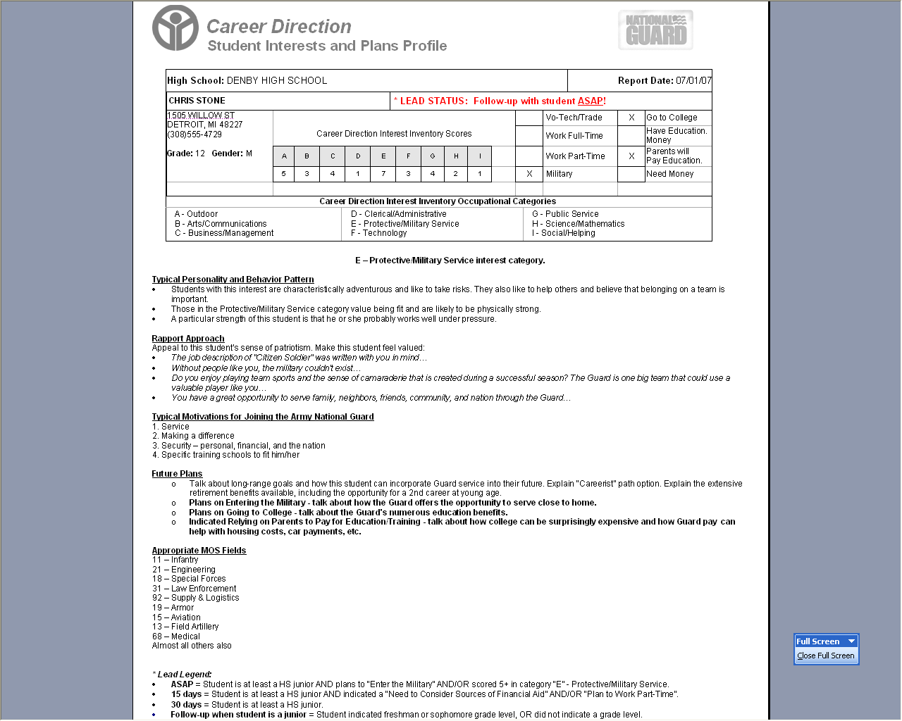
RRNCO Report
Each student ranked by follow-up priority.
The RRNCO will be emailed a Refined Lead Report detailing critical information about each student.
Typical Personality and
Behavior Pattern
Most Effective
Rapport Approach
Typical Motivations
For Joining the ARNG
Future Plans
Appropriate MOS Fields
RRNCO Report
Notes:
RRNCOs love their report. Use this information to strategize effective follow-up conversations.

Slide 10
RRNCO Report
Definition:
Follow-up ASAP!
Student is at least a HS junior AND indicated plans to “Enter the Military” AND/OR scored 5+ in category “E” – Protective/ Military Service.
RRNCO Report

Slide 11
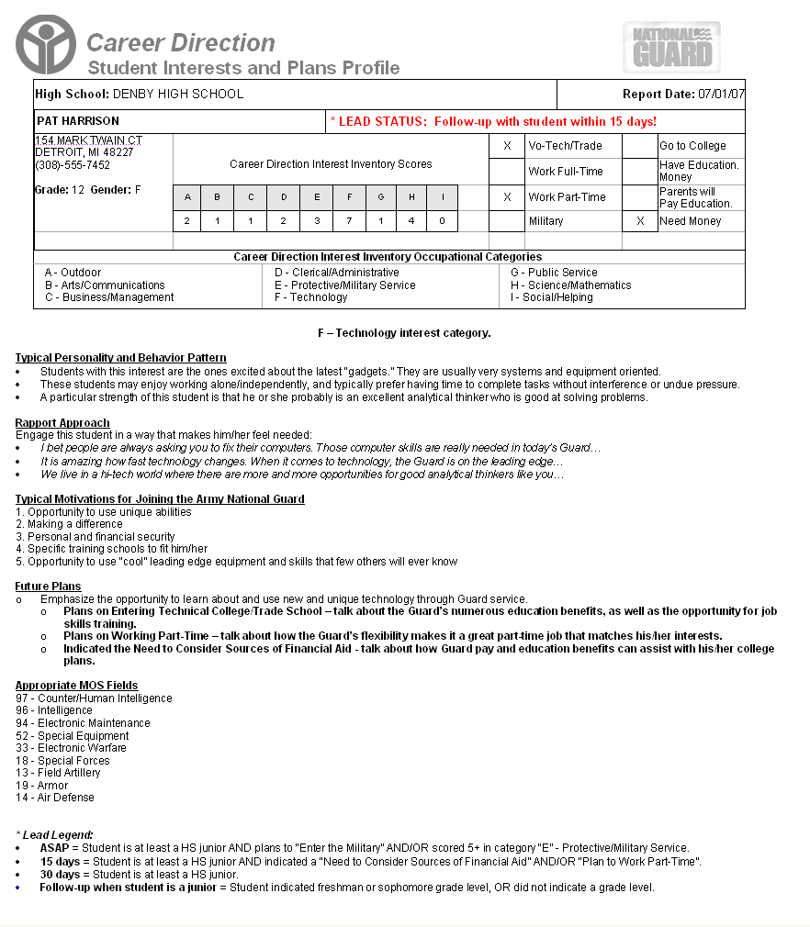
RRNCO Report
Definition:
Follow-up 15 Days
Student is at least a HS junior AND indicated “Need to consider financial aid” AND/OR “work part time.”
RRNCO Report

Slide 12
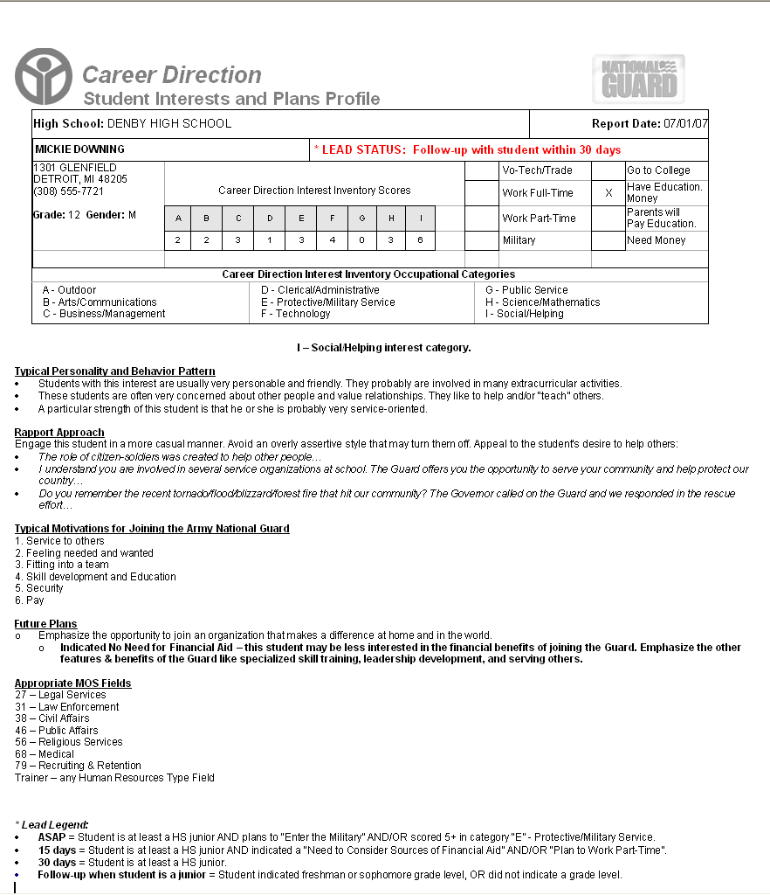
RRNCO Report
Definition:
Follow-up 30 Days
Student is at least a HS junior.
RRNCO Report

Slide 13
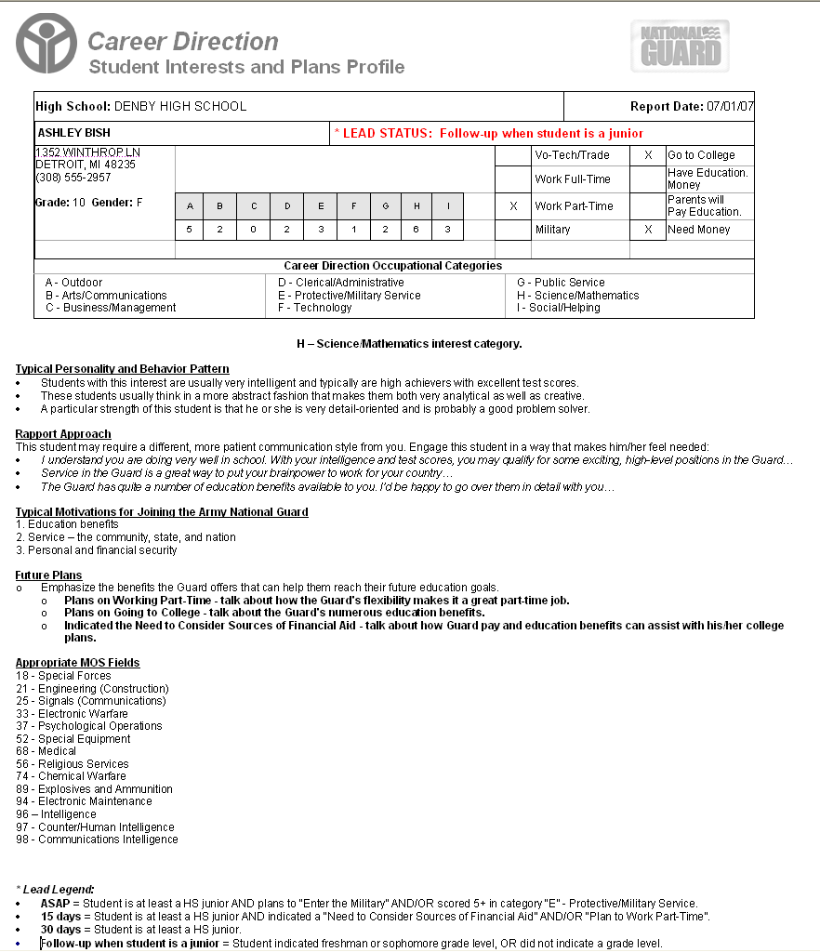
RRNCO Report
Definition:
Follow-up when Jr.
Student indicated freshman or sophomore grade level, OR did not indicate a grade level.
RRNCO Report

Slide 14
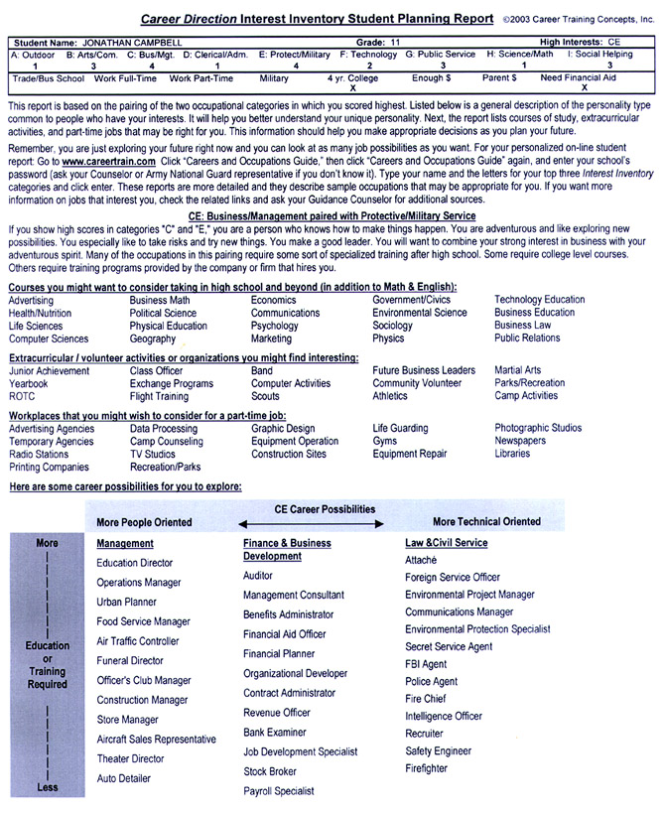
Counselor’s Report
A “Student Planning Report” is emailed directly to the counselor and to you.
Recommends:
Curriculum
Clubs/Activities
Part-Time Jobs
Occupational Choices
Counselor Report
Notes:
Counselors love the Student Planning Report. In one page, they have all the information they need for curriculum advisement and for helping students make post-secondary education and training plans.

Slide 15
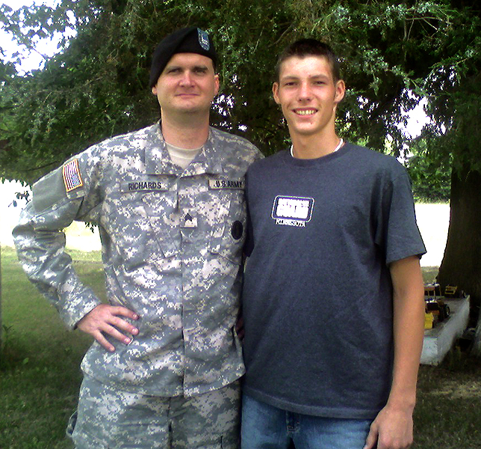
Career Direction Success Story Example
PFC Jason Kiley enlisted on June 30, 2006 as a result of SGT Timothy Richards’ Career Direction class in Upsala, MN.
How many Career Direction leads will you enlist?
Notes:
Sometimes it takes time to nurture a relationship from Career Direction class to enlistment, but sometimes it happens FAST!

Slide 16


