Slide 1
REPLACEMENT SLIDES FOR
CAREER DIRECTION POWERPOINT
This download contains replacement slides you will need to paste into the version of Career Direction you are presenting.
Always make sure your PowerPoint version matches the workbook version you are presenting.
Open both presentations in “slide sorter” view.
Highlight and paste these slides into your presentation.
Delete the slides with pictures of the old Web site.
Notes:
Here’s how you can go on-line to get your own individualized career guidance report. Feel free to use this Web site as many times as you like!
First, you need to write your school’s password in your workbook on page 14.
You (the RRNCO) should register your school before the class. The procedure is:
Go to www.careertrain.com
Click on “Careers and Occupations Guide”
Click on “School Registration”
Enter the school’s ZIP code and check “Career Direction”
Enter the authorization code, which is “cdguard”
If the school is listed as “Not activated” select it and continue with step 7
If the school is listed, select it and continue with step 9
If the school is not listed, select that option and complete the school POC’s information. Note: The teacher’s phone number and e-mail address are very IMPORTANT!
Click “Finish Registration” and be sure to write the password down so you can give it to the students.
Use the poster provided in your RRNCO Resource Guide. It has a space for the password.

Slide 2

Careers and Occupations Guide
www.careertrain.com
Notes:
You will go to www.careertrain.com (home page). Click on the top left button, “Careers and Occupations Guide.”

Slide 3
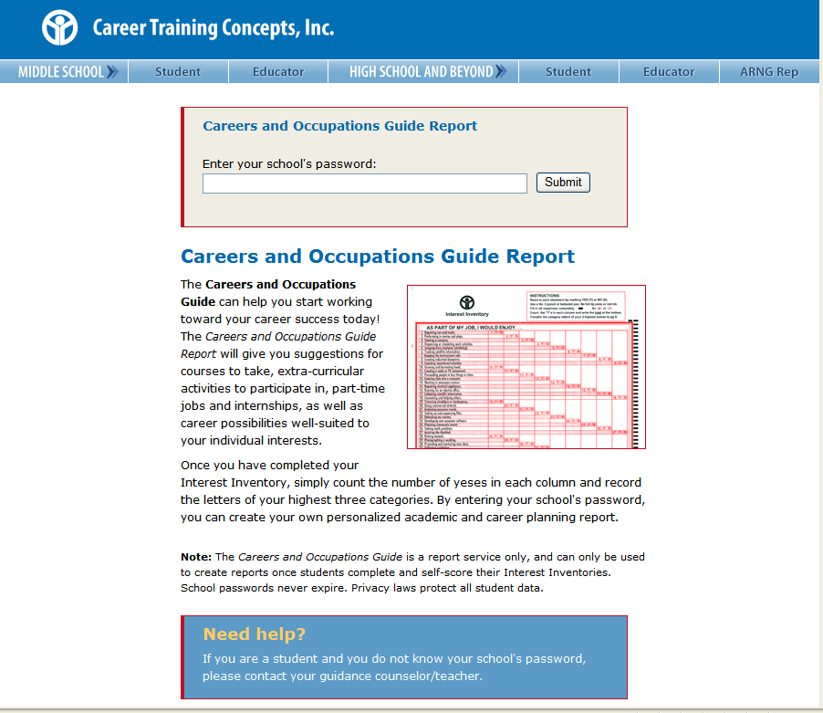
Enter your school’s
unique password
www.careertrain.com
Notes:
Enter the password I just gave you. Remember what it is?
Repeat the password for anyone who didn’t get it right the first time.
The formula for the school password is “cd followed by the school’s Zip code followed by two digits.” A school must be registered in order for a password to be activated.

Slide 4
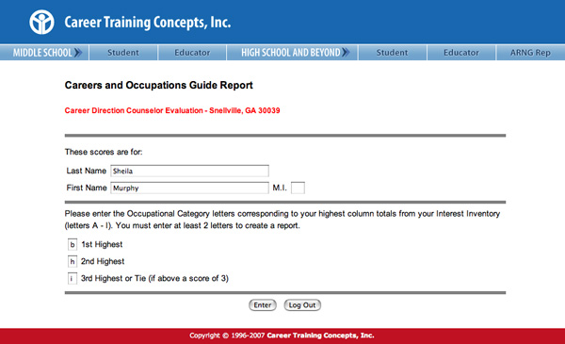
Next, enter your name
Then, enter the category letters
of your 3 highest CDII scores
www.careertrain.com
Notes:
You will be asked for your name, the school password, and the category letters corresponding to your top two or three interest inventory scores which you recorded on page 9 of your workbook. You need at least two scores to create a report.
A report will be generated based on the blends of the scores. If three letters are entered, three reports will be produced. (A, B, C will create report sets AB, BC, and AC.)

Slide 5
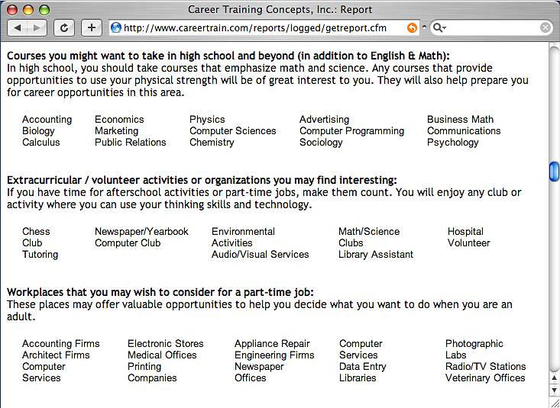
Course suggestions
Extracurricular activities
Part-time jobs
www.careertrain.com
Notes:
You’ll see suggestions for classes and extracurricular activities you might enjoy. These classes and activities will give you more experience in the areas in which you have shown interest.

Slide 6
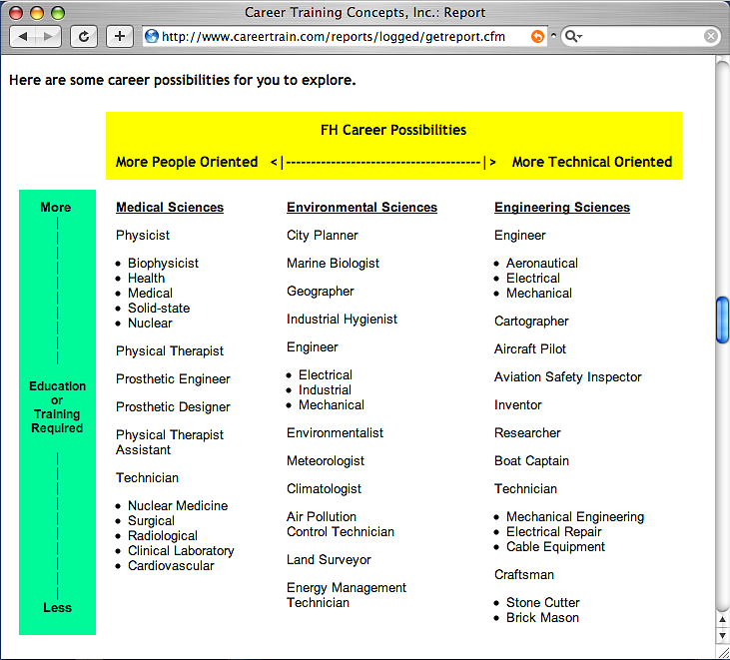
Are you more people-oriented or more technical-oriented?
How much education and training do you want?
www.careertrain.com
Notes:
Your report will list occupations well-suited to your interests.
The occupations are organized by level of education required and people versus technical orientation.

Slide 7
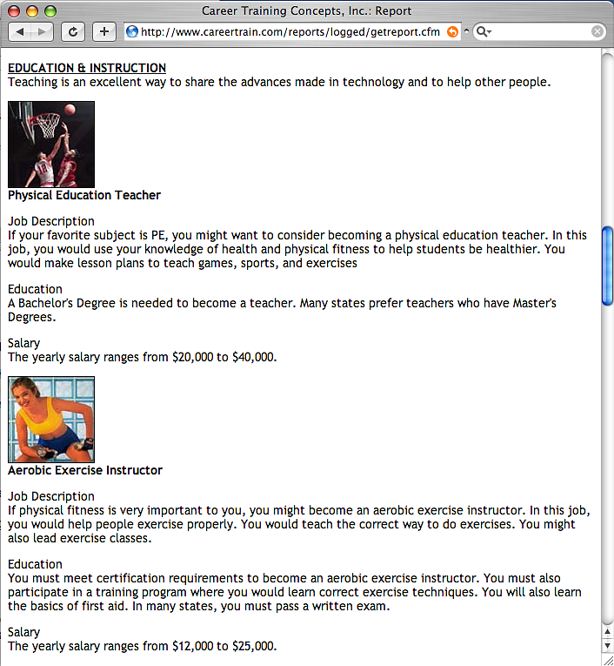
Appropriate jobs for your interests are described in terms of:
    responsibilities
    education/training requirements
    salary range
www.careertrain.com
Notes:
You will see detailed descriptions of a few sample jobs. These jobs are described in terms of their responsibilities, education requirements, and salary range.
At the end of the 1st and 2nd reports, students are prompted to click to the next report. At the end of the last report, students are invited to provide feedback by clicking on the button labeled “Let us know what you think!”

Slide 8
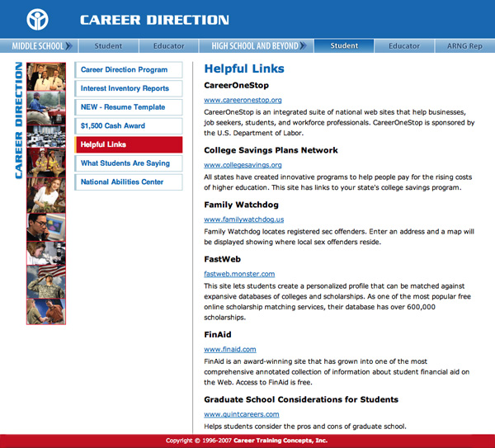
“Helpful Links” page has resources for
additional information
on your education and career options.
www.careertrain.com
Notes:
You can learn more about careers you are interested in by using the hyperlinks on the “Cool Links” page.
Encourage students to use the Web links provided on our “Cool Links” page for additional research regarding their career interests.
If you are doing one 50-minute class, skip to slide 54 (page 18).

