Slide 1

COVID-19 Data Analysis in Santa Clara County
CREATING A Public Record for Future Generations
Steve KIRSCH
Former high tech executive INDEPENDENT JOURNALIST

Slide 2

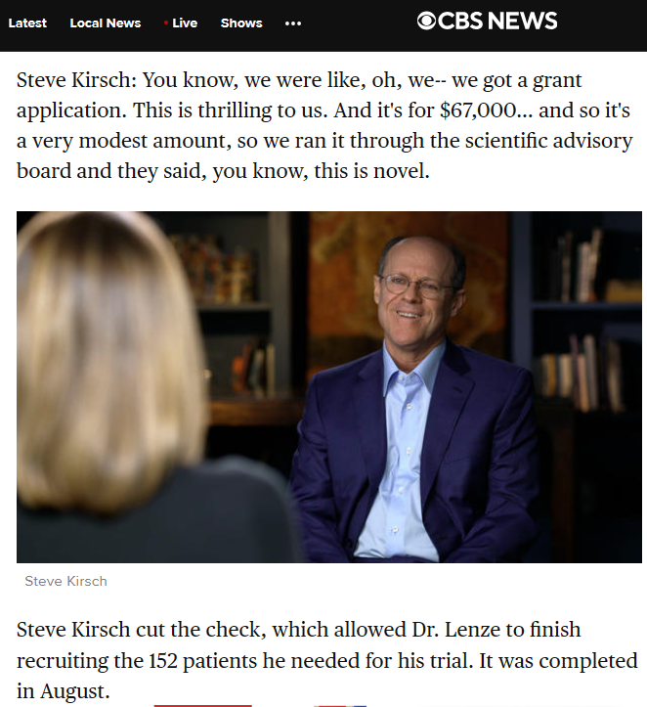
Featured on 60 Minutes

Slide 3
Goal of This Presentation
To create a historical public record to show future generations about COVID-19 outcomes in Santa Clara County based on data published by the Public Health Department (PHD).

Slide 4
Key Findings from SCC PHD Data
1. Vaccinated residents had substantially higher rates of COVID infections than unvaccinated.
2. Vaccination substantially increased the Case Fatality Rate (CFR), indicating a higher risk of death from COVID among vaccinated individuals.
Both differences were large and highly statistically significant.

Slide 5
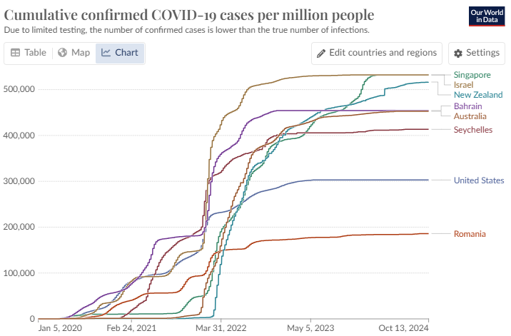
Worldwide data: Higher vax rate → higher cases

Slide 6
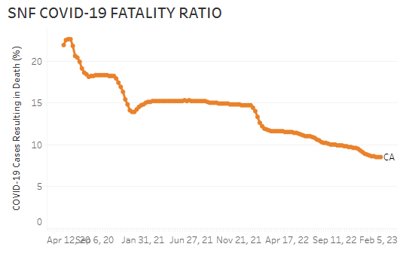
CDPH data: Vaccine did NOT reduce COVID mortality at all in CA
Dec 13, 2020
Dec 26, 2021
Source: https://www.cdph.ca.gov/Programs/CID/DCDC/Pages/COVID-19/SNFsCOVID_19.aspx

Slide 7
Data Source and Availability
The data was obtained through a Freedom of Information Act (FOIA) request and published by the PHD on their website.
Data is available at: github.com/skirsch/covid/santa_clara_county

Slide 8

Public Health Department response was underwhelming
PHD refused to comment even when asked by the County Executive!
Sean Woodland ghosted me
This lack of transparency is troubling. No apology.

Slide 9
Two questions
1. Should the Public Health Department be held accountable for their policy decisions?
2. Is there any Board member willing to ask questions?

