Slide 1

Predicting Bank Marketing Campaign Success Using Machine Learning
Sevda Kisacikoglu

Slide 2
PROBLEM STATEMENT
Instead of mass marketing, the bank has chosen to be more proactive in identifying potential buyers and communicate straight to the customer via telephone calls
The goal of this project is to perform post-campaign analytics to identify the potential subscribers of the term deposit product for future campaigns.
The data mining task is to create a classification model identifying potential subscribers by using supervised learning algorithms.

Slide 3
DATA DESCRIPTION
Available in the UCI Machine learning Repository, which can be retrieved from http://archive.ics.uci.edu/ml/datasets/Bank+Marketing#.
Python 3 and JupyterNotebook to upload and analyze the data
41,188 customers on direct marketing campaigns (phone calls) with 21 variables.

Slide 4
Categorical Variables
Categorical Variables:
Column Name | Description
job | Client's occupation
marital | Marital status
education | Client's education level
default | Indicates whether the client has credit in default
housing | Indicates whether the client has a housing loan
loan | Indicates whether the client has a personal loan
contact | Type of contact communication
month | Month that last contact was made
day of week | Day that last contact was made
poutcome | Outcome of the previous marketing campaign
y | Indicates whether the client has subscribed for a term deposit

Slide 5
Numerical Variables
Column Name | Description
age | Age of the Client
duration | Duration of last contact in seconds
campaign | Number of contacts performed during this campaign for this client (including last contact)
pdays | Number of days since the client was last contacted in a previous campaign
previous | Number of contacts performed before this campaign for this client
empvarrate | Employment variation rate (quarterly indicator)
conspriceidx | Consumer price index (monthly indicator)
consconfidx | Consumer confidence index (monthly indicator)
euribor3m | Euribor 3-month rate (daily indicator)
nremployed | Number of employees (quarterly indicator)

Slide 6
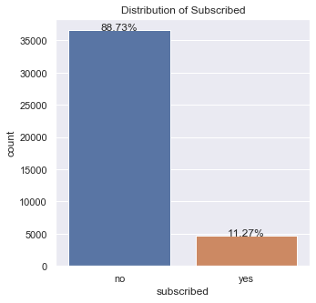
EXPLORATORY DATA ANALYSIS
Target Variable:

Slide 7
EXPLORATORY DATA ANALYSIS
Necessary Variables:
age, job type, marital status, education, campaign, previous, contact type ,month, day of week, previous outcome and social and economic features.
Unnecessary Variables:
duration, pdays, default, housing, loan

Slide 8
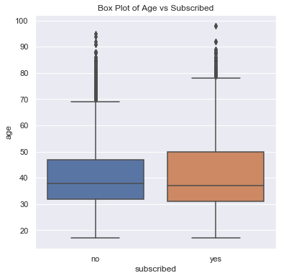
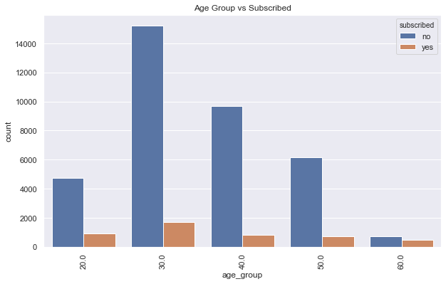
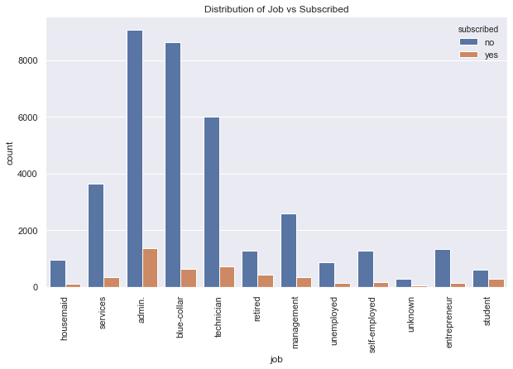
Features Related with Clients Information
Age:
Job:

Slide 9
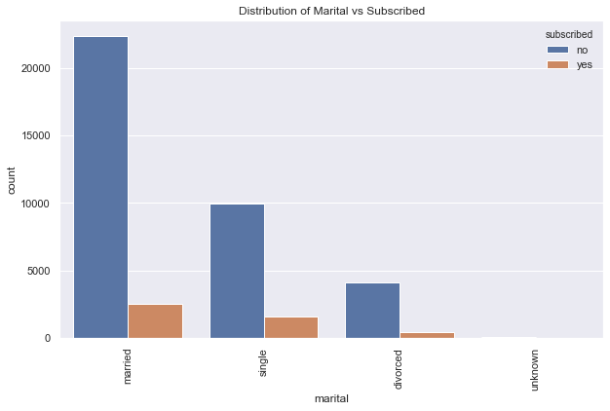
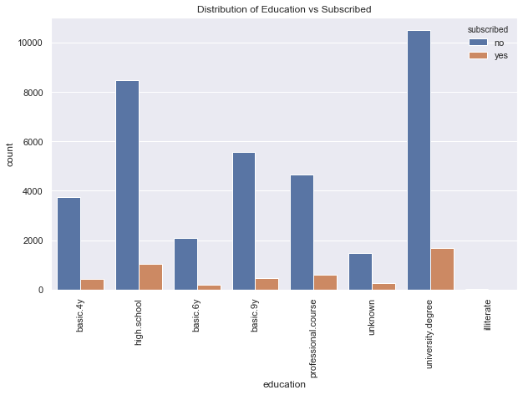
Features Related with Clients Information
Marital Status:
Education:

Slide 10
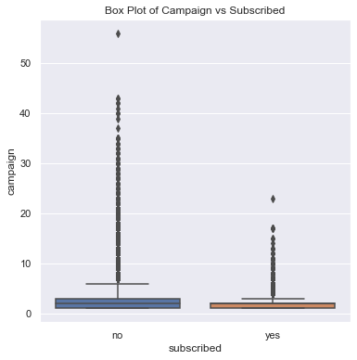
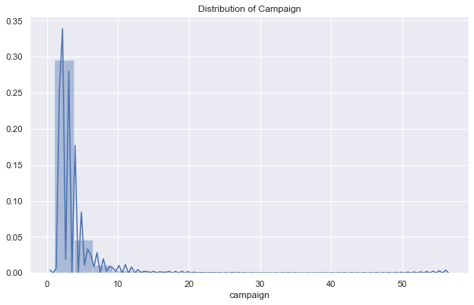
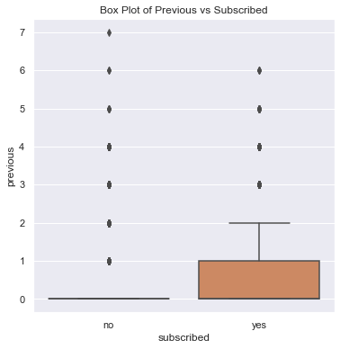
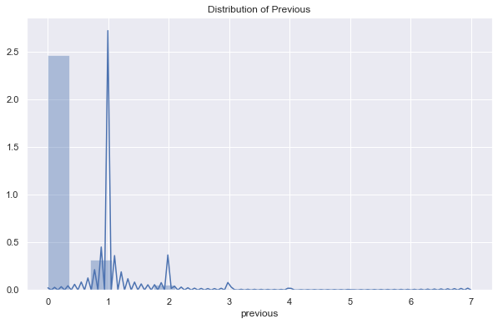
Features Related with Campaign
Campaign:
Previous:

Slide 11
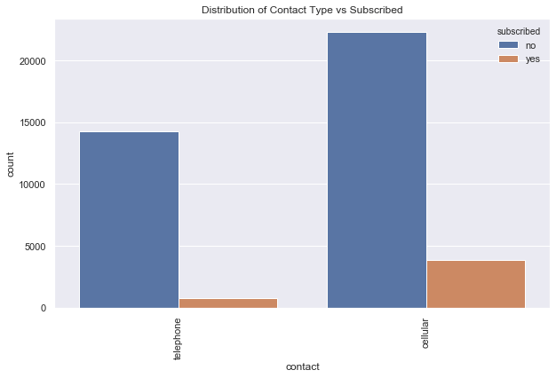
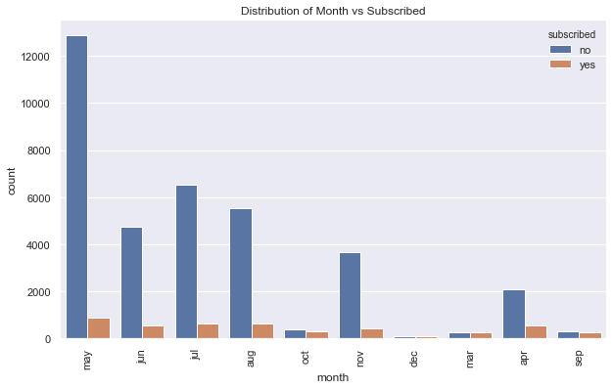
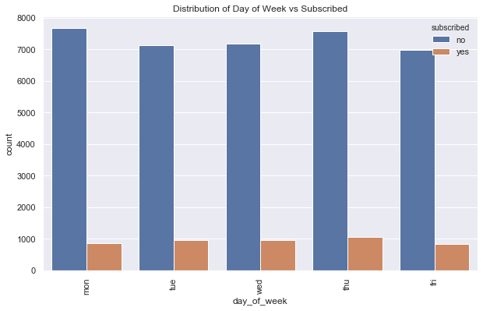
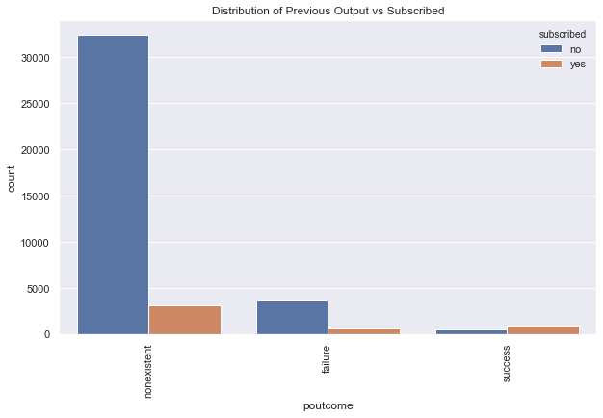
Features Related with Campaign
Month:
Previous Output:
Contact Type:
Day of Week:

Slide 12
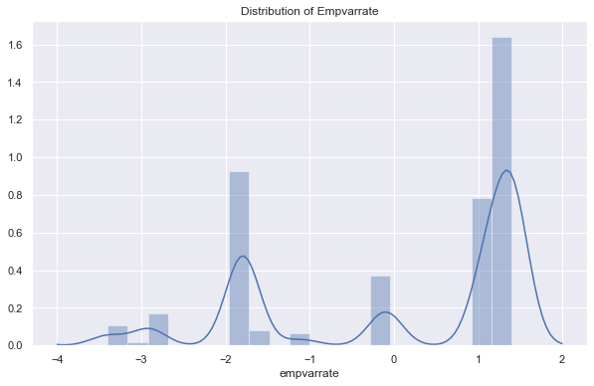
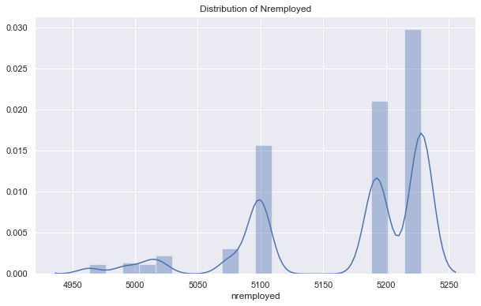
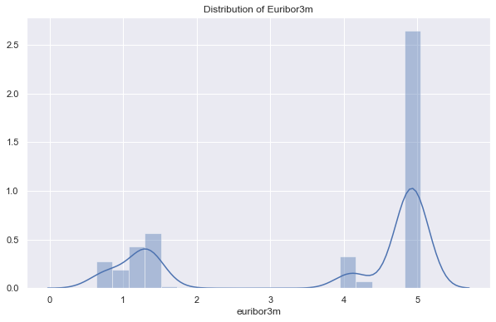
Features Related with Social and Economic Context

Slide 13
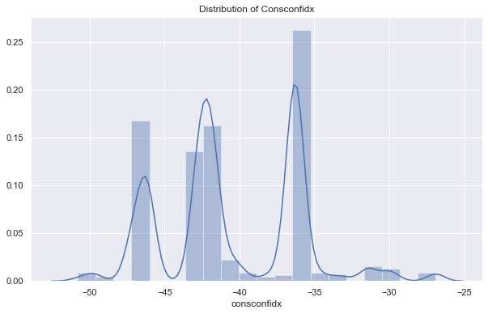
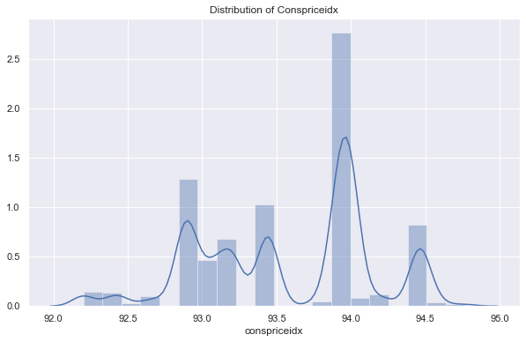
Features Related with Social and Economic Context

Slide 14
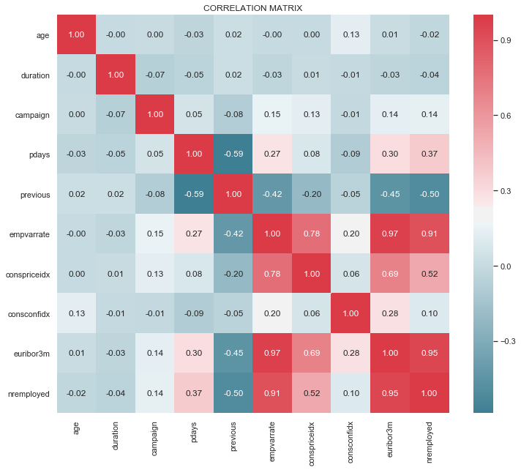
Correlation Between Numerical Features

Slide 15
DATA PREPROCESSING
Unnecessary columns, missing values and outliers
- 39,191 rows
- 16 variables
Feature Scaling and Train-Test Split
- Standardization
- 80% training, 20% testing

Slide 16
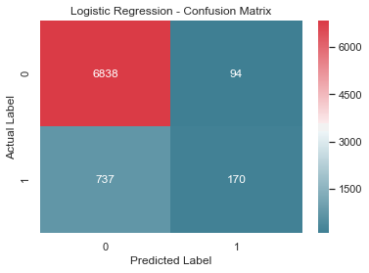
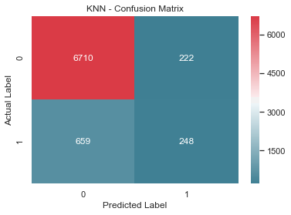

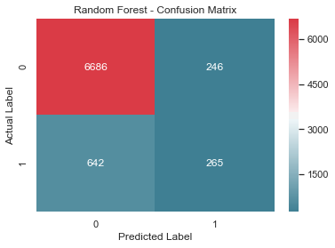
MACHINE LEARNING
KNN
Random Forest
Logistic Regression
SVM

Slide 17
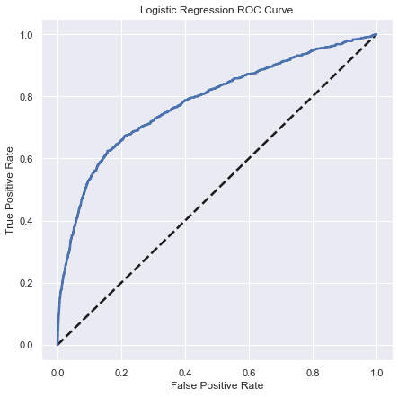
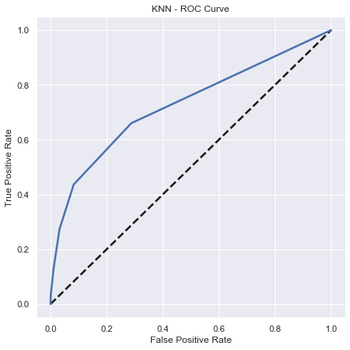

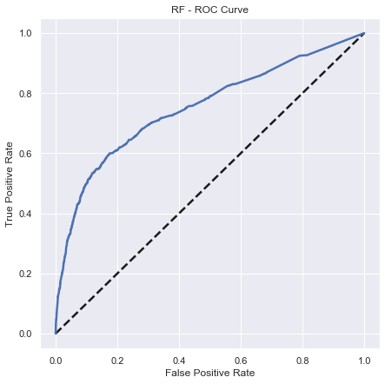
MACHINE LEARNING
KNN
Random Forest
Logistic Regression
SVM

Slide 18
MACHINE LEARNING
KNN
Random Forest
Logistic Regression
SVM

Slide 19
MACHINE LEARNING
Model | AUC Score
Logistic Regression | 0.782
KNN | 0.727
SVM | 0.715
Random Forest | 0.752
Best Score

Slide 20
Conclusion
The age of customer should be greater than 60 and less than 30.
The job type should be student and retired.
The client should have university degree
The client should be single
The classification and estimation model were successfully built by applying logistic regression
The bank can allocate more marketing efforts to the clients who are classified as highly likely to accept term deposits
Increase in the efficiency of the bank’s telemarketing campaign, saving time and efforts.

