Slide 1


Predicting Movie Rating & Building a Recommender System
Sevda Kisacikoglu
Data Scientist

Slide 2
PROBLEM STATEMENT
The first goal of this project : understanding the important features of movie sector and predicting a movie rate.
The second goal of this project : building a recommender system to provide recommendations for different users.

Slide 3
DATA DESCRIPTION
https://www.kaggle.com/tmdb/tmdb-movie-metadata
https://www.kaggle.com/rounakbanik/undefined#ratings_small.csv
4803 movie entries
Movies
Budget
genre
homepage
id
Keywords
original_language
original_title
overview
popularity
production_companies
production_countries
release_date
Credits
movie_id
title
cast
crew
Ratings
userId
movieId
rating
timestamp

Slide 4
DATA WRANGLING

Slide 5
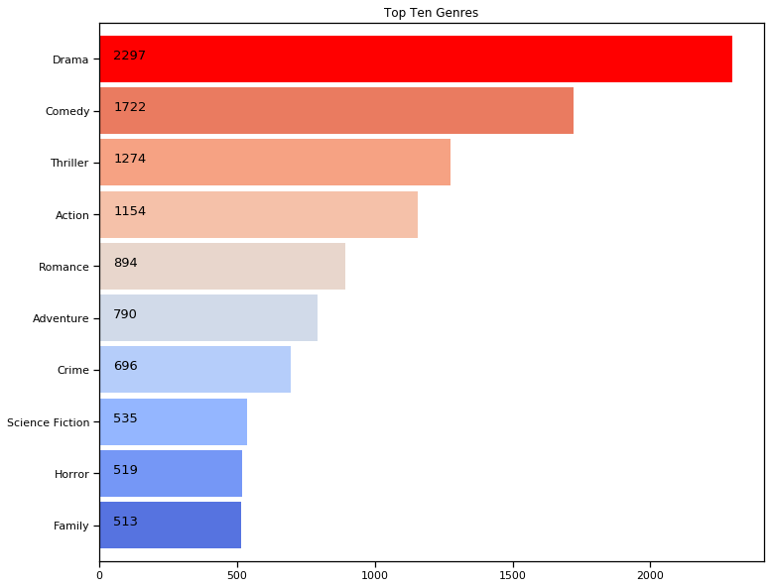
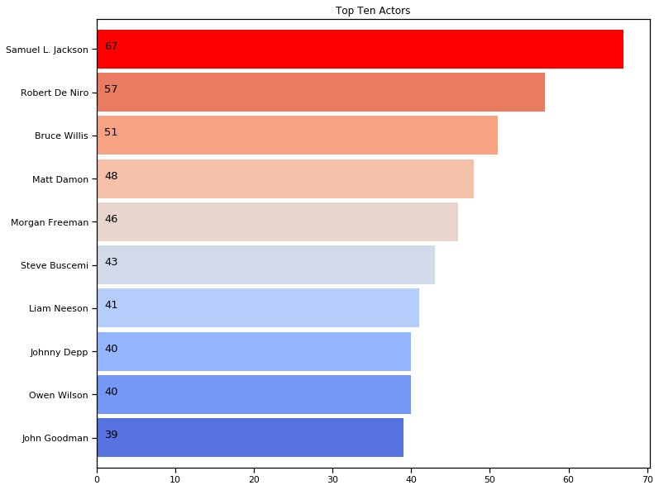
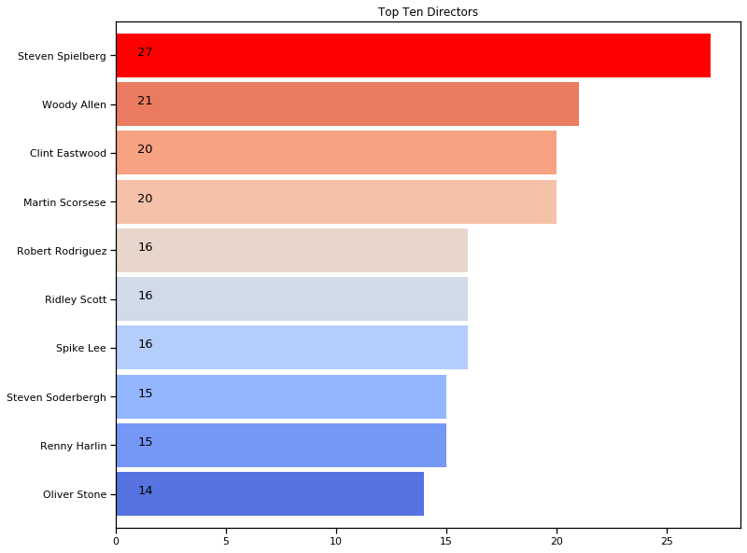
EXPLORATORY DATA ANALYSIS

Slide 6
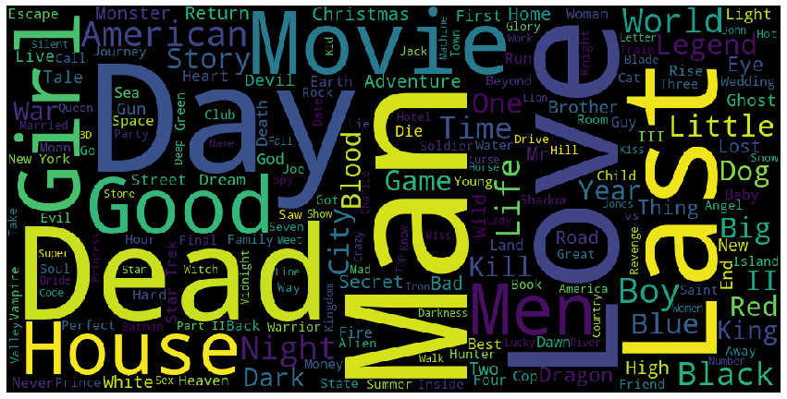
EXPLORATORY DATA ANALYSIS
Movie Title World Cloud

Slide 7
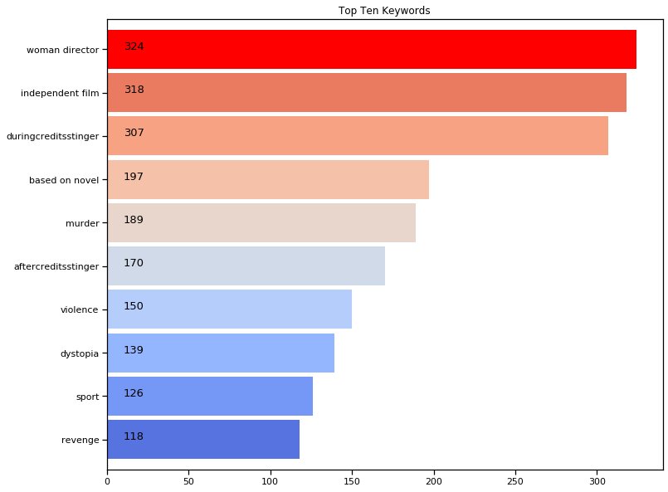
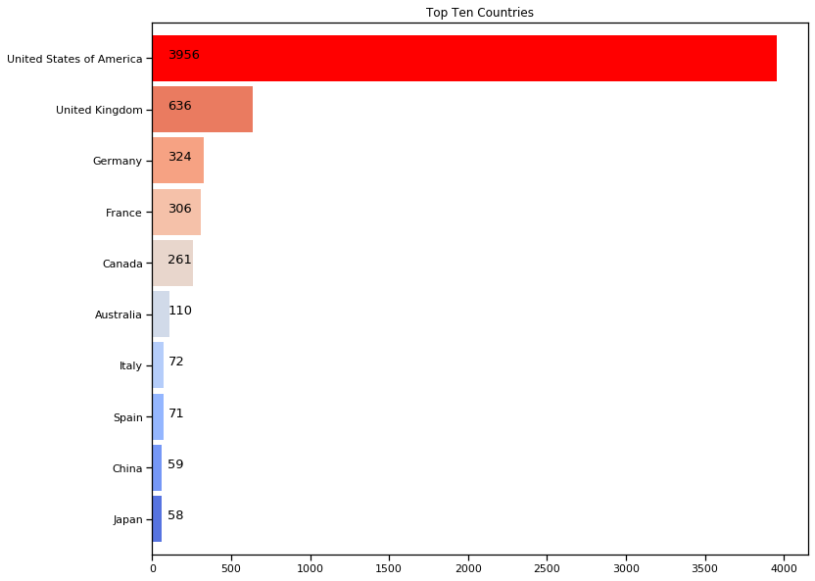
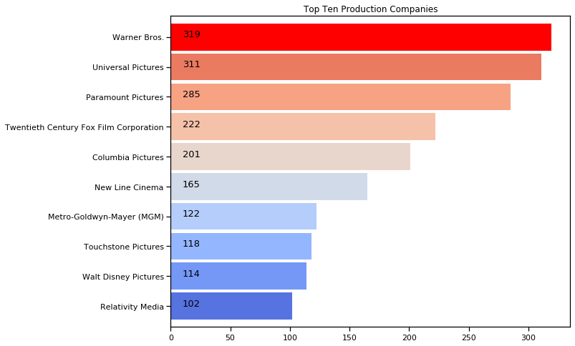
EXPLORATORY DATA ANALYSIS

Slide 8
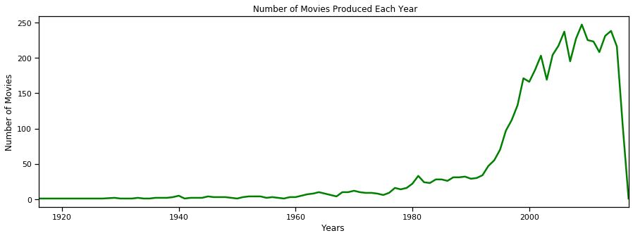
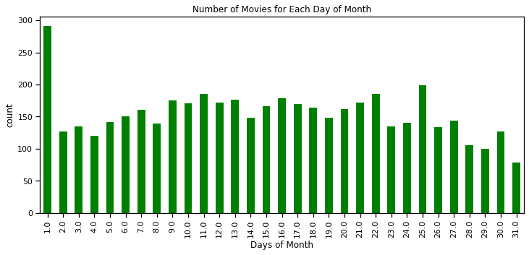
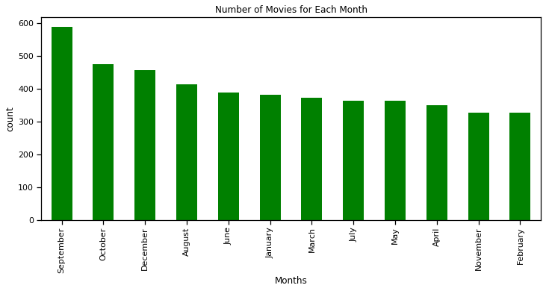
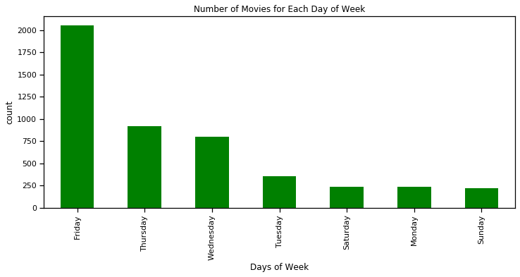
EXPLORATORY DATA ANALYSIS

Slide 9
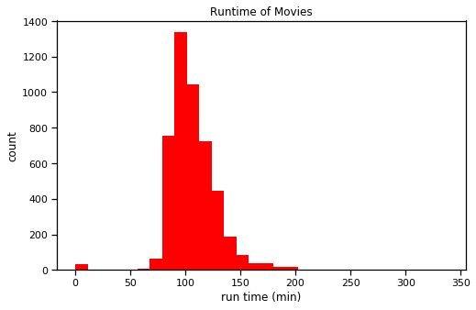
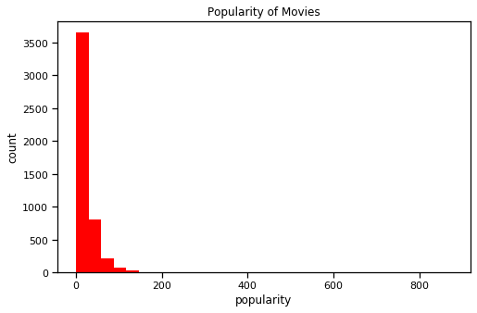
EXPLORATORY DATA ANALYSIS

Slide 10
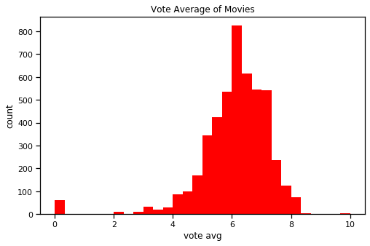
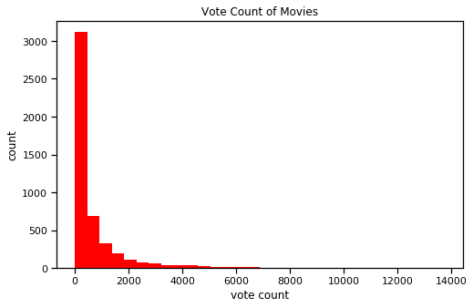
EXPLORATORY DATA ANALYSIS

Slide 11
EXPLORATORY DATA ANALYSIS
title | vote average | vote count | release date
The Shawshank Redemption | 8.5 | 8205 | 1994-09-23
The Godfather | 8.4 | 5893 | 1972-03-14
Pulp Fiction | 8.3 | 8428 | 1994-10-08
Fight Club | 8.3 | 9413 | 1999-10-15
Spirited Away | 8.3 | 3840 | 2001-07-20
The Godfather: Part II | 8.3 | 3338 | 1974-12-20
Schindler's List | 8.3 | 4329 | 1993-11-29
Whiplash | 8.3 | 4254 | 2014-10-10

Slide 12
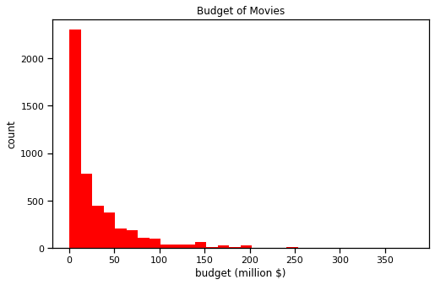
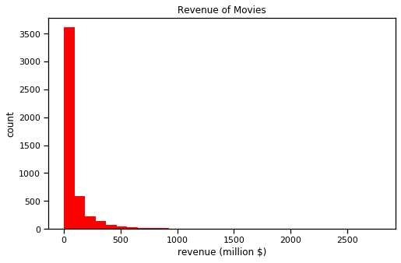
EXPLORATORY DATA ANALYSIS

Slide 13
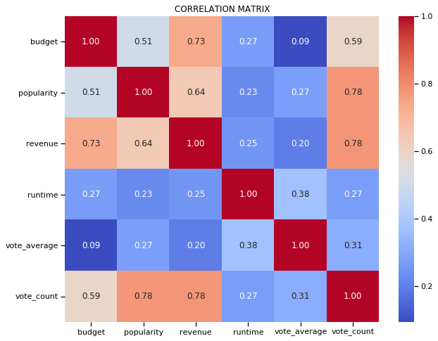
EXPLORATORY DATA ANALYSIS

Slide 14
PREDICTING VOTE AVERAGE
Linear Model RMSE: 1.142936955228411
KNN Model RMSE for k = 5 : 0.917
KNN Model RMSE for k = 6 : 0.907
KNN Model RMSE for k = 7 : 0.908
KNN Model RMSE for k = 8 : 0.899
KNN Model RMSE for k = 9 : 0.886
KNN Model RMSE for k Singular Value Decomposition (SVD= Singular Value Decomposition (SVD10 : 0.882
RF RMSE for n_estimator = 50 : 0.869
RF RMSE for n_estimator = 70 : 0.866
RF RMSE for n_estimator = 90 : 0.864
RF RMSE for n_estimator = 110 : 0.873
RF RMSE for n_estimator = 130 : 0.870
RF RMSE for n_estimator = 150 : 0.868
RF RMSE for n_estimator = 170 : 0.865
RF RMSE for n_estimator = 190 : 0.865
Minimum RMSE

Slide 15
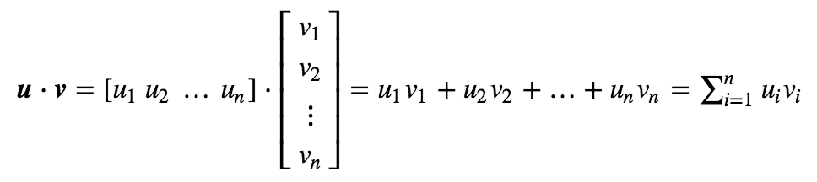
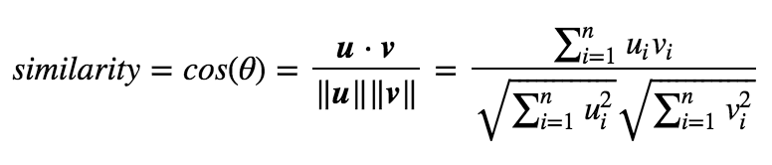
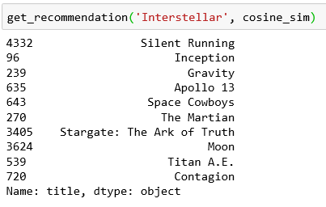
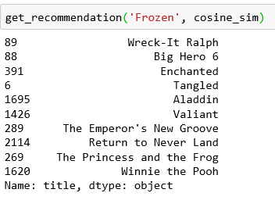
RECOMMENDER SYSTEM
Content Based Filtering
(cast, director, keywords, genres, production companies)

Slide 16
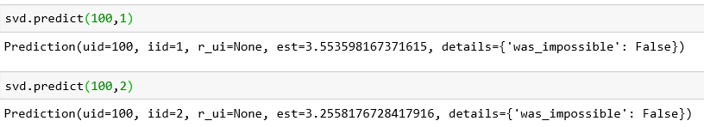
RECOMMENDER SYSTEM
Collaborative Filtering
Singular Value Decomposition (SVD)
RMSE ~ 0.90
 | userId | movieId | rating | timestamp
15273 | 100 | 1 | 4.0 | 854193977
15274 | 100 | 3 | 4.0 | 854194024
15275 | 100 | 6 | 3.0 | 854194023
15276 | 100 | 7 | 3.0 | 854194024

