Slide 1
Speaker Entrainment
Internship Project
Shikhar Mohan | 16/12/2021
Notes:
I’m a ML Research Intern and I will be giving a talk on the topic of Speaker Entrainment. This talk will be structured as follows:
Literature review: Psychosocial analysis + implementation experiments

Slide 2
What is Entrainment?
Definition
Entrainment (also termed accommodation or alignment) is the phenomenon of speakers becoming similar to each other in the course of conversation.
It is a psycholinguistic behaviour exhibited by people in human-human interactions.
Multiple studies have shown that entrainment is related to trustworthiness and task success.

Slide 3

Literature Review
Psycholinguistic Analysis
Speaker entrainment has been studied thoroughly for over a decade in psycho-sociology.
Entrainment has been known to occur in various aspects of speech:
Acoustic/prosodic: perceived $f_{0}$, intensity, ROA [Levitan & Hirschberg, 2011]
Lexical: Choice of referring expressions [Brennan & Clark, 1996]
Linguistic Style: Speech syntax [Danescu-Niculescu-Mizil et al., 2011]
Notes:
A lot of work at the junction of psycholinguistics and computer science has been done by Rivka Levitan. The literature survey draws from her thesis on this topic as well.
ROA - Rate of articulation
Levitan and Hirschberg, 2011 paper details various acoustic/prosodic aspects over which entrainment is observable in an open-conversation dataset. E.g. min f0, max f0, min intensity, max intensity, shimmer, jitter. It also makes these observations separate for inter and intra-gender interactions (Male-Male, Female-Female, Male-Female). It’s also observed that the prevalence of different prosodic aspects in entrainment is different for different pairs.
Lexical: monkey/ape example
Linguistic Style: at what time did you reach the office? at five o clock

Slide 4
Literature Review
Implementational Experiments
Compared to the psychosocial studies, there is a relatively lesser amount of research on entrainment in computer-based dialogue systems.
We look at two papers primarily.
Lubold et al., 2016
Looks only at the pitch, matching performed in three ways
Hoegen et al., 2019:
Divides features into acoustic and content variables.
Acoustic variables matched by averaging
Content variables maximised by reprioritising beam search results
Notes:
Compared to the psychosocial analysis of entrainment, there is a relatively lesser amount of research investigating the efficacy of speaker entrainment in computer-based dialogue systems
We look at two papers primarily to observe how speaker entrainment has been implemented in computer-based dialogue systems.
Lubold:
Only uses pitch, but in three different ways: mirror(match pitch contour exactly), shift+contour (shift contour to maintain mean pitch, semi-realistic baseline), shift+flatten (flatten contour to pitch, most unrealistic baseline)
Explain the beam search thing (top-10, reprioritise)
Metrics and Experimental setups will be discussed later

Slide 5
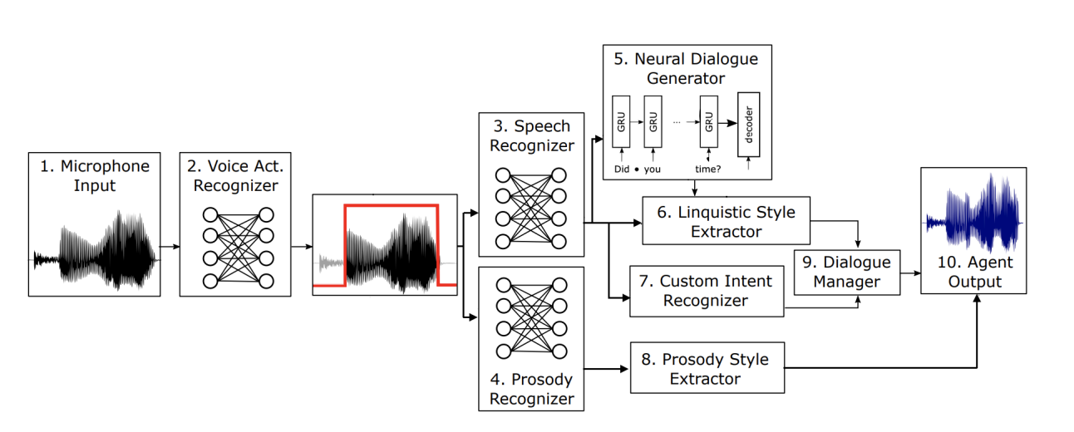
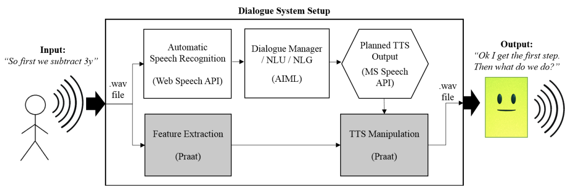
Figure 1: Block diagram for Hoegen et al.
Figure 2: Block diagram for Lubold et al.

Slide 6

Problem Setting
How can it be helpful at Skit
Inbound calls have the most amount of interaction from the user’s end, hence more suitable for entrainment.
Some people face discomfort in trying to interact with a robot, which manifests itself in various ways, the most evident example of which is hesitation.
Managing the ROA and length of inter-turn pauses can lead to better accommodation for users.
Entraining for other low-level speech aspects such as observed pitch and intensity has the potential to build more comfort, lead to better interactions.
Notes:
Inbound calls have the most amount of interaction in terms of utterance length and number of turns, etc. hence
this is a scenario they aren’t used to at all

Slide 7
Model Development
Baseline
As a baseline model, we plan to use a few low-level features to entrain our bot.
From an analysis of our data as well as from Levitan & Hirschberg, 2011 we obtain ROA, pitch and intensity (and relevant statistics) as features.
Similar implementation to Hoegen et al. will be adopted, where feature values are averaged over an interval to guide the speech aspects in TTS generation.
Shimmer and Jitter will be explored as well.
Self-recorded voice samples simulating key use-cases used for testing.
Notes:
Relevant statistics such as in Lubold et al.
Averaging to avoid drastic changes in speech style
shimmer & jitter (Levitan & Hirschberg, 2011) shown to be effective.
shimmer: the average absolute difference between the amplitude of a period and the mean amplitudes of its two neighbours, divided by the average amplitude.
Jitter is defined as the parameter of frequency variation from cycle to cycle

Slide 8
Experimental Setup
Three sets of experiments will be conducted
Open conversation dataset:
Here we have three sets of pairs of speakers, human-human, human-bot and human-bot (entrained).
Third-person will be asked questions to evaluate entrainment.
Second-person judge
Here we have a first-person with a situation script
The first-person will be the judge as well, asked questions to evaluate performance.
Obtain useful features from the above experiments, to be used for A/B testing in production.
Notes:
human-bot will work on the transcript generated by human B in the A-B conversation. Similar to Lubold et al. and other psychosocial experiments that use Amazon Mechanical Turk to annotate.
2nd is similar to Hoegen et al

Slide 9
Experimentation Setup
Questions
Mean Opinion Score (MOS) for TTS to be used to evaluate quality of voice (naturalness)
5 point Likert scale for score evaluation in the rest (1 = not at all to 5 = very much).
Similar to Shamekhi et al., a subset of questions used (to accommodate for the more formal setting here):
how engaging, how focused, do you trust the agent and how likeable was the agent?
The scores from these two experiments will be analysed to investigate the efficacy of entrainment.
Notes:
Shamekhi et al is a reference to a research paper by Microsoft Research

Slide 10
Future Work
Build a working demo
Incorporate higher-level features from deeper representation spaces.
These features can be learnt from real human-human conversations.
Investigate the potential discrepancy between a third-person judge and a second-person judge.
Notes:
- Perception module is present, implementing entrainment in TTS still needs some tweaking

