Slide 1
Real-time Polling App Introduction
http://polling.ng.bluemix.net/
BlueMix SME Team B
Welcome to join us via QQ Group: 159881891
Notes:
1

Slide 2

Summary
The Real-Time Polling App provides a poll service online . You can create a poll topic and monitor a polling real-time progress. You can create a poll topic with specified a user group and an anonymous poll topic . Share a polling topic to any pop social medium.
The App was built on Node.js + MongoDB + WebSocket +Jquery + Bootstrap+HTML5.So your browser must support HTML5. The Web App automatically adapts to any mobile devices browser.
The App is developed for skills learning , in order to discuss the relative skills with you. Code source is open to you.

Slide 3

Agenda
App Demo
App Architecture
Node.JS
MongoDB
WebSocket
App Deployment
Notes:
To be updated.

Slide 4
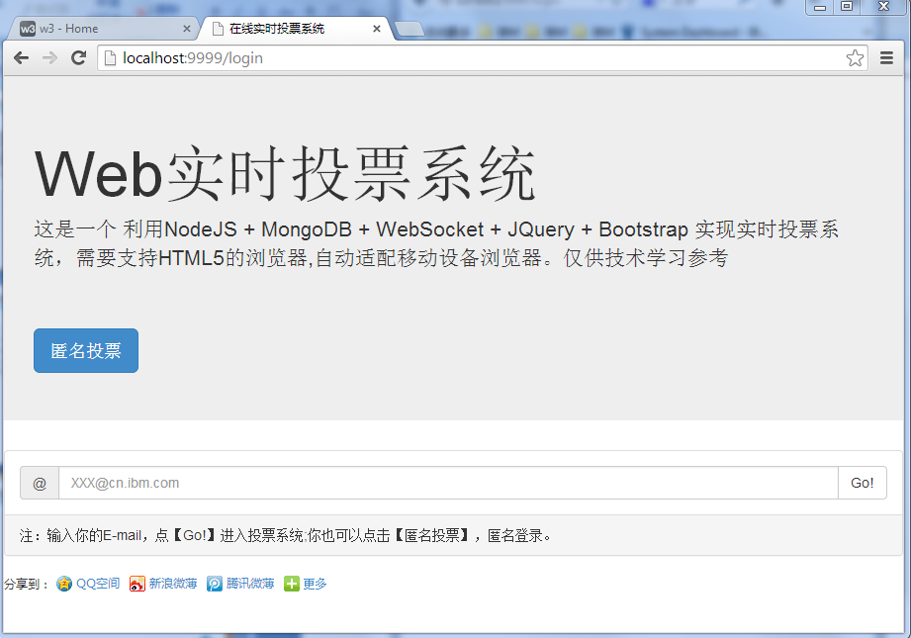
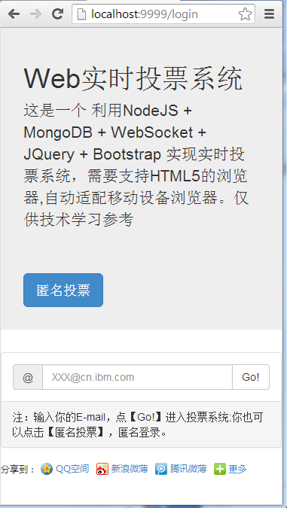
App Demo - Login

Slide 5
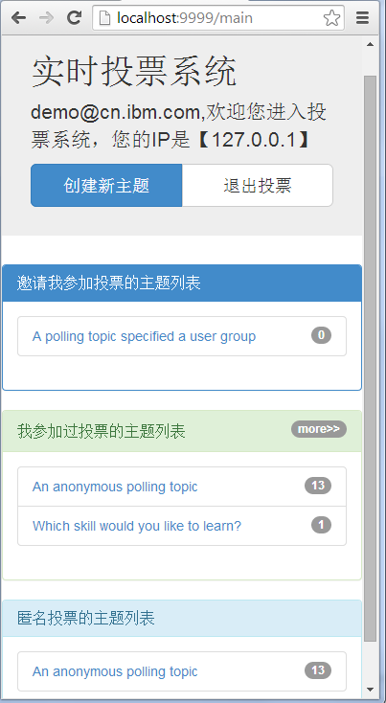
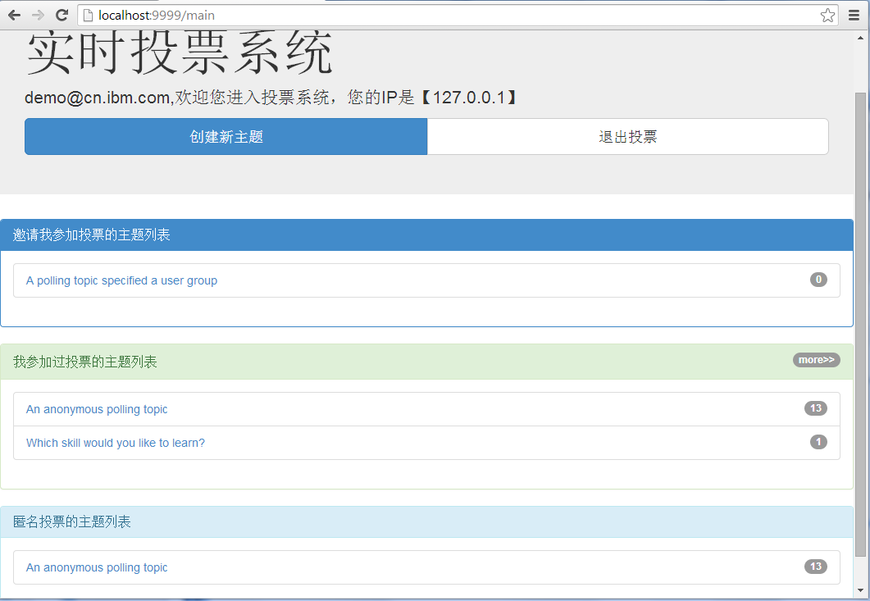
App Demo - Home

Slide 6
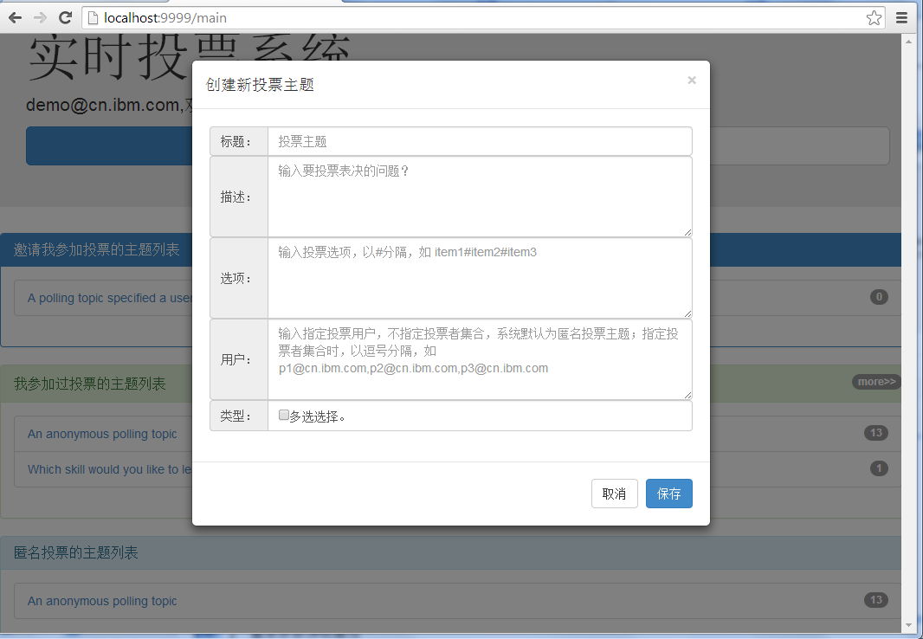
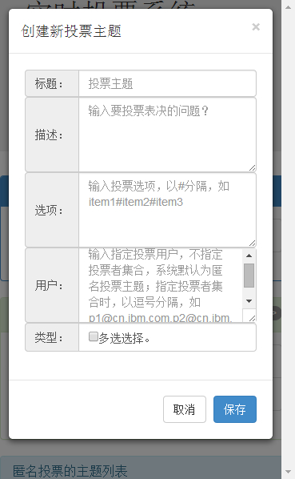
App Demo – Topic Creation

Slide 7
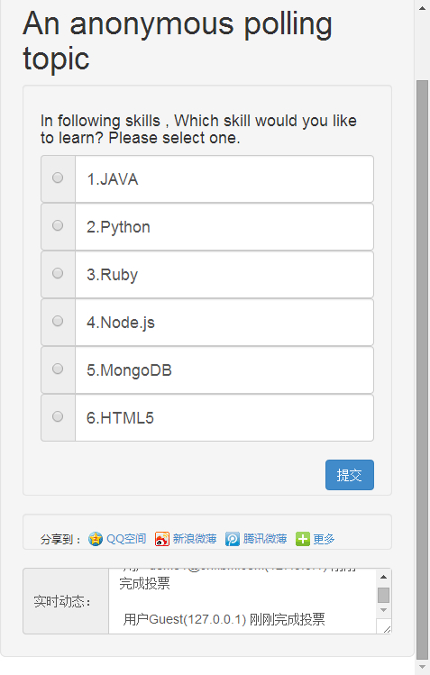
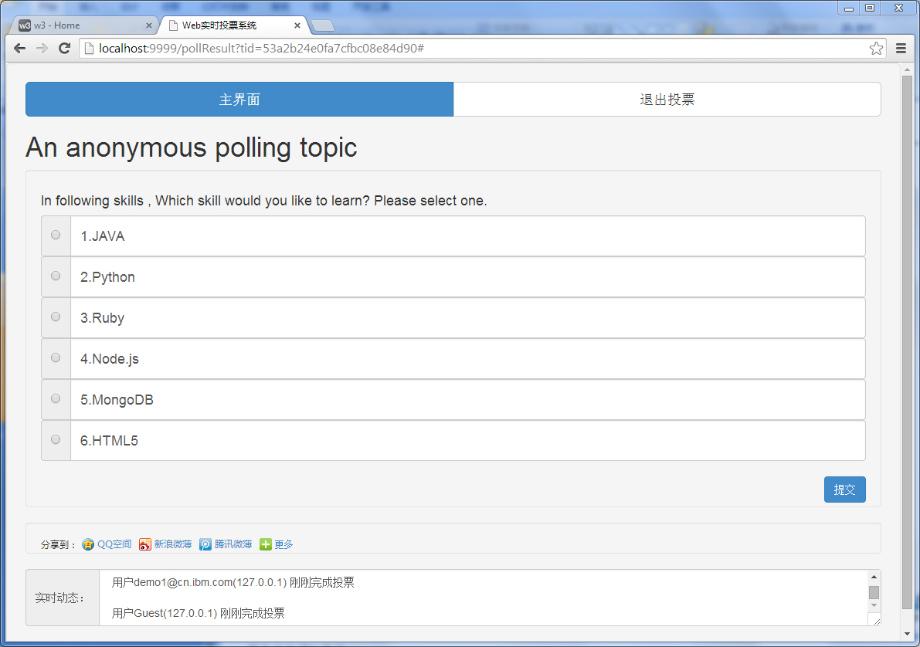
App Demo – Vote

Slide 8
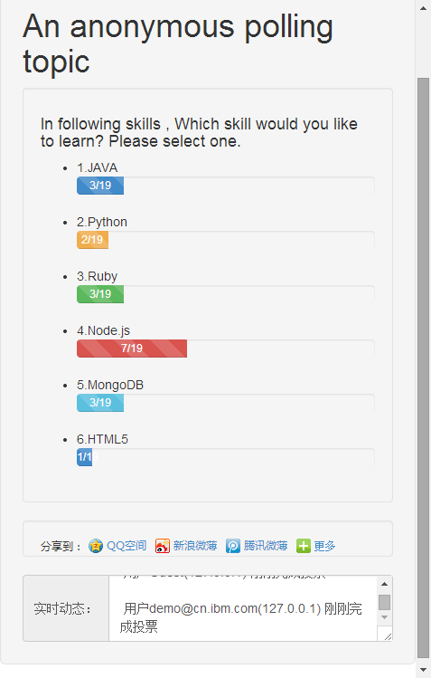
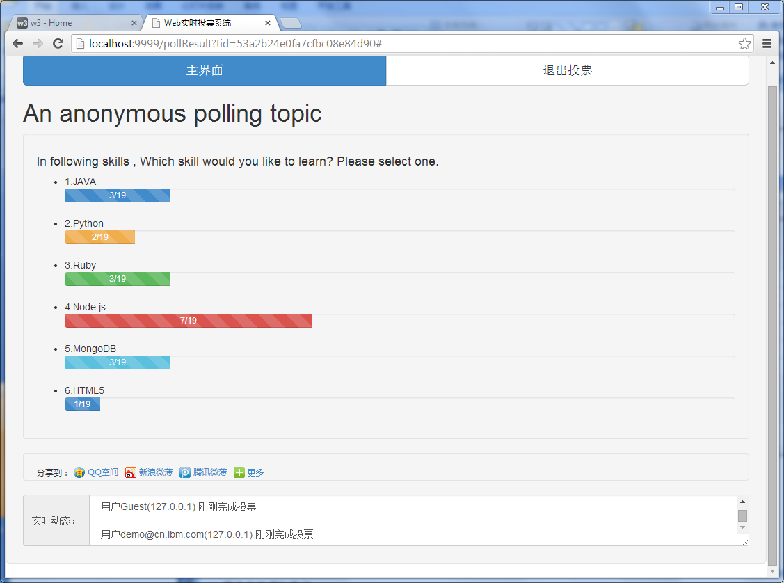
App Demo – Monitor

Slide 9



App Architecture
Internet
BlueMix Platform
Firewall、Load balance Services
Node.js Runtime
MongoDB Service
Poll
The Polling App

Slide 10
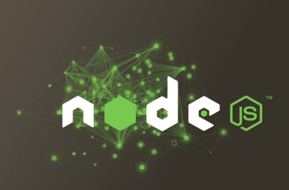
Node.js
1.What is Node.js?
Node.js is a platform built on Chrome's JavaScript runtime for easily building fast, scalable network applications. Node.js uses an event-driven, non-blocking I/O model that makes it lightweight and efficient, perfect for data-intensive real-time applications that run across distributed devices.
2.Hello Word!
var http = require('http');
http.createServer(function (req, res) {
res.writeHead(200, {'Content-Type': 'text/plain'});
res.end('Hello World\n');
}).listen(1337, '127.0.0.1');
console.log('Server running at http://127.0.0.1:1337/');
Notes:
nodejs作为一个新兴的后台语言，有很多吸引人的地方：
RESTful API
单线程
Node.js可以在不新增额外线程的情况下，依然可以对任务进行并行处理 —— Node.js是单线程的。它通过事件轮询（event loop）来实现并行操作，对此，我们应该要充分利用这一点 —— 尽可能的避免阻塞操作，取而代之，多使用非阻塞操作。
非阻塞IO
V8虚拟机
事件驱动

Slide 11
MongoDB
RDBMS-ACID
The CAP Theorem
NoSql - BASE
A
A
A
C
P
C
P
C
P
A= Atomicity
C= Consistency
I = Isolation
D= Durability
A= Availability
C= Consistency
P = Tolerance to network Partitions
BA= Basically Availble
S= Soft-state
E= Eventual Consistency
Notes:
nodejs作为一个新兴的后台语言，有很多吸引人的地方：
RESTful API
单线程
Node.js可以在不新增额外线程的情况下，依然可以对任务进行并行处理 —— Node.js是单线程的。它通过事件轮询（event loop）来实现并行操作，对此，我们应该要充分利用这一点 —— 尽可能的避免阻塞操作，取而代之，多使用非阻塞操作。
非阻塞IO
V8虚拟机
事件驱动

Slide 12
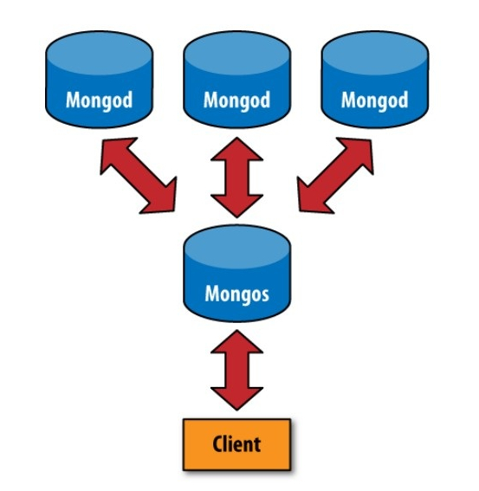
MongoDB
What is MongoDB?
MongoDB (from "humongous") is an open-source document database, and the leading NoSQL database. Written in C++, MongoDB features:
Document-Oriented Storage | Full Index Support | Replication & High Availability | Auto-Sharding | Querying
Fast In-Place Updates | Map/Reduce | GridFS | MongoDB Management Service | Reduce cost
Notes:
Document-Oriented Storage
JSON-style documents with dynamic schemas offer simplicity and power.
Full Index Support
Index on any attribute, just like you're used to.
Replication & High Availability
Mirror across LANs and WANs for scale and peace of mind.
Auto-Sharding
Scale horizontally without compromising functionality.
Querying
Rich, document-based queries.
Fast In-Place Updates
Atomic modifiers for contention-free performance.
Map/Reduce
Flexible aggregation and data processing.
GridFS
Store files of any size without complicating your stack.
MongoDB Management Service
Monitoring and backup designed for MongoDB.
Partner with MongoDB
Reduce cost, accelerate time to market, and mitigate risk with proactive support and enterprise-grade capabilities.

Slide 13
MongoDB Design
Traditional Design
MongoDB Design
{
_id:
title:
des:
items:[ ]
users:[ ]
results:[
{
email:,
ip:,
date:,
items:[ ]
}
]
}
User
Id Email name
Topic
Id title description
TopicUser
Id topicid userid
Result
Id UseriID TopicId Polldate IP ItemIDs
TopicItem
Id TopicId Content ItemNo
Notes:
Document-Oriented Storage
JSON-style documents with dynamic schemas offer simplicity and power.
Full Index Support
Index on any attribute, just like you're used to.
Replication & High Availability
Mirror across LANs and WANs for scale and peace of mind.
Auto-Sharding
Scale horizontally without compromising functionality.
Querying
Rich, document-based queries.
Fast In-Place Updates
Atomic modifiers for contention-free performance.
Map/Reduce
Flexible aggregation and data processing.
GridFS
Store files of any size without complicating your stack.
MongoDB Management Service
Monitoring and backup designed for MongoDB.
Partner with MongoDB
Reduce cost, accelerate time to market, and mitigate risk with proactive support and enterprise-grade capabilities.

Slide 14
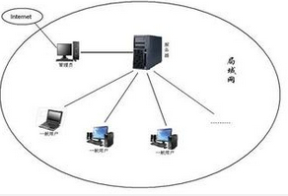
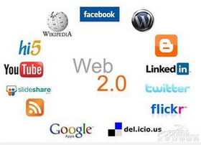

WebSocket
PC
C/S
Web
AJAX
WebSocket
Different communication techniques brought us into different Ages…
Full-Duplex communication
What Age is comming by WebSocket?

Slide 15
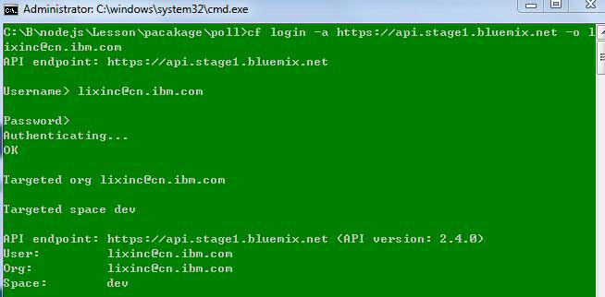
App Deployment
CLI(command-line interface) Deploy your App
>cf login -a https://api.stage1.bluemix.net –o lixinc@cn.ibm.com
Notes:
CLI是Command Line Interface的缩写，即命令行界面。CLI界面是所有路由器、TM（Termination Multiplexer，终端复用器）、CM（Cable Modem，电缆调制解调器）等产品提供的界面，如CISCO， LUCENT，Arris， 华为等。它是路由器产品的标准。目前市场上有些产品为了降低成本，不提供CONSOLE口，因此不能使用CLI。使用CLI具有使用要求低（只需要串行口），容易使用，功能扩充方便等优点，特别是当有很多（如10台）台路由器设备需要配置的时候，可以通过COPY/PASTE功能很快完成所有路由器的配置。不需要通过IE一台台配置。
传统的Unix环境是 CLI（命令行界面），即在命令行下键入命令，执行想要的操作。相比之下，这种方式执行起来更快，功能也更强，不足之处是用户需要了解相关操作的命令。早期的计算机操作系统都只有命令行操作模式，没有现在非常流行的“图形用户界面（GUI）”。

Slide 16
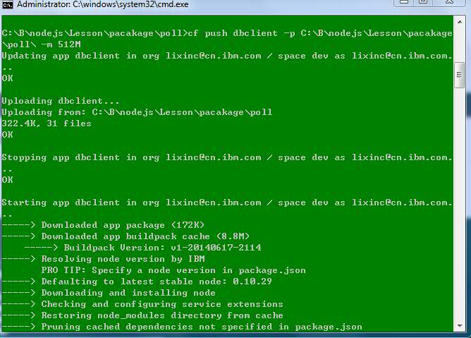
App Deployment
> cf push poll -p C:\B\nodejs\Lesson\pacakage\poll

Slide 17
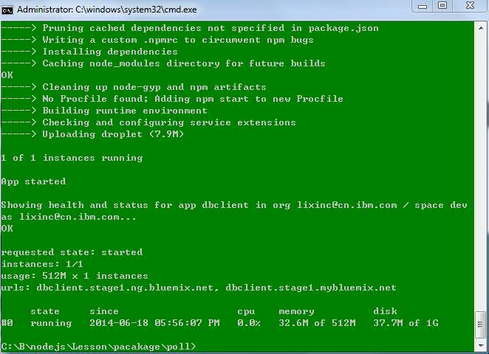
App Deployment Result

Slide 18

App Deployment
https://www.ng.bluemix.net/docs/#starters/nodejs/index.html#deploynodejsapp
Notes:
Document-Oriented Storage
JSON-style documents with dynamic schemas offer simplicity and power.
Full Index Support
Index on any attribute, just like you're used to.
Replication & High Availability
Mirror across LANs and WANs for scale and peace of mind.
Auto-Sharding
Scale horizontally without compromising functionality.
Querying
Rich, document-based queries.
Fast In-Place Updates
Atomic modifiers for contention-free performance.
Map/Reduce
Flexible aggregation and data processing.
GridFS
Store files of any size without complicating your stack.
MongoDB Management Service
Monitoring and backup designed for MongoDB.
Partner with MongoDB
Reduce cost, accelerate time to market, and mitigate risk with proactive support and enterprise-grade capabilities.

Slide 19
Questions?
Invite you to join us via QQ Group: 159881891 again.

