Slide 1
How to Setup Node.js Development Environment?
BlueMix SME Team B
Welcome to our QQ Group: 159881891
Notes:
1

Slide 2
Agenda
Node.JS
WebStrom
MongoDB
Notes:
To be updated.

Slide 3
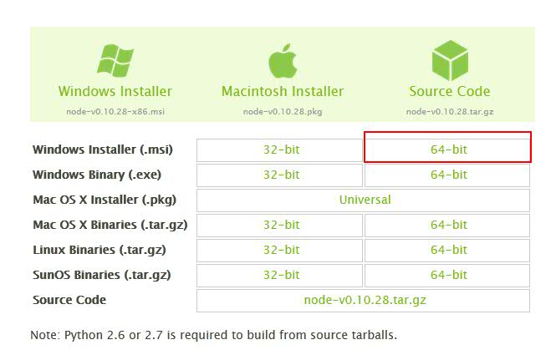
Node.js Step1
Download Node.js From http://nodejs.org/download/

Slide 4
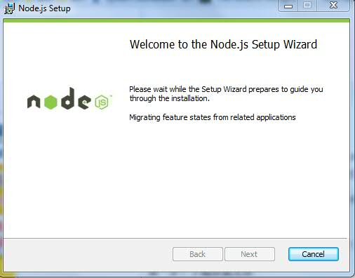
Node.js Step2

Slide 5
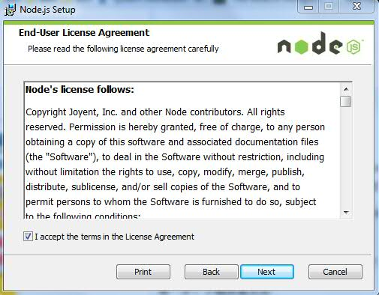
Node.js Step3

Slide 6
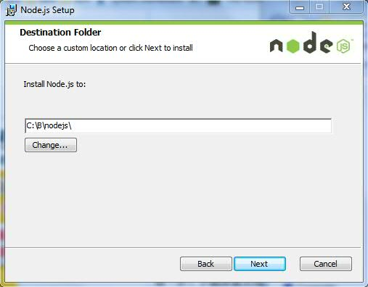
Node.js Step4
Change into your floder

Slide 7
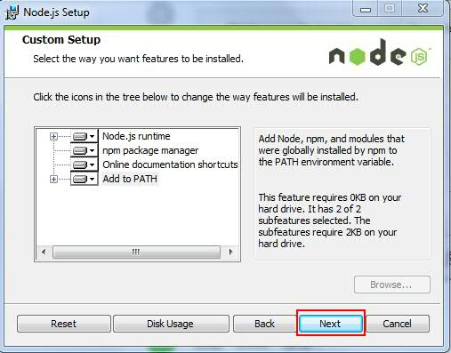
Node.js Step5

Slide 8
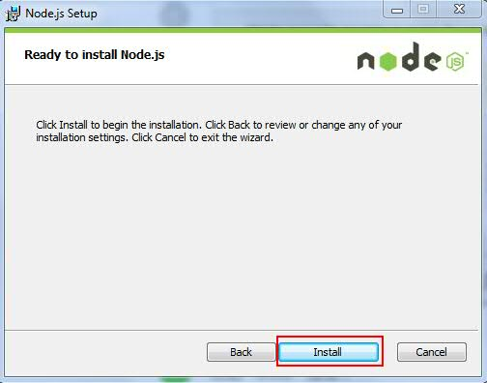
Node.js Step6

Slide 9
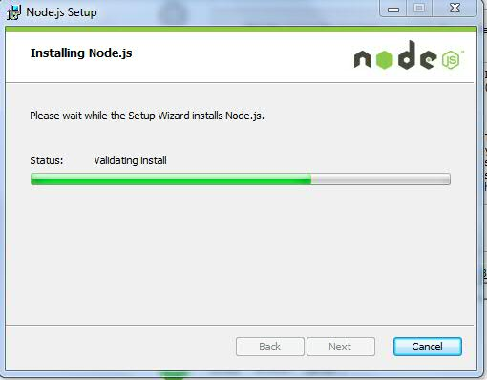
Node.js Step7

Slide 10
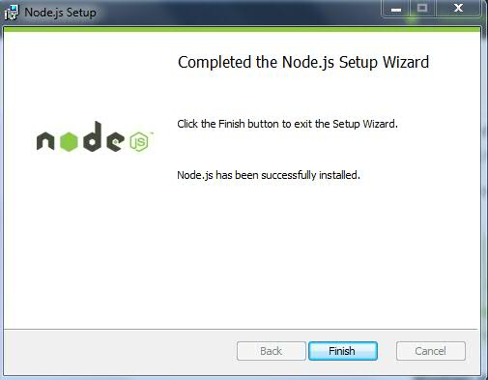
Node.js Step8

Slide 11
WebStorm Step1
Download WebStorm From
http://download.jetbrains.com/webstorm/WebStorm-8.0.4.exe

Slide 12
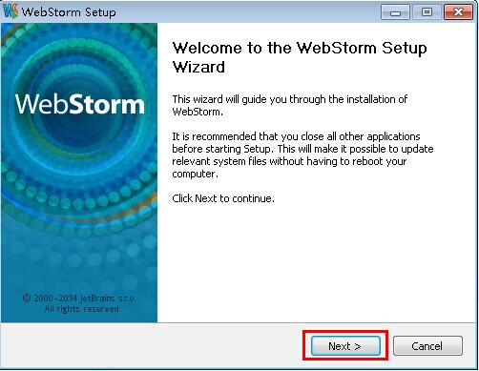
WebStorm Step2

Slide 13
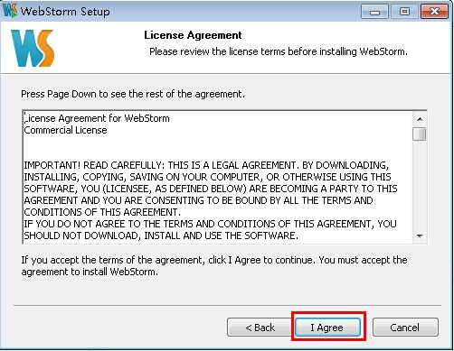
WebStorm Step3

Slide 14
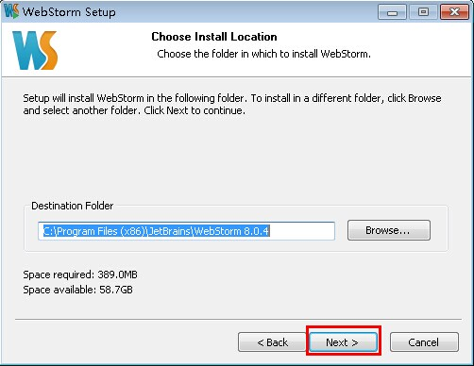
WebStorm Step4

Slide 15
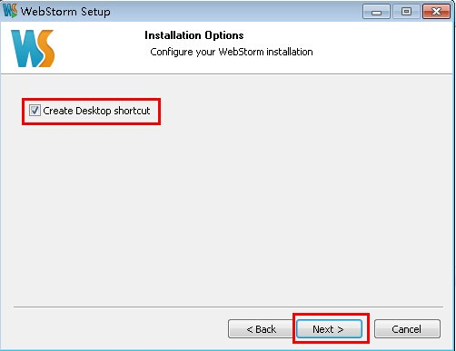
WebStorm Step5

Slide 16
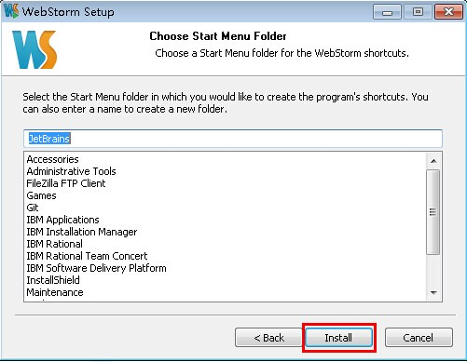
WebStorm Step6

Slide 17
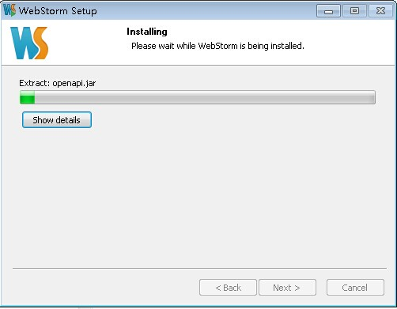
WebStorm Step7

Slide 18
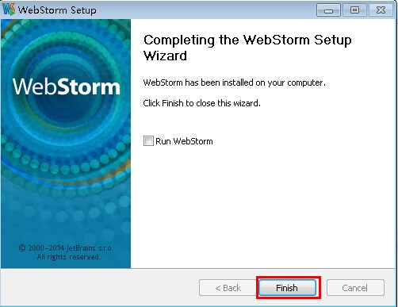
WebStorm Step8

Slide 19
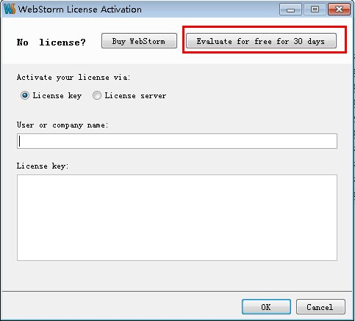
WebStorm Step9
Blow license only for node.js learning. It is
belong to IBM CDL Connections Team
User Name:
EMBRACE
License Key:
===== LICENSE BEGIN =====
24718-12042010
00001h6wzKLpfo3gmjJ8xoTPw5mQvY
YA8vwka9tH!vibaUKS4FIDIkUfy!!f
3C"rQCIRbShpSlDcFT1xmJi5h0yQS6
===== LICENSE END =====

Slide 20
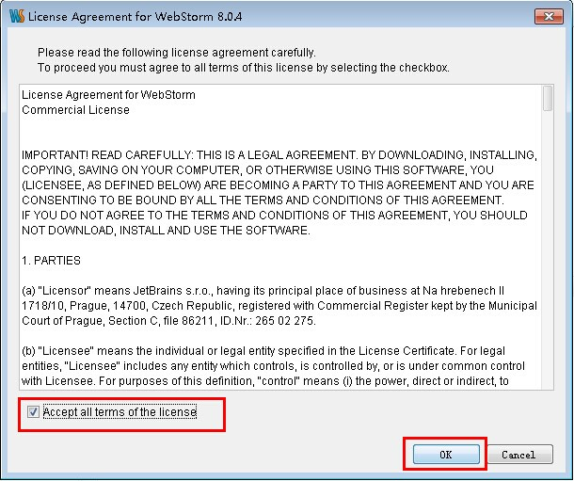
WebStorm Step10

Slide 21
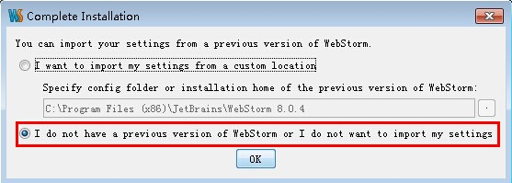
WebStorm Step11

Slide 22
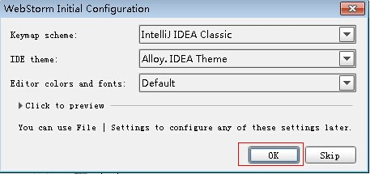
WebStorm Step12

Slide 23
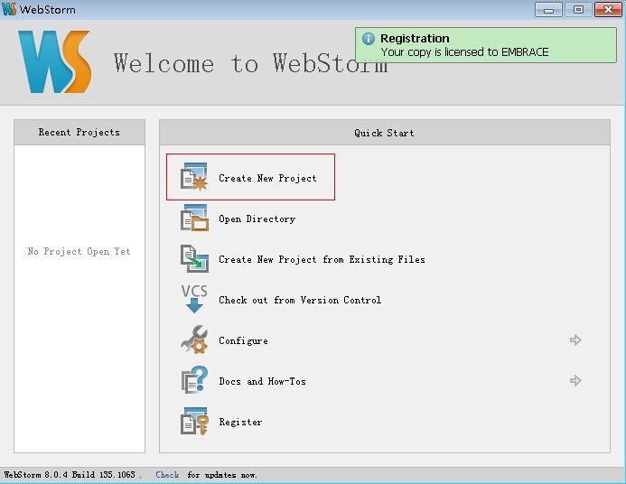
WebStorm Step13

Slide 24
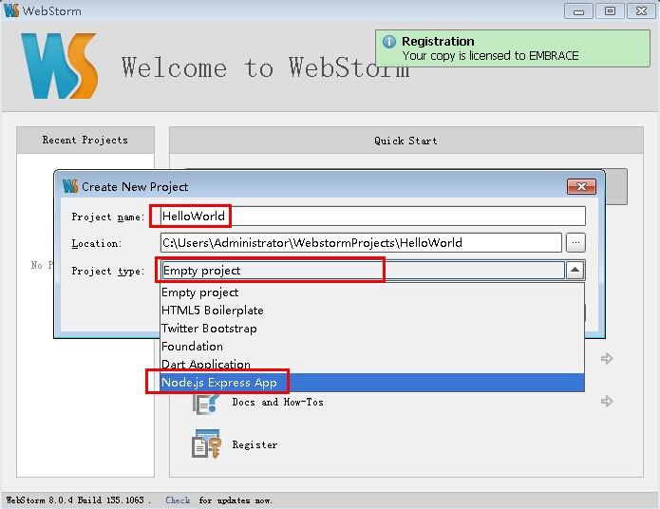
WebStorm Step14

Slide 25
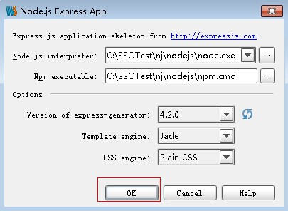
WebStorm Step15

Slide 26
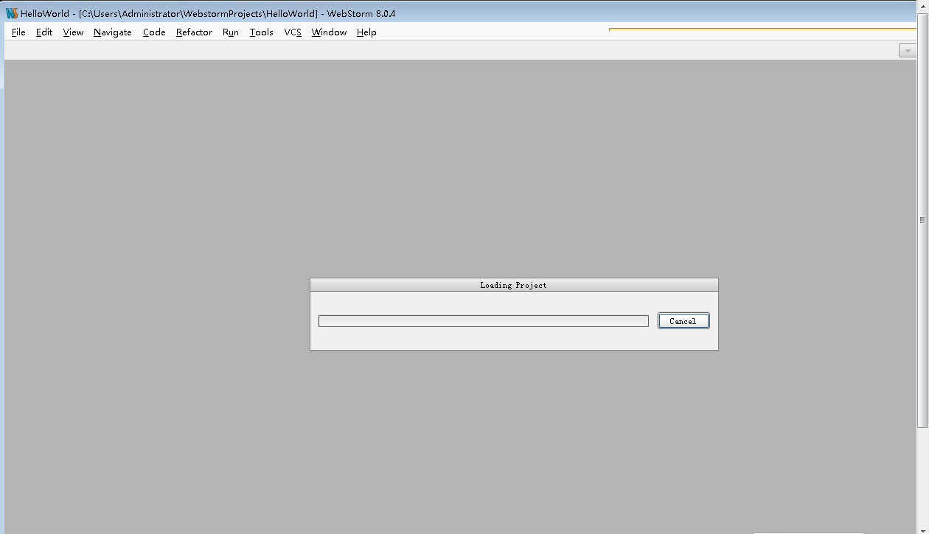
WebStorm Step16

Slide 27
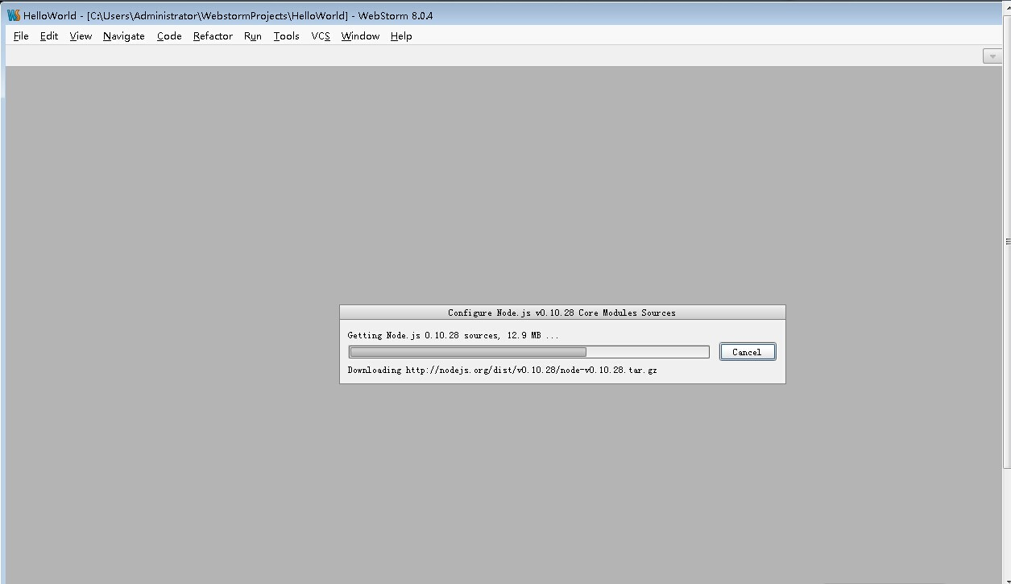
WebStorm Step17

Slide 28
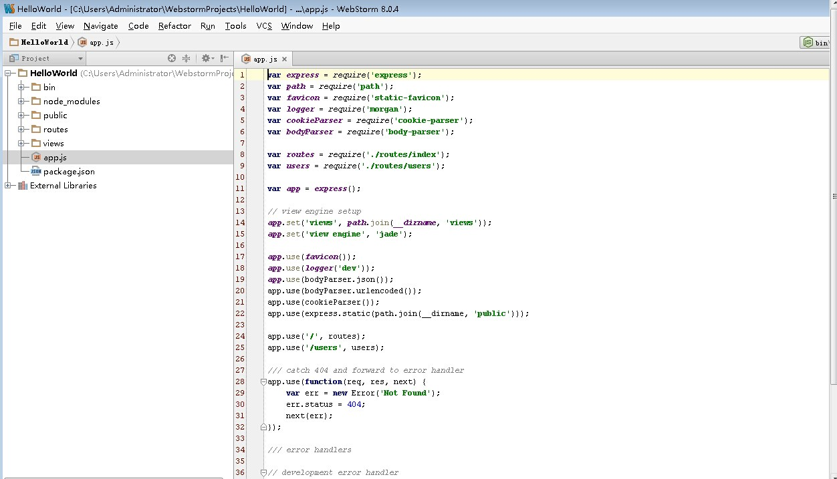
WebStorm Step18
IDE Workspace

Slide 29
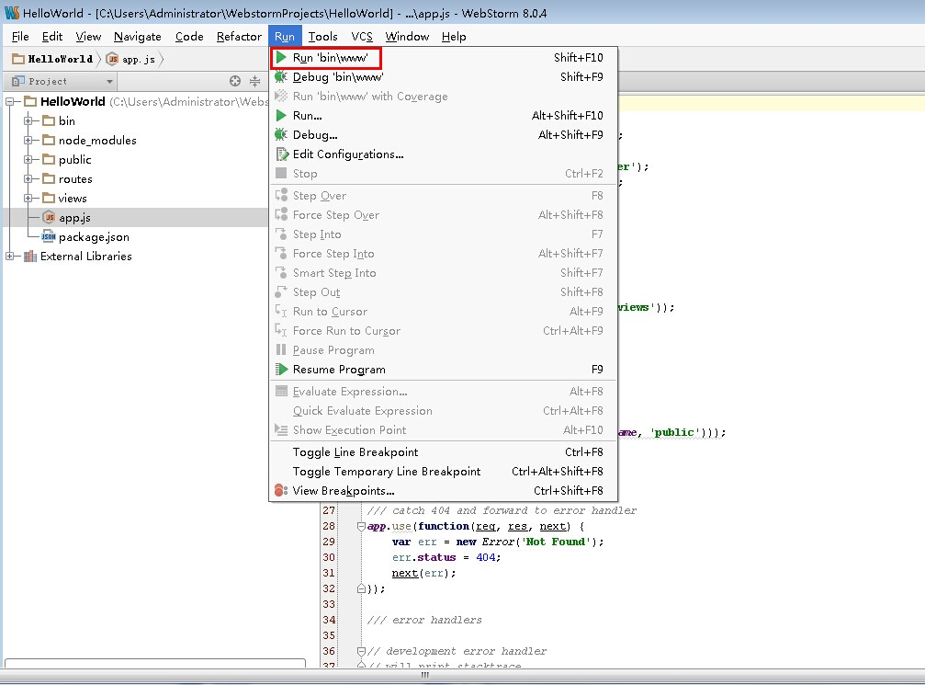
WebStorm Step19
Click Menu 【Run】 – 【Run “bin\www”】 as below

Slide 30
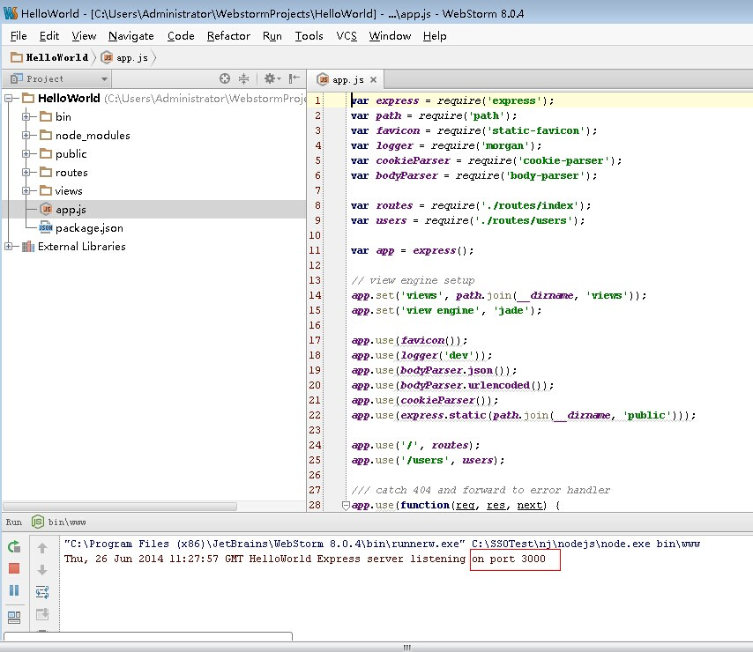
WebStorm Step 20

Slide 31
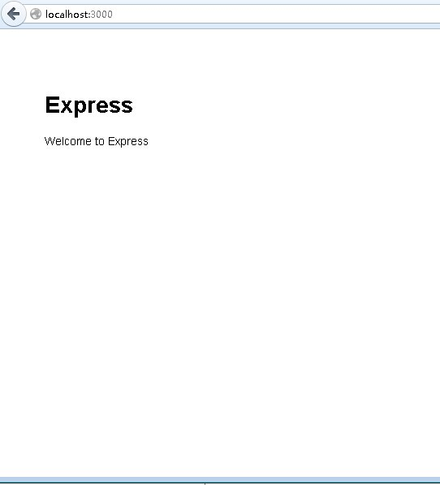
WebStorm Step21
OK

Slide 32
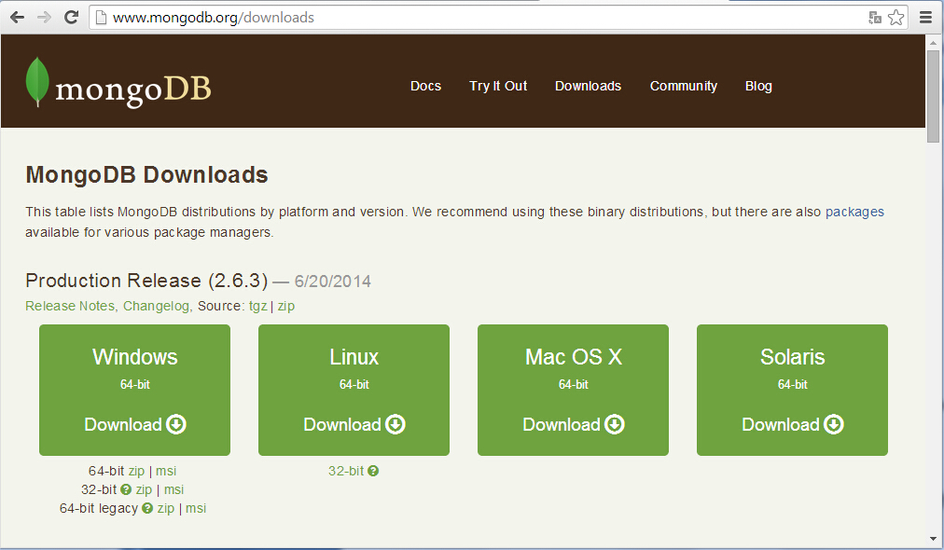
MongoDB Step1
Download MongoDB 64-bit zip file From
http://www.mongodb.org/downloads

Slide 33
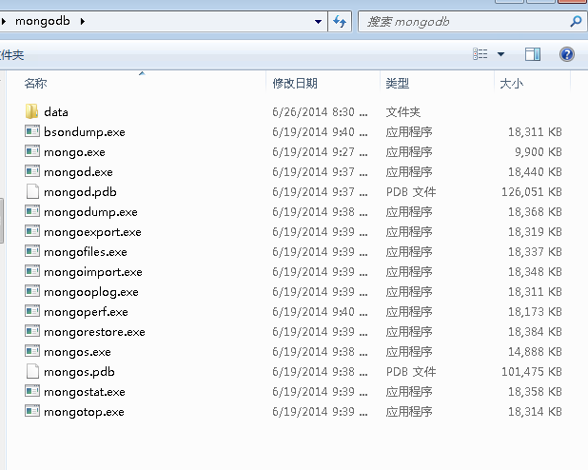
MongoDB Step2
Extract to C:\tmp ( or your other folder )
Copy files from C:\tmp\ mongodb-win32-x86_64-2008plus-2.6.3\bin
to C:\mongodb
Create a folder named as data c:\mongodb\data

Slide 34
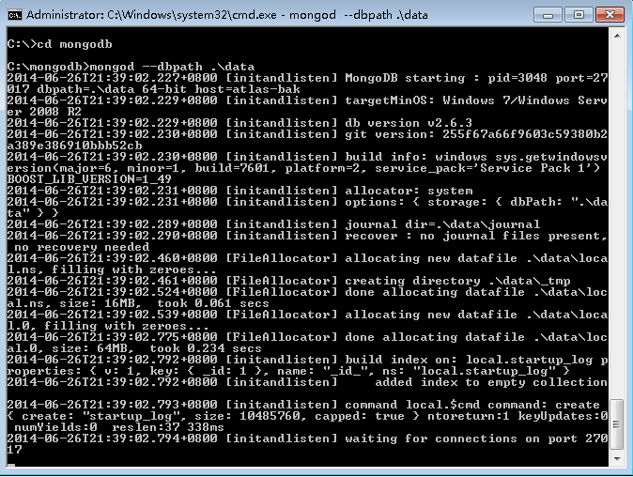
MongoDB Step3
Start mongodb server
>cd c:\mongodb
>mongod –dbpath .\data

Slide 35
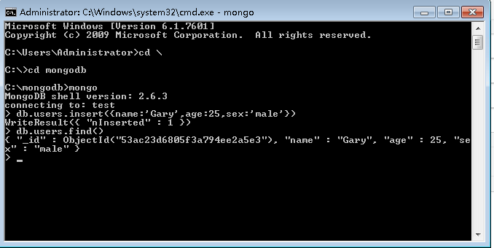
MongoDB Step4
Connect your mongodb server

Slide 36
Congratulations!!!
The coolest development environment on the Blue Planet is belong to you, You can build your blue dreams and deploy them to the BlueMix Platform. Share your great ideas with others. thanks
Invite you to join us via QQ Group: 159881891 again.

