Slide 1
*Bluemix and Cloud Technical Training Boot Camp
*Cloud Foundry and Bluemix: Bluemix Architecture
Notes:
This is the Bluemix architecture topic of the Cloud Foundry and Bluemix module of the Bluemix and cloud technical training boot camp. Let’s get started.

Slide 2
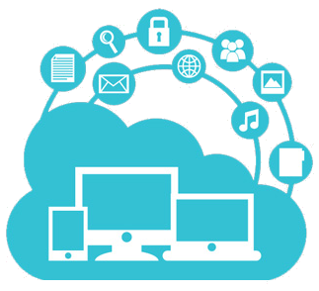
When you complete viewing this video, you should be able to:
Describe the Bluemix architecture
Notes:
When you complete viewing this video, you should be able to describe the Bluemix architecture.

Slide 3
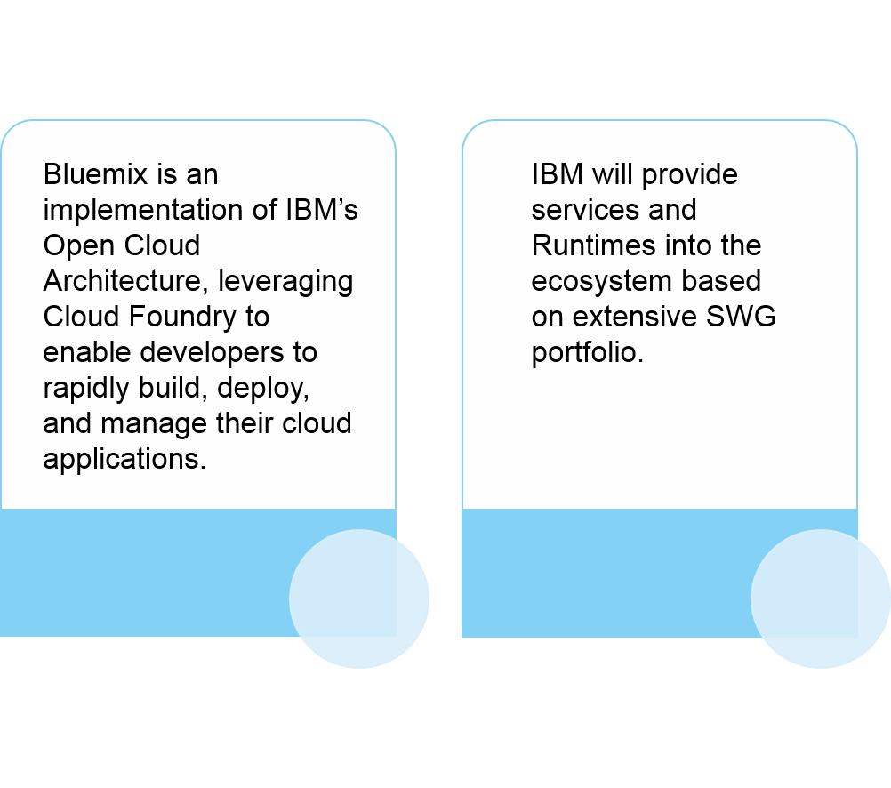
What is Bluemix?
Notes:
Bluemix is an implementation of IBM’s open cloud architecture. It is built on the open source Cloud Foundry project and it really enables developers to very quickly build, deploy, and manage their cloud-based applications. Developers do this rapidly and quickly because there is a very, very large growing ecosystem of available services and runtime frameworks that they can leverage. We’ve seen that in earlier topics. We’ve talked a lot about the catalog and how it is a differentiator.
IBM provides a lot of services there and runtimes and with IBM’s very extensive Software Group portfolio of products – a lot of these IBM Software Group products are being added to the Bluemix catalog and being offered as services that developers can leverage to build their applications and it’s on a consumption model. It’s very easy for organizations to handle. Remember that the catalog, it’s not just IBM services. It’s also third party. Third parties have been engaged by IBM to add their services into the catalog and there’s also community based services that are available.
For developers, what all this means is that they can create applications very, very quickly, provision them very quickly, not worry about the infrastructure. It gives them the flexibility in terms of capacity, storage, bandwidth, processing power, and they cannot spend time worrying about the infrastructure but focus on writing code and building applications that add business value.

Slide 4
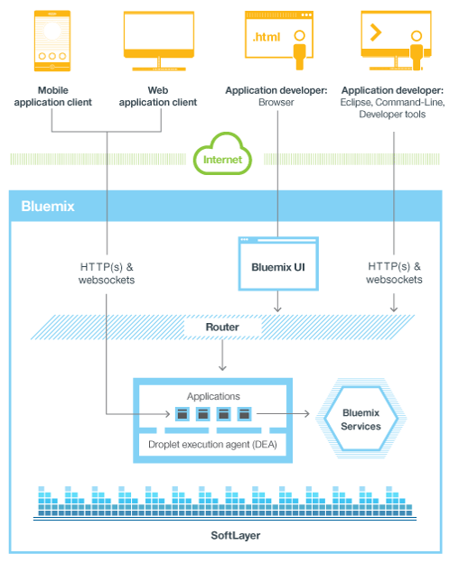
Let us look at the high-level Bluemix architecture
Notes:
So let’s take a look in a little more detail what’s under the covers in Bluemix. At its core, Bluemix is an environment for building applications and leveraging the set of services that are in the catalog to help speed up the creation of these applications. We’ve talked about it as being a composition environment where developers are composing applications by leveraging these services and APIs that are in the catalog. Bluemix also provides the hosting environment. These applications need to run somewhere and they’re run in Bluemix. Bluemix provides that environment where these applications are hosted and where they’re run. Bluemix, we said, is a platform as a service. It runs on an infrastructure as a service and Bluemix runs on IBM SoftLayer. SoftLayer is the infrastructure as a service in which Bluemix runs and Bluemix, the Cloud Foundry, deploys a set of virtual containers, and each virtual container hosts an application. The applications are deployed in these virtual containers. This provides an environment where the application can leverage those pre-built services and the application runs in that virtual container. Now, in the diagram you see the virtual container at the bottom of the screen where you see a box that says applications and you see four little boxes that represent four applications and that’s the droplet execution agent, the DEA, and you’ve probably heard DEA a few times. That’s the droplet execution agent. Droplet is your application that’s packaged with the runtime and everything it needs to run in this virtual container. So the droplet is what runs in a virtual container in this DEA. All platforms as a service have this concept of a container, so if you go look at Heroku, for example, Heroku is a very popular platform as a service that is owned by Salesforce.com. And if you look at Heroku, you’ll see that they call their containers where the applications run, they call them dynos. They have dynos and Cloud Foundry has droplets. They have very, very similar concepts. Now if you look at this diagram and you go slightly higher than where that droplet execution agent is, you see the Bluemix UI. That’s the Bluemix ACE user interface and it’s communicating through the router and so on. So an application developer, right at the top you see the application developer is using a browser that’s using the Bluemix UI that’s communicating with the router and communicating with the applications that are in the droplet execution agent and those applications connect to Bluemix services, which you see on the lower right-hand side and right at the bottom you see SoftLayer. Everything – Bluemix runs on SoftLayer. You can see that there’s applications like a mobile application or a web application that you’ve built that’s running in Bluemix, is going to speak with the server side components, the things that are running in Bluemix via HTTP or WebSockets. You also see on the right most side, you see the application developer working in Eclipse or using the command line interface, the CF command line interface and that all communicates to Bluemix via HTTP and WebSockets as well through the router and to the applications.

Slide 5
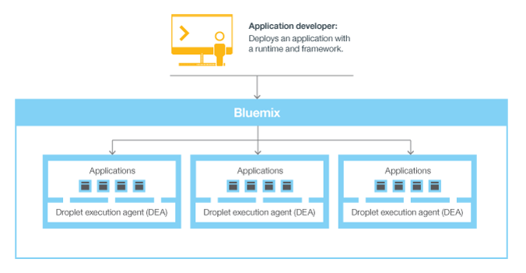
We will now look at the droplet execution agents
Notes:
Taking a bit of a look at the droplet execution agents. When an application is deployed, the application developer obviously needs to tell Bluemix. It needs to configure it with some information. For example, what’s the runtime, what are the frameworks, what are the services, and so on? And each execution environment is kept isolated from the other application environment, even though they may reside on the same physical machine.
For example, you see the droplet execution agent. The droplet execution agent is running on a physical machine and it’s got four applications in there. The applications are in their own virtual containers. They could all be on the same physical machine, but they’re isolated. They don’t talk to each other.

Slide 6
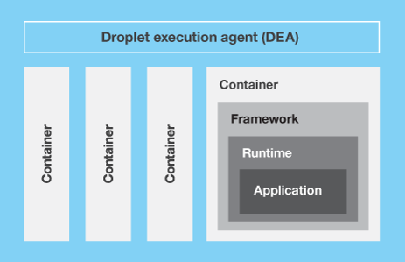
Here is a little more detailed view of the Bluemix architecture
Notes:
So here’s a little more detailed view again. You can see four containers here and on the right most container, we’ve kind of zoomed in on it, and you see what makes up the container. You see a framework, you see the runtime, and then you see the application running in it. That’s the droplet: The framework, the runtime, the application all packaged up into a droplet and that droplet is what runs in the container. As a developer creates an application and deploys it to Bluemix, the Bluemix environment determines what virtual machine is the best machine for that application to be deployed to, and it really depends. Bluemix is going to use several different factors to figure out okay, which virtual machine should I send this application to? So it’s going to look at what’s the load already on the different machines that it has that it could possibly deploy to, and what runtimes and frameworks are supported by that virtual machine, because a DEA could be on a certain machine and only supports particular runtimes for example. Once you deploy an application Cloud Foundry and Bluemix is going to figure out, okay, which virtual machine should I push that – where should I send that application for it to run? Once the virtual machine is chosen, there’s an application manager on each virtual machine, and that application manager is the guy that’s going to install the proper frameworks and runtimes that your application needs. If necessary, the application will be deployed into that framework and when that all is done, the application itself is actually started.
Now, you might be starting, let’s say, more than one instance. It’s the same process for it to get started, and that process would be repeated for the different – depending on how many instances you have, it would be repeated for how many instances you need to get started. Now, within each virtual machine there’s this application manager and it’s its job to also communicate with the rest of the Bluemix infrastructure and give it the necessary information of what’s going on within each of those virtual machines, within each of the containers that are on their virtual machine. Within each container, obviously Bluemix will install appropriate frameworks and runtimes that are needed for each of the applications.
Once the application is actually deployed and it’s running, if it has a web interface, for example, it could be a Java application for example, a Java web application, or maybe it’s REST-based services that you’ve deployed which maybe the REST-based services are going to be accessed by a mobile app or something of that sort. Users of the application can really work with application via normal HTTP. You’ll set up the route and they’ll be able to use that route.

Slide 7
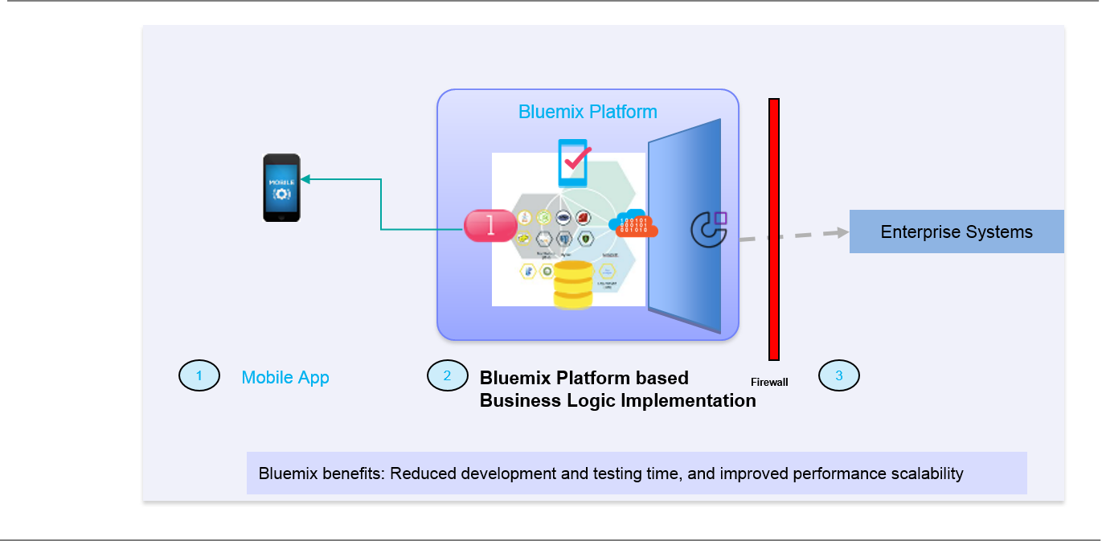
Now, we will see a sample mobile app developed in Bluemix
Notes:
On this slide, what I’m showing you, we’re approaching the end of this module. This is a typical Bluemix use case. What you see, this is a mobile application. It is leveraging the Bluemix platform. The development of this mobile application has been significantly accelerated so the development and testing time has been reduced drastically by leveraging services that are available in Bluemix like push notifications, mobile data, mobile quality assurance, and so on, and those services have been stitched together to build an application that meets what the business is looking for, and also this application can be integrated with enterprise systems, legacy systems that are on premises or in private clouds. It could be as simple as a database or could be a web service of some kind and you would do that using the cloud integration service, which is illustrated here by the Cast Iron icon.
It would be cloud integration which uses the Cast Iron Live product to integrate to enterprise systems. So this is a very, very typical Bluemix scenario on how to leverage Bluemix, leverage the services in its catalog, the APIs in its catalog, to accelerate the development of some very interesting systems of engagement type applications.

Slide 8
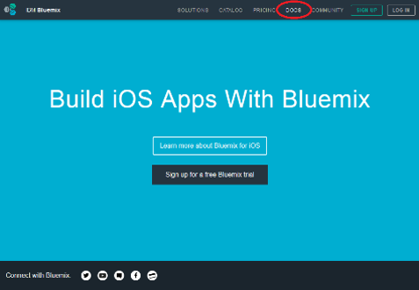
Bluemix Documentation is extensive
Notes:
The very last message I’d like to leave you with is that the Bluemix documentation is extensive. There’s a lot of documentation. It is very developer focused. They’ve put a lot of effort and time into creating this documentation.

Slide 9
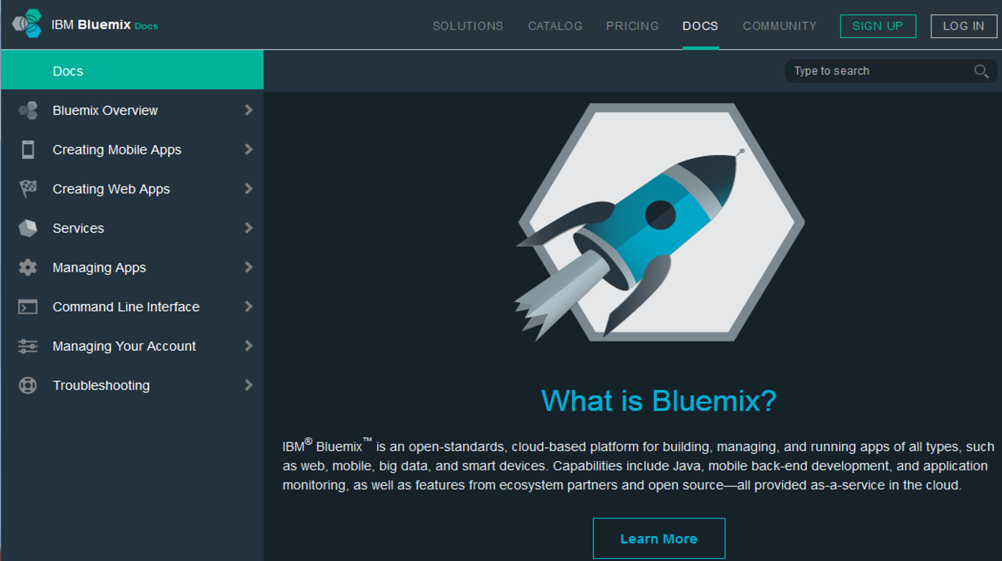
The Bluemix Documentation link can be found in the Bluemix user interface
Notes:
Lots of good information in this documentation, so make sure that you leverage this documentation and there’s a lot of documentation, lots of articles in the developerWorks website. What I’m seeing now is that, remember, Bluemix itself, platform as a service, Cloud Foundry, the learning curve is low. The learning curve for all the services and APIs that are available in the catalog is where the learning curve effort is, and that’s when you become a really good Bluemix developer and designer, is when you know what services are available and you know how to use a lot of those services to implement your applications. Take advantage of the documentation.
What I’m seeing in developerWorks, we’re seeing articles come out that are covering each of the services in some detail, providing simple applications, tutorials to walk through creating such applications, and the applications code is available in either GitHub or IBM DevOps Services. You can play around with some of the services.

Slide 10

Here is a recap of what you have learned in this video:
Bluemix is an implementation of IBM’s open cloud architecture.
It is built on the open source Cloud Foundry project and it really enables developers to very quickly build, deploy, and manage their cloud-based applications.
Notes:
To recap, here is what you’ve learned in this video. Bluemix is an implementation of IBM’s open cloud architecture. It is built on the open source Cloud Foundry project, and it really enables developers to very, very quickly build, deploy and manage their cloud-based applications.

Slide 11
Important links
Here are some important links:
Open Cloud Architecture
Cloud Foundry
Bluemix Documentation

Slide 12
Thank you
Notes:
Thank you for your participation in this training and for completing this topic.

