Slide 1
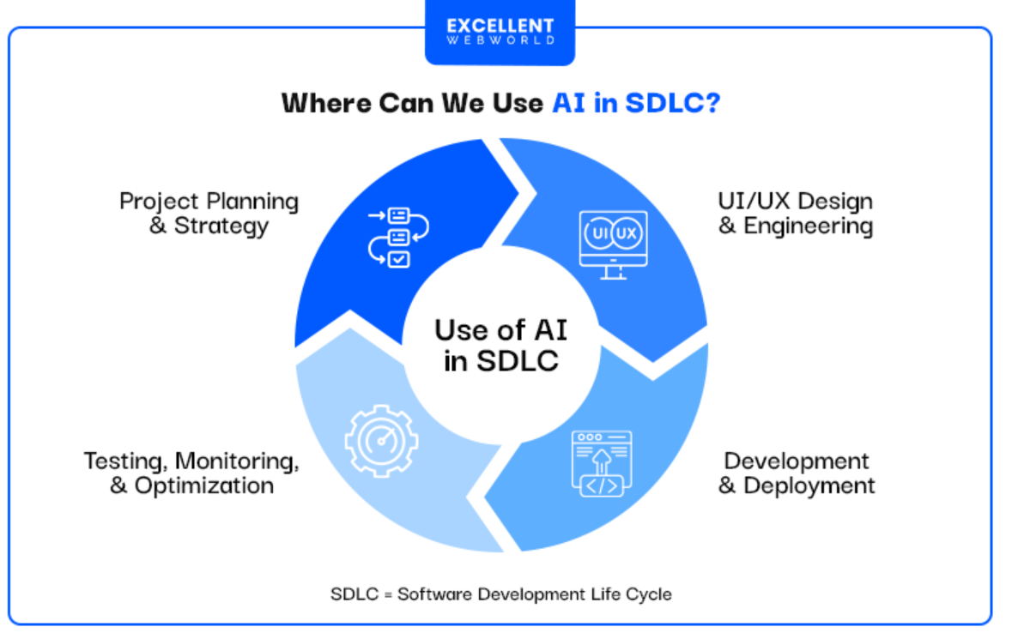
AI in SDLC

Slide 2
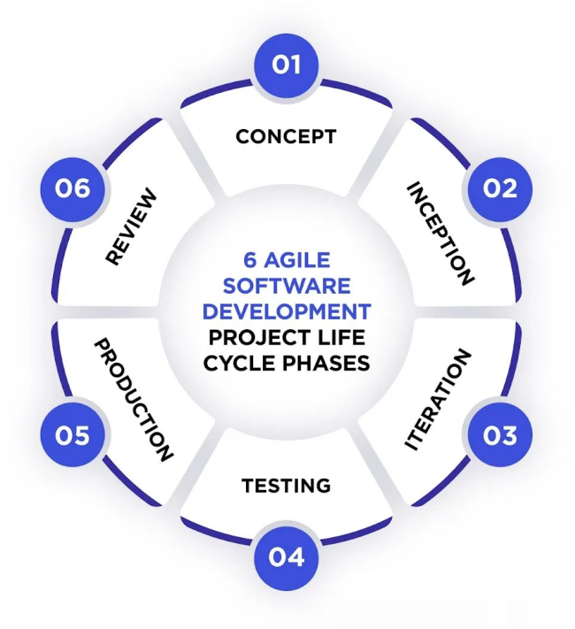
Current Productivity Challenges in SDLC
Rewriting boilerplate code (CRUD, configs, DTOs)
Writing repetitive unit & integration tests
Recreating documentation (Swagger, READMEs)
Understanding legacy code during changes
Inconsistent patterns across teams
Knowledge Transfer

Slide 3
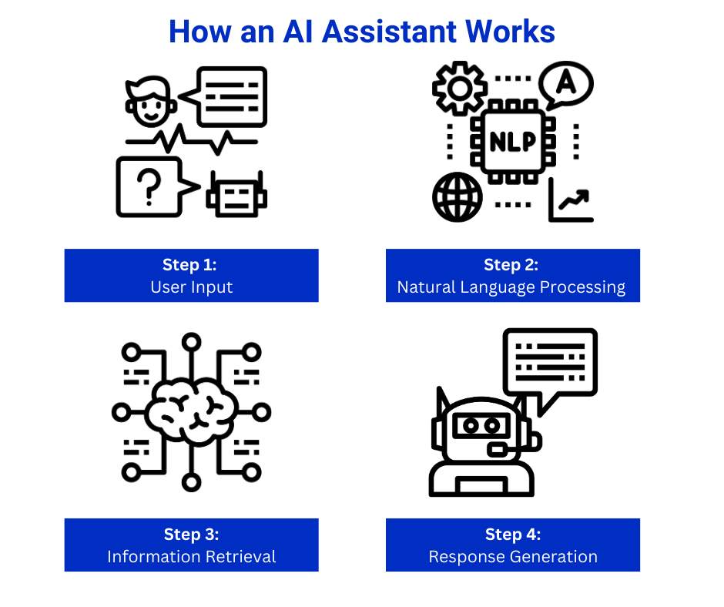
Coding Assistants
1. Introduction
AI Coding Assistants help developers write, review, and understand code faster.
They use large language models (LLMs) trained on programming languages and documentation.
Integrated into IDEs (VS Code, JetBrains, GitHub), they provide code suggestions, fix bugs, generate tests, and automate repetitive tasks.
2. How AI Coding Assistants Work
Context Awareness: Read surrounding code, files, and project structure.
LLM Reasoning: Predict the next best code or action based on learned patterns.
Natural Language Understanding: Convert developer instructions into code or actions.
Tool/IDE Integration: Provide inline suggestions, refactoring, documentation, and multi-step workflows.
3. Available AI Models
LLMs: GPT, Claude, Gemini etc..

Slide 4
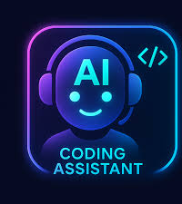
What AI assistants can help with?
Code Generation & Scaffolding
Create boilerplate, APIs, services, CLIs, configs, and infra templates.
Refactoring & Code Quality
Improve readability, modularize, enforce patterns, suggest best practices.
Bug Detection & Fixes
Identify defects, propose patches, explain root causes.
Test Authoring
Unit/integration/e2e test generation; edge cases; test data synthesis.
Docs & Developer Experience
Generate READMEs, inline docs, ADRs, changelogs, release notes.
API/DB Integration
Client code, schema migrations, query optimization, contract tests.
Reviews & Governance
PR summaries, lint fixes, compliance hints, security checks.
Agentic Workflows
Plan multi‑step tasks, call tools (linters, test runners), create/edit files.

Slide 5
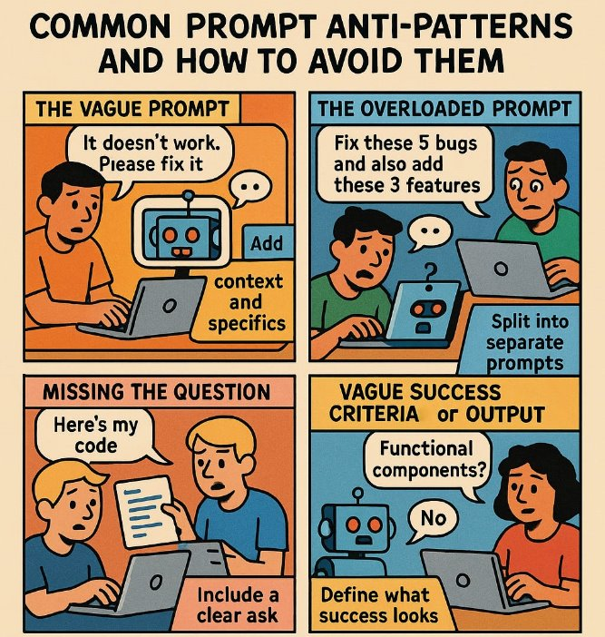
Prompting & Reusable templates
How to Write Effective Prompts
State the Role & Goal Clearly
“You are a senior backend engineer. Build a REST endpoint for X.”
Provide Context
Include stack, versions, file paths, domain rules, sample data.
Constrain the Output
Languages, frameworks, patterns, performance/SLA, security constraints.
Define the Format
“Return: (1) plan, (2) code blocks per file, (3) test cases, (4) next steps.”
Give Examples & Edge Cases
Provide 1–2 examples; list known pitfalls.
Ask for Validation Steps
Request commands, tests, and acceptance criteria to verify results.
Iterate Briefly
Use short follow‑ups: “Refactor for DI and add pagination.”
Reusable Prompt Templates
Central Templates (Org‑wide)
Purpose: Consistency, governance, reuse across teams.
Local Templates (Team/Project)
Purpose: Adapt to domain specifics and codebase conventions.

Slide 6
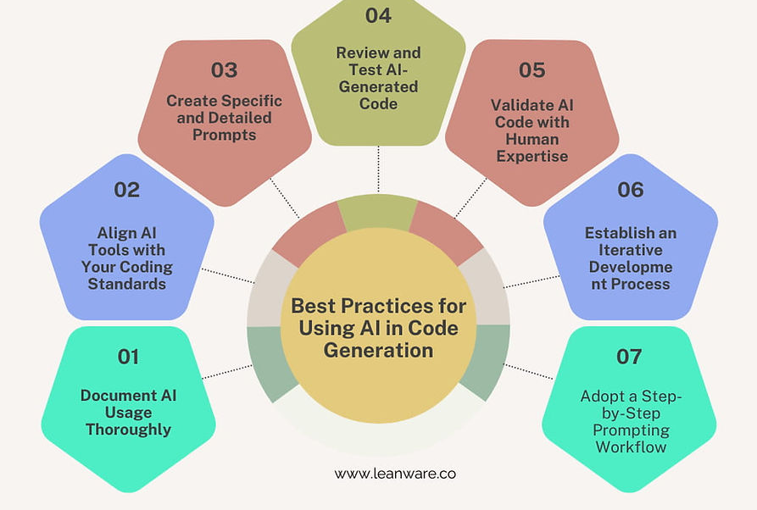
Key Considerations & Best Practices
Give one task at a time
Avoid long, multi‑objective prompts—LLMs perform best with focused instructions.
Always review the generated code
Treat AI output as a draft; validate logic, patterns, and security implications.
Always test the output
Run unit/integration tests, validate edge cases, and check regressions.
Do not trust blindly
AI can hallucinate APIs, libraries, or logic—verify dependencies and assumptions.
Provide clear context
Add filenames, code snippets, architecture, constraints, and expectations for higher accuracy.
Use prompt best practices
Specify role, task, constraints, coding style, and output format.
Break down complex tasks
Use step‑by‑step instructions or ask for a plan before generating code.
Use reusable prompt templates
Maintain consistency across teams (central) and projects (local).
Enforce security & compliance checks
Watch for secrets, incorrect crypto use, unsafe patterns, and potential vulnerabilities.
Stay within known tech stack
Remind the assistant of versions, frameworks, coding guidelines.
Iterate and refine
Provide short feedback loops: “Expand tests,” “Refactor for clean code,” “Optimize for performance.”

Slide 7
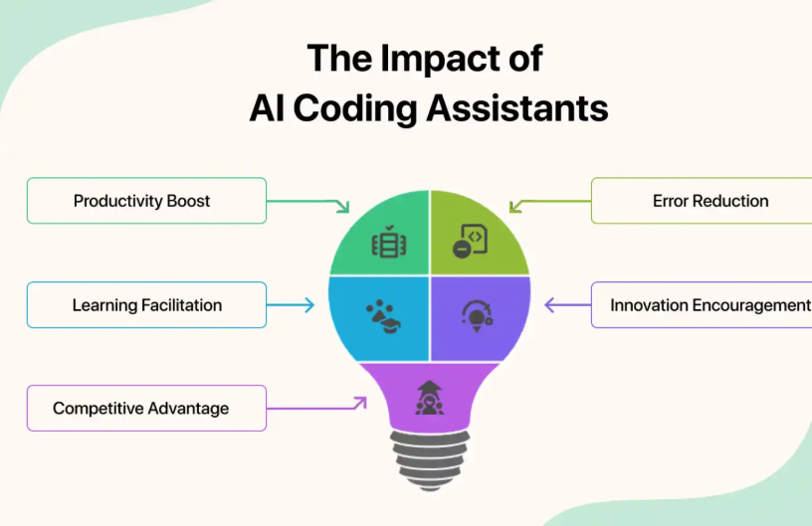
What outcomes can be expected ?
Expected Gains (Conservative Estimates)​
30–50% faster feature delivery​
40% reduction in manual test effort​
25–35% reduction in rework​
Higher consistency across teams​
Faster confidence in changes​
Faster onboardings and KT.​

Slide 8


Slide 9


