Slide 1
Cognitive Modelling
Week 4: Aggregating data across participants
2026
Erik Skjoldan Mortensen

Slide 2
Course overview
Lecture 1 (w16): Introduction + What is a (cognitive) model?
Lecture 2 (w17): Parameter estimation
Lecture 3 (w18): Bayesian modelling
Lecture 4 (w19): Hierarchical models
Lecture 5 (w20): Model comparison
Lecture 6 (w21): Neural network models
(w22): Pentecost, no lecture! But still seminars
Lecture 7 (w23): Summary, exam questions, no seminars
Exam (w24): 4-11th June

Slide 3
Course overview
Lecture 1 (w16): Introduction + What is a (cognitive) model?
Lecture 2 (w17): Parameter estimation
Lecture 3 (w18): Bayesian modelling
Lecture 4 (w19): Hierarchical models
Lecture 5 (w20): Model comparison
Lecture 6 (w21): Neural network models
(w22): Pentecost, no lecture! But still seminars
Lecture 7 (w23): Summary, exam questions, no seminars
Exam (w24): 4-11th June

Slide 4
Recap from last week(s)
With neighbour:
What are some key difference between optimisation versus Bayesian parameter estimation?
What do we need to do Bayesian estimation of the posterior?

Slide 5
Plan today
Options for aggregating data from multiple groups/subjects/other structure in the data
Complete pooling
No pooling
Partial pooling
Continue working with Stan: Implement your own multi-level model

Slide 6
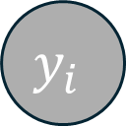
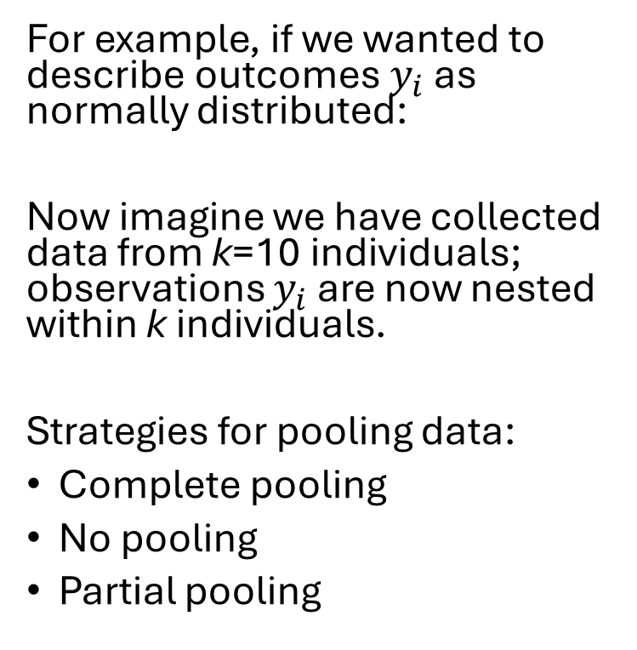
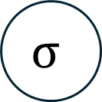


So far we have fit models to individuals; what about when we have a group of individuals?
$$μ$$
$$σ$$
For example, if we wanted to describe outcomes $y_{i}$ as normally distributed:
Now imagine we have collected data from k=10 individuals; observations $y_{i}$ are now nested within k individuals.
Strategies for pooling data:
Complete pooling
No pooling
Partial pooling
$$y_{i}$$
$$i$$

Slide 7
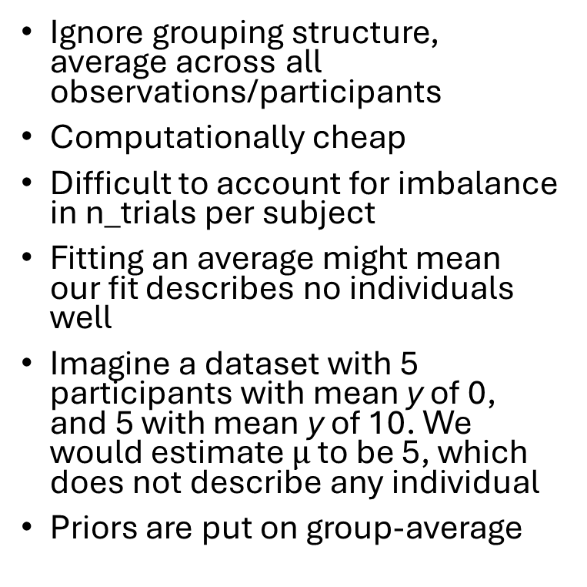
Complete pooling
Ignore grouping structure, average across all observations/participants
Computationally cheap
Difficult to account for imbalance in n_trials per subject
Fitting an average might mean our fit describes no individuals well
Imagine a dataset with 5 participants with mean y of 0, and 5 with mean y of 10. We would estimate $μ$ to be 5, which does not describe any individual
Priors are put on group-average
$$μ$$
$$σ$$
$$y_{i}$$
$$i$$

Slide 8





No pooling
Fit cognitive models to each individual
Allows description of between-individual differences
Easier to spot fitting issues
(More) likely to overfit to noise in data
Can work well for large n_trials; less well, or not at all for small n_trials
We can describe group-level characteristics by summarising individual parameter estimates; we are however discarding uncertainty at this step
Difficult to account for imbalance in n_trials per subject
Priors are put on subject-level parameters
$$μ_{k}$$
$$σ_{k}$$
$$y_{i}$$
$$i$$
$$k$$

Slide 9





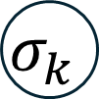

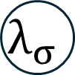
Partial pooling
$$μ_{μ}$$
$$μ_{σ}$$
$$λ_{σ}$$
Model subjects as samples from a group; e.g., subject means are normally distributed within the group
Put priors on group-level parameters; learn subject-level priors during fitting
Allows for bi-directional pooling of information; group-level estimates informs subject-level estimates, and vice versa
$$μ_{k}$$
$$σ_{k}$$
$$y_{i}$$
$$i$$
$$k$$

Slide 10
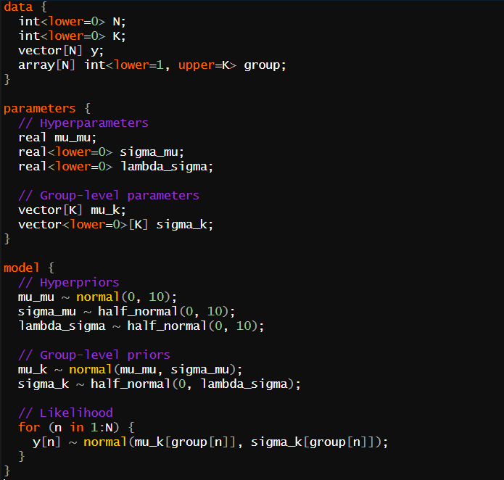








Partial pooling in Stan
$$μ_{μ}$$
$$μ_{σ}$$
$$λ_{σ}$$
$$μ_{k}$$
$$σ_{k}$$
$$y_{i}$$
$$i$$
$$k$$

Slide 11
Partial pooling in Stan
Input data
$$μ_{μ}$$
$$μ_{σ}$$
$$λ_{σ}$$
$$μ_{k}$$
$$σ_{k}$$
$$y_{i}$$
$$i$$
$$k$$

Slide 12
Partial pooling in Stan
Input data
$$μ_{μ}$$
$$μ_{σ}$$
$$λ_{σ}$$
Parameters to fit
$$μ_{k}$$
$$σ_{k}$$
$$y_{i}$$
$$i$$
$$k$$

Slide 13
Partial pooling in Stan
Input data
$$μ_{μ}$$
$$μ_{σ}$$
$$λ_{σ}$$
Parameters to fit
$$μ_{k}$$
$$σ_{k}$$
Priors
$$y_{i}$$
$$i$$
$$k$$

Slide 14
Partial pooling in Stan
Input data
$$μ_{μ}$$
$$μ_{σ}$$
$$λ_{σ}$$
Parameters to fit
$$μ_{k}$$
$$σ_{k}$$
Priors
$$y_{i}$$
Likelihood
$$i$$
$$k$$

Slide 15
Partial pooling in Stan
Input data
$$μ_{μ}$$
$$μ_{σ}$$
$$λ_{σ}$$
Parameters to fit
$$μ_{k}$$
$$σ_{k}$$
Priors
$$y_{i}$$
Likelihood
$$i$$
$$k$$

Slide 16
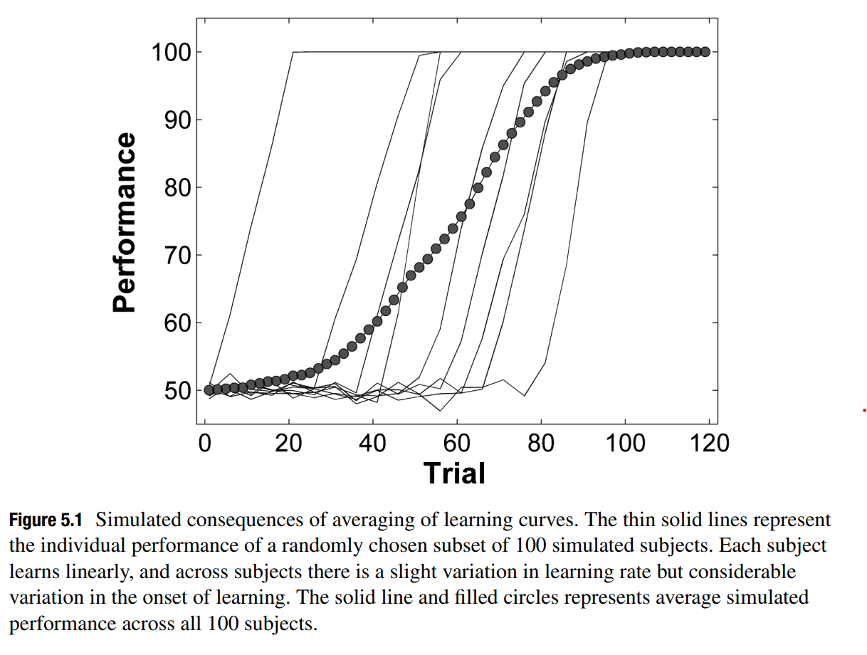
Traditional approaches to grouped data
Ignore grouping structure, average across all observations/participants
Fit cognitive models to each individual
Farrel & Lewandowsky, chapter 5

Slide 17
Traditional approaches to grouped data
Ignore grouping structure, average across all observations/participants
Fit cognitive models to each individual
Easy to overfit! Especially for smaller data sets.
When summarising effects across the group, we are discarding uncertainty
Difficult to account correctly for unbalanced samples

Slide 18
Hierarchical modelling
Model the actual individual, not the averaged effect
Model participant structure in the data
Handle unbalanced observations within groups
Propagate uncertainty correctly across hierarchies

Slide 19
Topics
Lecture:
Fitting an average participant
Fitting single participants
Bootstrap (hierarchical bootstrap)
Hierarchical modelling (classic & Bayes)
Seminar:
Model presentation: Theory of Visual Attention (TVA)
Setting up and using STAN for Bayesian Hierarchical TVA
Implementing TVA as a simulation
Relevant reading: F&L Ch. 5 and 9

Slide 20
Motivation
Until now, we have considered fitting cognitive models to datasets of single participants only
Cognitive models are, in general, non-linear models, making aggregation of data from multiple participants difficult
Today, we are treating different methods to aggregate data, model fits, or modelling an entire sample of data from multiple participants at the same time

Slide 21
Aggregation
Averaging and Vincentizing

Slide 22
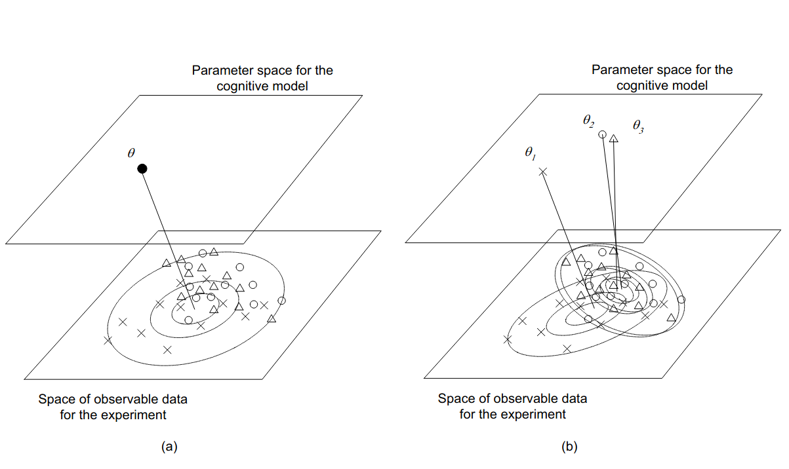
Principal approaches to aggregation
Fitting a model to averaged data (a)
Fitting a model to individual datasets (b)
Navarro, Griffiths, Steyvers, & Lee (2006)

Slide 23
Fitting the model to averaged data
We can fit a single model to the averaged data (the “average participant”)
Advantages:
Fastest option
The fitting to average data usually involves much less problems than fitting to individual data
Depending on the model (e.g., DDM) the parameter estimates are approximately the same as those obtained from averaging individual fits

Slide 24
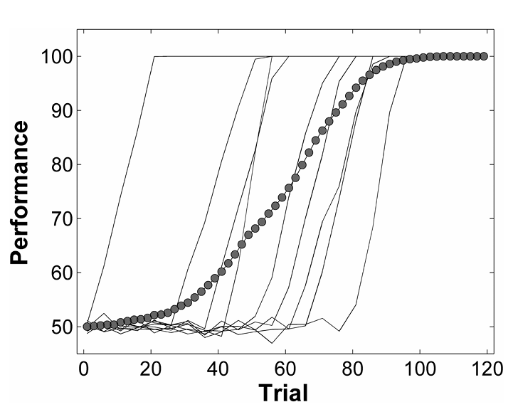
Fitting the model to averaged data
Alternatively, we can fit the model once to the averaged data (the “average participant”)
Disadvantages:
Absolutely no information about individual performance
Approach makes little sense from a Bayesian perspective
Averaging can lead to an artificial dataset that is not indicative of any individual performance

Slide 25
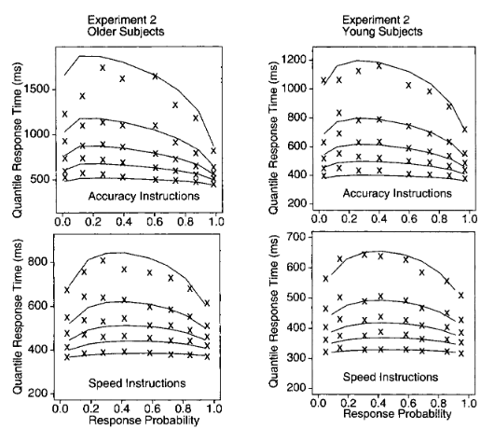
Example: Data averaging
„Ratcliff’s diffusion model (…) is designed to account for response time and accuracy in experimental paradigms in which participants are asked to make two-choice decisions. The model has been successful in dealing with both averaged group data and with data from individual subjects across a range of experimental paradigms (…).
Ratcliff, Thapar, & McKoon (2001).

Slide 26
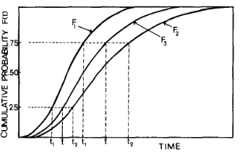
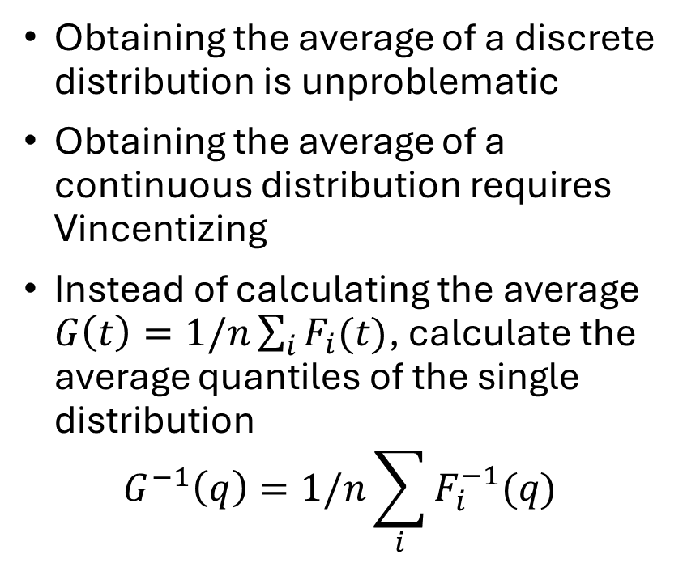
Vincentizing
Obtaining the average of a discrete distribution is unproblematic
Obtaining the average of a continuous distribution requires Vincentizing
Instead of calculating the average $G\left(t\right)=1/n\sum_{i}{F_{i}(t)}$, calculate the average quantiles of the single distribution $G^{−1}\left(q\right)=1/n\sum_{i}{F_{i}^{−1}(q)}$
Ratcliff (1979). Psychol Bulletin
Notes:
Exact solution for some distribution (exponential, Weibull, logistic), good approximation for other distribution (Gamma)

Slide 27
Parameter averaging
An alternative approach is to fit the model to each individual dataset and perform statistical analyses on the obtained estimates
Advantages:
Easy screening of individual fits for problems and re-fitting, if necessary
Sampling variability is accounted for
Standard methods (w. random effects) for further analyses of parameters
Individual parameters can be used for participant-specific analyses (e.g., diagnostic tool in clinical applications)

Slide 28
Parameter averaging
An alternative approach is to fit the model to each individual dataset and perform statistical analyses on the obtained estimates
Disadvantages:
Depending on the model, this can be time-consuming or no option at all
Hypothesis testing on the estimates not the most powerful test option

Slide 29
Interval estimates
Bootstrap, hierarchical bootstrap

Slide 30
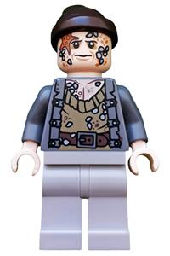
Interval estimates
Yarr! Re-sample your data!
The procedures discussed so far only provide point estimates (e.g., the estimate that maximises the likelihood)
Often, we are interested in other properties of the estimator, such as its variation
In the classic frequentist view, variation is due to sampling
Solution: resampling of the obtained data
Bootstrap Bill (from: www.brickeconomy.com/minifig/poc033/bootstrap-bill)
Efron (1979). SIAM

Slide 31
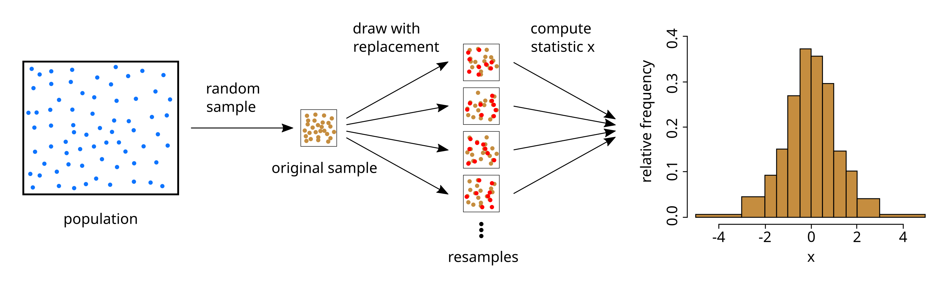
Outline of the bootstrap procedure
!!
https://en.wikipedia.org/wiki/Bootstrapping_(statistics)#/media/File:Illustration_bootstrap.svg

Slide 32
Bootstrap procedure
The frequentist account includes sampling variation
This variation can be taken into account with analytic solutions
If an analytic solution is not available, this variation can be simulated by re-sampling from the observed data
In the bootstrap procedure, we sample with replacement
nDataPts <- 20
…
nboot<-10000
bootpar <- matrix(0, nboot, ncol=2)
for (i in 1:nboot) {
bootdata<- data[ceiling(runif(nDataPts,min=0,max=nDataPts)),]
simplexboot<-optim(startParms, rmsd, data1=bootdata)
bootpar[i,]<-simplexboot$par
}
confint(lm(data[,1] ~ data[,2]))
2.5 % 97.5 %
(Intercept) -0.1489338 0.3535273
data[, 2] 0.4061242 0.9398372
quantile(bootpar[,1], c(0.025, 0.975))
2.5% 97.5%
0.4608943 0.8805472
quantile(bootpar[,2], c(0.025, 0.975))
2.5% 97.5%
-0.1188268 0.3230926
Empirical bootstrap procedure based on Listing 3-1 (F&L)

Slide 33
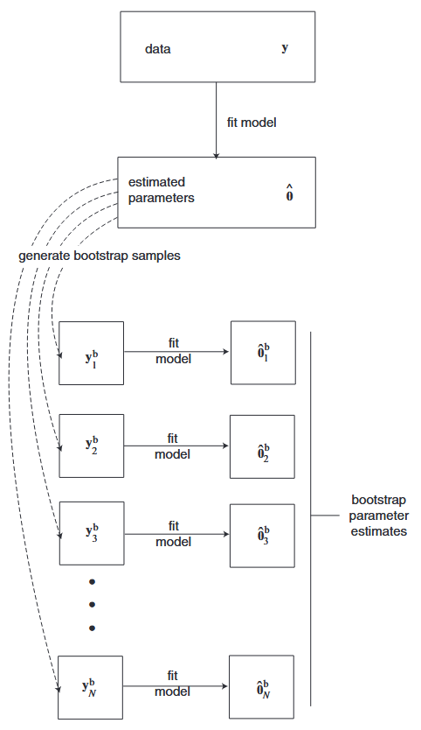
Model-based bootstrap
In a model-based approach, it can be advantageous to use the model and its estimated parameters to create bootstrap samples (“parametric bootstrap”)
Smaller samples can include “leverage points” that greatly influence single bootstrap samples
With increasing sample size and number of bootstrap samples, the two approaches should converge

Slide 34
Model-based bootstrap
In a model-based approach, it can be advantageous to use the model and its estimated parameters to create bootstrap samples (“parametric bootstrap”)
Smaller samples can include “leverage points” that greatly influence single bootstrap samples
With increasing sample size and number of bootstrap samples, the two approaches should converge
nDataPts <- 20
lm0<-lm(data[,1] ~ data[,2])
estSigma<-sum(residuals.lm(lm0)^2)/(nDataPts-2)
simplex0 <- optim(startParms, rmsd, data1=data)
…
nboot<-10000
bootpar2 <- matrix(0, nboot, ncol=2)
for (i in 1:nboot) {
bootdata<-cbind(rnorm(nDataPts)*sqrt(estSigma) + data[ ,2]*simplex0$par[1] + simplex0$par[2], data[,2] )
simplexboot<-optim(startParms, rmsd, data1=bootdata)
bootpar2[i,]<-simplexboot$par
}
confint(lm0))
2.5 % 97.5 %
(Intercept) -0.1489338 0.3535273
data[, 2] 0.4061242 0.9398372
quantile(bootpar2[,1], c(0.025, 0.975))
2.5% 97.5%
0.4200182 0.9248614
quantile(bootpar2[,2], c(0.025, 0.975))
2.5% 97.5%
-0.1300771 0.3344593
Model-based bootstrap procedure based on Listing 3-1 (F&L)

Slide 35
Model-based bootstrap
In a model-based approach, it can be advantageous to use the model and its estimated parameters to create bootstrap samples (“parametric bootstrap”)
Smaller samples can include “leverage points” that greatly influence single bootstrap samples
With increasing sample size and number of bootstrap samples, the two approaches should converge
nDataPts <- 200
…
confint(lm(data[,1] ~ data[,2]))
2.5 % 97.5 %
(Intercept) -0.03512928 0.1265954
data[, 2] 0.81929266 0.9697833
quantile(bootpar[,1], c(0.025, 0.975))
2.5% 97.5%
0.8108842 0.9748676
quantile(bootpar[,2], c(0.025, 0.975))
2.5% 97.5%
-0.03510039 0.12772456
quantile(bootpar2[,1], c(0.025, 0.975))
2.5% 97.5%
0.8219002 0.9682651
quantile(bootpar2[,2], c(0.025, 0.975))
2.5% 97.5%
-0.03581619 0.12720128
Both bootstrap procedures with increased sample size

Slide 36
Hierarchical bootstrap
Re-sample participants, then for each sampled participant do:
The bootstrap procedure can easily be extended to multiple participants
Participants are also sampled with replacement
For each sampled participant, we perform a separate bootstrap

Slide 37
Hierarchical modelling
Bayesian Hierarchical modelling, JAGS/STAN

Slide 38
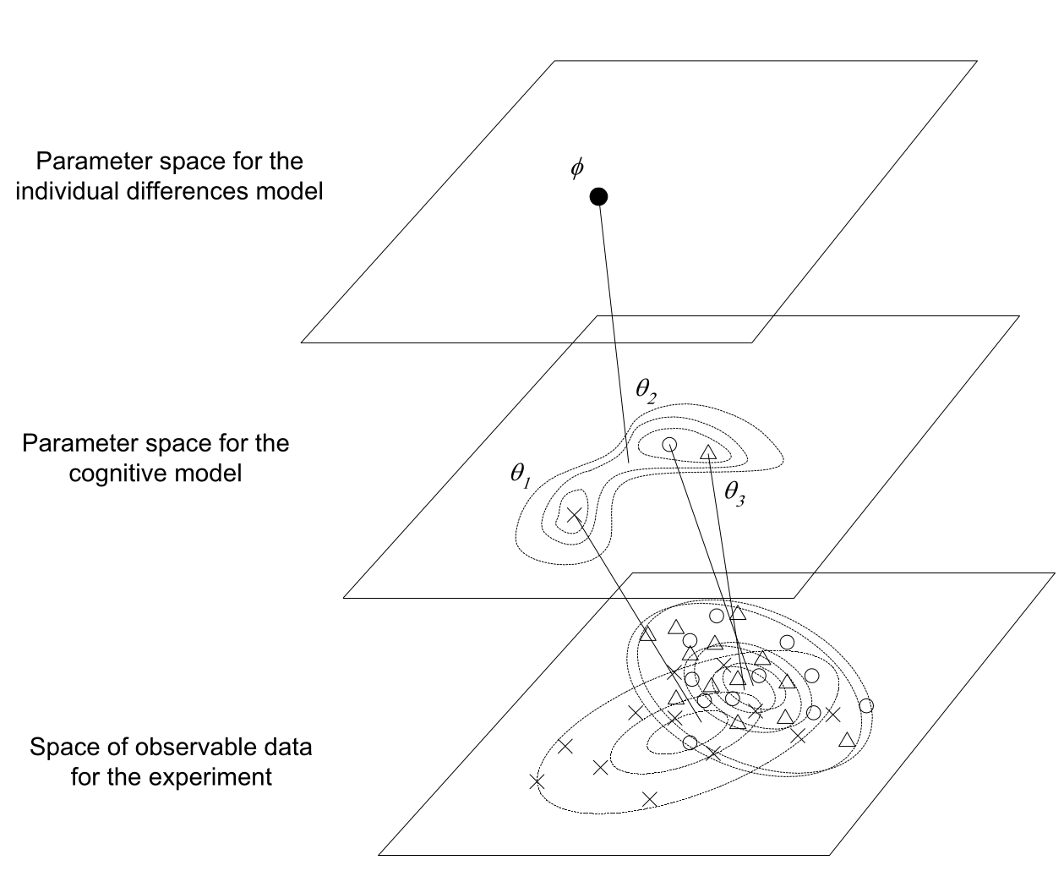
Hierarchical modelling
The goal of hierarchical modelling is to model fixed effects (e.g., conditions) together with random effect (participants)
The linear mixed model (LMM) is an example of hierarchical modelling
The approach is compatible with both the classic/frequentist view and the Bayesian view
In practise, (G)LMM is one of few frequentist approaches, all other models are typically Bayesian
Navarro, Griffiths, Steyvers, & Lee (2006)

Slide 39
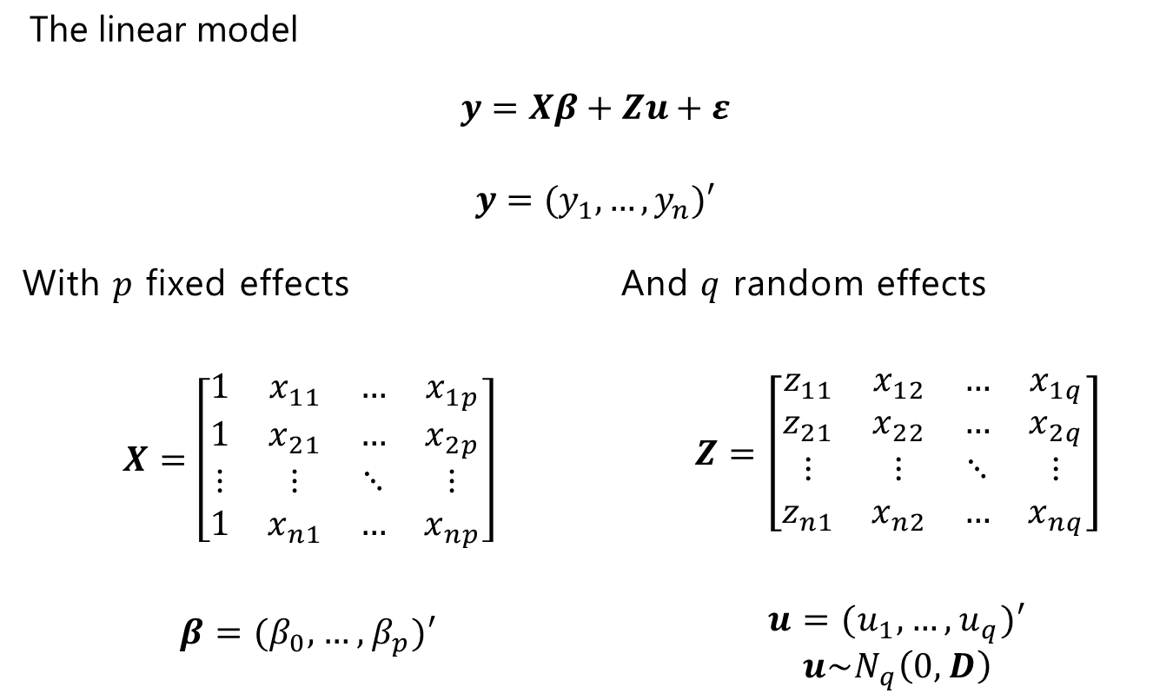
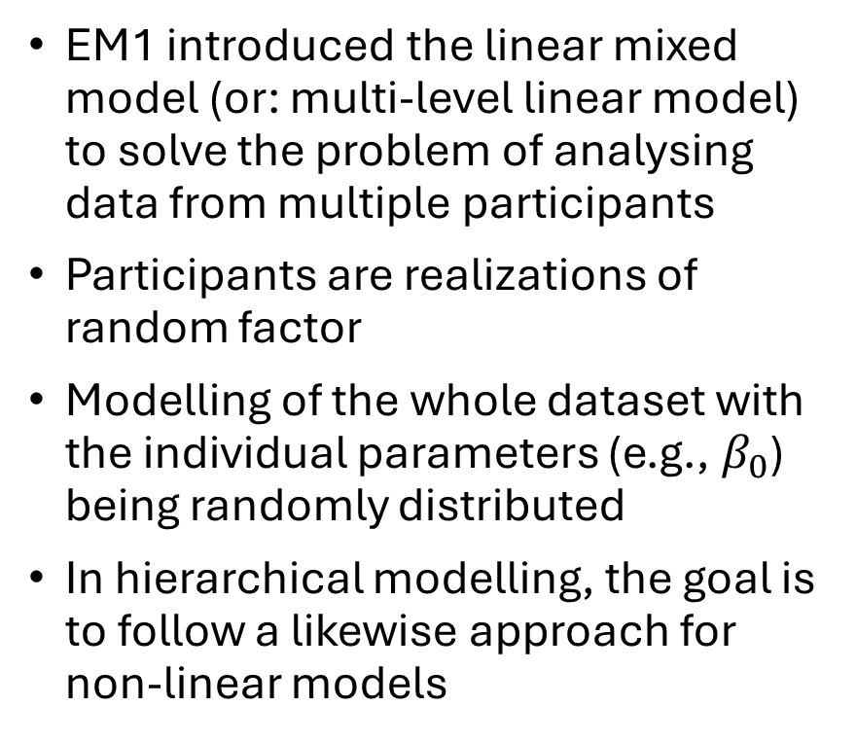
LMM as hierarchical modelling
EM1 introduced the linear mixed model (or: multi-level linear model) to solve the problem of analysing data from multiple participants
Participants are realizations of random factor
Modelling of the whole dataset with the individual parameters (e.g., $β_{0}$) being randomly distributed
In hierarchical modelling, the goal is to follow a likewise approach for non-linear models

Slide 40
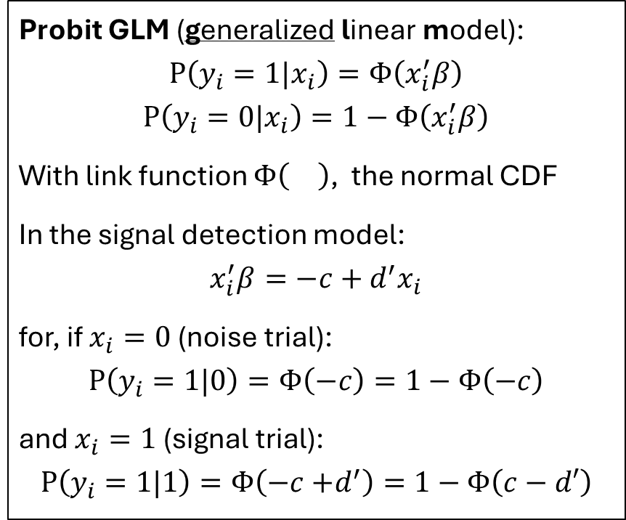
Hierarchical modelling via LMM
If a model can be reduced to a linear model via a link function, we can use LMM for hierarchical modelling
This is very practical, as we can simply use the LMM functions (glmer() instead of lmer() in R)
Examples:
Logistic regression with logit() link function
Signal detection theory, with probit() link function (see right)
Probit GLM (generalized linear model):
$$P\left(y_{i}=1|x_{i}\right)=Φ\left(x_{i}^{′}β\right)$$
$$P\left(y_{i}=0|x_{i}\right)=1−Φ\left(x_{i}^{′}β\right)$$
With link function $Φ\left(\right)$, the normal CDF
In the signal detection model:
$$x_{i}^{′}β=−c+d^{′}x_{i}$$
for, if $x_{i}=0$ (noise trial):
$$P\left(y_{i}=1|0\right)=Φ\left(−c\right)=1−Φ\left(−c\right)$$
and $x_{i}=1$ (signal trial):
$$P\left(y_{i}=1|1\right)=Φ\left(−c{+d}^{′}\right)=1−Φ\left(c−d′\right)$$

Slide 41
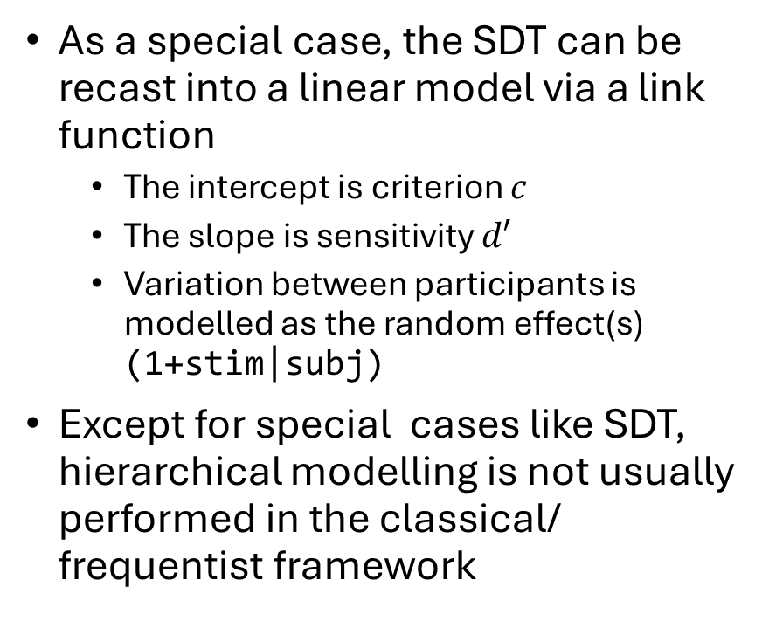
Hierarchical modelling via LMM
As a special case, the SDT can be recast into a linear model via a link function
The intercept is criterion $c$
The slope is sensitivity $d′$
Variation between participants is modelled as the random effect(s) (1+stim|subj)
Except for special cases like SDT, hierarchical modelling is not usually performed in the classical/ frequentist framework
> mlhierarchSDT <- glmer(resp ~ stim + (1+stim|subj), family=binomial("probit"))
> summary(mlhierarchSDT)
Generalized linear mixed model fit by maximum likelihood (Laplace Approximation) ['glmerMod']
Family: binomial ( probit )
Formula: resp ~ stim + (1 + stim | subj)
AIC BIC logLik -2*log(L) df.resid
2039.8 2067.8 -1014.9 2029.8 1995
Random effects:
Groups Name Variance Std.Dev. Corr
subj (Intercept) 0.014530 0.12054
stim 0.008151 0.09028 -0.56
Number of obs: 2000, groups: subj, 10
Fixed effects:
Estimate Std. Error z value Pr(>|z|)
(Intercept) -1.23121 0.06600 -18.66 <2e-16 ***
stim 1.51745 0.07312 20.75 <2e-16 ***

Slide 42
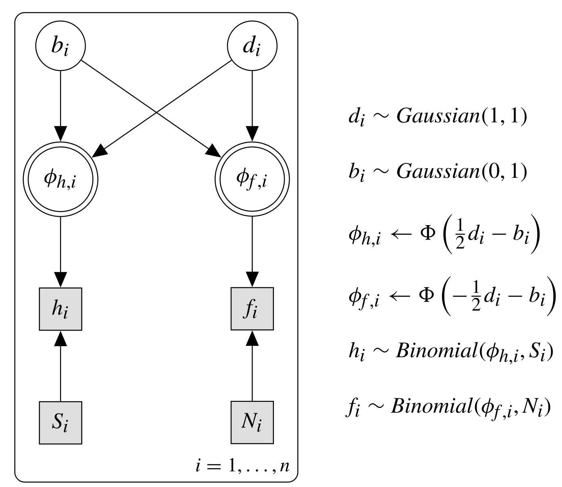
Bayesian hierarchical modelling
A reason for most hierarchical modelling being Bayesian is because the extra level in the hierarchy can be quite easily incorporated in a Bayesian framework
That means, for Bayesian hierarchical modelling, we can simply use various sampling techniques, implemented, for example, in JAGS or STAN
hyper-parameters
Bayesian model of SDT for a single participant

Slide 43

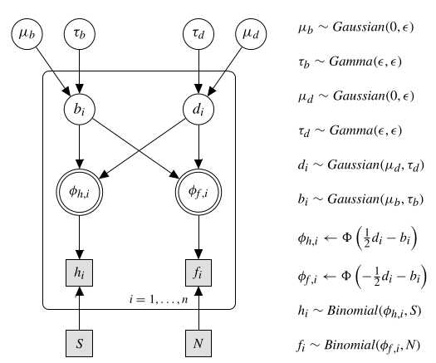
Bayesian hierarchical modelling
A reason for most hierarchical modelling being Bayesian is because the extra level in the hierarchy can be quite easily incorporated in a Bayesian framework
That means, for Bayesian hierarchical modelling, we can simply use various sampling techniques, implemented, for example, in JAGS or STAN
hyper-hyper-parameters
hyper-parameters
Bayesian model of SDT for multiple participants

Slide 44
Hierarchical Bayes in JAGS
Specifying a hierarchical Bayesian model in JAGS is relatively simple
We add the additional layer of the hierarchy as (parent) distribution of parameters of the participant distribution
The are specified by hyper-hyperparameters, or parameters of the parent distribution
# Hierarchical Signal Detection Theory
model{
# parent distributions for priors
mud ~ dnorm(0,epsilon)
mub ~ dnorm(0,epsilon)
taud ~ dgamma(epsilon,epsilon)
taub ~ dgamma(epsilon,epsilon)
#modeling all n subjects
for (i in 1:n) {
# priors for discriminability and bias
d[i] ~ dnorm(mud,taud)
b[i] ~ dnorm(mub,taub)
# predictions for hits and false alarms
phih[i] <- phi( d[i]/2 - b[i])
phif[i] <- phi(-d[i]/2 - b[i])
# Observed hits and false alarms
h[i] ~ dbin(phih[i],sigtrials)
f[i] ~ dbin(phif[i],noistrials)
}
}
JAGS model definition of hierarchical SDT (Listing 9-1)

Slide 45
Hierarchical Bayes in JAGS
Specifying a hierarchical Bayesian model in JAGS is relatively simple
We add the additional layer of the hierarchy as (parent) distribution of parameters of the participant distribution
The are specified by hyper-hyperparameters, or parameters of the parent distribution
library(rjags)
#simulate data from experiment with 10 subjects
n <- 10
sigtrials <- noistrials <- 100
h <- rbinom(n,sigtrials, .8)
f <- rbinom(n,noistrials,.2)
#initialize for JAGS
oneinit <- list(mud=0, mub=0, taud=1, taub=1, d=rep(0,n), b=rep(0,n))
myinits <- list(oneinit)[rep(1,4)]
sdtjh <- jags.model("SDThierarch.j",
data = list("epsilon"=0.001,"h"=h, "f"=f,
"n"=n, "sigtrials" =sigtrials,
"noistrials"=noistrials),
inits=myinits, n.chains=4)
# burnin
update(sdtjh,n.iter=1000)
# perform MCMC
parameters <- c("d", "b", "taud", "taub", "mud", "mub", "phih", "phif")
mcmcfin<-coda.samples(sdtjh,parameters,5000)
Running the JAGS model definition (Listing 9-1) in R

Slide 46
Hierarchical Bayes in STAN
Specifying a (hierarchical) Bayesian model in STAN largely follows the approach in JAGS
We add the additional layer of the hierarchy as (parent) distribution of parameters of the participant distribution
The are specified by hyper-hyperparameters, or parameters of the parent distribution
data {
int<lower=1>N; // number of participants
int<lower=1>n; // number of trials (signal/noise)
array[N] int<lower=0> h;
array[N] int<lower=0> f;
real<lower=0>epsilon;
}
parameters {
real mu_b;
real mu_d;
real<lower=0>tau_b;
real<lower=0>tau_d;
vector[N] b;
vector[N] d;
}
transformed parameters {
…
}
model {
// priors of the parent distribution
mu_b ~ normal(0, inv_sqrt(epsilon));
mu_d ~ normal(0, inv_sqrt(epsilon));
tau_b ~ gamma(epsilon, epsilon);
tau_d ~ gamma(epsilon, epsilon);
// priors
b ~ normal(mu_b, sigma_b);
d ~ normal(mu_d, sigma_d);
// likelihood*prior; observed hits and false alarms
h ~ binomial(n, pred_prob_h);
f ~ binomial(n, pred_prob_f);
}
STAN model definition of hierarchical SDT (Listing 9-1)

Slide 47
Hierarchical Bayes in STAN
Specifying a (hierarchical) Bayesian model in STAN largely follows the approach in JAGS
After having defined the model in STAN, the interfacing via, for example, R is very similar to JAGS
STAN uses even more efficient sampling than JAGS (Hamiltonian Monte Carlo instead of Gibbs)
#simulate data from experiment with 10 subjects
n <- 10
sigtrials <- noistrials <- 100
h <- rbinom(n,sigtrials, .8)
f <- rbinom(n,noistrials, .2)
### using STAN
library(rstan)
data <- list("epsilon"=0.001,"h"=h, "f"=f, "N"=n,
"n" =sigtrials)
inits <- list(list(d=rep(0, n), b=rep(0, n), mu_d=0,
mu_b=0, tau_d=1, tau_b=1))
model_SDThierarch<-stan_model("SDThierarch.stan")
fit<-sampling(model_SDThierarch, data=data, chains=4,
init=rep(inits,4), iter=5000, warmup=1000)
stan_trace(fit)
stan_hist(fit)
Running the STAN model definition (adapted Listing 9-1) in R

Slide 48
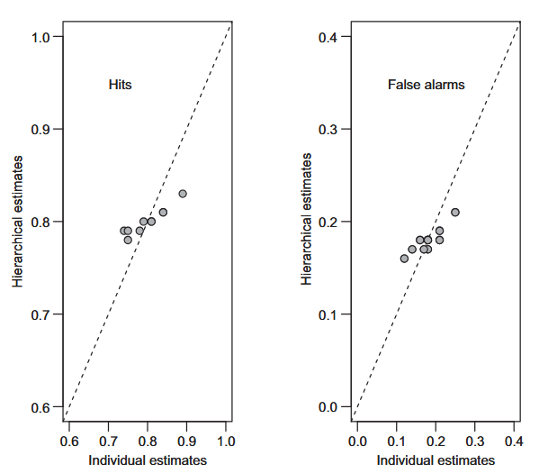
Advantages of hierarchical modelling
Hierarchical modelling allows to model the entire dataset in a single model
Hierarchical modelling provides an elegant solution to the trade-off between fitting individuals and averaged data
Better estimates for single participants, especially relevant, with small dataset per participant
Shrinkage, demonstrated by using hierarchical SDT

Slide 49
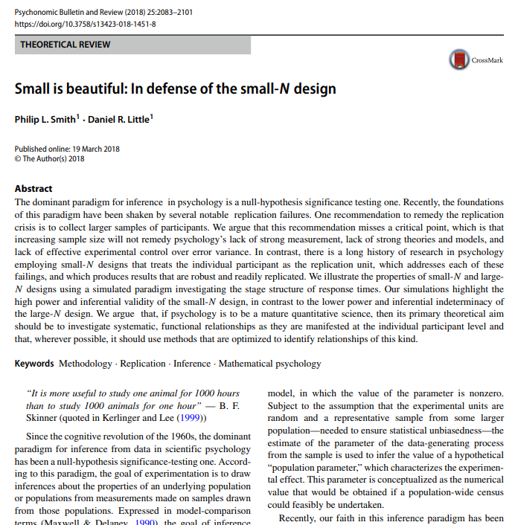
Small N-design (EM1)
“It is more useful to study one animal for 1000 hours than to study 1000 animals for one hour” — B. F. Skinner
It has been argued that massive within-subject designs with few participants have massive advantages when it comes to replicability
Each participant is an experiment and analysed on single subject level
Each participant can be considered a replication

Slide 50
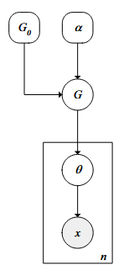
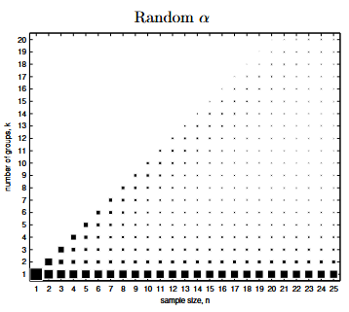
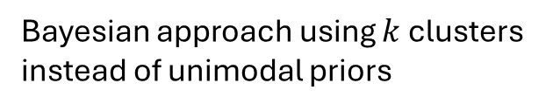
Disadvantages of hierarchical modelling
While hierarchical modelling is an advanced form of modelling data from multiple participants, there are some caveats
Often, we use unimodal hyperpriors, which are unlikely to hold if the participants are inhomogeneous
Complicated and slow (> not part of the exam)
Bayesian approach using $k$ clusters instead of unimodal priors
Navarro, Griffiths, Steyvers, & Lee (2006)

Slide 51
Summary
When working with data from multiple participants, we need to choose whether and how to aggregate the single subject data
Depending on model complexity, we can fit a model to individual datasets
The most advanced method is multilevel/hierarchical modelling
Hierarchical modelling is often connected (but not restricted) to Bayesian hierarchical modelling
Hierarchical modelling is a very elegant solution to the small-N/ big-n vs. big-N/small-n problem
Not a good solution, if we are interested in individual differences/clustering or have an inhomogeneous sample
computationally VERY expensive

Slide 52
Coming up next
Seminar (May 14th):
Presentation: Theory of Visual Attention (TVA)
Bayesian hierarchical modelling with STAN (RStanTVA)
Implementing TVA
Introduction to weekly assignment (individually, mandatory)
Lecture & Seminar (next week):
Model comparison
Presentation: Elimination by Aspects (EBA)
Nested model tests with Likelihood-Ratio test
AIC/BIC and the Bayes Factor
Introduction to final weekly assignment (group, voluntary)

