Slide 1
Cognitive Modelling
Week 5: model comparison
2026
Erik Skjoldan Mortensen

Slide 2
Course overview
Lecture 1 (w16): Introduction + What is a (cognitive) model?
Lecture 2 (w17): Parameter estimation
Lecture 3 (w18): Bayesian modelling
Lecture 4 (w19): Hierarchical models
Lecture 5 (w20): Model comparison
Lecture 6 (w21): Neural network models
(w22): Pentecost, no lecture! But still seminars
Lecture 7 (w23): Summary, exam questions, no seminars
Exam (w24): 4-11th June

Slide 3
Course overview
Lecture 1 (w16): Introduction + What is a (cognitive) model?
Lecture 2 (w17): Parameter estimation
Lecture 3 (w18): Bayesian modelling
Lecture 4 (w19): Hierarchical models
Lecture 5 (w20): Model comparison
Lecture 6 (w21): Neural network models
(w22): Pentecost, no lecture! But still seminars
Lecture 7 (w23): Summary, exam questions, no seminars
Exam (w24): 4-11th June

Slide 4
Todays plan: Model comparison
Likelihood ratio testing (for nested models)
Akaike Information Criterion (AIC)
Leave-one-out-cross-validation (LOO-CV)
Bayes factor (BF)
Notes:
Endtil videre har vi taget modeller som “givet” og været interesseret I at finde parametrene der bedst passer til data (MLE) eller de mest sandsynlige distributioner af parameter, givet data.
Vi bør dog principielt tage stilling til den udfordring, at alle modeller er forkerte, nogle er brugbare, og nogle er mere brugbare end andre.
Modelsammenligning er da en tilgang hvor der er principielle metoder til at sammenligne forskellige modeller for at finde frem til hvilken model bedst predictor ny data, og/eller er mest sandsynlig til at have genereret dataen.

Slide 5
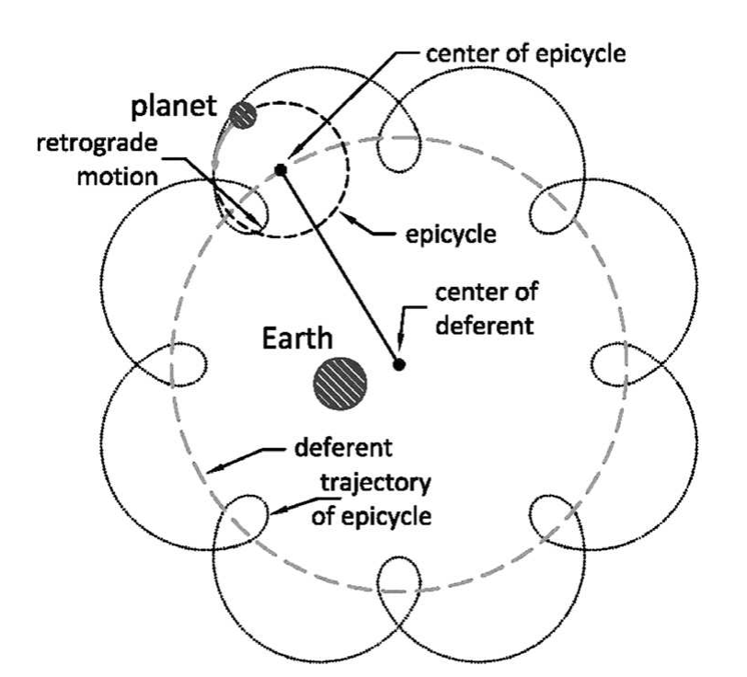
Todays plan: Model comparison
Which of M1, M2 and M3 best fit an observed data set?
All models are wrong, some are useful – and some are more useful than others
General issue: If we are comparing 3 different Ptolemaic-style models, one of them can be substantially “better” than the rest by some measure: It is still a misleading model
(There is no guarantee that the “true” model is included in the set)
Notes:
Endtil videre har vi taget modeller som “givet” og været interesseret I at finde parametrene der bedst passer til data (MLE) eller de mest sandsynlige distributioner af parameter, givet data.
Vi bør dog principielt tage stilling til den udfordring, at alle modeller er forkerte, nogle er brugbare, og nogle er mere brugbare end andre.
Modelsammenligning er da en tilgang hvor der er principielle metoder til at sammenligne forskellige modeller for at finde frem til hvilken model bedst predictor ny data, og/eller er mest sandsynlig til at have genereret dataen.

Slide 6
Todays plan: Model comparison
So far, we have considered fitting cognitive models, either to individuals or groups, and thereby inferring the distribution of parameter values which are most probable given the data and the model
This assumes an a-priori choice of model
In some instances, we may have multiple candidate models which could all be fitted to the data
Model comparison involves systematic approaches to comparing models in their ability to predict the obtained data set, while accounting for their complexity
All else being equal, we generally favour simpler models if their predictive performance are similar

Slide 7
Model comparison
Nested model tests, likelihood ratio (LR) test

Slide 8
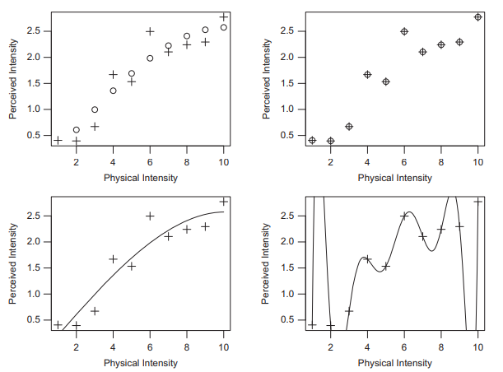
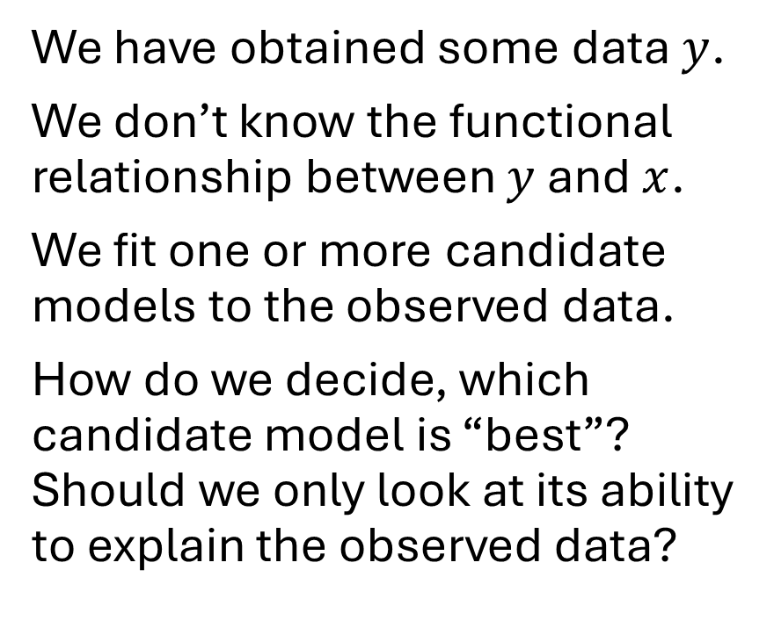
The problem of model complexity
We have obtained some data $y$.
We don’t know the functional relationship between $y$ and $x$.
We fit one or more candidate models to the observed data.
How do we decide, which candidate model is “best”? Should we only look at its ability to explain the observed data?
Notes:
A model may fit better because it is a good characterisation of the true data generation process, or because it is simply more flexible

Slide 9
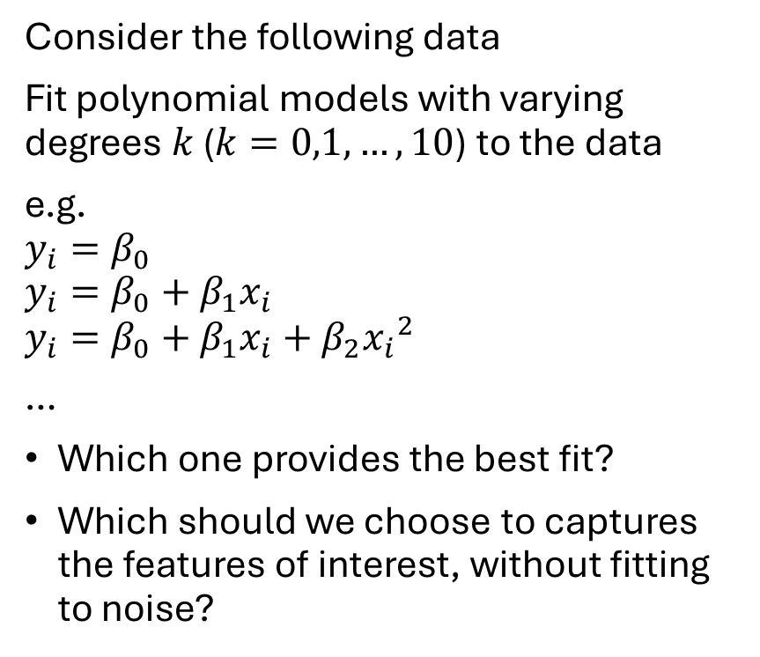
The problem of model complexity
Consider the following data
Fit polynomial models with varying degrees $k$ ($k=0,1,…, 10$) to the data
e.g.
$$y_{i}=β_{0}$$
$$y_{i}=β_{0}+β_{1}x_{i}$$
$$y_{i}=β_{0}+β_{1}x_{i}+β_{2}{x_{i}}^{2}$$
…
Which one provides the best fit?
Which should we choose to captures the features of interest, without fitting to noise?

Slide 10
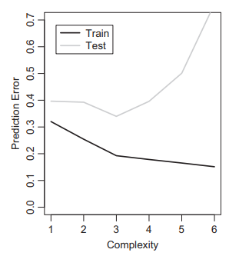
Overfitting
If we only go for the best fit and disregard model complexity, we risk overfitting
Overfitting means that in addition to some effects of interest we also fit the model to effects of no interest (noise)
If there is overfitting, this becomes evident in cross-validation
E.g., Leave-one-out-cross-validation (LOO-CV)

Slide 11
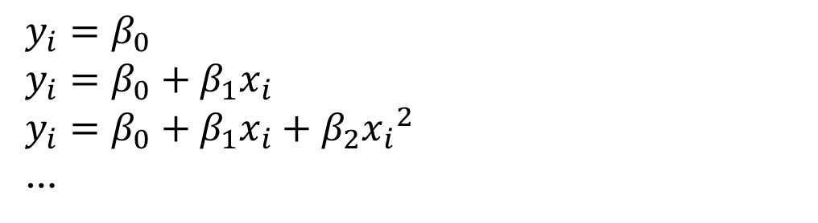
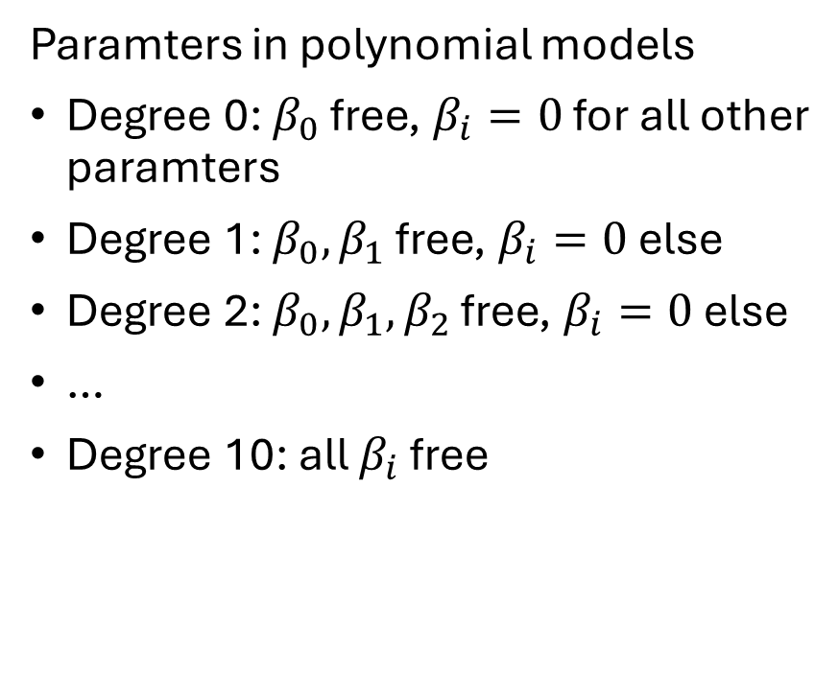
Nested model tests
$$y_{i}=β_{0}$$
$$y_{i}=β_{0}+β_{1}x_{i}$$
$$y_{i}=β_{0}+β_{1}x_{i}+β_{2}{x_{i}}^{2}$$
…
Comparing different polynomial models constitutes a form of nested model tests
Nested model tests are formally based on model selection, but essentially test one or more specific parameters
Stepwise procedure in linear regression
Testing fixed-effects of parameters across conditions
Paramters in polynomial models
Degree 0: $β_{0}$ free, $β_{i}=0$ for all other paramters
Degree 1: $β_{0},β_{1}$ free, $β_{i}=0$ else
Degree 2: $β_{0},β_{1},β_{2}$ free, $β_{i}=0$ else
…
Degree 10: all $β_{i}$ free

Slide 12
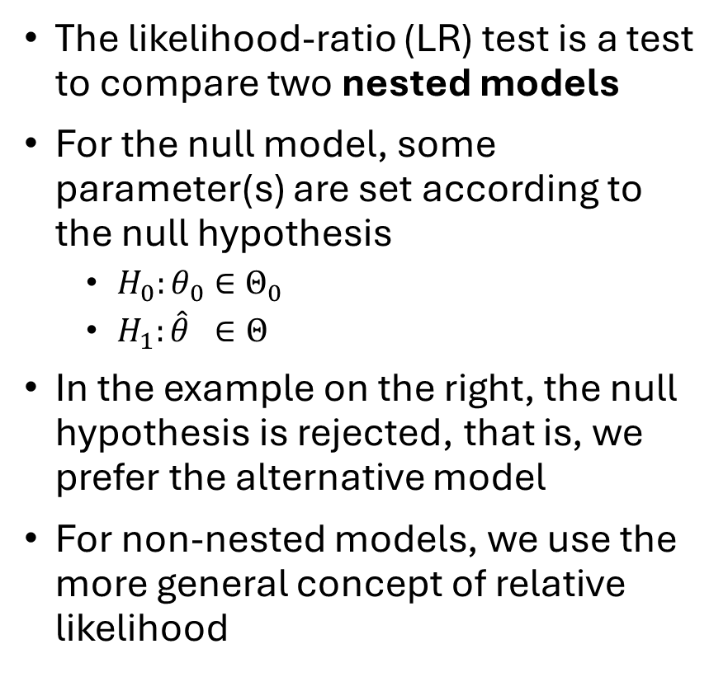
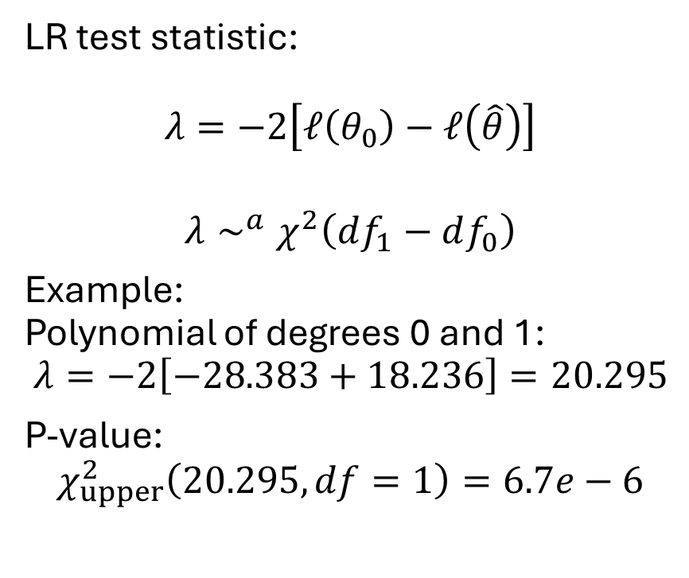
The likelihood-ratio test
The likelihood-ratio (LR) test is a test to compare two nested models
For the null model, some parameter(s) are set according to the null hypothesis
$H_{0}:θ_{0}∈Θ_{0}$
$H_{1}:\hat{θ} ∈Θ$
In the example on the right, the null hypothesis is rejected, that is, we prefer the alternative model
For non-nested models, we use the more general concept of relative likelihood
LR test statistic:
$$λ=−2\left[ℓ\left(θ_{0}\right)−ℓ\left(\hat{θ}\right)\right]$$
$$λ∼^{a}χ^{2}\left(df_{1}−df_{0}\right)$$
Example: Polynomial of degrees 0 and 1:
$$λ=−2\left[−28.383+18.236\right]=20.295$$
P-value:
$$χ_{upper}^{2}\left(20.295, df=1\right)=6.7e−6$$
Notes:
L0: the smaller nested model
L1: the larger more complex model
Their likelihood ratio: lambda = L0/L1: small ratio = large loss of “fit” for the smaller model: close to 1: minimal loss of fit
Deviance = -2loglik
D = 2(L1-L0)
2 makes it asymptotically follow a chi-squared distribution
Lambda = -2(loglik1 – loglik0)

Slide 13
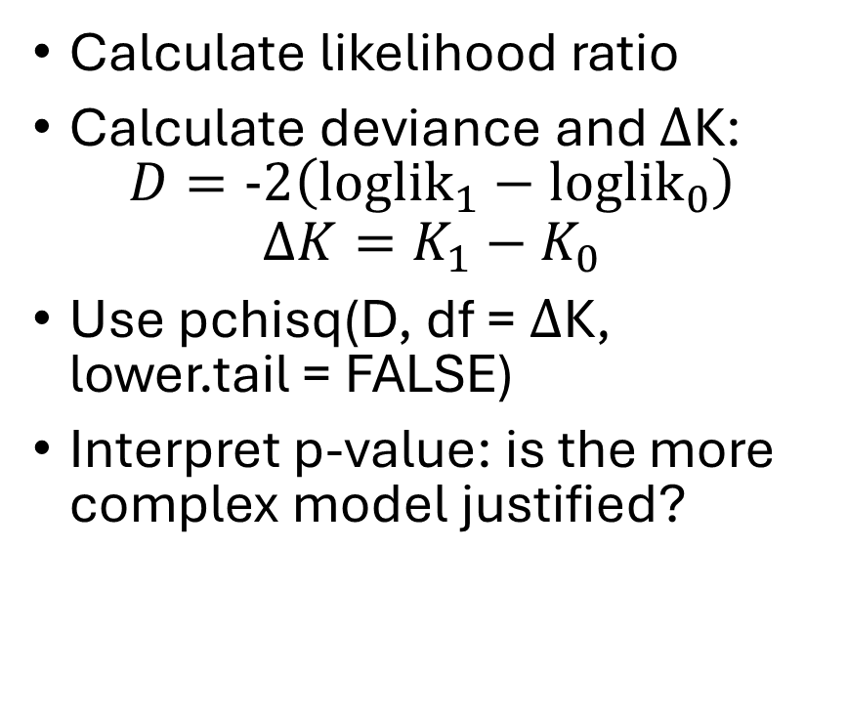
Practice task:
Open your LBA solution code
Take your two datasets which includes the fast vs accurate instruction.
Now prepare and fit two likelihood functions:
M0, a simplified model which assumes a shared threshold (b_speed = b_acc)
M1, the “full” model where they are allowed to be different
Calculate likelihood ratio
Calculate deviance and $Δ$K: $D=-2\left({loglik}_{1}−{loglik}_{0}\right)$
$$ΔK=K_{1}−K_{0}$$
Use pchisq(D, df = $Δ$K, lower.tail = FALSE)
Interpret p-value: is the more complex model justified?

Slide 14

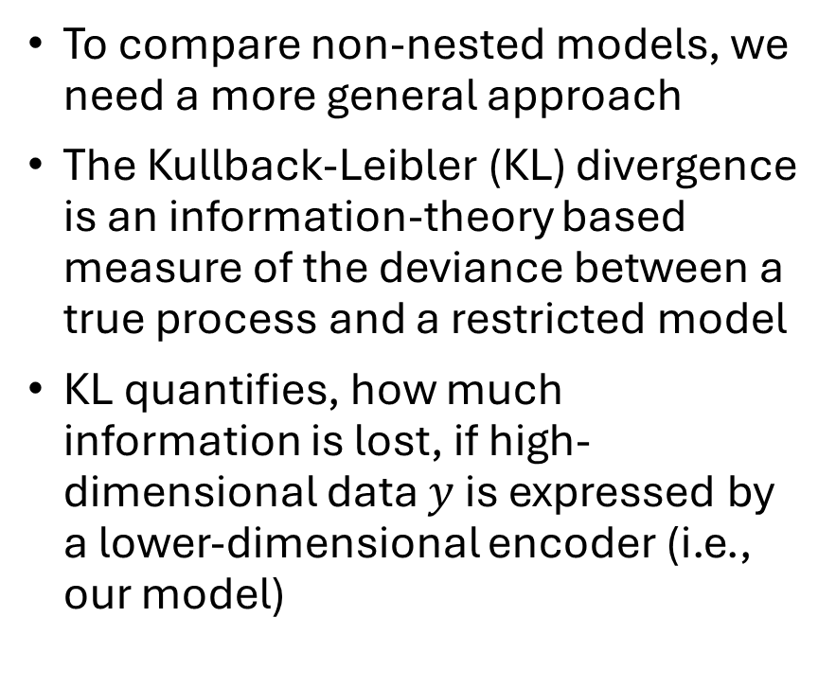
Non-nested model tests
To compare non-nested models, we need a more general approach
The Kullback-Leibler (KL) divergence is an information-theory based measure of the deviance between a true process and a restricted model
KL quantifies, how much information is lost, if high-dimensional data $y$ is expressed by a lower-dimensional encoder (i.e., our model)
$KL=$
$$\underset{entropy of data}{\underbrace{∫p\left(x\right)\log\left[p\left(x\right)\right]dx}}−\underset{cross−entropy}{\underbrace{∫p\left(x\right)\log\left[q\left(y|θ\right)\right]dx}}$$

Slide 15
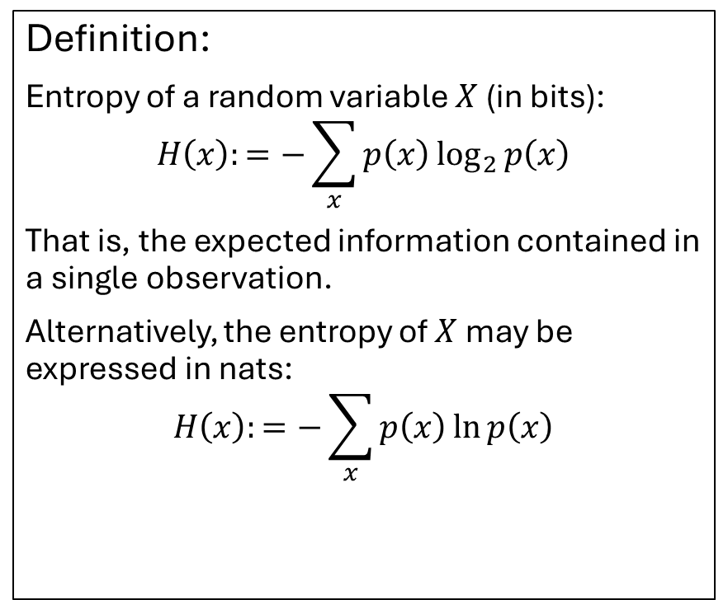
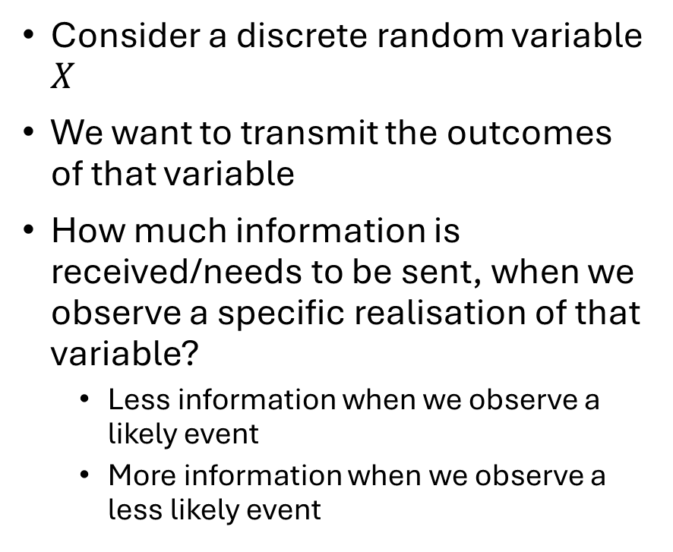
Information theory
Consider a discrete random variable $X$
We want to transmit the outcomes of that variable
How much information is received/needs to be sent, when we observe a specific realisation of that variable?
Less information when we observe a likely event
More information when we observe a less likely event
Definition:
Entropy of a random variable $X$ (in bits):
$$H\left(x\right):=−\sum_{x}{p\left(x\right)\log_{2}{p\left(x\right)}}$$
That is, the expected information contained in a single observation.
Alternatively, the entropy of $X$ may be expressed in nats:
$$H\left(x\right):=−\sum_{x}{p\left(x\right)\ln{p\left(x\right)}}$$

Slide 16
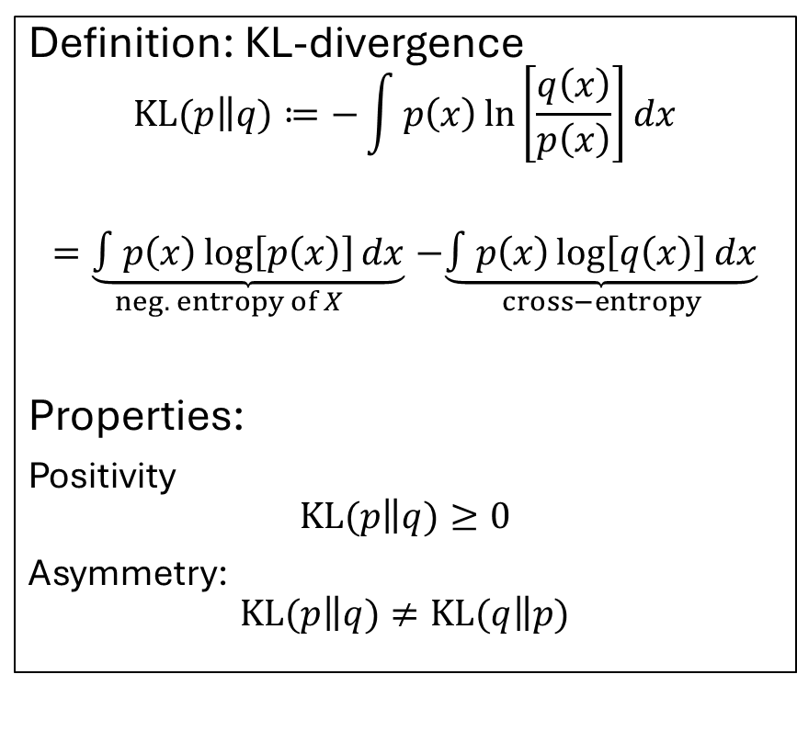
KL-divergence
Let p(x) be the true distribution (of X, potentially unknown) which we seek to approximate with some distribution q(x)
We may ask, then, how much information from X is retained by the approximation
This gives rise to the concept of relative entropy
Relative entropy is defined by the Kullback-Leibler (KL) divergence
Definition: KL-divergence
$$KL(p\left\|q)\right.≔−\int{p\left(x\right)\ln\left[\frac{q\left(x\right)}{p\left(x\right)}\right]dx}$$
$$\underset{neg. entropy of X}{=\underbrace{∫p\left(x\right)\log\left[p\left(x\right)\right]dx}}−\underset{cross−entropy}{\underbrace{∫p\left(x\right)\log\left[q\left(x\right)\right]dx}}$$
Properties:
Positivity
$$KL(p\left\|q)\right.≥0$$
Asymmetry:
$$KL(p\left\|q)\right.≠KL(q\left\|p)\right.$$
Kullback & Leibler (1951)

Slide 17
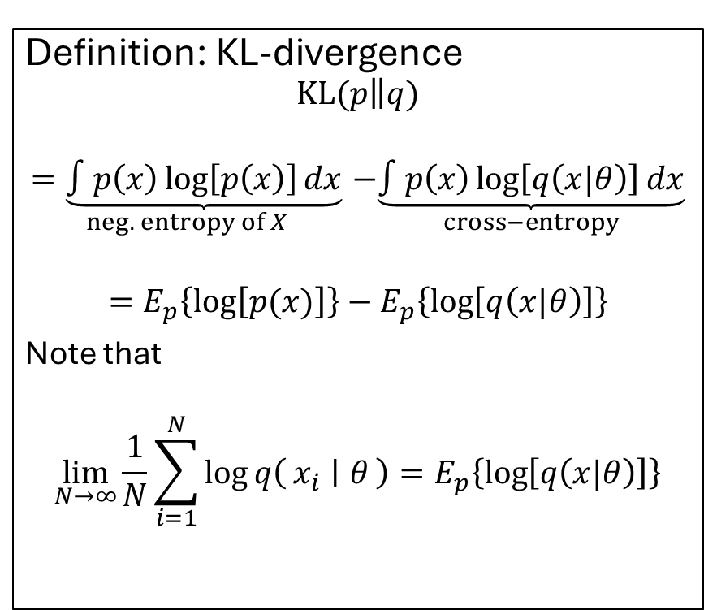
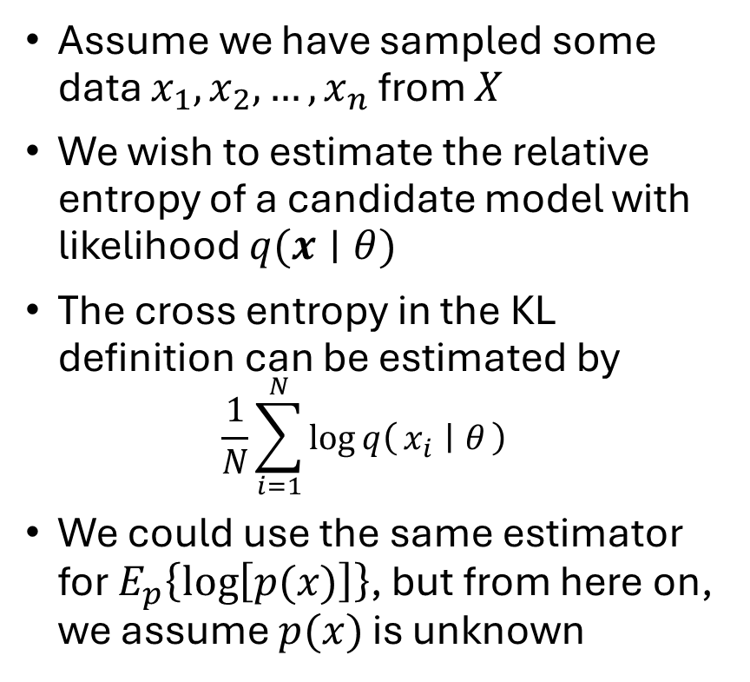
Estimating KL-divergence
Assume we have sampled some data $x_{1}, x_{2}, …, x_{n}$from $X$
We wish to estimate the relative entropy of a candidate model with likelihood $q(x∣θ)$
The cross entropy in the KL definition can be estimated by $\frac{1}{N}\sum_{i=1}^{N}{\log{q\left(x_{i} ∣ θ\right)}}$
We could use the same estimator for $E_{p}\left\{\log\left[p(x)\right]\right\}$, but from here on, we assume $p(x)$ is unknown
Definition: KL-divergence
$$KL(p\left\|q)\right.$$
$$\underset{neg. entropy of X}{=\underbrace{∫p\left(x\right)\log\left[p\left(x\right)\right]dx}}−\underset{cross−entropy}{\underbrace{∫p\left(x\right)\log\left[q\left(x|θ\right)\right]dx}}$$
$$=E_{p}\left\{\log\left[p(x)\right]\right\}−E_{p}\left\{\log\left[q\left(x|θ\right)\right]\right\}$$
Note that
$$\lim_{N→∞}{\frac{1}{N}\sum_{i=1}^{N}{\log{q\left(x_{i} ∣ θ\right)}}}=E_{p}\left\{\log\left[q\left(x|θ\right)\right]\right\}$$

Slide 18
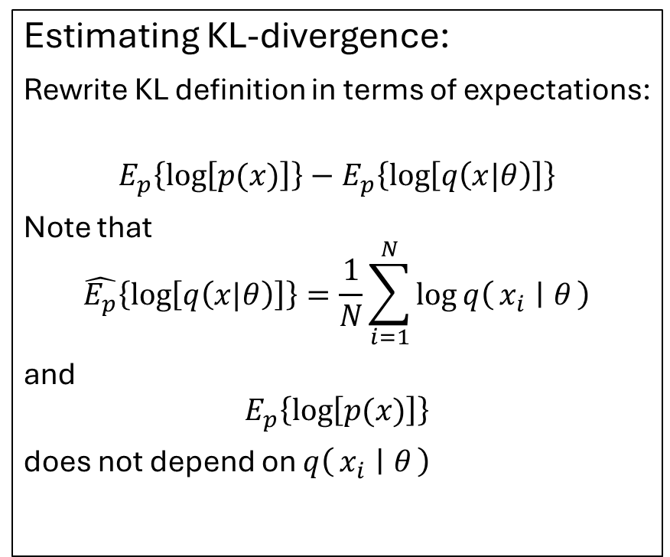
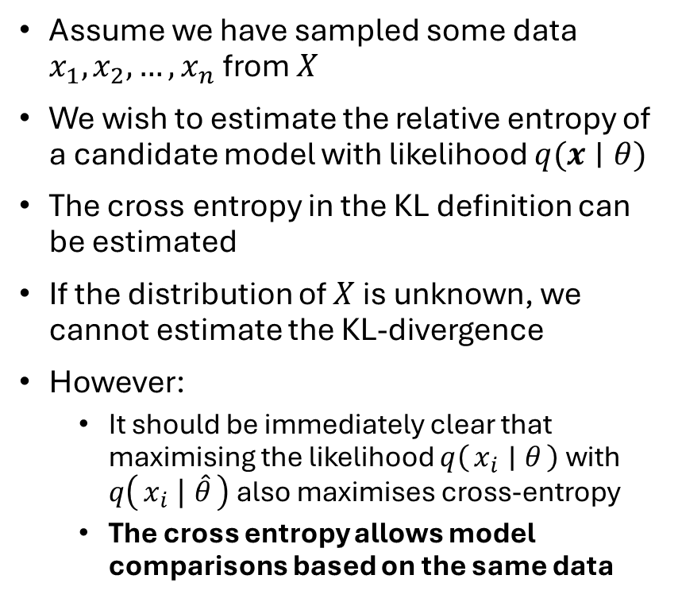
An information criterion
Assume we have sampled some data $x_{1}, x_{2}, …, x_{n}$from $X$
We wish to estimate the relative entropy of a candidate model with likelihood $q(x∣θ)$
The cross entropy in the KL definition can be estimated
If the distribution of $X$ is unknown, we cannot estimate the KL-divergence
However:
It should be immediately clear that maximising the likelihood $q\left(x_{i} ∣ θ\right)$ with $q\left(x_{i} ∣ \hat{θ}\right)$ also maximises cross-entropy
The cross entropy allows model comparisons based on the same data
Estimating KL-divergence:
Rewrite KL definition in terms of expectations:
$$E_{p}\left\{\log\left[p(x)\right]\right\}−E_{p}\left\{\log\left[q\left(x|θ\right)\right]\right\}$$
Note that
$$\hat{E_{p}}\left\{\log\left[q\left(x|θ\right)\right]\right\}=\frac{1}{N}\sum_{i=1}^{N}{\log{q\left(x_{i} ∣ θ\right)}}$$
and
$$E_{p}\left\{\log\left[p(x)\right]\right\}$$
does not depend on $q\left(x_{i} ∣ θ\right)$
Akaike (1974)

Slide 19
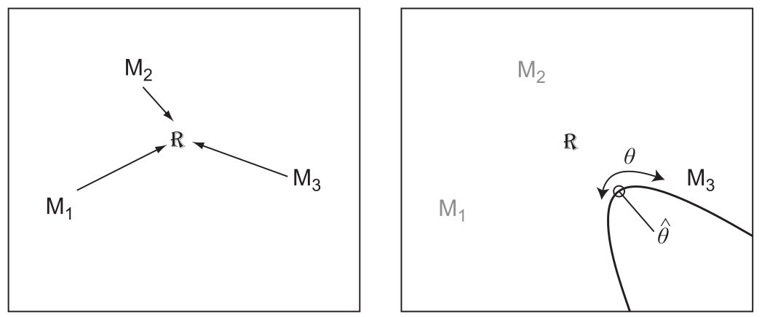
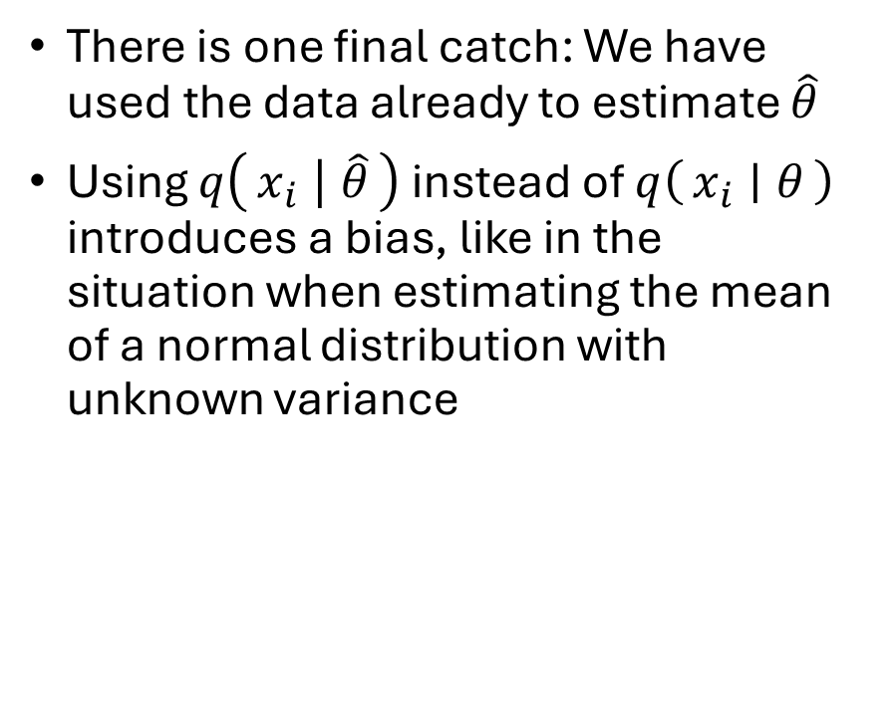
Akaike information criterion
There is one final catch: We have used the data already to estimate $\hat{θ}$
Using $q\left(x_{i} ∣ \hat{θ}\right)$ instead of $q\left(x_{i} ∣ θ\right)$ introduces a bias, like in the situation when estimating the mean of a normal distribution with unknown variance

Slide 20
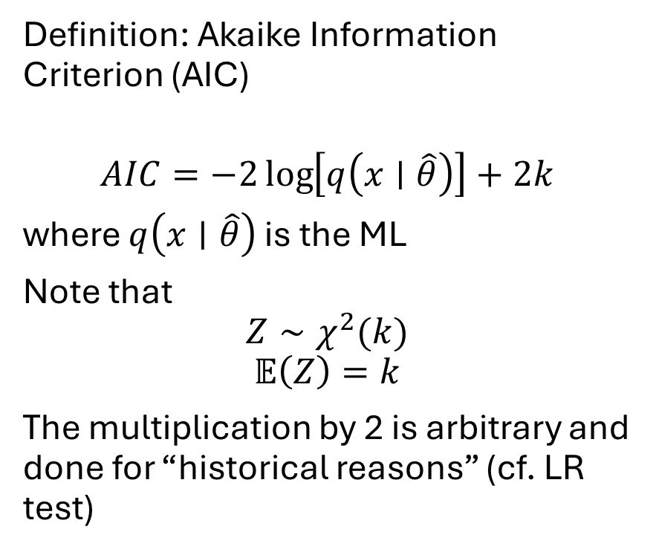
Akaike information criterion
Akaike has shown that (under certain conditions) this bias follows a chi-square distribution with the degree of freedom equal to the number of restricted parameters
By introducing the penalty term, which is motivated by removing the bias associated with , AIC penalizes models with more parameters
Definition: Akaike Information Criterion (AIC)
$$AIC=−2\log\left[q\left(x∣\hat{θ}\right)\right]+2k$$
where $q\left(x∣\hat{θ}\right)$ is the ML
Note that
$$Z∼χ^{2}(k)$$
$$𝔼\left(Z\right)=k$$
The multiplication by 2 is arbitrary and done for “historical reasons” (cf. LR test)
Notes:
Q(): likelihood of the fitted model at the MLE

Slide 21
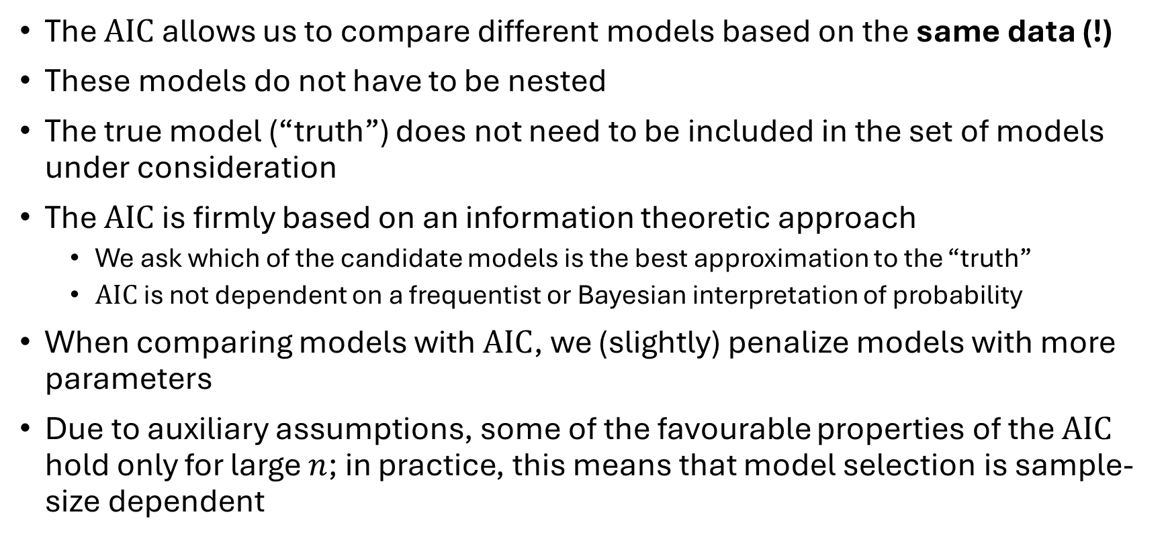
Interim summary
The $AIC$ allows us to compare different models based on the same data (!)
These models do not have to be nested
The true model (“truth”) does not need to be included in the set of models under consideration
The $AIC$ is firmly based on an information theoretic approach
We ask which of the candidate models is the best approximation to the “truth”
$AIC$ is not dependent on a frequentist or Bayesian interpretation of probability
When comparing models with $AIC$, we (slightly) penalize models with more parameters
Due to auxiliary assumptions, some of the favourable properties of the $AIC$ hold only for large $n$; in practice, this means that model selection is sample-size dependent

Slide 22
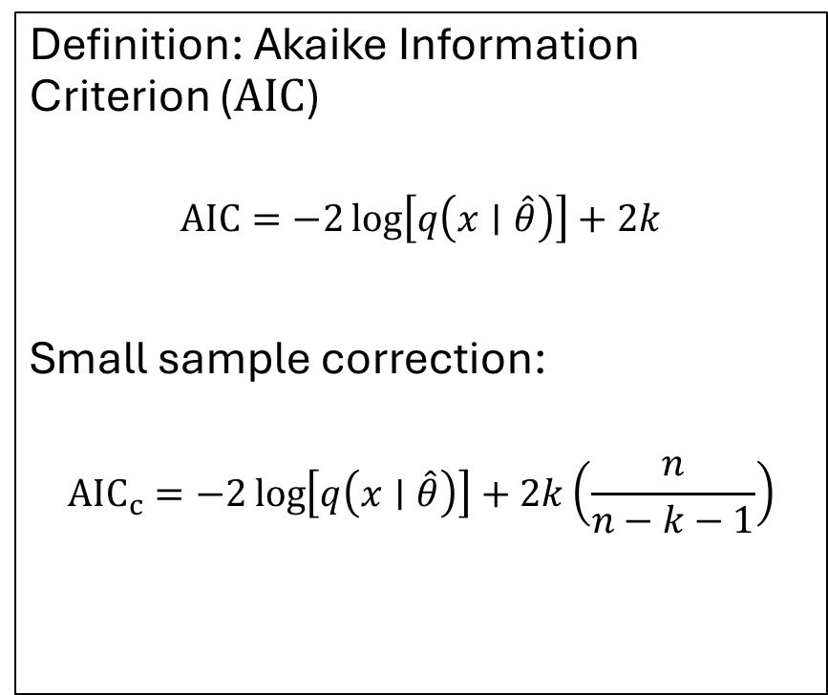
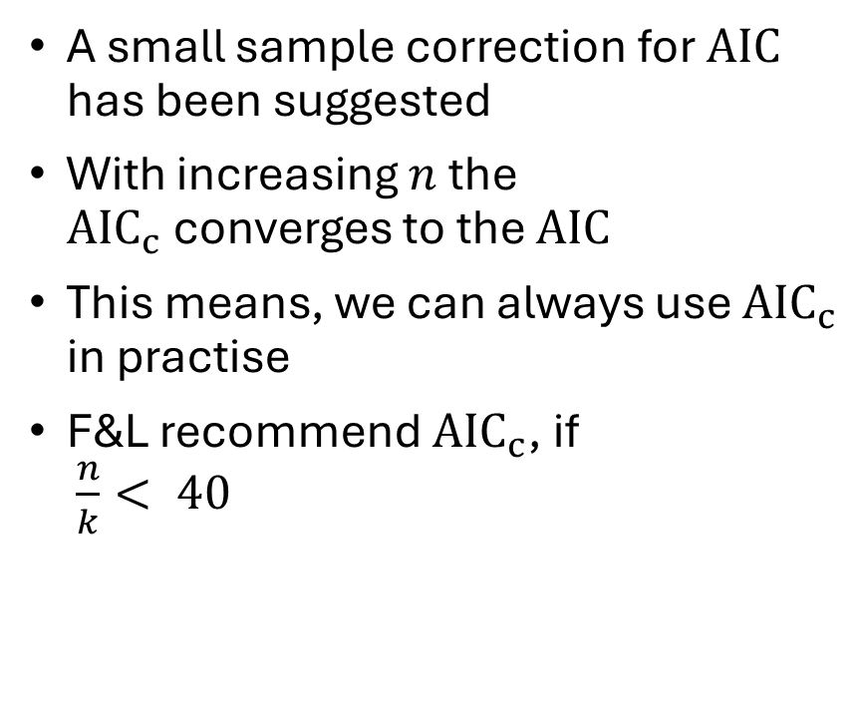
Correction for small samples
A small sample correction for $AIC$ has been suggested
With increasing $n$ the $AIC_{c}$converges to the $AIC$
This means, we can always use $AIC_{c}$ in practise
F&L recommend $AIC_{c}$, if $\frac{n}{k}< 40$
Definition: Akaike Information Criterion ($AIC$)
$$AIC=−2\log\left[q\left(x∣\hat{θ}\right)\right]+2k$$
Small sample correction:
$${AIC}_{c}=−2\log\left[q\left(x∣\hat{θ}\right)\right]+2k\left(\frac{n}{n−k−1}\right)$$

Slide 23
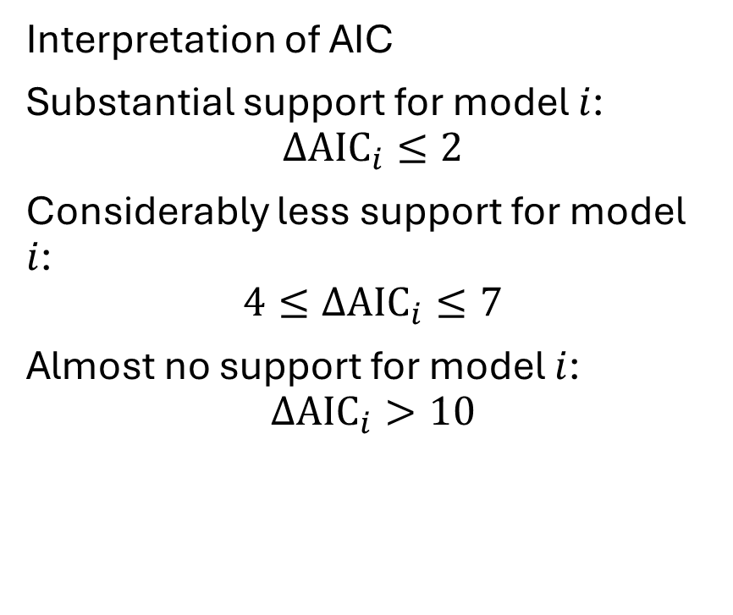
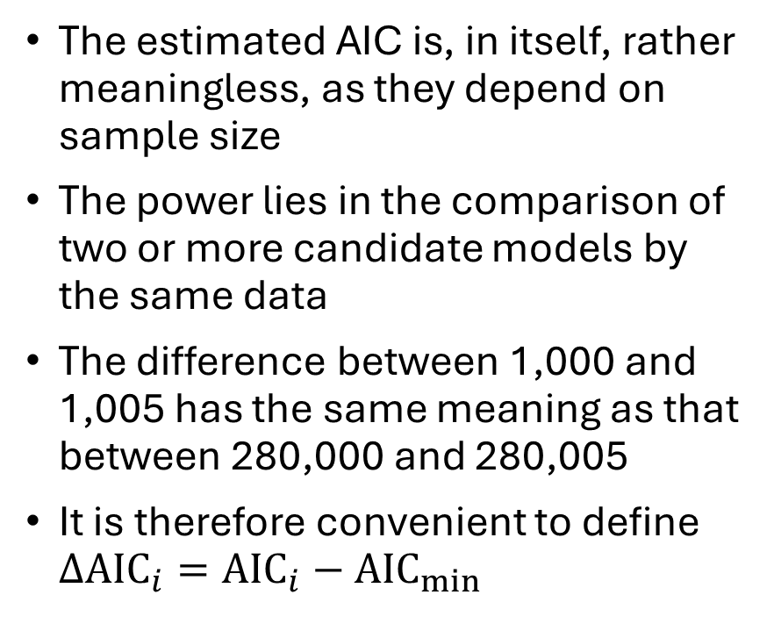
AIC in practise
The estimated AIC is, in itself, rather meaningless, as they depend on sample size
The power lies in the comparison of two or more candidate models by the same data
The difference between 1,000 and 1,005 has the same meaning as that between 280,000 and 280,005
It is therefore convenient to define $ΔAIC_{i}=AIC_{i}−AIC_{min}$
Interpretation of AIC
Substantial support for model $i$:
$$ΔAIC_{i}≤2$$
Considerably less support for model $i$:
$$4≤ΔAIC_{i}≤7$$
Almost no support for model $i$:
$$ΔAIC_{i}>10$$

Slide 24
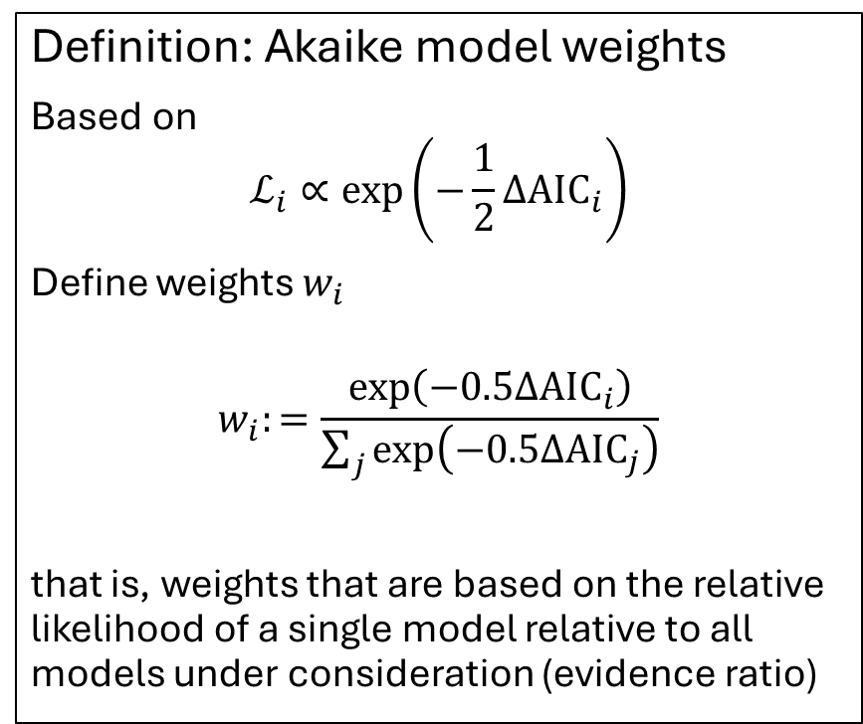
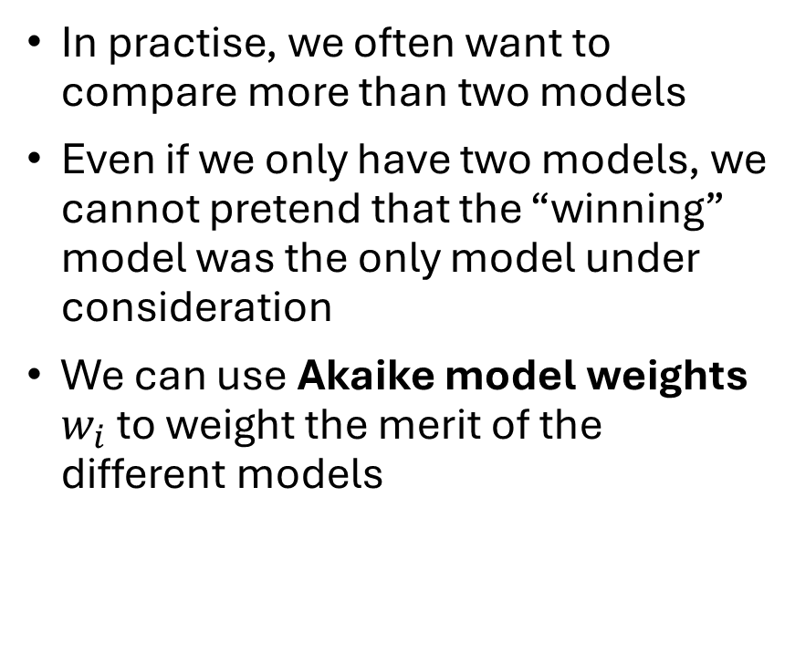
Multi-model comparisons
In practise, we often want to compare more than two models
Even if we only have two models, we cannot pretend that the “winning” model was the only model under consideration
We can use Akaike model weights $w_{i}$ to weight the merit of the different models
Definition: Akaike model weights
Based on
$$ℒ_{i}∝\exp\left(−\frac{1}{2}ΔAIC_{i}\right)$$
Define weights $w_{i}$
$$w_{i}:=\frac{\exp\left(−0.5ΔAIC_{i}\right)}{\sum_{j}{\exp\left(−0.5ΔAIC_{j}\right)}}$$
that is, weights that are based on the relative likelihood of a single model relative to all models under consideration (evidence ratio)

Slide 25
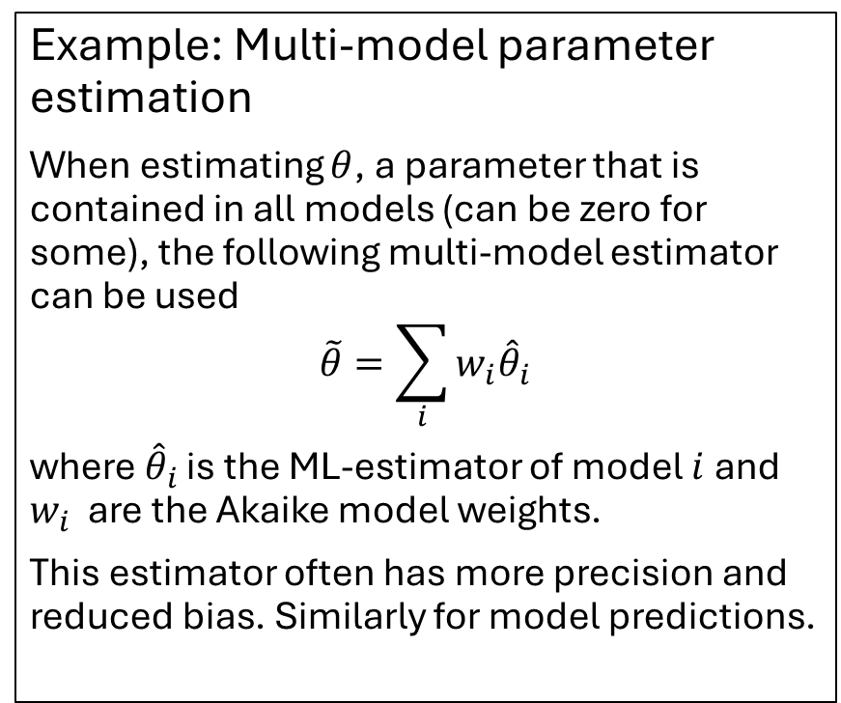
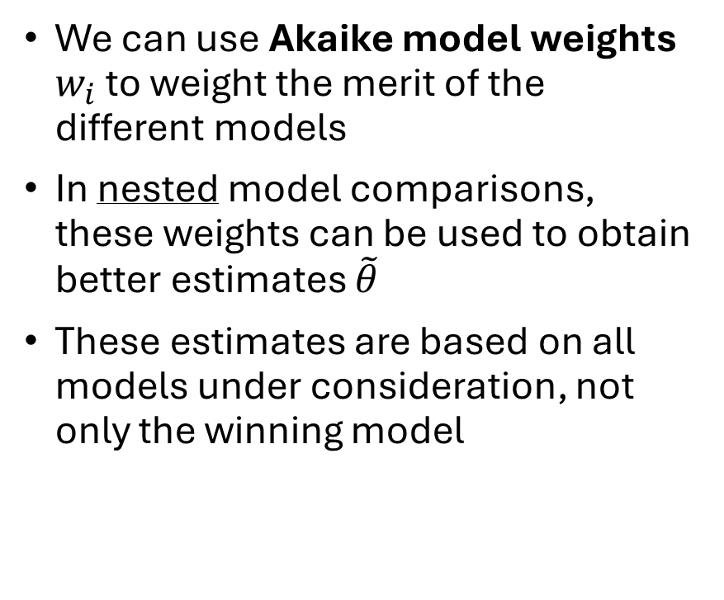
Multi-model comparisons
We can use Akaike model weights $w_{i}$ to weight the merit of the different models
In nested model comparisons, these weights can be used to obtain better estimates $\tilde{θ}$
These estimates are based on all models under consideration, not only the winning model
Example: Multi-model parameter estimation
When estimating $θ$, a parameter that is contained in all models (can be zero for some), the following multi-model estimator can be used
$$\tilde{θ}=\sum_{i}{w_{i}{\hat{θ}}_{i}}$$
where ${\hat{θ}}_{i}$ is the ML-estimator of model $i$ and $w_{i}$ are the Akaike model weights.
This estimator often has more precision and reduced bias. Similarly for model predictions.

Slide 26

Corrected AIC
When using AIC in small samples (more speficially: if the number of parameters is relatively large in comparison to the number of data point), one should use the corrected AIC, AIC_{c}
As the AIC_{c} approximates AIC with increasing sample size, it is sometimes recommended to always use AIC_{c}
Definition: AIC_{c}
$$AIC_{c}≔−2\ln\left(ℒ\right)+2K\left(\frac{N}{N−K−1}\right)$$

Slide 27
Leave-one-out-cross-validation (LOO-CV)
A (perhaps) more intuitive approach to estimating out-of-sample predictive power: test it
For N obs:
For (i in N):
Fit(data[-i])
Pred(data[i])
I.e., evaluate model only on untrained data
Can be very Expensive!
For Bayesian models we can approximate it with Pareto-smoothed importance sampling (PSIS)
During model sampling, we save the likelihood of each observation given the current set of parameter estimates
This let's us estimate how much each datapoint contributes to the posterior, and approximate the effect of leaving out said data point

Slide 28
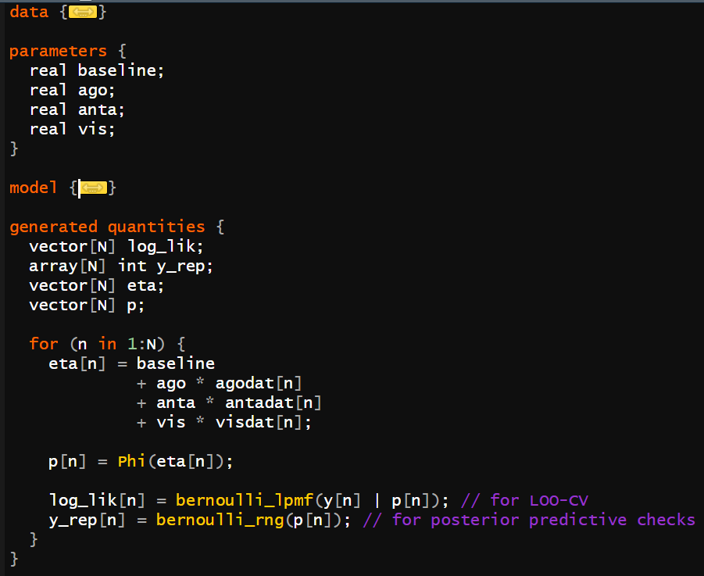
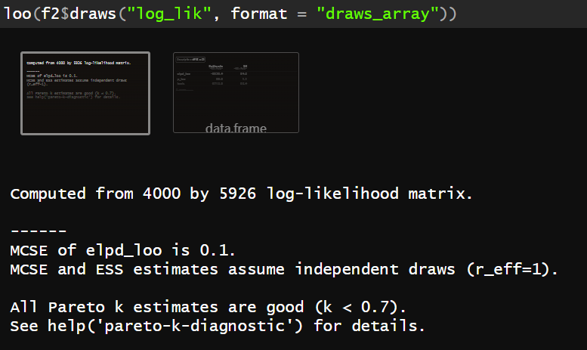
Practice task: PSIS-LOO-CV
Install the “loo” package
Fit two versions of the SDT type model we worked on last Friday
One, where the visual predictor is assumed to be a linear predictor on the latent scale
One, where we fit an independent predictor to each of the 4 levels: (-2, -1, +1, +2)
Compare models with LOO-CV; Should we prefer the simpler or more complex model?

Slide 29
AIC and LOO-CV
AIC and LOO-CV both approach the question of predictive performance on new data from true data-generating process
Both correct for overfitting;
AIC: correction by +2K
LOO-CV: empirical hold out
They are asymptotically equivalent
LOO-CV:
Leave out 1 data point
Fit model to remaining data, and predict left-out data; compare to actual obs
Repeat for all data points
Expensive, but can be cheaply approximated with pareto-smoothed importance sampling (PSIS-LOO)

Slide 30
Model comparison
Non-nested model tests: Bayes factor

Slide 31
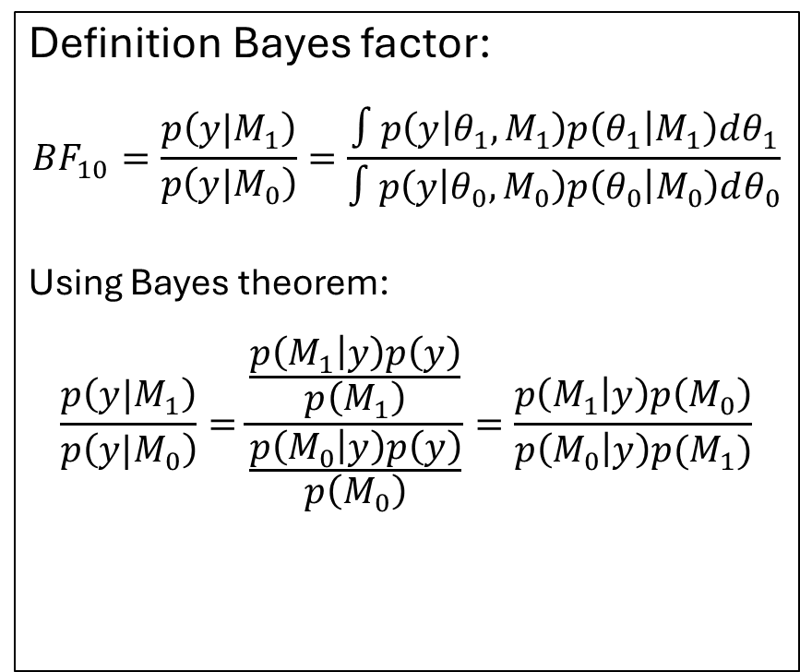
Bayes factor
In a pairwise comparison, the Bayes factor is defined as the likelihood ratio of the two models under consideration
Unlike the frequentist LR ratio test which uses ML, the Bayes factor is based on the integral over the parameter space
Using Bayes’ theorem, the ratio can be expressed by the ratio of the posterior distributions
Definition Bayes factor:
$$BF_{10}=\frac{p\left(y|M_{1}\right)}{p\left(y|M_{0}\right)}=\frac{∫p\left(y | θ_{1},M_{1}\right)p\left(θ_{1} | M_{1}\right)dθ_{1}}{∫p\left(y | θ_{0},M_{0}\right)p\left(θ_{0} | M_{0}\right)dθ_{0}}$$
Using Bayes theorem:
$$\frac{p\left(y|M_{1}\right)}{p\left(y|M_{0}\right)}=\frac{\frac{p\left(M_{1} | y\right)p\left(y\right)}{p\left(M_{1}\right)}}{\frac{p\left(M_{0} | y\right)p\left(y\right)}{p\left(M_{0}\right)}}=\frac{p\left(M_{1} | y\right)p\left(M_{0}\right)}{p\left(M_{0} | y\right)p(M_{1})}$$

Slide 32
Bayes factor
Bayes factor is the ratio of marginal likelihood
In contrast to the maximal likelihood, the marginal likelihood is the average fit of the model, weighted by the prior
Naturally accounts for model complexity
Directly tells us the us how much more likely M1 is compared to M2 for producing the observed data
Definition Bayes factor:
$$BF_{10}=\frac{p\left(y|M_{1}\right)}{p\left(y|M_{0}\right)}=\frac{∫p\left(y | θ_{1},M_{1}\right)p\left(θ_{1} | M_{1}\right)dθ_{1}}{∫p\left(y | θ_{0},M_{0}\right)p\left(θ_{0} | M_{0}\right)dθ_{0}}$$
Using Bayes theorem:
$$\frac{p\left(y|M_{1}\right)}{p\left(y|M_{0}\right)}=\frac{\frac{p\left(M_{1} | y\right)p\left(y\right)}{p\left(M_{1}\right)}}{\frac{p\left(M_{0} | y\right)p\left(y\right)}{p\left(M_{0}\right)}}=\frac{p\left(M_{1} | y\right)p\left(M_{0}\right)}{p\left(M_{0} | y\right)p(M_{1})}$$

Slide 33
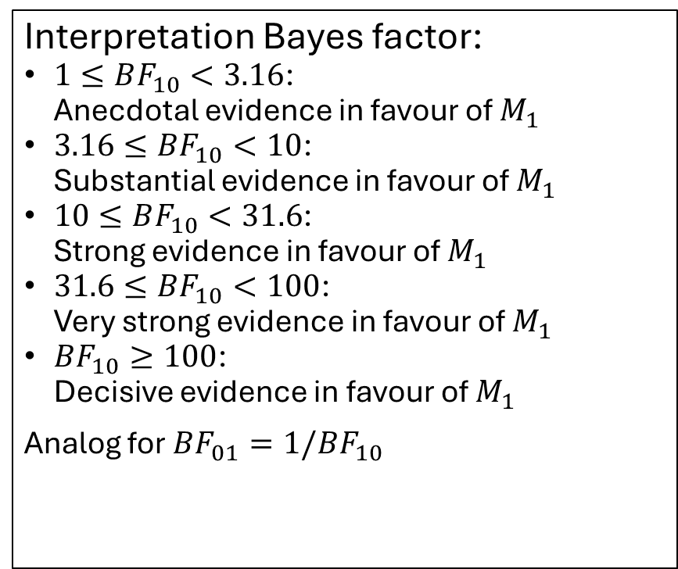
Bayes factor
In a pairwise comparison, the Bayes factor is defined as the likelihood ratio of the two models under consideration
Unlike the frequentist LR ratio test which uses ML, the Bayes factor is based on the integral over the parameter space
For models in which the posterior cannot be solved analytically, we need to approximate the BF
Highly prior-sensitive! Should probably not be used with the type of regularising, minimally informative priors we have used for parameter estimation
Interpretation Bayes factor:
$1≤BF_{10}<3.16$: Anecdotal evidence in favour of $M_{1}$
$3.16≤BF_{10}<10$: Substantial evidence in favour of $M_{1}$
$10≤BF_{10}<31.6$: Strong evidence in favour of $M_{1}$
$31.6≤BF_{10}<100$: Very strong evidence in favour of $M_{1}$
$BF_{10}≥100$: Decisive evidence in favour of $M_{1}$
Analog for $BF_{01}=1/BF_{10}$

Slide 34
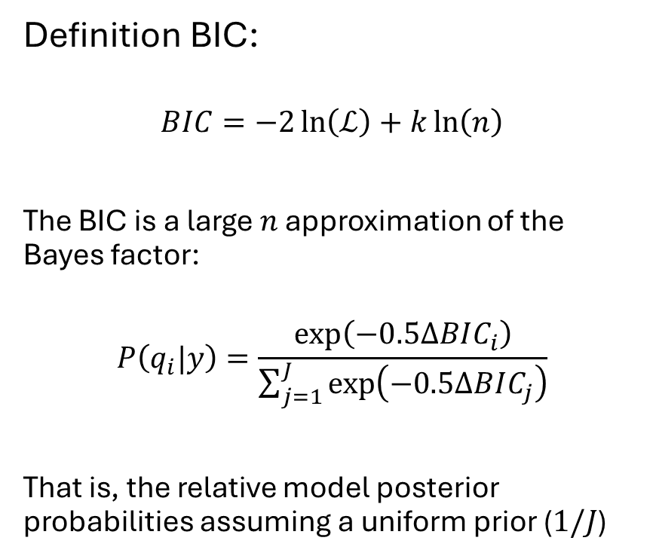
Bayesian information criterion
The Bayesian information criterion (BIC) follows a similar approach as the AIC
However, the BIC is not based on information theory, but firmly grounded in Bayesian inference
The BIC can be used to approximate the Bayes factor, using only the ML
The BIC can be used for model comparison, just like the AIC. In this case, the BIC can be (and is) used in frequentist approaches also
Definition BIC:
$$BIC=−2\ln\left(ℒ\right)+k\ln\left(n\right)$$
The BIC is a large $n$ approximation of the Bayes factor:
$$P\left(q_{i}|y\right)=\frac{\exp\left(−0.5ΔBIC_{i}\right)}{\sum_{j=1}^{J}{\exp\left(−0.5ΔBIC_{j}\right)}}$$
That is, the relative model posterior probabilities assuming a uniform prior ($1/J$)

Slide 35
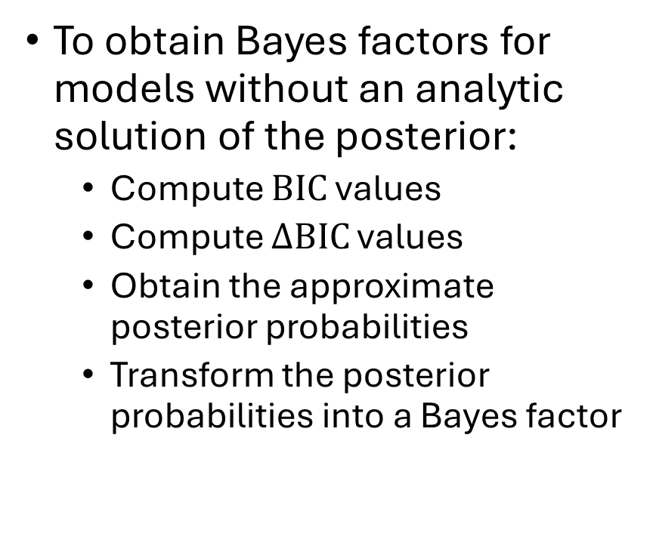
Approximating Bayes factors by BIC
To obtain Bayes factors for models without an analytic solution of the posterior:
Compute $BIC$ values
Compute $ΔBIC$ values
Obtain the approximate posterior probabilities
Transform the posterior probabilities into a Bayes factor
bic2bf <- function(BIC) {
dBIC <- BIC - min(BIC) # delta BIC
posterior <- exp(-.5*dBIC)/
sum(exp(-.5*dBIC))
BF <- posterior / min(posterior)
data.frame(BIC, posterior, BF)
}
bic2bf(BIC=c(2.32, 5.45, 7.13, 1.91))
BIC posterior BF
1 2.32 0.39574517 11.078430
2 5.45 0.08274557 2.316367
3 7.13 0.03572213 1.000000
4 1.91 0.48578712 13.599051

Slide 36
Model comparison
Beyond parameter count: Minimum description length

Slide 37
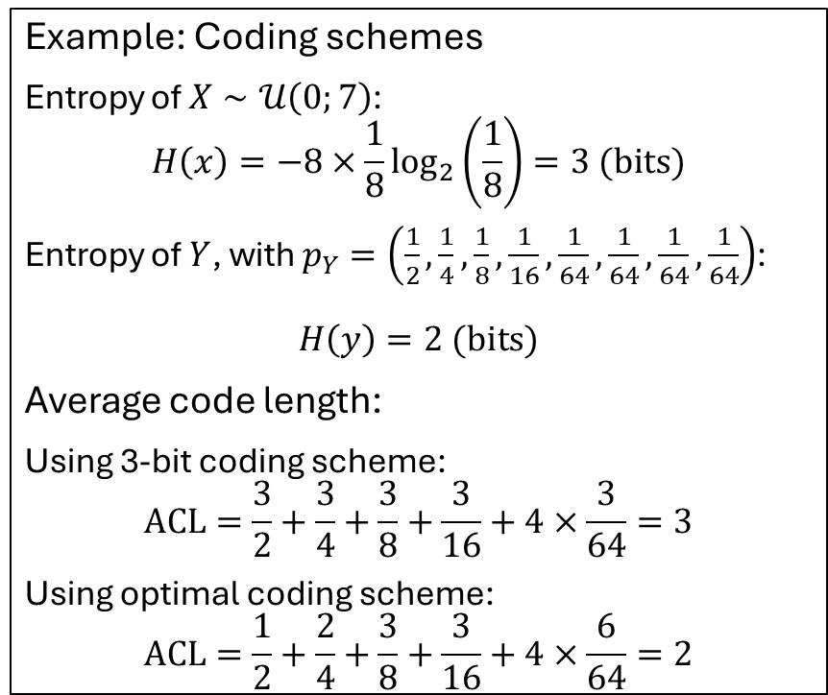
Source coding theorem
Minimum description length is, like AIC, an information theory derived quantity
In addition to entropy, the coding scheme determines, how much information we need to transmit to a receiver
Optimal coding:
More likely events should have shorter coding length
Longer coding lengths for less likely events
Example: Coding schemes
Entropy of $X∼𝒰\left(0;7\right)$:
$$H\left(x\right)=−8×\frac{1}{8}\log_{2}\left(\frac{1}{8}\right)=3 (bits)$$
Entropy of $Y$, with $p_{Y}=\left(\frac{1}{2},\frac{1}{4},\frac{1}{8},\frac{1}{16},\frac{1}{64},\frac{1}{64},\frac{1}{64},\frac{1}{64}\right)$:
$$H\left(y\right)=2 (bits)$$
Average code length:
Using 3-bit coding scheme:
$$ACL=\frac{3}{2}+\frac{3}{4}+\frac{3}{8}+\frac{3}{16}+4×\frac{3}{64}=3$$
Using optimal coding scheme:
$$ACL=\frac{1}{2}+\frac{2}{4}+\frac{3}{8}+\frac{3}{16}+4×\frac{6}{64}=2$$
Shannon, 1948

Slide 38
Source coding theorem
Optimal coding:
More likely events should have shorter coding length
Longer coding lengths for less likely events
However, optimal coding requires knowledge of the pmf/likelihood
Without that knowledge, we need to resort to less efficient coding schemes
Example: Coding schemes
Entropy of $X∼𝒰\left(0;7\right)$:
$$H\left(x\right)=−8×\frac{1}{8}\log_{2}\left(\frac{1}{8}\right)=3 (bits)$$
Entropy of $Y$, with $p_{Y}=\left(\frac{1}{2},\frac{1}{4},\frac{1}{8},\frac{1}{16},\frac{1}{64},\frac{1}{64},\frac{1}{64},\frac{1}{64}\right)$:
$$H\left(y\right)=2 (bits)$$
Average code length:
Using 3-bit coding scheme:
$$ACL=\frac{3}{2}+\frac{3}{4}+\frac{3}{8}+\frac{3}{16}+4×\frac{3}{64}=3$$
Using optimal coding scheme:
$$ACL=\frac{1}{2}+\frac{2}{4}+\frac{3}{8}+\frac{3}{16}+4×\frac{6}{64}=2$$
Shannon, 1948

Slide 39
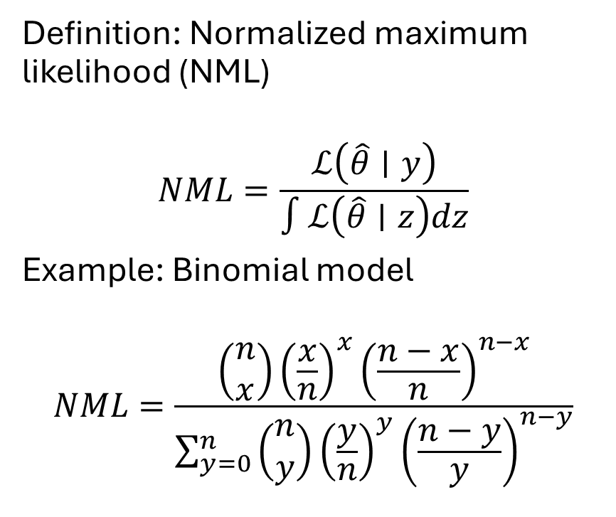
Minimum description length
So far, we have exclusively focused on the number of parameters as a source of complexity
However, models differ in their inherent ability to account for data
Also, we have so far assumed that there is a true distribution that generated the data
Using minimum description length for model comparison, we take inherent complexity into account and dispose of the true distribution assumption
Definition: Normalized maximum likelihood (NML)
$$NML=\frac{ℒ\left(\hat{θ}∣y\right)}{∫ℒ\left(\hat{θ}∣z\right)dz}$$
Example: Binomial model
$$NML=\frac{\left(\begin{aligned}n \\ x\end{aligned}\right){\left(\frac{x}{n}\right)}^{x}{\left(\frac{n−x}{n}\right)}^{n−x}}{\sum_{y=0}^{n}{\left(\begin{aligned}n \\ y\end{aligned}\right){\left(\frac{y}{n}\right)}^{y}{\left(\frac{n−y}{y}\right)}^{n−y}}}$$

Slide 40
Further considerations
Parameter identifiability and model testability

Slide 41
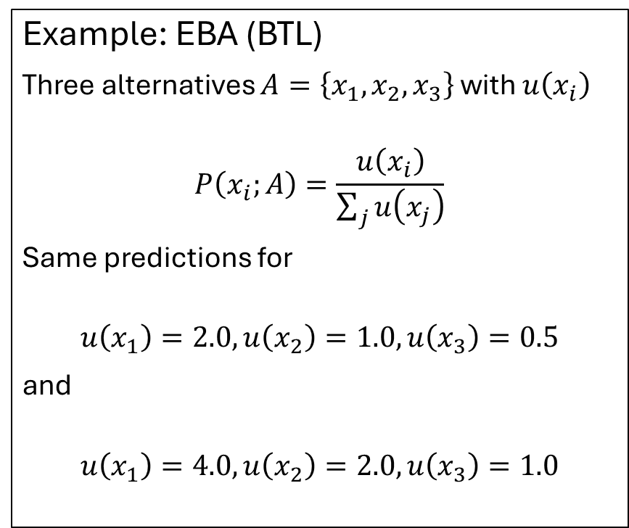
Parameter identifiability
There are situations in which parameters cannot be uniquely identified
Scaling: In some models (e.g., DDM, LBA, EBA) one or more parameters need to be fixed, so that the remaining ones are identifiable
Without this restriction, the solution is not unique; there can be infinitely many combinations that provide the same quality of fit and predictions
Example: EBA (BTL)
Three alternatives $A=\left\{x_{1},x_{2},x_{3}\right\}$ with $u\left(x_{i}\right)$
$$P\left(x_{i};A\right)=\frac{u\left(x_{i}\right)}{\sum_{j}{u\left(x_{j}\right)}}$$
Same predictions for
$$u\left(x_{1}\right)=2.0, u\left(x_{2}\right)=1.0, u\left(x_{3}\right)=0.5$$
and
$$u\left(x_{1}\right)=4.0, u\left(x_{2}\right)=2.0, u\left(x_{3}\right)=1.0$$

Slide 42
Model testability
The question if a model is testable is a different but related issue
Testability issues arises most frequently, if the number of datapoints is low in relation to the number of free parameters
If the number of free data points equals the number of free parameters, those parameters are identifiable, but the model is not testable
Examples:
Polynomial regression in which the grade of the polynomial is one less than data points
Signal detection theory: In an experiment with signal and noise trials there are only two free data points, the equal variance SDT has exactly two free parameters (hits and False alarm; since both rows must sum to 1, misses and correct rejections are given). The model is therefore not testable

Slide 43
Summary
After fitting a model to data, we want to know how good the fit is
Quality of fit is best assessed in comparison to another model
This can be done via significance tests for nested models
For non-nested models, other criteria (AIC, BIC) are needed
Model comparisons allow for testing the influence of single parameters
In addition, we need to pay attention to parameter identifiability and if the model is testable at all

