Slide 1
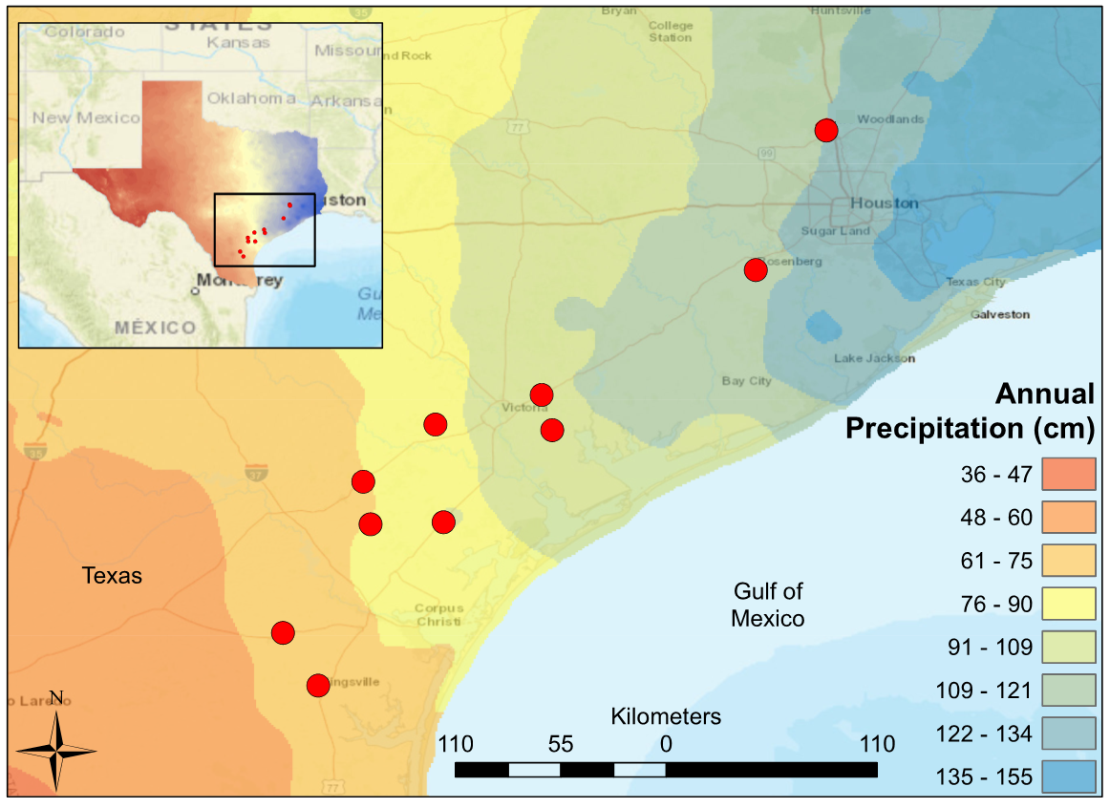
Notes:
Figure 1: Map of South-Central Texas, where 10 USGS gaged Streams were sampled in the Spring of 2017. An annual precipitation overlay indicates that the sample sites span a gradient from 61 cm/yr in the Southwest to 134 cm/yr in the Northeast.

