Slide 1
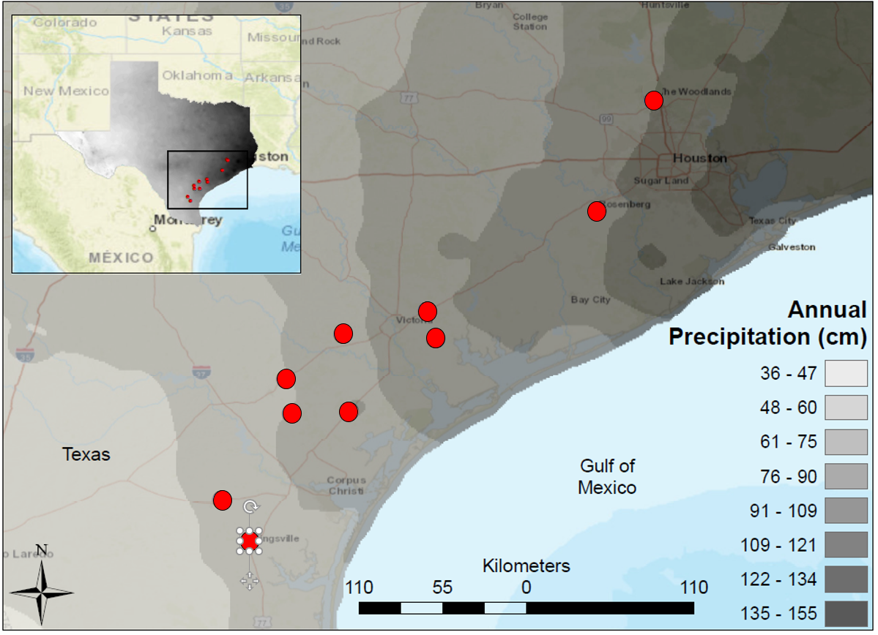
Notes:
Map of South Central Texas, where 10 USGS gaged Streams were sampled in the Spring of 2017. An annual precipitation overlay indicate that the sample sites span a gradient from 61 cm/yr in the Southwest to 134 cm/yr in the Northeast.

Slide 2
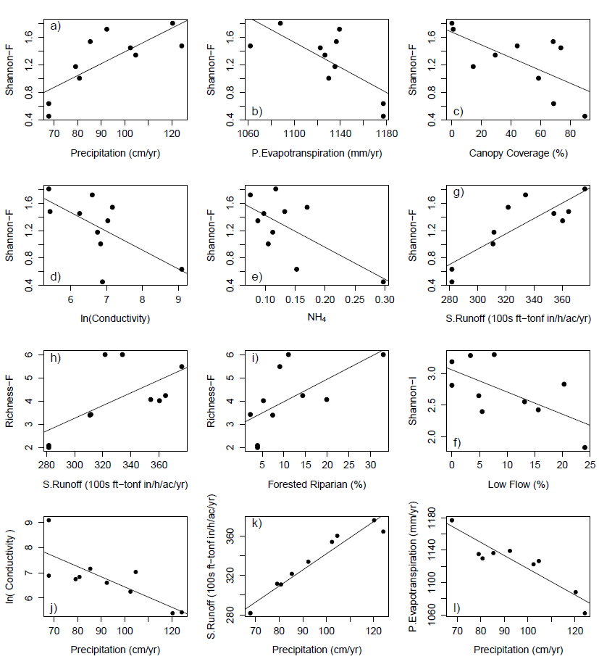
Notes:
Strongest relationships between environmental variables (a-f) Fish Shannon Diversity, (h,i) Fish Rarified Richness, (f) Invertebrate Shannon Diversity, (j-l) Annual Precipitation. Fish diversity increases with increasing precipitation and Forested Riparian. Fish diversity decreases as NH4+ increases. Invertebrate diversity decreases as Low Flow (LFPP) increases. Conductivity, Surface Runoff, and Potential Evapotranspiration covary with precipitation and fish diversity.

Slide 3
Rarified Richness - Fish
Predictor | Slope | df | R² | F statistic | p-value | p < .05
PET | -0.02 | 8 | 0.27 | 2.93 | 0.13
Precip. | 0.04 | 8 | 0.32 | 3.77 | 0.09
RH | 0.33 | 8 | 0.18 | 1.81 | 0.22
Av.Flow | 0.02 | 8 | 0.30 | 3.47 | 0.10
Flash.I | 0.99 | 8 | 0.02 | 0.16 | 0.70
HFPP | -0.42 | 8 | 0.00 | 0.00 | 0.95
LFPP | -0.10 | 8 | 0.35 | 4.40 | 0.07
Bas.Dev | 0.00 | 8 | 0.00 | 0.01 | 0.92
Bas.forest | 0.08 | 8 | 0.33 | 3.96 | 0.08
Bas.Plant | 0.01 | 8 | 0.03 | 0.22 | 0.65
Rip.forest | 0.10 | 8 | 0.40 | 5.42 | 0.05 | *
S.runoff | 0.03 | 8 | 0.41 | 5.67 | 0.04 | *
Soil.Org | 0.77 | 8 | 0.09 | 0.79 | 0.40
Soil.Perm | -0.14 | 8 | 0.01 | 0.06 | 0.81
DO | -0.14 | 8 | 0.03 | 0.26 | 0.63
ln(Cond) | -0.71 | 8 | 0.26 | 2.81 | 0.13
ln(NO3-) | 0.01 | 8 | 0.00 | 0.00 | 0.99
NH₄⁺ | -10.67 | 8 | 0.23 | 2.34 | 0.16
pH | -0.16 | 8 | 0.00 | 0.02 | 0.90
PO₄⁻ | -0.34 | 8 | 0.15 | 1.43 | 0.27
T.water | -0.15 | 8 | 0.10 | 0.86 | 0.38
Turbidity | 0.05 | 8 | 0.13 | 1.23 | 0.30
Bank.H | -4.21 | 8 | 0.33 | 3.98 | 0.08
Canopy | -0.02 | 8 | 0.31 | 3.55 | 0.10
d50 | -0.02 | 8 | 0.02 | 0.18 | 0.68
Rosgen | 0.03 | 8 | 0.00 | 0.04 | 0.85
Notes:
Relationships between climate, basin, and local drivers and fish community rarified richness (left).

Slide 4
Shannon Diversity - Fish
Predictor | Slope | df | R² | F statistic | p-value | p < .05
PET | -0.01 | 8 | 0.52 | 8.60 | 0.02 | *
Precip. | 0.02 | 8 | 0.60 | 12.10 | 0.01 | *
RH | 0.12 | 8 | 0.24 | 2.49 | 0.15
Av.Flow | 0.01 | 8 | 0.16 | 1.56 | 0.25
Flash.I | 0.34 | 8 | 0.02 | 0.19 | 0.67
HFPP | 0.75 | 8 | 0.02 | 0.17 | 0.69
LFPP | -0.03 | 8 | 0.34 | 4.10 | 0.08
Bas.Dev | 0.00 | 8 | 0.04 | 0.30 | 0.60
Bas.forest | 0.02 | 8 | 0.27 | 2.98 | 0.12
Bas.Plant | 0.00 | 8 | 0.06 | 0.53 | 0.49
Rip.forest | 0.03 | 8 | 0.36 | 4.55 | 0.07
S.runoff | 0.01 | 8 | 0.72 | 20.22 | 2.0E-03 | *
Soil.Org | 0.28 | 8 | 0.12 | 1.10 | 0.32
Soil.Perm | 0.01 | 8 | 0.00 | 0.00 | 0.95
DO | -0.02 | 8 | 0.01 | 0.06 | 0.81
ln(Cond) | -0.27 | 8 | 0.41 | 5.46 | 0.05 | *
Ln(NO3-) | 0.00 | 8 | 0.00 | 0.00 | 1.00
NH4+ | -4.65 | 8 | 0.45 | 6.42 | 0.04 | *
pH | -0.03 | 8 | 0.00 | 0.01 | 0.94
PO4- | -0.14 | 8 | 0.26 | 2.79 | 0.13
T.water | -0.07 | 8 | 0.20 | 1.99 | 0.20
Turbidity | 0.02 | 8 | 0.21 | 2.10 | 0.19
Bank.H | -1.13 | 8 | 0.25 | 2.61 | 0.14
Canopy | -0.01 | 8 | 0.45 | 6.49 | 0.03 | *
d50 | 0.00 | 8 | 0.02 | 0.13 | 0.73
Rosgen | 0.02 | 8 | 0.03 | 0.22 | 0.65
Notes:
Relationships between climate, basin, and local drivers and fish community Shannon diversity.

Slide 5
Rarified Richness - Invertebrate
Predictor | Slope | df | R² | F statistic | p-value | p < .05
PET | 0.02 | 8 | 0.01 | 0.04 | 0.84
Precip. | -0.09 | 8 | 0.06 | 0.48 | 0.51
RH | 1.32 | 8 | 0.11 | 0.98 | 0.35
Av.Flow | 0.08 | 8 | 0.12 | 1.05 | 0.34
Flash.I | 10.45 | 8 | 0.08 | 0.70 | 0.43
HFPP | -38.95 | 8 | 0.20 | 1.99 | 0.20
LFPP | -0.49 | 8 | 0.31 | 3.53 | 0.10
Bas.Dev | -0.07 | 8 | 0.05 | 0.40 | 0.55
Bas.forest | 0.28 | 8 | 0.16 | 1.51 | 0.25
Bas.Plant | -0.05 | 8 | 0.02 | 0.18 | 0.68
Rip.forest | 0.30 | 8 | 0.14 | 1.30 | 0.29
S.runoff | -0.04 | 8 | 0.03 | 0.26 | 0.62
Soil.Org | -3.18 | 8 | 0.06 | 0.49 | 0.50
Soil.Perm | -1.14 | 8 | 0.02 | 0.16 | 0.70
DO | -1.90 | 8 | 0.20 | 2.05 | 0.19
ln(Cond) | 0.00 | 8 | 0.19 | 1.93 | 0.20
ln(NO3-) | -1.33 | 8 | 0.03 | 0.25 | 0.63
NH4+ | -2.87 | 8 | 0.00 | 0.00 | 0.95
pH | -5.09 | 8 | 0.08 | 0.67 | 0.44
PO4- | 1.64 | 8 | 0.13 | 1.21 | 0.30
T.water | -0.18 | 8 | 0.01 | 0.04 | 0.84
Turbidity | -0.22 | 8 | 0.08 | 0.74 | 0.41
Bank.H | -12.21 | 8 | 0.10 | 0.93 | 0.36
Canopy | 0.01 | 8 | 0.00 | 0.01 | 0.93
d50 | 0.17 | 8 | 0.06 | 0.54 | 0.48
Rosgen | -0.96 | 8 | 0.20 | 2.01 | 0.19
Notes:
Relationships between climate, basin, and local drivers and Invertebrate community rarified richness (left).

Slide 6
Shannon Index - Invertebrate
Predictor | Slope | df | R² | F statistic | p-value | p < .05
PET | 0.00 | 8 | 0.00 | 0.00 | 0.95
Precip. | 0.00 | 8 | 0.02 | 0.14 | 0.72
RH | 0.10 | 8 | 0.15 | 1.41 | 0.27
Av.Flow | 0.01 | 8 | 0.13 | 1.24 | 0.30
Flash.I | 0.62 | 8 | 0.08 | 0.65 | 0.44
HFPP | -2.08 | 8 | 0.15 | 1.40 | 0.27
LFPP | -0.03 | 8 | 0.41 | 5.59 | 0.05 | *
Bas.Dev | 0.00 | 8 | 0.03 | 0.25 | 0.63
Bas.forest | 0.02 | 8 | 0.15 | 1.39 | 0.27
Bas.Plant | 0.00 | 8 | 0.01 | 0.08 | 0.79
Rip.forest | 0.02 | 8 | 0.13 | 1.20 | 0.30
S.runoff | 0.00 | 8 | 0.00 | 0.03 | 0.86
Soil.Org | -0.18 | 8 | 0.05 | 0.39 | 0.55
Soil.Perm | -0.06 | 8 | 0.01 | 0.10 | 0.75
DO | -0.16 | 8 | 0.36 | 4.55 | 0.07
ln(Cond) | 0.00 | 8 | 0.39 | 5.17 | 0.05
ln(NO3-) | -0.06 | 8 | 0.02 | 0.12 | 0.73
NH4+ | -0.04 | 8 | 0.00 | 0.00 | 0.99
pH | -0.52 | 8 | 0.21 | 2.11 | 0.18
PO4- | 0.10 | 8 | 0.12 | 1.12 | 0.32
T.water | -0.01 | 8 | 0.01 | 0.05 | 0.82
Turbidity | -0.01 | 8 | 0.06 | 0.47 | 0.51
Bank.H | -0.83 | 8 | 0.13 | 1.15 | 0.32
Canopy | 0.00 | 8 | 0.00 | 0.00 | 0.97
d50 | 0.01 | 8 | 0.04 | 0.35 | 0.57
Rosgen | -0.05 | 8 | 0.17 | 1.61 | 0.24
Notes:
Relationships between climate, basin, and local drivers and Invertebrate community rarified richness (left) or Shannon diversity (right).

Slide 7
Annual Precipitation
Predictor | Slope | df | R² | F statistic | p-value | p < .05
NO3+ | 0.27 | 8 | 0.00 | 0.01 | 0.94
PO4- | -4.36 | 8 | 0.13 | 1.16 | 0.31
RH | 3.58 | 8 | 0.11 | 1.00 | 0.35
Av.Flow | 0.13 | 8 | 0.05 | 0.42 | 0.53
Flash.I | -2.50 | 8 | 0.00 | 0.01 | 0.94
HFPP | -0.10 | 8 | 0.00 | 0.00 | 1.00
LFPP | -0.38 | 8 | 0.03 | 0.21 | 0.66
Bas.Dev | 0.55 | 8 | 0.38 | 4.86 | 0.06
Bas.forest | 0.39 | 8 | 0.04 | 0.36 | 0.57
Bas.Plant | 0.17 | 8 | 0.04 | 0.32 | 0.59
Rip.forest | 0.72 | 8 | 0.12 | 1.04 | 0.34
S.runoff | 0.58 | 8 | 0.94 | 122.45 | 4.0E-06 | *
Soil.Org | 11.16 | 8 | 0.10 | 0.87 | 0.38
Soil.Perm | 7.92 | 8 | 0.13 | 1.18 | 0.31
DO | 2.29 | 8 | 0.04 | 0.34 | 0.57
ln(Cond) | -15.18 | 8 | 0.62 | 12.82 | 0.01 | *
Ln(NO3-) | 3.82 | 8 | 0.03 | 0.29 | 0.60
NH4+ | -150.58 | 8 | 0.23 | 2.41 | 0.16
PET | -0.53 | 8 | 0.87 | 52.49 | 8.9E-05 | *
pH | -9.95 | 8 | 0.04 | 0.34 | 0.58
T.water | -3.28 | 8 | 0.25 | 2.63 | 0.14
Turbidity | 1.03 | 8 | 0.27 | 2.94 | 0.12
Bank.H | -14.13 | 8 | 0.02 | 0.16 | 0.70
Canopy | -0.30 | 8 | 0.23 | 2.43 | 0.16
d50 | -0.06 | 8 | 0.00 | 0.01 | 0.92
Rosgen | 0.42 | 8 | 0.01 | 0.04 | 0.84
Notes:
Relationships between climate, basin, and local drivers and Annual Precipitation.

Slide 8
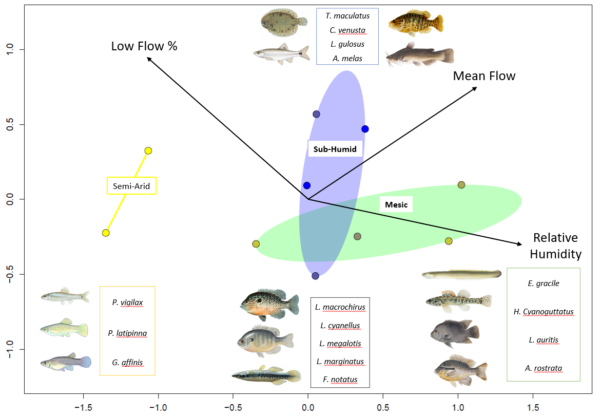
NMDS 2
NMDS 1
Notes:
NMDS of fish communities. Sites are grouped by precipitation regime; Semi-Arid (yellow), Mesic (green), and Sub-Humid (blue). Arrows indicate the strongest fitted environmental variables (p-value < 0.1) with length and direction corresponding to explanatory power. Semi-arid communities are dominated by livebearers (Poecilidae), Mesic and Sub-Humid communities contain a variety of sunfish (Centrarchidae), and Sub-Humid communities uniquely contain catfish (Ictaluridae). Relative Humidity correlates strongly with variation along the NMDS1, on which community grouping separate. Fish NMDS stress: 0.09826665

Slide 9
Fitted Environmental Vectors NMDS - Fish
Predictor | NMDS1 | NMDS2 | R² | p-value | p < .10
PET | -0.68 | -0.73 | 0.38 | 0.19
Precip. | 0.50 | 0.87 | 0.31 | 0.27
RH | 0.98 | -0.21 | 0.53 | 0.08 | *
Av.Flow | 0.83 | 0.55 | 0.45 | 0.10
Flash.I | 0.04 | -1.00 | 0.07 | 0.81
HFPP | -0.53 | -0.85 | 0.23 | 0.40
LFPP | -0.75 | 0.66 | 0.51 | 0.09 | *
Bas.Dev | 0.17 | 0.99 | 0.30 | 0.27
Bas.forest | 0.43 | -0.90 | 0.22 | 0.45
Bas.Plant | 0.99 | -0.15 | 0.01 | 0.96
Rip.forest | 0.55 | -0.84 | 0.24 | 0.40
S.runoff | 0.66 | 0.75 | 0.31 | 0.27
Soil.Org | -0.95 | 0.31 | 0.01 | 0.97
Soil.Perm | 0.10 | 0.99 | 0.04 | 0.93
DO | -0.32 | 0.95 | 0.12 | 0.65
ln(Cond) | -0.71 | -0.70 | 0.27 | 0.33
Ln(NO3-) | -0.33 | 0.94 | 0.12 | 0.66
NH4+ | -0.55 | 0.83 | 0.33 | 0.23
pH | -0.21 | -0.98 | 0.12 | 0.66
PO4- | -0.41 | 0.91 | 0.00 | 0.98
T.water | -0.68 | 0.74 | 0.07 | 0.74
Turbidity | 0.05 | 1.00 | 0.03 | 0.90
Bank.H | -0.50 | 0.87 | 0.18 | 0.51
Canopy | -1.00 | -0.04 | 0.04 | 0.85
d50 | 0.82 | 0.58 | 0.16 | 0.62
Rosgen | -0.53 | -0.85 | 0.30 | 0.28
Notes:
Scores for fitted environmental vectors on the fish NMDS. The direction cosines are the coordinates of the heads of the vectors (NMDS 1, NMDS 2).
Fish NMDS stress: 0.09826665

Slide 10
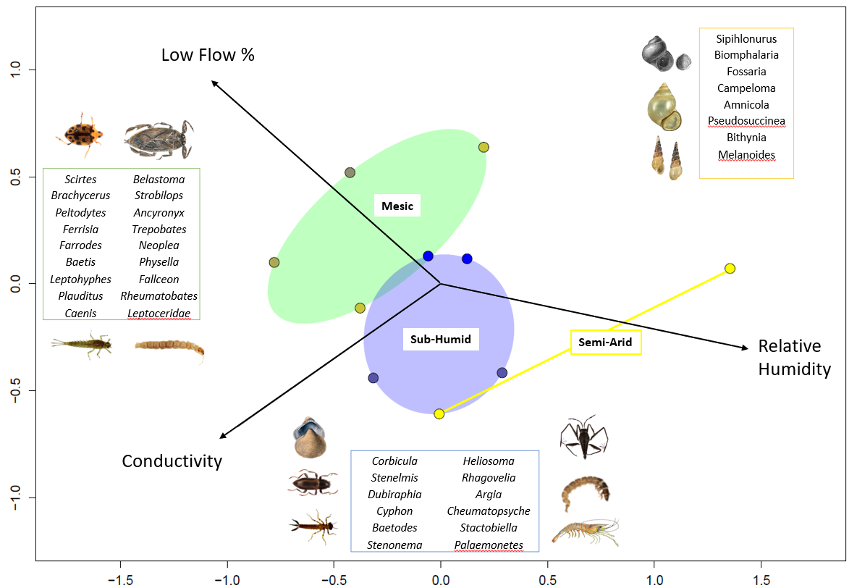
NMDS 2
NMDS 1
Notes:
NMDS of Invertebrate communities. Sites are grouped by precipitation regime; Semi-Arid (yellow), Mesic (green), and Sub-Humid (blue). Arrows indicate the strongest fitted environmental variables (p-value < 0.1) with length and direction corresponding to explanatory power. Semi-arid communities are dominated by snails (Gastropoda). Mesic communities contain a mixture of mayfly (Ephemeroptera), caddisfly (Trichoptera), true-bug (Hemiptera), and beetle (Coleoptera) taxa. Sub-Humid communities contain different species of mayfly, caddisfly, true-bug, and beetle, but uniquely contain shrimp (Crustacea) and dragonfly (Odonata) taxa. Relative Humidity and Low Flow % correlate strongly with the axis on which community groupings seperate. Invertebrate NMDS stress: 0.1555986

Slide 11
Fitted Environmental Vectors NMDS - Invertebrate
Predictor | NMDS1 | NMDS2 | R² | p-value | p < .10
PET | -0.68 | -0.73 | 0.38 | 0.18
Precip. | 0.50 | 0.87 | 0.31 | 0.28
RH | 0.98 | -0.21 | 0.53 | 0.09 | *
Av.Flow | 0.83 | 0.55 | 0.45 | 0.10
Flash.I | 0.04 | -1.00 | 0.07 | 0.79
HFPP | -0.53 | -0.85 | 0.23 | 0.38
LFPP | -0.75 | 0.66 | 0.51 | 0.09 | *
Bas.Dev | 0.17 | 0.99 | 0.30 | 0.26
Bas.forest | 0.43 | -0.90 | 0.22 | 0.47
Bas.Plant | 0.99 | -0.15 | 0.01 | 0.96
Rip.forest | 0.55 | -0.84 | 0.24 | 0.43
S.runoff | 0.66 | 0.75 | 0.31 | 0.26
Soil.Org | -0.95 | 0.31 | 0.01 | 0.97
Soil.Perm | 0.10 | 0.99 | 0.04 | 0.93
DO | -0.32 | 0.95 | 0.12 | 0.65
ln(Cond) | -0.82 | -0.58 | 0.40 | 0.08 | *
Ln(NO3-) | -0.33 | 0.94 | 0.12 | 0.65
NH4+ | -0.55 | 0.83 | 0.33 | 0.24
pH | -0.21 | -0.98 | 0.12 | 0.64
PO4- | -0.41 | 0.91 | 0.00 | 0.97
T.water | -0.68 | 0.74 | 0.07 | 0.73
Turbidity | 0.05 | 1.00 | 0.03 | 0.90
Bank.H | -0.50 | 0.87 | 0.18 | 0.54
Canopy | -1.00 | -0.04 | 0.04 | 0.85
d50 | 0.82 | 0.58 | 0.16 | 0.58
Rosgen | -0.53 | -0.85 | 0.30 | 0.27
Notes:
Scores for fitted environmental vectors on the invertebrate NMDS. The direction cosines are the coordinates of the heads of the vectors (NMDS 1, NMDS 2).

