Slide 1
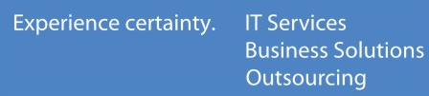
m-MediAssure :
Empowering: “KNOW to NO”
Leading Edge Entry
from TCS Innovation Labs Mumbai.

Slide 2
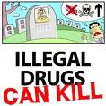
At a Glance
Medicines We Buy…
Impact on us !!!
Measures undertaken
Innovation Details
Business model
Impact of Innovation
Challenges in Implementing
Road Map & milestones

Slide 3
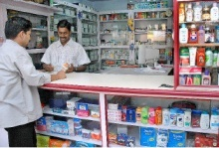
Medicines We Buy…
Background, Innovation Details, Business Model, Impact, Challenges, Roadmap & Milestones
Counterfeit drugs are classified into
  Spurious Drugs
  Pass-On
  Drugs from unauthorized territory
  (e.g Illegal drugs from neighbouring countries)
Trade part of the problem
  Unregistered medical stores
  Untrained person behind the counter
  Inadequate control and monitoring by Government
Consumers
  Unawareness

Slide 4
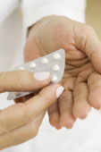
A bitter pill for India !!!
Background, Innovation Details, Business Model, Impact, Challenges, Roadmap & Milestones
7,00,000 deaths per year……… millions impacted *
Rs. 8000 cr revenue loss to Indian pharma Industry
Rs. 320-Rs.960 cr revenue loss to Government
  * Only due to malaria and tuberculosis fake drugs [ International Policy Network, 2009 ]

Slide 5
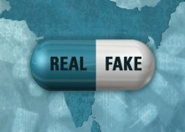
Measures undertaken
Background, Innovation Details, Business Model, Impact, Challenges, Roadmap & Milestones
Drug Inspectors
Various monitoring organizations like CDSCO
Recommendations from Govt. Committees like Mashelkar etc.
Huge Government investments…
Scalability?
Reachability?
Consumer Participation?
Many More??

Slide 6
Empowering the Consumer, Social Movement Against Fake Drugs seem to be the solution… m – MediAssure
An Innovative Tool in the Hands of Consumer is the beginning...
Background, Innovation Details, Business Model, Impact, Challenges, Roadmap & Milestones

Slide 7

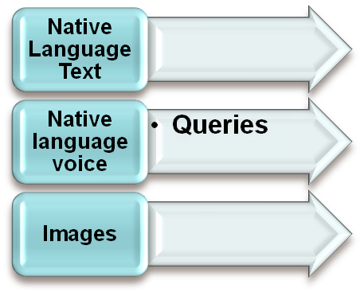
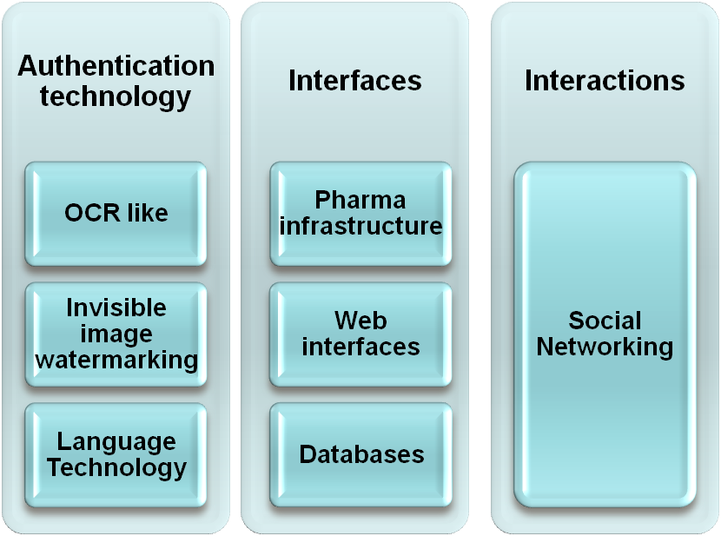

Technology platform
Background, Innovation Details, Business Model, Impact, Challenges, Roadmap & Milestones
Response
Authentic/fake
m-MediAssure Platform

Slide 8

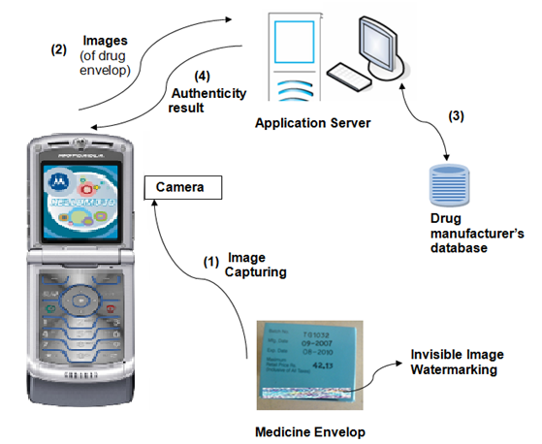
Background, Innovation Details, Business Model, Impact, Challenges, Roadmap & milestones
Innovation details
Recognize Batch
Number / expiry date
Verification of the
logo / invisible image
watermark
Database Interface
  Interface to the
  server
Regional language
interface
  Location identification
  Medication reminder

Slide 9
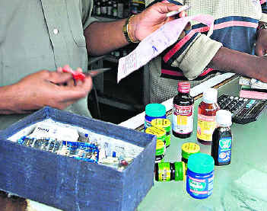
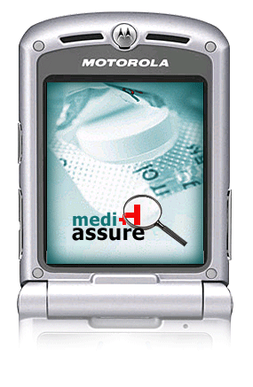
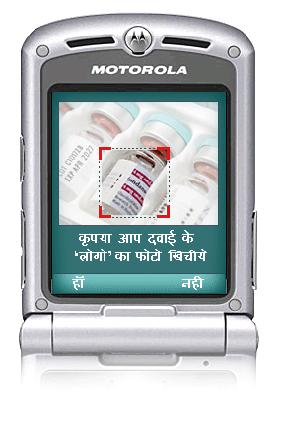
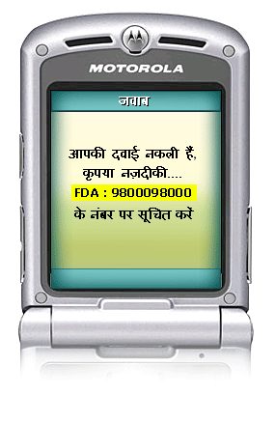
User interface…
Background, Innovation Details, Business Model, Impact, Challenges, Roadmap & Milestones

Slide 10

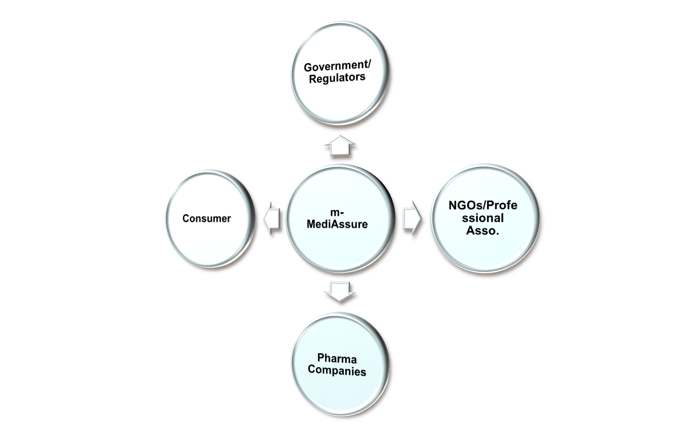
Operation: “KNOW to NO”
Background, Innovation Details, Business Model, Impact, Challenges, Roadmap & Milestones
Implementing Agency
Beneficiary
Create Awareness
Enablers

Slide 11
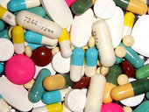
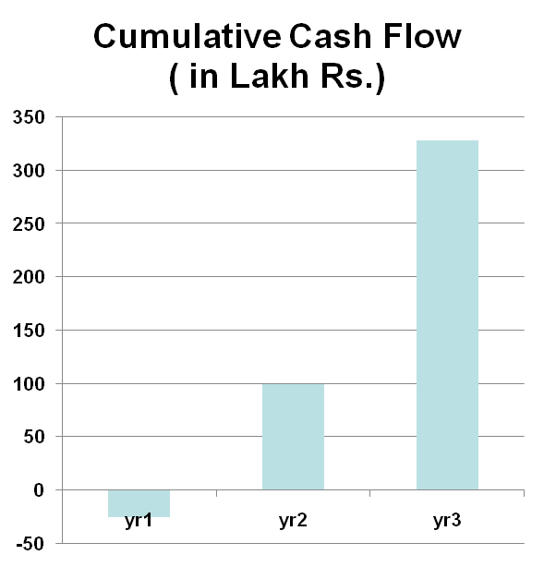
Business Projections
Background, Innovation Details, Business Model, Impact, Challenges, Roadmap & Milestones
Year | Yr1 | Yr2 | Yr3
CapEx ( in Lakh Rs.) | 50 | 50 | 50
OpEx ( in Lakh Rs.) | 100 | 100 | 100
Total Cost per annum( in Lakh Rs.) | 150 | 150 | 150
No of Pharama Companies | 250 | 275 | 303
% Potential | 10% | 20% | 25%
No of companies (Market Share of 2%-5%-toal revenue 60-146 crore) | 25 | 55 | 76
Gross Revenue( in Lakh Rs.) | 125 | 275 | 378
Net Revenue( in Lakh Rs.) | -25 | 125 | 228
Cumulative Cash Flow( in Lakh Rs.) | -25 | 100 | 328

Slide 12
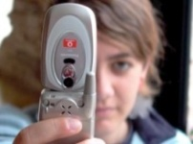
Impact of the Innovation
Background, Innovation Details, Business Model, Impact, Challenges, Roadmap & Milestones
Masses are empowered with authenticity information “KNOW TO NO”
Strengthen drug regulatory infrastructure of India through people participation
Rs. 8000 cr additional revenue to pharma companies
Rs. 320 cr - Rs. 960 cr additional revenue to Govt.
Creates global goodwill for Indian drug market

Slide 13

Challenges in Implementation
Background, Innovation Details, Business Model , Impact, Challenges, Roadmap & Milestones
Partnering with stakeholders
Harmonization of existing drug control infrastructure
Non-uniform enforcement
Overcoming the “neighbourhood” psychology

Slide 14
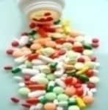

Road Map
Background, Innovation Details, Business Model , Impact, Challenges, Roadmap & Milestone
Phase I:
  Build and Test the Tool in the field.
  Convince organizations like OPPI, IDMA, AIOCD, to participate in the testing of the tool
Phase II
  Involve NGOs, Health Ministry, CDSCO, CII, Pharmaceutical companies’ organization.
  Conduct Field Trials in urban and rural areas
Milestone
Extending this platform to FMCG
Notes:
sfdfd

Slide 15

“ No invention is worthwhile unless it is useful for the masses”. - JRD Tata
Thank You

Slide 16

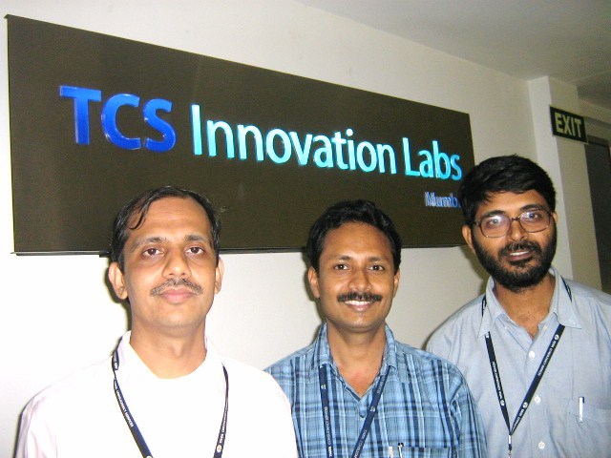
The Team
Mr.Sanjay Kimbahune, Dr.Lajish.V.L & Dr.Sunil Kumar Kopparapu

Slide 17
Annexure

Slide 18


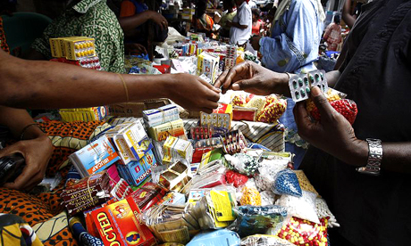
Background
Background, m-MediAssure, Innovation Details, Challenges, Benefits, Impact, Roadmap

Slide 19
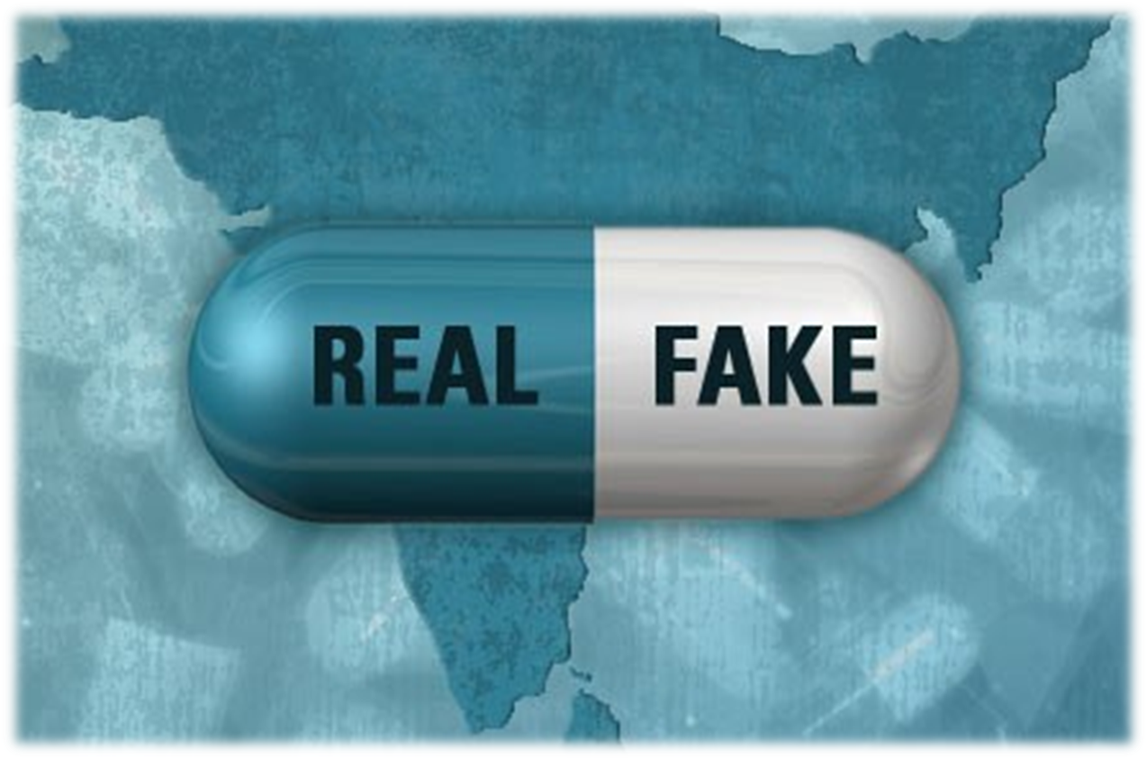
Factually...
Background, m-MediAssure, Innovation Details, Challenges, Benefits, Impact, Roadmap
  Approximately 7,00,000 deaths from malaria and tuberculosis are attributable to fake drug [ International Policy Network, 2009 ]
WHO statistic places India as the leader, with as much as 35% of world’s production of fake drugs [The Lancet, 2 June 2001]
40% of the pharmacy market in India, approximately i.e. 8000 crores INR is under the grip of spurious and black marketed drugs [WHO]
  Alarmingly, most of the time, fake drugs escape all controls and monitoring systems [WHO report].

Slide 20
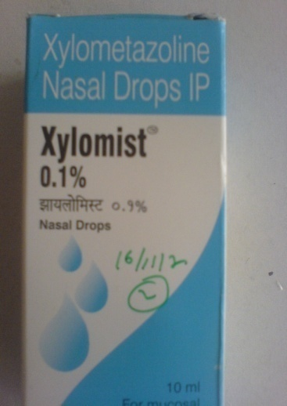
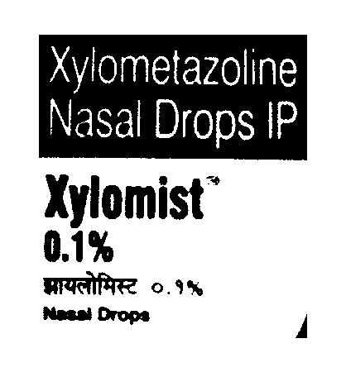
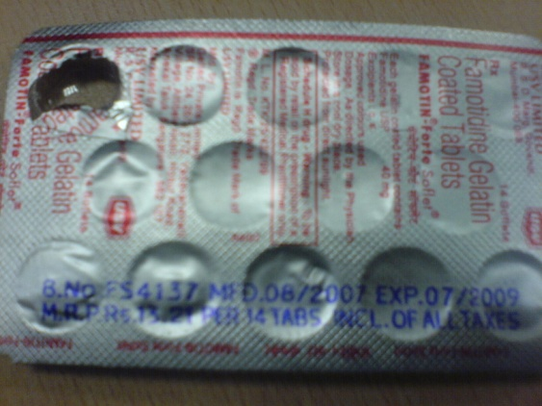
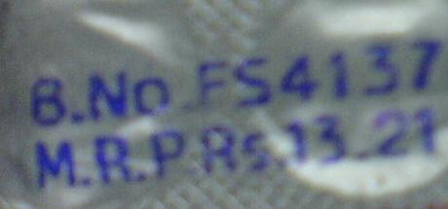
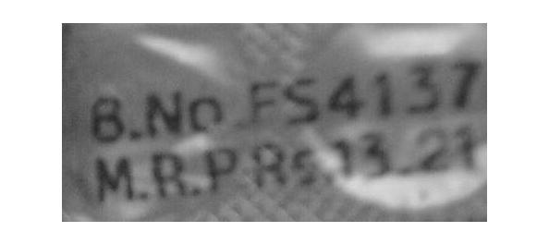
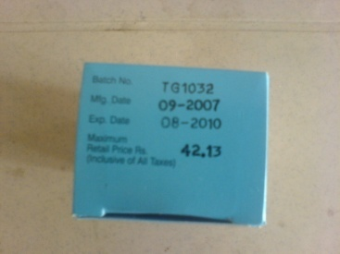
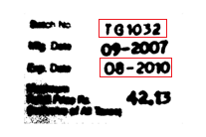
Technology break through…
Background, m-MediAssure, Innovation Details, Challenges, Benefits, Impact, Roadmap
Digital Image processing & pattern recognition
Invisible Image watermarking
Indian language script rendering on mobile phones

