Slide 1
Natural Language Usable User Interface
Keynote: Broader Perspectives of Language, Thinking and Technology
Dr. Sunil Kumar Kopparapu
TCS Innovation Labs – Mumbai, Thane (West)
SunilKumar.Kopparapu@TCS.Com
July 03, 2010

Slide 2
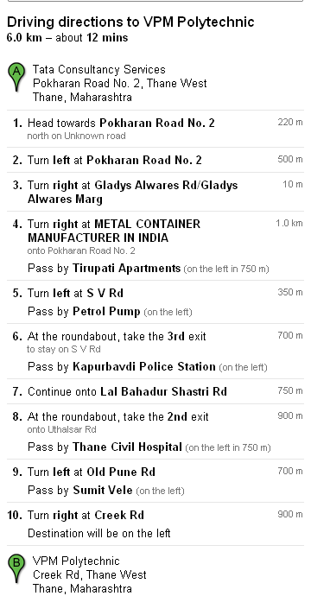
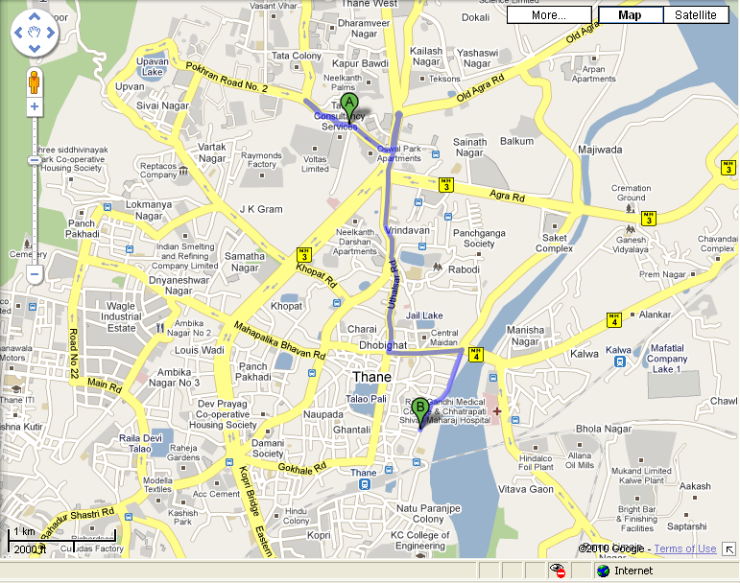
Usable Interface (From TCS to Here!)‏

Slide 3
Natural Language Interface -- What is it?
Language
  a systematic creation and usage of a set of symbols
  a specific symbol is paired with an intended meaning
  meaning is usually established through social conventions
  Language is a system of symbols for encoding and decoding information
Natural Language
  languages used by human
  it is full of intended meaning and
  the language rules are generally tricky and complex
Natural Language Interface
  allows human like interaction with machines
  no constrain to use a set of predefined keywords
    Ask as you like!
    Ask what you like
  performance in the absence of exact answers
    respond with natural close alternatives
    avoids ‘no records found’ syndrome
    Human-human like experience when interacting with a machine (Text or Speech)!

Slide 4
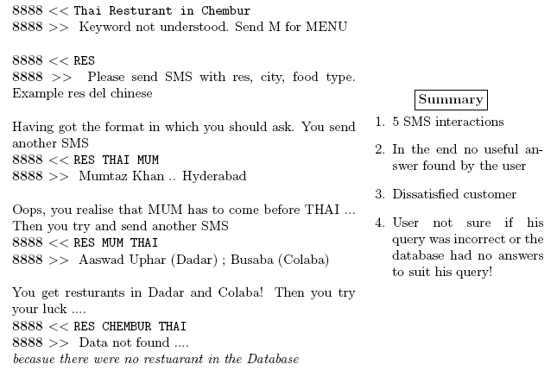

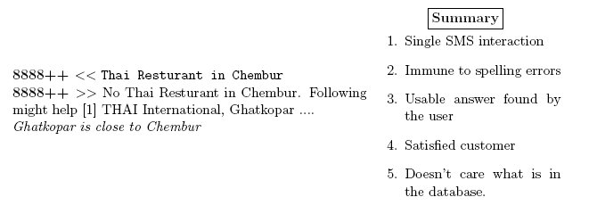
Example: Seeking Information from Yellow Pages (Text)‏

Slide 5
Example: Seeking Information Indian Railway (Speech)‏
Please Speak a Service you want to Enquire about
Arrival
Departure
Ticket availability
Fare
PNR
Speak Train
Name
Speak Train
Name
Speak Train
Name
Speak Train
Name
Gitanjali Express
Post Status
Play
Station Name
Station Name
Source &
Destination
Station Name
Source &
Destination
Station Name
CST
Raipur
Post Status
Play
Post Status
Play
23/July
Date
Post Status
Play
Availability of Ticket
are as follows
2 AC 6 seats
3 AC 12 seats
Sleeper 203 seats
Post Status
Play

Slide 6


Example: Seeking Information Indian Railway (Speech)‏
“Availability in Gitanjali
Express from Mumbai to
Raipur on 23 july”
“Is there any ticket for
Gitanjali Express on
23 July from cst to
Raipur”
Internet
“Can I get ticket on 23
July from CST to Raipur
in Gitanjali Express”
NL Speech IVR
Caller
Availability of Ticket
are as follows
2 AC 6 seats
3 AC 12 seats
Sleeper 203 seats
Railway Data Server

Slide 7
Origin of a Natural Language Query
There are a number of ways in which the user can query the system to seek answers
Modes of transactions (examples),
  the user can speak a query
    a speech recognition engine converts the audio into text
  user can type in text on a web portal
    which might have errors in the form of spelling mistakes and grammar
  user can SMS a query
    which might additionally have SMS lingo in the text in addition to no grammar
  user can send a media file (an image or a video) seeking similar information
    This is converted into a natural language text ... using machine intelligence
What is Common?
  Invariably the query in any modality lands up as a string of natural language text
Observe
  Query could be complex ... but the domain is known
  Query is transactional in nature (seeks answers)‏
  Intent hidden in important phrases or words
  What should be done?

Slide 8
Processing Natural Language Query
Natural Language Query to be processed to derive the intent
  in the presence of errors in terms of grammar,
  in terms of spelling mistakes,
  in terms of the errors in the process of conversion of the query
    example output of speech recognition system
Query has to be organized in a way that is
  suitable to obtain desired answers from a database
  suitable to enable deriving close alternatives in the absence of true answers
  suitable to check if the query is complete (answerable)

Slide 9
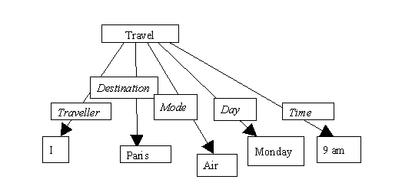
Usable Approach
In every meaningful query,
  there is usually one word (key-concept),
  which binds together a set of semantically related words (key-words)
Example,
  “I purchased a book from Amazon.Com for 250 Euro yesterday”
    the crucial word is ‘purchase’.
    Purchase (I, book, Amazon.Com, Euro 250, yesterday).
    It is possible to understand the meaning even in this form.
  “I shall be travelling to Paris by Air on Monday at 9 am” implies
    Travel (I, Paris, air, Monday, 9am) and is represented by the structure
Key Concept - Key Word based Approach

Slide 10
Key Concept – Key Word Approach
Key concept
  ‘holds’ all the key words together
  If key concept word is removed, all the others fall apart.
Once the key concept is known, what other key words to expect is known
  the relevant key words can then be extracted from the query.
Query Representation
  a mathematical functional
    'function names' which carry 'arguments'
    eg. KC₁ (KW₁, KW₂, KC₂ (KW₃, KW₄))‏
  Key concept fixes the nature and dimensionality of the associated key words
  arguments defined in terms of syntacto-semantic variables
    eg. destination has to be “noun – city name”; price has to be “noun – number”
Observe
  Approach can be quite effective solution
    to the problem of natural language understanding in general,
    and particularly in man-machine interaction systems.
  the mathematical functional is a form that is suitable for (machine) SQL query

Slide 11
Some More Examples: Natural Language Interfaces
Mobile Interface to Register Citizen Complaint
Voice Based Self Help System

Slide 12
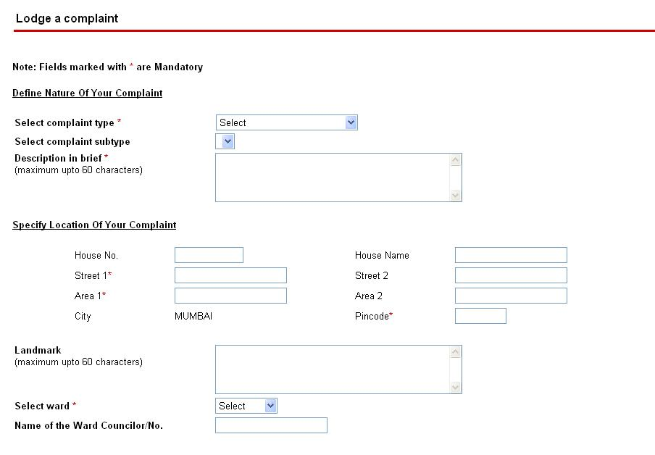
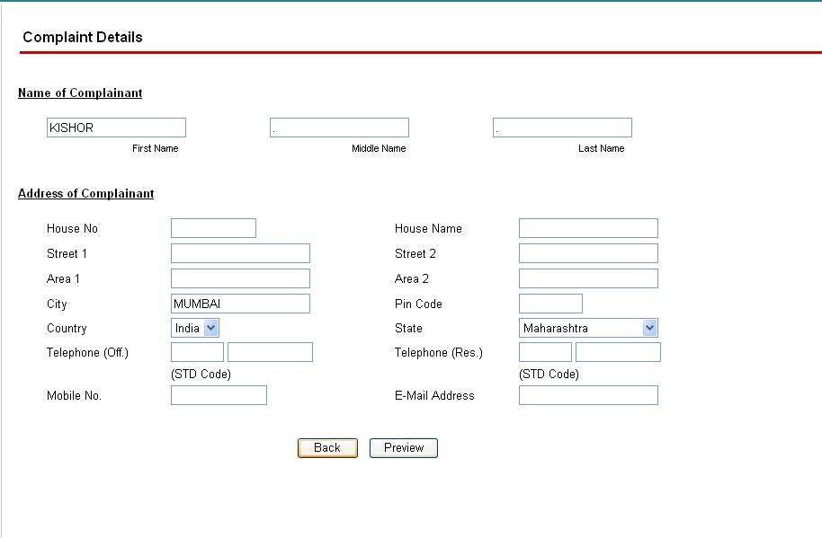
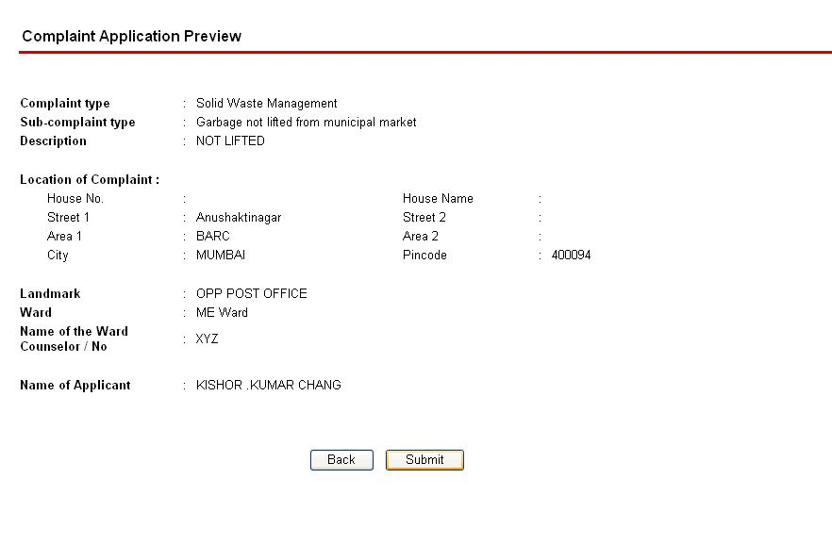
MCGM Complaint Registration on the Web: Today
Need to have access to networked computer
Aware of category and sub category of complaint
Need to aware of ward details
Several clicks and hyperlink traversals
Need to note the complaint number for future tracking
Difficult to upload images of complaint scenes

Slide 13
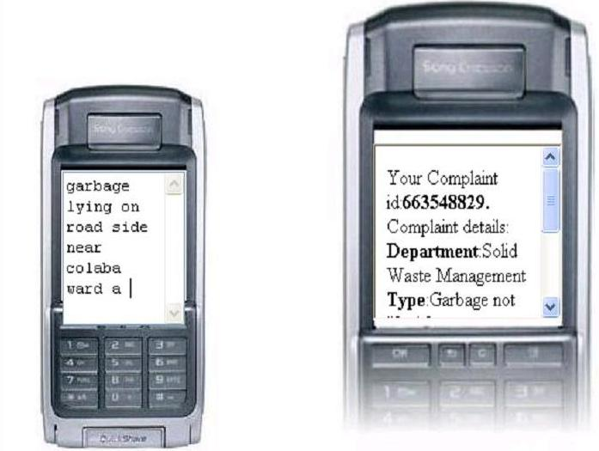
Natural Language Mobile Interface: Possible

Slide 14
How?
User composes a SMS complaint on his mobile device
  natural language; free of format free;160 char
Sends the SMS to MCGM
System interprets the intent of the complaint (Minimal Parsing; KC-KW approach)‏
Insufficient information?
  Intelligently asks for missing information
Files the complaint on the MCGM portal (existing backend)‏
Retrieves the complaint number
Send the complaint number to the user as SMS
  For future reference
Complaint filing made easy and simple

Slide 15
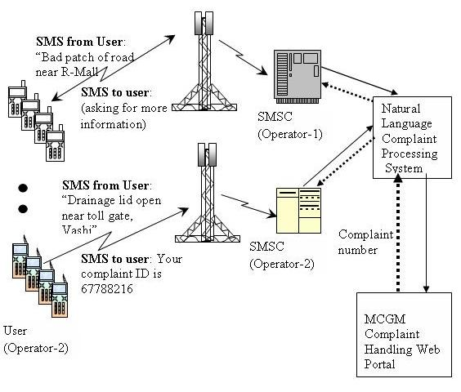
System Architecture

Slide 16
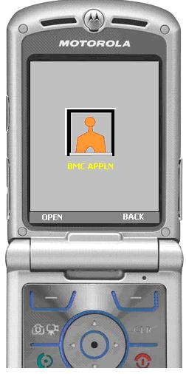
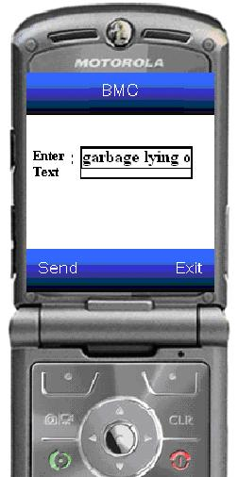
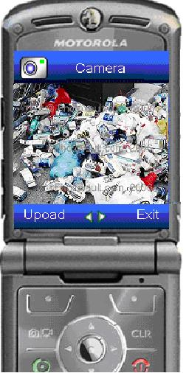
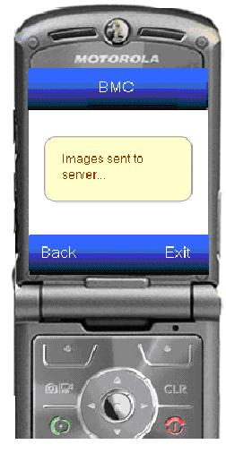
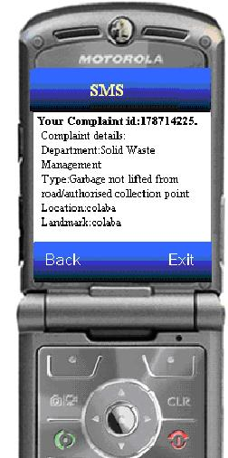
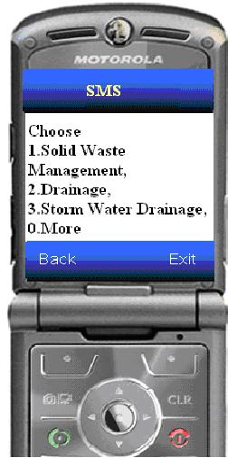
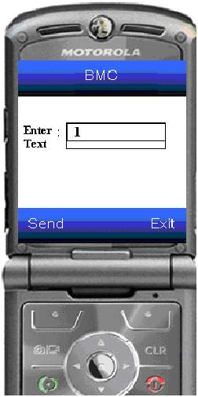
Mobile User Interface++: Usage Example

Slide 17
What is a Voice Based Self Help System?
Self Help Systems, typically are automated systems that enable users to help themselves.
When the medium of transaction is voice or speech, it is called a Voice Based Self Help System.
Query
Transaction Begin
User
Self Help System
Response
Transaction End
An Example ….

Slide 18


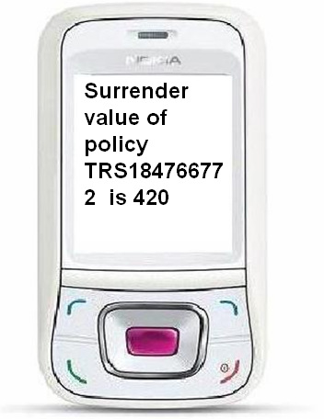
Voice Enabled Self Help System: An Example
Query: What is the surrender value of policy TRS184766772 ?
Agent Speaks query
Self Help
Self Help speaks out the response
(Insurance) Agent
Surrender value of policy TRS184766772 is 420
Insurance Agent’s PC
Self Help sends SMS response

Slide 19
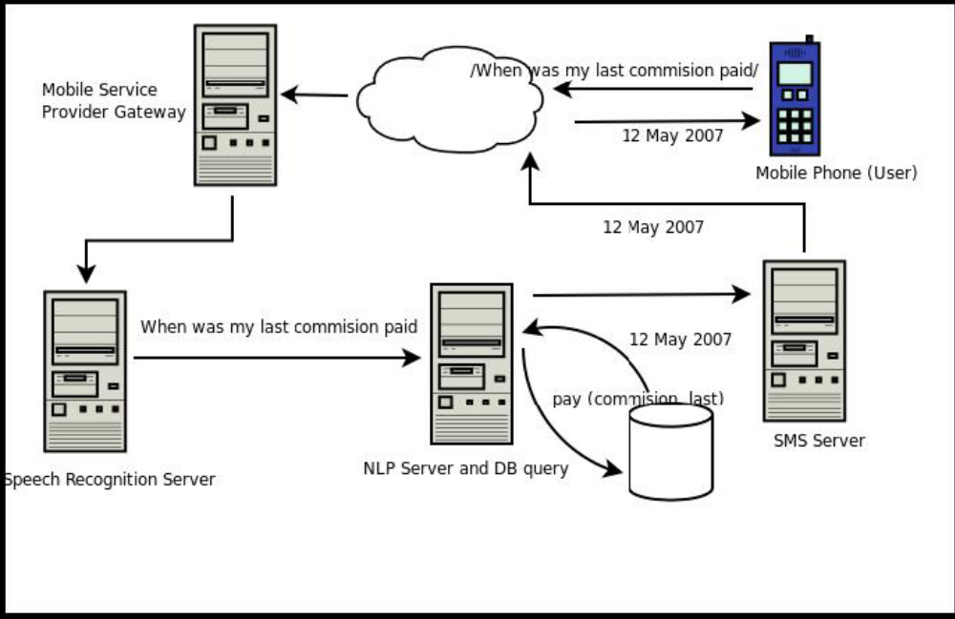
Voice Based Self Help System: Block Diagram
Speech Recognition (Acoustic)‏
+
Language Processing (Grammar)‏
Natural Language Processing

Slide 20
Conclusions
Facts
  Natural Language is complex and full of intended meanings
  Humans are able to decode it with ease
  Machines (computers) use formal languages (programming languages)
  It is not easy for machines to process Natural Language
  Human interaction with machine is inevitable
  Building Natural Language Interfaces is difficult
What is the best we can do?
  Build usable interfaces
What are usable interfaces?
  Easy to use
  Natural to use
    Allows humans to ask queries naturally (text or spoken)‏
    Handle human mistakes (no strict grammar, spelling)‏
  Gradual degradation of performance
    When there is no answer
    Allows machines to answer with a close approximate answers when true answers are absent in their knowledge-base
  Intelligent
    Ask for information when the query lacks complete information

Slide 21
Thank You
Natural Language
Usable
User Interface
Questions, Comments
sunilkumar.kopparapu@tcs.com
+ 91 22 6778 8216

