Slide 1
Recognition of Mixed Language Speech without Language Identification
Kiran Kumar Bhuvanagiri, Sunil Kumar Kopparapu
TCS Innovation Labs - Mumbai, Thane, Maharashtra, INDIA
kirankumar.bhuvanagiri@tcs.com
24-25 Jan 2011 ICSSA 2011

Slide 2
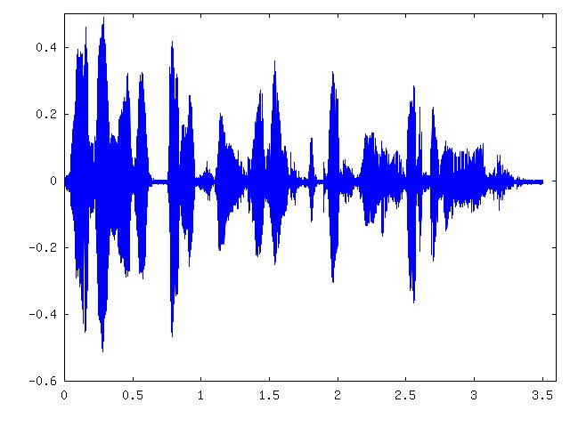
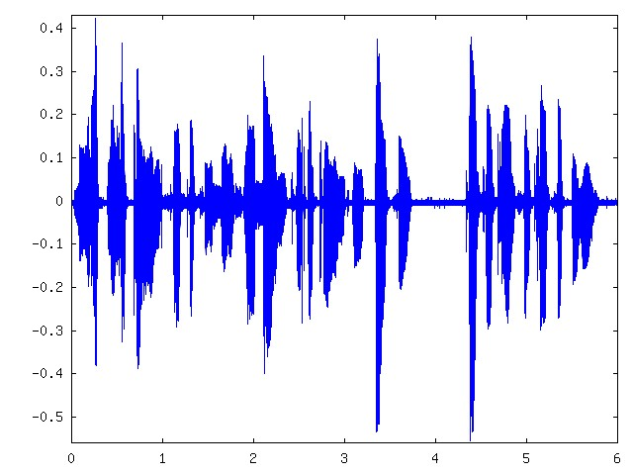
What is Mixed Language Speech ?
Mixed Language Speech is a mixture of two or more languages within a spoken
sentence with no information of instants at which language (code) switching occur.
मुझे मेरा Telephone Identification Number बदलना है
मै अपने account से किसी दूसरे bank के account मे पैसा कैसे Transfer कर सकता हुँ ?
मुझे मेरा Telephone Identification Number बदलना है

Slide 3
Mixed Language Speech
Relevance
With urbanization and globalization, multilingual skills are increasing.
Very commonly used in day to day conversations.
Accepted style of communication
It is style for anchors, politicians etc., to get attention of audience
Challenges
Availability of Mixed language speech database
  To build acoustic models
Frequent code-switching (language switch)
Lack of knowledge of code-switching time instants

Slide 4
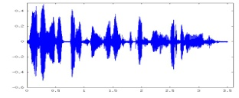
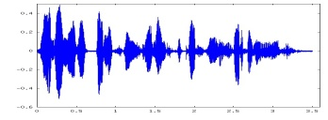
Multi-Pass Approach (Chung, 2006)
मै अपने account से किसी दूसरे bank के account मे पैसा कैसे Transfer कर सकता हुँ
Input mixed language speech
L-1 segments
ASR L-1
Language
Boundary
detection
Language
Identification
+
Output recognized string
L1
L2
L1
L3
L-N segments
ASR L-N
Language
Boundary
detection
Language
Boundary
detection
ASR L-N
+
Output

Slide 5
Multi-Pass Approach: Pros and Cons
Advantages
No need to collect mixed language speech data
ASR performance can be high
  as language specific Acoustic models are used
Disadvantages
Overall accuracy depends on the performance of “Language
Boundary detection”
Needs Acoustic models of all possible languages in mixed speech.

Slide 6

One-pass Approach (Cheng, 2006)
Super Acoustic model
Mai apne account se kisee doosare bank ke account me paisa kaise Transfer kar sakatha hum
Input Speech
Mixed-speech Recognizer
Output
Language model
Lexicon
Advantages
Language boundary detection and Language identification blocks not necessary
Approach is along similar lines of a standard ASR
Disadvantages
Requires building a super acoustic model.
Mixed-Language database (speech) is required

Slide 7
Database
Hindi-English Mixed language database.
  Hindi is primary language.
  English is secondary language.
Data is recorded using telephony card (Dialogic).
Data recording done at 16 KHz and 8 bits per sample.
46 speakers uttered 213 sentences. Total number of words 1946.
Language switch rate varies between 2 and 8 per sentence.
About 62% speech is from Hindi language, 28% is from English and 10% is
proper names.
Number of distinct words (size of dictionary) are 130.
Hindi-English Mixed language database. Hindi is primary language and English is secondary
language.
Data is recorded using telephony card (Dialogic).
Data recording is done at 11KHz and 8 bits per sample.
46 speakers uttered 225 sentences. Total number of words are 2071.
Language switch rate varies between 2 and 8 per sentence.
About 62% of speech is from Hindi language, 28% from English and 10% are proper nouns.
Number of distinct words (size of dictionary) are 130.

Slide 8
Our Approach
English acoustic model
Mai apne account se kisee doosare bank ke account me paisa kaise Transfer kar sakatha hum
Mixed speech recognizer
Input Speech
Output
Dictionary (using Hindi
to English phonetic
mapping)
Language model
(using transliterated
sentences)
English acoustic model
Mai apne account se kisee doosare bank ke account me paisa kaise Transfer kar sakatha hum
Mixed speech recognizer
Input Speech
Output
Dictionary
(using Hindi to
English phonetic
mapping)
Language model
(using transliterated
sentences)

Slide 9
Approximate phoneme mapping
Hindi to English phoneme mapping:-
Need for Hindi ASR is avoided by mapping Hindi phonemes to English phonemes.
Consider a word मत्स्यगंध spelt as mathsyagandh.
Phonetic mapping using CMU toolkit is M AE TH S AY AH G AH N D (39 phonemes)
Phonetic mapping using Hindi phonemes is M A T A S Y A G A N DH A (59 phonemes)
Mapping from Hindi Phonemes to English M AH TH AH S Y AH G AH N DH HH AH

Slide 10
Dictionaries
ENG:BALANCE B AE L AH N S
ENG:BANK B AE NG K
ENG:IDENTIFICATION AY D EH N T AH F AH K EY SH AH N
JANKAREE JH AE NG K AH R IY IY
KRUPAYA K R UW P EY AH
NAME:MATHSYAGANDH M AE TH S AY AH G AH N D
ENG:BALANCE B AA L A N: S A
ENG:BANK B AA N K
ENG:IDENTIFICATION EI D E N: T: I PH I K EI SH A N A
JANKAREE J AA N A K AA R II
KRUPAYA K RX P A Y AA
NAME:MATHSYAGANDH M A T A S Y A G A N DH A
(b)
(a)
Hindi Phoneme to English phoneme mapping
(a) Dictionary using English phonemes (#39) using CMU-Toolkit
(b) Dictionary using Hindi phonemes (#59).
(c) Dictionary using phonetic mapping from Hindi to English.
ENG:BALANCE B AE L AH N S
ENG:BANK B AE N K
ENG:IDENTIFICATION AY D EH N T IY F IY K EY SH AH N
JANKAREE JH AA N K AA R IY
KRUPAYA K R UH P AH Y AA
NAME:MATHSYAGANDH M AH TH S Y AH G AH N DH HH A
(c)

Slide 11
Experiments
We conducted four different experiments depending on how dictionaries are generated
and which acoustic models are used for recognition.
Expt No | English words | Hindi words | Proper names | Acoustic model
1 | CMU | CMU | CMU | HUB4
2 | CMU | CMU | AM | HUB4
3 | CMU | AM | AM | HUB4
4 | HIN | HIN | HIN | Hindi ASR
CMU -> Using CMU toolkit (English phonemes)
AM -> Approximated phoneme mapping from
Hindi to English
HIN -> Using Hindi Phonemes.
HUB4 -> Hub4 Acoustic models[HUB4]
Hindi ASR -> Hindi acoustic models.[HASR]
In case of recognition on Train dataset, we used transcription of all 213 sentences for
generating language model.
In case of recognition on Test dataset, we did cross validation on three equal sets. For the
given test set, language model is generated using complimentary test sets.

Slide 12
Results
TABLE 1
WER (Train Data set)
Experiments | English words(100-%correct) | Hindi words(100-%correct) | Proper names(100-%correct) | Word Error Rate
1 | 51.69% | 51.94% | 78.79% | 64.80%
2 | 45.51% | 47.99% | 79.55% | 56.78%
3 | 41.58% | 44.69% | 48.49% | 51.31%
4 | 45.89% | 38.59% | 34.10% | 49.64%
TABLE 2
WER (Test Data set)
Experiments | English words(100-%correct) | Hindi words(100-%correct) | Proper names(100-%correct) | Word Error Rate
1 | 53.31% | 53.19% | 86.36% | 67.93%
2 | 47.45% | 46.71% | 84.09% | 57.29%
3 | 44.61% | 46.29% | 60.61% | 53.64%
4 | 49.50% | 40.62% | 45.31% | 53.39%

Slide 13
Conclusions
Proposed method is simple and required only acoustic models of one language.
Approximate phoneme mapping enables increase of ML-ASR accuracy.
It does not require the use of super phoneme set.
By using acoustic model of primary (main) language, accuracies are further
increased.
This approach is applicable to any mix of Indian language.

Slide 14
Bibliography
[Cheng,2006] Dau-Cheng Lyu, Ren-Yuan Lyu, Yuang-chin Chiang and Chun- Nan Hsu,
“Speech recognition on code-switching among the Chinese dialects”, of IEEE
International Conference on Acoustics, Speech and Signal Processing,
Toulouse, France, May. 2006
[Chung, 2006] Chung-Hsien Wu,Yu-Hsein Chie, Chi Jiun Shia, Chun-Yu Lin , “Automatic
segmentation and identification of mixed language speech using Delta-BIC
and LSA based GMMs”, ICASSP 06, vol 14, No 1, 266-276.
[HASR] www.Sourceforge.net/projects/hindiasr.
[HUB4] http://cmusphinx.sourceforge.net/

