Slide 1
An Unsupervised Approach to Automated Selection of Good Essays
By
Arijit De
Sunilkumar Kopparapu
(TCS Innovation Labs – Mumbai)

Slide 2
Outline
Problem Definition
Steps in Essay Selection
Experiments and Results.

Slide 3
Problem Definition
C is a collection of N essays
  C = {E_{i}, 1 ≤ i ≤ N}.
  E_{i} represent the i^{th} essay in the collection.
Objective:
  Select the m best essays (typically m << N) from this corpus.
  Create a set G = {E_{i} , E_{i} ε C} & |G| = m.

Slide 4
Steps in Essay Selection
Essay Segmentation and Feature Selection
Creating Probability Density Functions for each feature
Computing Kullback–Leibler divergence
Creating the Super Essay
Selecting Essays based on a Feature
Aggregation of KL Distances

Slide 5
Essay Segmentation and Feature Selection
Fp: Features associated with a paragraph.
  Number of sentences per paragraph.
  Number of words per paragraph.
  Number of nouns per paragraph.
  Number of verbs per paragraph.
  Number of adjectives per paragraph.
Fs: Features associated with a sentence.
  Number of words per sentence.
  Number of nouns per sentence.
  Number of verbs per sentence.
  Number of adjectives per sentence.
  Number of articles per sentence.

Slide 6
Creating Probability Density Functions for each Feature
Algorithm 1: Constructing probability density function Φ for a feature in F_{p}.
Input: An essay E_{i} A feature f ε F_{p} /* e. g: Number of words per paragraph */ Output: Φ: probability density function array Define: W: frequency counts array R: raw values for feature f. e: error n: number of zero values in distribution Z: array that stores probability values

Slide 7
Creating Probability Density Functions for each Feature
Algorithm 1: Constructing probability density function Φ for a feature in F_{p}.
Algorithm: Identify all P paragraphs in E_{i} /*essay segmentation */ R = { } TOT = total count of f in all P n = 0 for i = 1 to P do k ← count(f) in P /*e.g., count # of words in Paragraph */ R ← R U k (Add k to set of raw values, R) Increment W[k] TOT ← TOT +k end for

Slide 8
Creating Probability Density Functions for each Feature
Algorithm 1: Constructing probability density function Φ for a feature in F_{p}.
Algorithm: for each k ε R Z[k] ← W[k]/TOT End for each k ε R if Z[k] = 0 then Z [k] = e Increment n End for each k ε R /* Approximating non zero values */ if Z[k] ≠ e then Z[k] = Z[k] - n∙e Increment n End Φ ← Z.

Slide 9
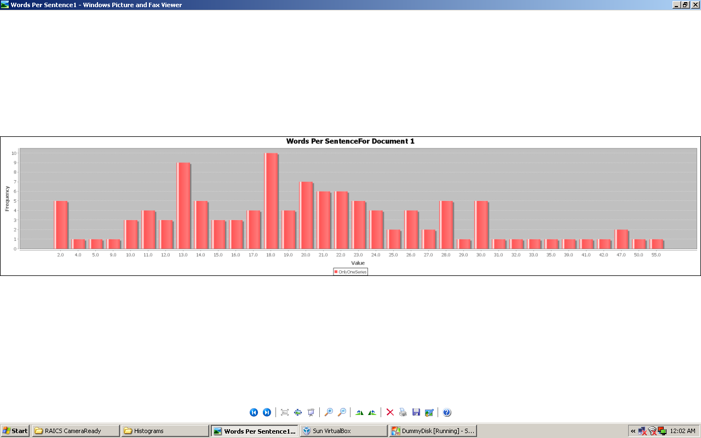
Creating Probability Density Functions for each Feature
Creating Probability Density Functions for each Feature

Slide 10
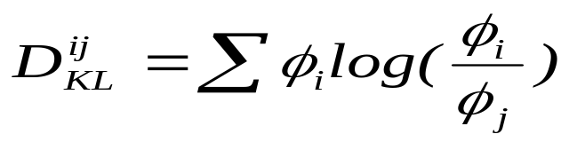
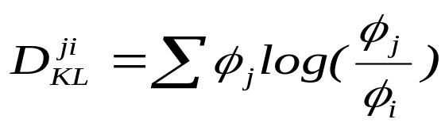
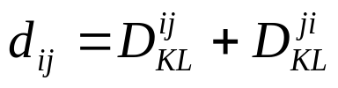
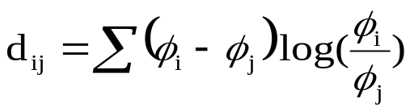
Computing Kullback–Leibler divergence
For any two Essays E_{i} and E_{j}

Slide 11
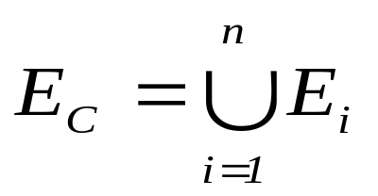
Creating Super Essays
We concatenate all essays in the collection to create a super essay E_{C}. Thus this super essay is the union of all essays within the collection

Slide 12
Selecting Essays Based on a Feature
For each essay E_{i} in the corpus C we have a KL distance D^{KL}(i, f).
  Here the distance D^{KL}(i, f) is for the i^{th} essay and feature f with reference to the super essay E_{c}.
We sort these distances in descending order and select the top m essays.

Slide 13
Selecting Essays Based on multiple Features
For all E_{i} ε C the KL distance for a feature f ε F is D^{KL}(i , f).
For each essay E_{i} ε C we have a set of KL distances for all the features, namely,
  {D^{KL}(i , f₁), D^{KL}(i , f₂), D^{KL}(i , f₃),….. , D^{KL}(i , f_{l})} where l = | F | or |Fp| + |Fs|.
Let D^{KL}(i , f_{k}) be represented as d_{k} for feature f_{k} ε F and essay E_{i}. So the set of distances for E_{i} can be written as D_{i} = {d₁, d₂, .., d_{p}}.

Slide 14
Selecting Essays Based on multiple Features – Strategies for aggregation
Strategies for selection
  Take the maximum distance
  Take the minimum distance
  Take mean or median distance
  Use Fuzzy selection

Slide 15
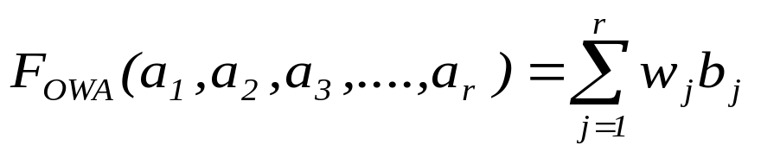
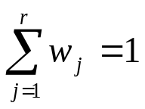
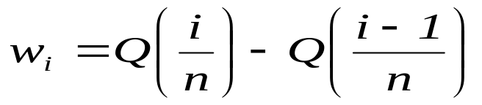
Selecting Essays Based on multiple Features – Using Fuzzy selection
OWA operator
Weight Generation through Linguistic Quantifiers

Slide 16
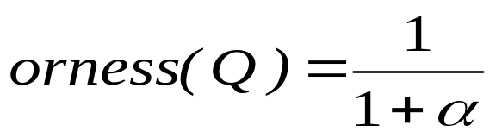
Selecting Essays Based on multiple Features – Using Fuzzy selection
Orness of Aggregation

Slide 17
Experiments
Dataset consisting of 19 essays (written on a technical topic 'Next Generation Mobile Phones') .
The objective of our experiments was to see if we could re-create the best 10 essays by using our methodology.
Average Precision: It is the ratio of number of essays common between the human judged essays and the automated methodology created by us, and the total number of essays in the human judged set.

Slide 18
Results
Feature | Precision
noun per sentence | 0.7
Verb per sentence | 0.6
adjectives per sentence | 0.7
word per sentence | 0.6
nouns per paragraph | 0.6
Verb per paragraph | 0.5
adjectives per paragraph | 0.6
Word per paragraph | 0.5
sentences per paragraph | 0.3

Slide 19
Results
Alpha (α) | Orness | Average Precision
0.25 | 0.80 | 0.60
0.50 | 0.67 | 0.60
1.00 | 0.50 | 0.50
1.50 | 0.40 | 0.50
2.00 | 0.33 | 0.50
2.50 | 0.29 | 0.60
3.00 | 0.25 | 0.60

Slide 20
References
Y. Attali and J Burstein, "Automatic essay scoring system", The Journal of Technology, Learning and Assessment, vol. 4(3), pp 53-84, February 2006.
B. Bigi, "Using Kullback-Leibler distance for text categorization" in Proc. of the 25th European Conference on Information Retrieval, Pizza, Italy, April, 2003, vol. 2633, pp. 305–319.
Y.Y. Chen, C.L. Liu, T.H. Chang and C. H. Lee, "An unsupervised automated essay scoring system", IEEE Intelligent Systems, vol. 25, pp 61–67, 2010.
T. Kakkonen, N. Myller, J. Timonen and E. Sutinen, "Automatic essay grading with Probabilistic Latent Semantic Analysis" in Proceedings of the second workshop on Building Educational Applications Using NLP, Association for Computational Linguistics, pp. 29–36, Morristown, NJ, USA (2005).
S. Kullback and R.A Leibler,"On Information and Sufficiency", Annals of Mathematical Statistics vol. 22(1), pp 79–86, 1951.
L.S. Larkey, "Automatic essay grading using text categorization techniques" in Proceedings of the 21st annual International ACM SIGIR conference on Research and Development in Information Retrieval, SIGIR ’98, pp. 90–95. New York, NY,USA (1998), ACM Press.
E. Tsagkias, “KL-divergence of two documents”, URL: http://staff.science.uva.nl/~tsagias/?p=185 (Last accessed July 2011).

Slide 21
References
R. Baeza-Yates and B. Ribeiro-Neto, Modern Information Retrieval. New York: ACM Press, Addison-Wesley,1999.
R. R. Yager, “On ordered weighted averaging aggregation operators in multi-criteria decision making”, Fuzzy Sets and Systems, vol. 10, 2, pp. 243-260, July 1983.
R. R. Yager, “Quantifier guided Aggregating using OWA operators”, International Journal of Intelligent Systems, vol. 11, 1, pp. 49-73, March 1996.
R. R. Yager, and V. Kreinovich, “On how to merge sorted lists coming from different web search tools”. Soft Computing Research Journal, vol. 3, 1, pp. 83-88, March 1999.
URL: www.ets.org/gre (Last accessed July 2011).
URL: www.ets.org (Last accessed July 2011).
URL: www.ets.org/toefl (Last accessed July 2011).
URL: http://www.gmac.com/gmac (Last accessed July 2011).
Pérez-Marín,Diana, Pascual-Nieto,Ismael, Rodríguez,Pilar,”, Computer-assisted assessment of free-text answers, The Knowledge Engineering Review, 24 (04), 353-374, 2009.
J. Burstein & M. Chodorow, “Progress and New Directions in Technology for Automated Essay Evaluation”, Chapter in The Oxford Handbook of Applied Linguistics, 2nd Edition, pp. 487–497, Editor: R. Kaplan, Oxford University Press, 2010

