Slide 1
Real Time Speaking Rate Monitoring System
Meghna Abhishek Pandharipande & Sunilkumar Kopparapu
TCS Innovations Lab – Mumbai, Maharastra, India.
2011 IEEE International Conference on Signal Processing, Communications and Computing, Sept 14-16, 2011, Xi'an Garden Hotel, Xi'an China.

Slide 2
Introduction
A metric to measure the rate at which speech is spoken
Why is the Need to Measure Speaking Rate?
Fast Speaking Rate makes conversation unintelligible
Whereas Slow Speaking Rate makes conversation boring
Monitoring of Speaking Rate can assist call center agents speak at the desired rate
Several aspects of a call conversation can be analyzed based on speaking rate
  Without actually having to convert speech to understandable text (speech to text)
What Influence Speaking Rate?
Speaking rate definitely varies depending on the emotional state of the person when s/he is speaking
Regional and cultural influences thespeaking rate
How is it Measured?
Measured in number of words spoken per minute or number of syllables spoken per second

Slide 3
Speaking Rate
As per studies, Average English-speaking rate
  between 130 and 200 Words Per Minute (WPM). applies to 90% of the English-speaking population.
  complex material, a speaking rate of 130 to 145 WPM may be required and
  average complexity, a speaking rate between 145 and 175 is optimal
  simple material, many listeners can accommodate over 175 WPM.
Monitoring Speaking Rate of a call center agent in real time is essential and can improve CSI (Customer Satisfaction Index) by several notches

Slide 4
Syllable Nuclei Detection Algorithm - Nivja Jong
The algorithm describes sequence of actions
  Find syllable nuclei using intensity (dB) and voicedness.
  Intensity is used to find peaks in the energy countour
    vowel within a syllable (the syllable nucleus) has higher energy than surrounding sounds
  Then use intensity contour to make sure that the intensity between the current peak and the preceding peak is sufficiently low.
  With this procedure, we delete multiple peaks within one syllable
  Finally, we use voicedness to exclude peaks that are unvoiced, which is required to delete surrounding voiceless consonants that have high intensity
  sound files that are quite noisy should be filtered so that the frequency range is speech-band limited.

Slide 5
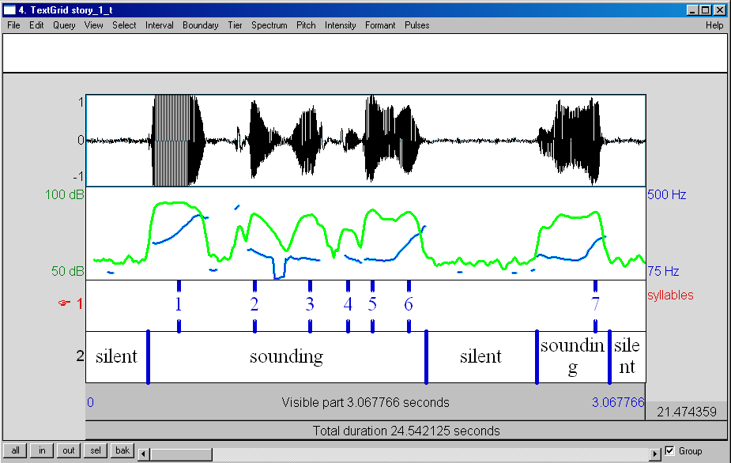
Detected Syllable Nuclei using Algorithm
N
SR(sps) = ---------------------
Ttotal - Tsilent
SR(wpm) = Ψ x SR(sps) x 60
Where, N = number of syllables spoken per unit time
Ttotal = total speech time
Tsilent = duration for which no speech was detected
Where conversion factor, Ψ = 1.5

Slide 6

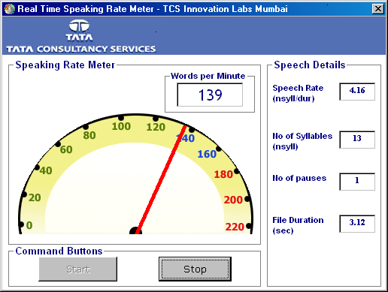



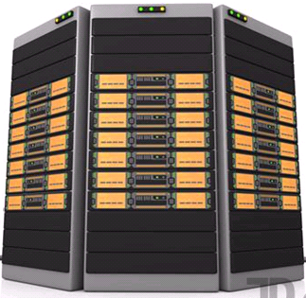



A Typical Call Center Senario
Speaking Rate Monitor
Speech Analysis
Feedback to
Agent
Customer
Agent Talking
To Customer
Agent's Desktop
Customer Talking
To Agent
Call Center PBX
MX10
Agent

Slide 7
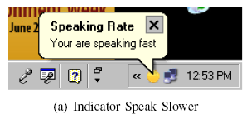
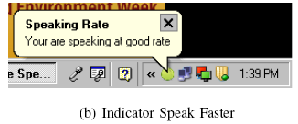
Speaking Rate Monitoring Real Time – Agent Interface
Speaking Rate as
words spoken per minute
Speaking Rate in
syllables per sec
No of syllables
No of Pauses
Speedometer
Duration of file on
which the analysis is
carried on

Slide 8
Experimentation and Results
Level 1: Performance Accuracy was tested on a text - “The first one believed in faith, he thought”
  Method 1: Using the Algorithm
    No of syllables = 8
  Method 2: Manually calculating the number of syllables in the text
    Th|e| f|i|rst |one| b|e|l|ie|v|e|d in f|ai|th, he th|ou|ght
      No of syllables = 8
Level 2: Performance Accuracy : A short paragraph in English was asked to be spoken by 10 persons with 3 different Speaking Rate
  The number of syllables identified using algorithm for these 30 spoken speech was within 10% of the actual number of syllables, present in the text

Slide 9
Challenges
For Enabling Real Time Speaking Rate Monitoring System we had the challenge of computing the speaking rate not only accurately but also quickly.
  Experimented with several duration of speech signal and converged to the fact that analyzing a 5 sec speech sample every 1 second gave the desired results of accuracy
Note: The longer the duration of the speech analyzed the better is the accuracy of detection of syllables and hence computation of speaking rate.
Further the delay of 5 sec was found to not cause any feel of a delay by the agent.

Slide 10
Conclusions
The speaking rate monitoring system was used on the agents desktop in the floor of a call center and gave a real time feedback to the agent.
The feedback allowed the agent to change the speaking rate on the fly
Speaking Rate icon on taskbar/popup messages has a significant effect on CSI in an Agent-Customer interaction
Use Cases
  Analysis based on Speaking Rate can identify calls with low CSI (agent speaking fast) and also where the customer is unhappy.

Slide 11
Thank You.
meghna.panddharipande@tcs.com
Tata Consultancy Services- India.

