Slide 1
KisanMitra: A Question Answering System For Rural Indian Farmers
Cognitive Systems Research Laboratory
Tata Consultancy Services Limited
Navi Mumbai
www.tcs.com
Notes:
Looks a bit too plain – add colour and a prettier font like Arial

Slide 2
Presentation Outline
What is KisanMitra?
Why KisanMitra?
Use of NL technology for Question Answering systems
Benefits of KisanMitra
Some snapshots of a working system
Information database (Crops, Cultivation Methods)
Typical Queries handled by KisanMitra
Conclusion
Notes:
What is the difference between bullets 1 and 4?

Slide 3
What is KisanMitra?
A CSR (corporate social responsibility) initiative of TCS
A Question Answering System for the rural community
Query in any Indian language
  currently in Hindi
Query in natural language
  no constraints on the way the query is posed
Notes:
Tell about …

Slide 4
Why KisanMitra?
5% of India’s population conducts business in English, the rest know only their own regional languages.
Lack of local language interaction facilities contributes to digital divide.
There is urgent need to build useful applications capable of taking inputs in Indian language.
Our system lets farmers to seek agriculture related information anywhere anytime.

Slide 5
Why KisanMitra? (2)
Farmers need expert advice on
  ways to obtain rich harvests from their crops
  information regarding subsidies, government schemes
Today, their only helpline is (monthly?) visit by local agricultural official to the village
KisanMitra, ‘farmers’ friend’, would provide expert answers to the farmer’s queries.

Slide 6
Natural Language Processing based Question Answering system
Web enabled QA system with Hindi interface.
User can query
  in their own language,
  in their own style,
  in natural language,
  no constraint on the user to use a set of predefined keywords to access system,
  poor grammar tolerated,
  spelling mistakes tolerated
Gives the closest answer in the absence of an exact answer in the info-base
Dispenses with ‘click and browse’ mode of operation

Slide 7
Benefits of KisanMitra
Answers the farmers’ queries like an expert
Is available 24x7
Has local language interface
Understands the intent of the query, provides ‘close’ answers if exact answers are not available

Slide 8
KisanMitra in Use
Snap shots are excerpted from a live system
  http://163.122.72.66/

Slide 9
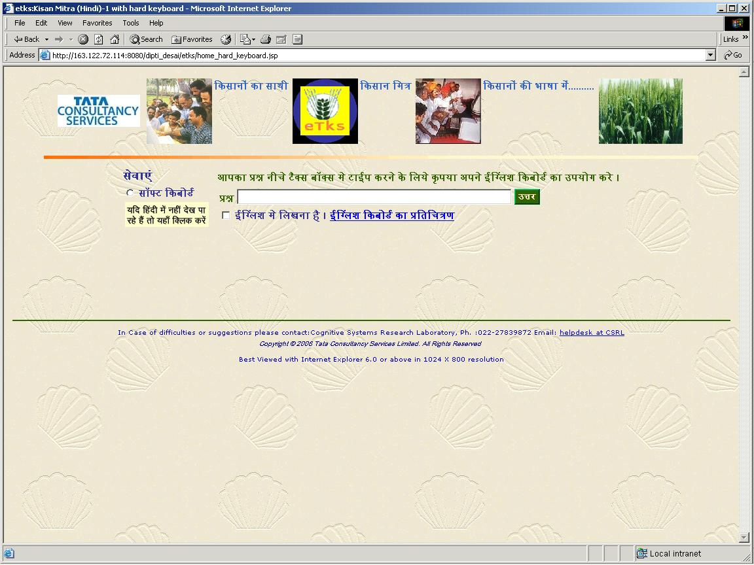
Web based user interface

Slide 10
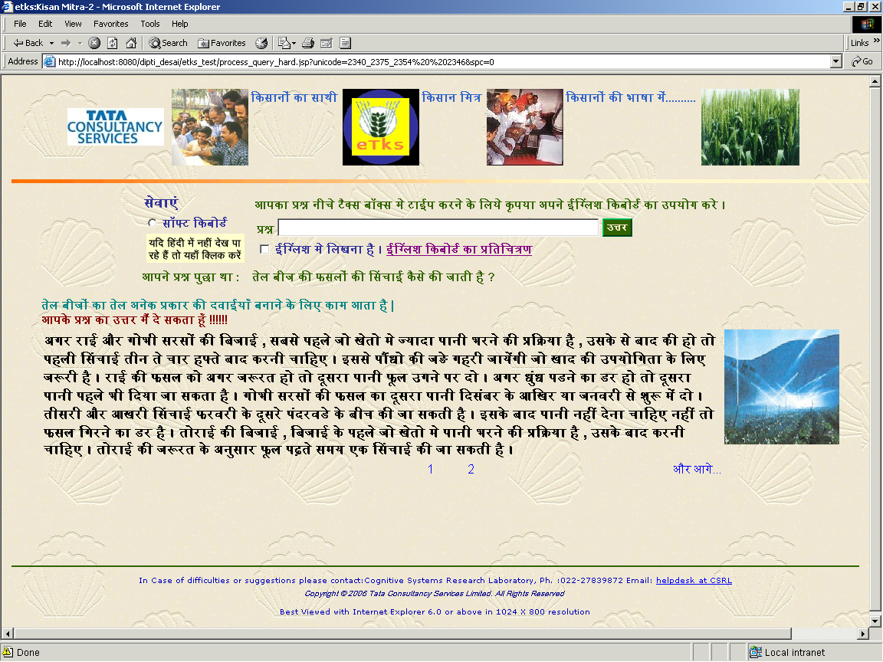
Question was “how to do irrigation of oil seeds” in Hindi.
Preludes are added to give a human touch in Hindi
Answer is given for “irrigation of oil seeds” in Hindi

Slide 11
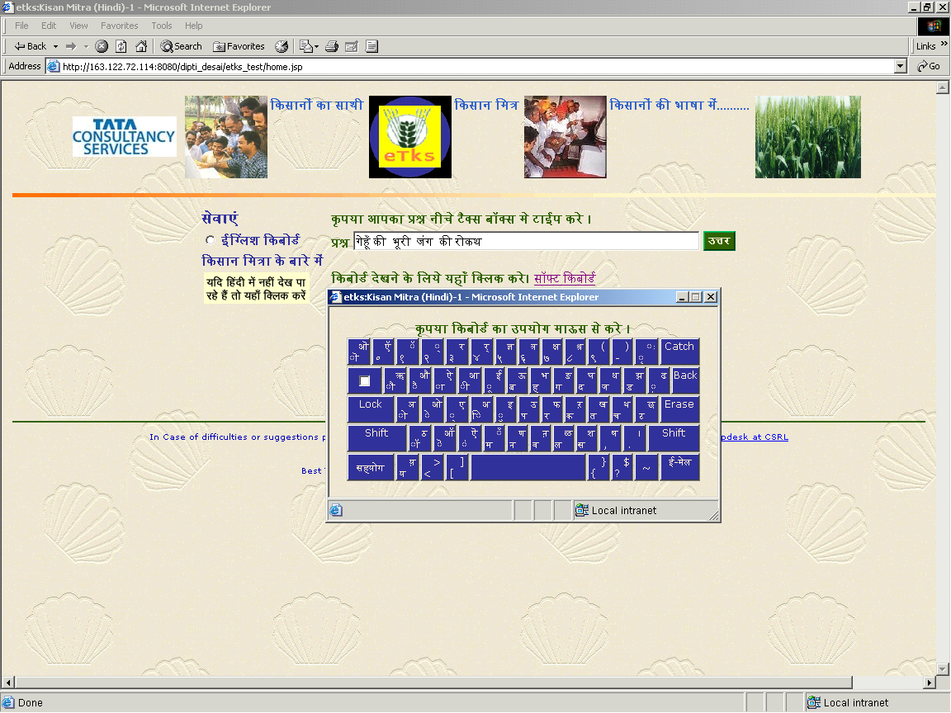
Soft keyboard is provided for entering Devnagari letters by clicking with mouse.

Slide 12
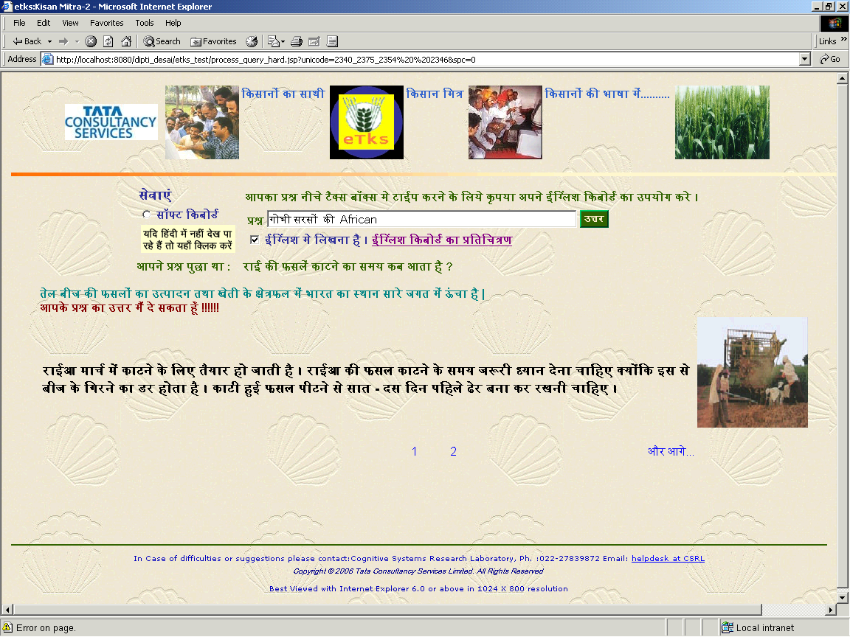
Option is provided for entering English letters
You can enter both Hindi and English words in a question

Slide 13
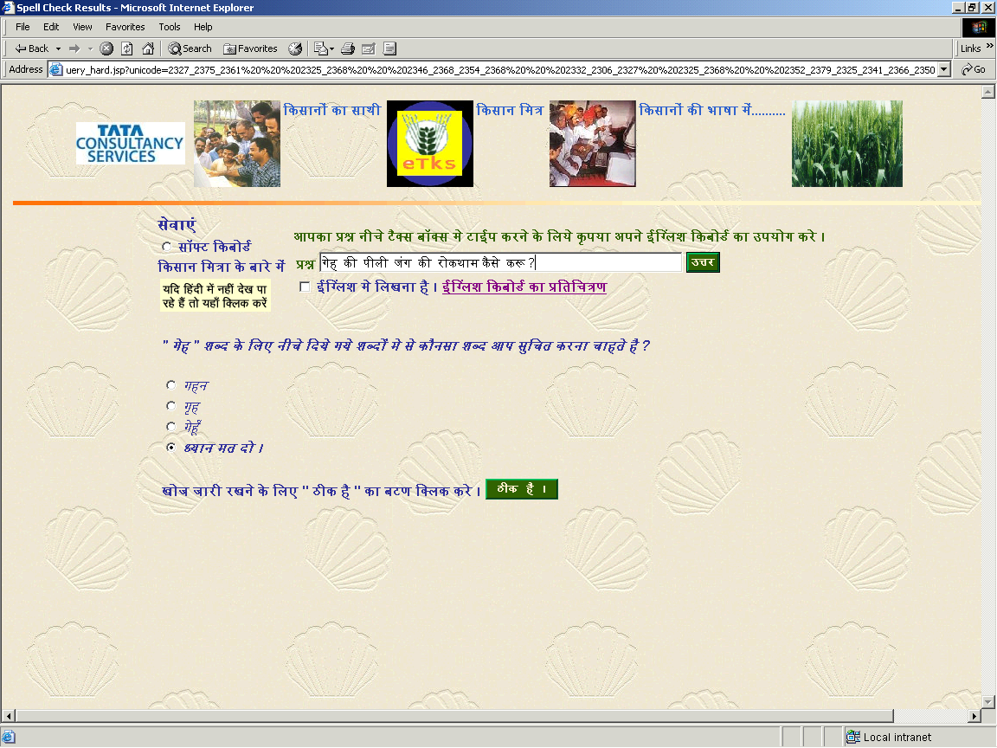
In case of spelling mistakes KisanMitra alerts you
Option are given for correct spellings

Slide 14
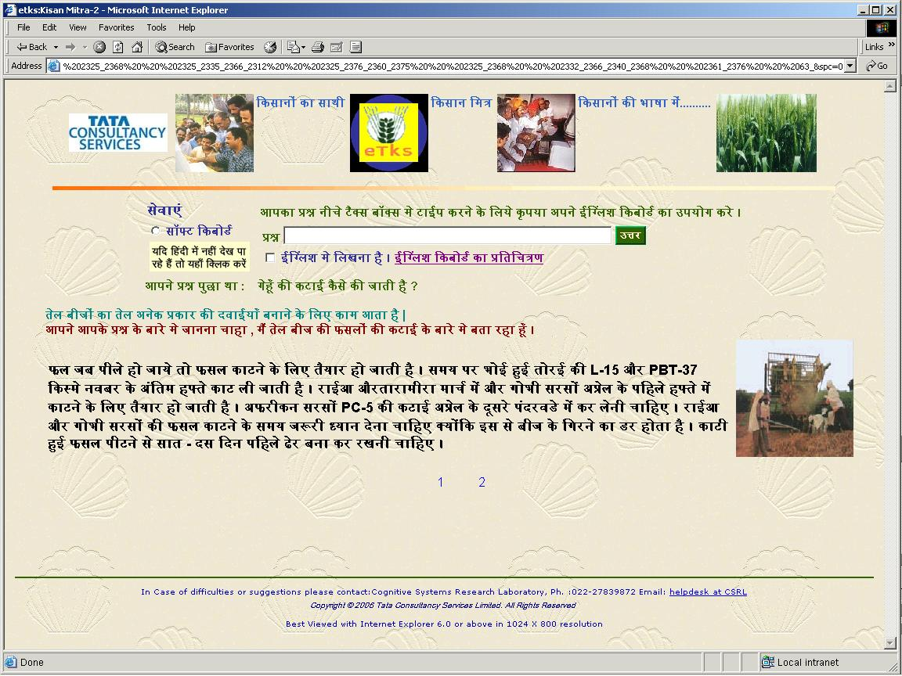
The question asked was “how to harvest wheat ?”
In the absence of exact answers not being present , It provides answers which are close in some sense.
Answer is provided as harvesting of oils seeds since exact answer was missing for the question

Slide 15
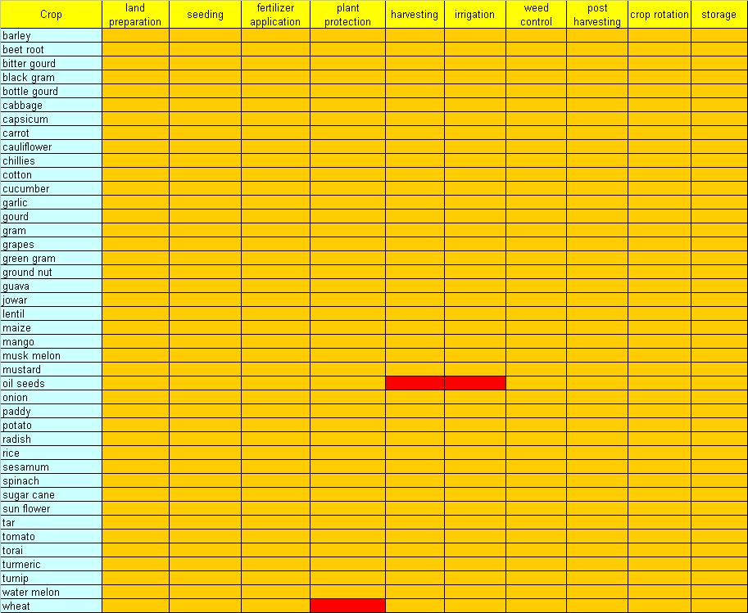
Current info-base
A list 42 of crops addressed by the system.
9 different cultivation methods
For all other (40 crops) we have partial data
Currently we have complete data answers for the crops oil seeds and wheat (cells painted in red)

Slide 16
Typical Queries Handled by System
How can I beneficially harvest oil seeds?
How to harvest oil seeds?
Procedure to harvest oil seed?
  Similar intent queries
  Answers related to the intent procedure for harvesting of oil seeds is displayed by KisanMitra.
  In a keywords based systems, all pages having words oil seeds and harvest will be fetched, which may include pages related to when to harvest oil seeds or best season to harvest oil seeds.
How can I control kernel bat disease in wheat?
When should I carry out a final irrigation for Gobhi Sarso?
What is the best crop to rotate with wheat?
How would I know that my wheat crop has been attacked by yellow rust?

Slide 17
Conclusions
QA system that addresses queries in the agricultural domain.
USPs
  handles queries in Indian languages
  accept queries in natural language
  tolerates grammar and spelling mistakes
  responds even to queries which have no exact answer in its knowledge-base by giving answers which are close to the query.
  is user friendly and is a more natural user interface
prototype has been built and is in the process of being deployed in North India.

