Slide 1
VOICE BASED SELF HELP SYSTEM
USER EXPERIENCE VS ACCURACY
Dr. Sunil Kumar Kopparapu
TCS Innovation Lab – Mumbai, Thane, Maharastra
INDIA
November 8, 2026

Slide 2
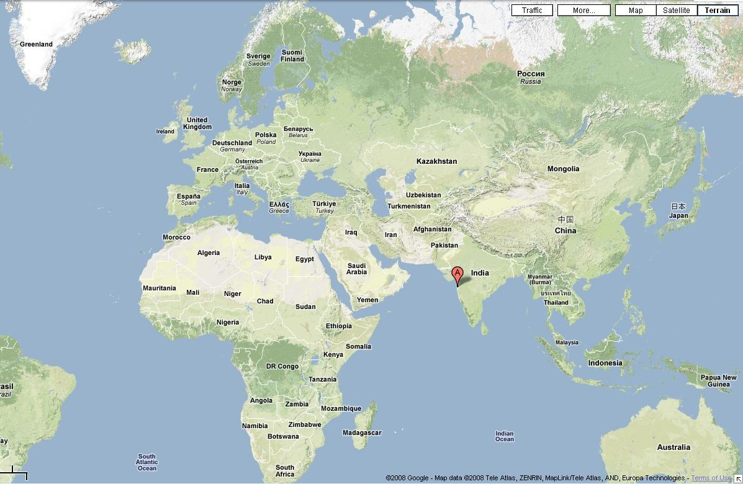
Location (Thane, Maharastra, India)

Slide 3
What is a Voice Based Self Help System?
Self Help Systems, typically are automated systems that enable users to help themselves.
When the medium of transaction is voice or speech, it is called a Voice Based Self Help System.
Query
Transaction Begin
User
Self Help System
Response
Transaction End
An Example ….

Slide 4




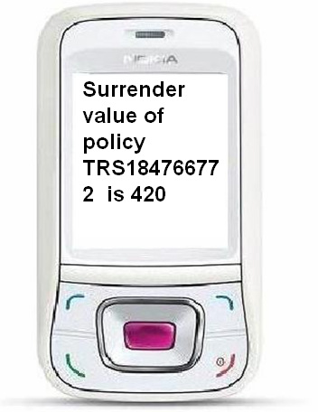
Voice Enabled Self Help System: An Example
Query: What is the surrender value of policy TRS184766772 ?
Client
Agent Speaks query
Self Help
Self Help speaks out the response
(Insurance) Agent
Surrender value of policy TRS184766772 is 420
Client
Insurance Agent’s PC
Self Help sends SMS response

Slide 5
What is a Successful Speech Solution?
For a speech solution to work in field there are two important parameters that needs to be satisfied
  the accuracy of the speech recognition engine and
  the overall user experience
Best solution
  better speech recognition accuracy
  better user experience
Feasibility of the best solution
  Speech Recognition Performance
    Better if user restricted to speak in a limited way
    Bad if the user has no restriction on what he can speak
  User Experience
    Better if the user has no restriction on what he can speak
    Bad if user restricted to speak only in a certain way
User Experience and Speech Recognition performance contradict
Optimal solution lies in between!

Slide 6
Measure: User Experience, Speech Recognition
User experience is measured by the freedom the system gives the user in terms of
  who can speak (speaker independent),
  what can be spoken (large vocabulary) and
  how to speak (restricted or free speech)
Speech recognition accuracies are measured as
  the ability of the speech engine to convert the spoken speech into exact spoken text.
  Word Error Rate

Slide 7
Overall Performance of Speech Solution
Time Sequence (/Qt/ ≡ Qs)
Speech Recognition (Acoustic)
+
Language Processing (Grammar)
String Sequence (Qs’)
Natural Language Processing
String Sequence (Qs’’)
Ideally Qs’’ should be equal to Qs
Overall performance of the system depends on how close Qs’’ is to Qs in the sense of intent

Slide 8
Language Processing in Speech Systems
Language processing happens both in speech recognition module and the natural language processing module.
The language processing in speech module is necessary to achieve reasonable recognition performance
  Language processing (or grammar) used in speech module is tightly coupled with the acoustic models (degree of configurability very limited)
Language processing in speech recognition module is not sufficient
  Because of the tight coupling; need separate language processing
  Why? A relatively high degree of configurability possible
Question: Do we need language processing in both the modules?
  isolate speech processing and language and have language processing only in language processing module or
  combine all language processing into speech module and do away with separate language processing module completely.
  Probably there is an optimal combination possible which produces a usable speech based solution.
Usable speech based solution
  A combination of speech module and language processing module such that their combined effort enables Qs’’ be as close as possible to the desired Qs

Slide 9
Language Processing in Speech Recognition Module
User experience can be controlled by changing the grammar (language processing) of the speech recognition engine
Type 3 (High User experience)
  Allow the user to speak anything (free speech; dictation like)
  Allow any user to speak (speaker independent)
Type 2 (Moderate User Experience)
  Allow the user to speak a large vocabulary – but not everything
  Configure for a particular user (speaker dependent)
Type 1 (Low User Experience)
  Allow the user to speak only what is expected (in terms of grammatical correctness)
  Ask to repeat if the user does not adhere to the preset format
  Configured to a particular speaker (Speaker dependent)
Best User Experience
Type 1
Type 2
Type 3
Best Speech Recognition

Slide 10
Need for Separate Language Processing Module
Ideal System
  Open Speech (free speech - speak without constraints),
  Speaker independent (different accents, dialects, age, gender)
  Environment independent (office, public telephone)
  Accurate speech recognition
For best User experience
  Type 3 speech recognition module
  ‘poor’ performance of the speech module
For best speech recognition accuracies
  Type 1 speech recognition module
  ‘poor’ user experience
Best of both; demands
  Need for a separate Language Processing Module to take care of poor performance of the speech engine while retaining the high user experience

Slide 11
Experimental Setup
A self help system was built for
  Insurance agents (act as intermediaries between insurance company and clients)
  To keep track and seek information for their clients (policy status, maturity status, change of address request)
  Information related to the insurance agent (When was my last commission paid?)
Why? build a self help system
  to enable the insurance company to lower the use of human call center
  providing up-to-date and dynamic information needed by agents
  both this together provide better customer service.
Using
  Speech Recognition engine of Microsoft using Microsoft SAPI SDK
  Language Processing module was developed in-house

Slide 12
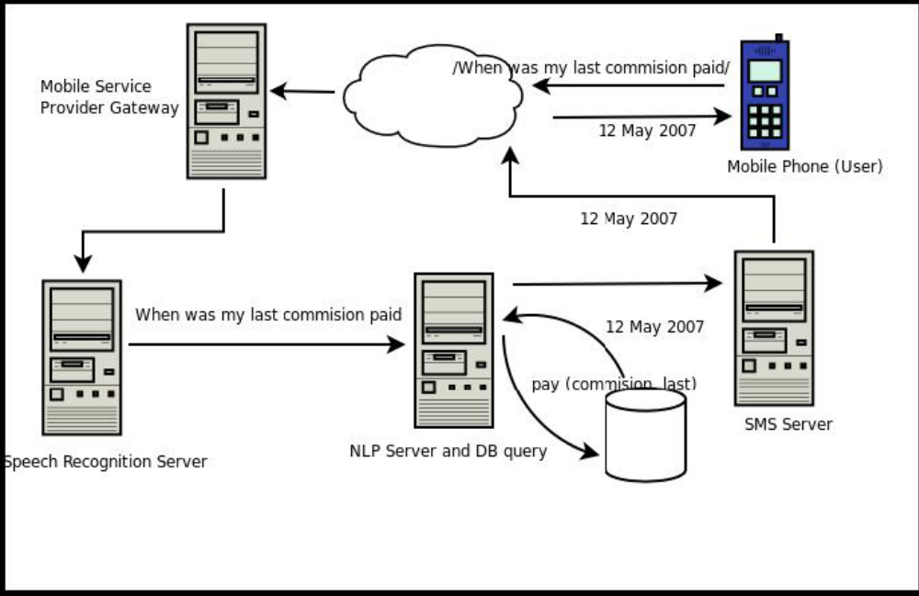
Voice Based Self Help System: Block Diagram
Speech Recognition (Acoustic)
+
Language Processing (Grammar)
Natural Language Processing

Slide 13
Type 1: Bad User Experience Best Speech Recognition
<GRAMMAR>
<RULE NAME="F_3" TOPLEVEL="ACTIVE">
<o> <RULEREF NAME="StartTag"/> </o>
<RULEREF NAME="KeyConcept"/>
<o> of <o> the </o>
<RULEREF NAME="KeyWord"/>
<o> <RULEREF NAME="EndTag"/> </o>
</RULE>
<RULE NAME="StartTag">
<P> What is the </P>
<P> Can you please send me</P>
<P> Can you tell me </P> </RULE>
<RULE NAME="KeyConcept">
<P> Surrender Value </P>
<P> Address Change </P> </RULE>
<RULE NAME="KeyWord">
<P> Policy Number </P> </RULE>
<RULE NAME="EndTag">
<P> Thank You </P> </RULE>
</GRAMMAR>
User
  Constrained Speech
Example Queries
  What is the surrender value of Policy number
  Can you please tell me the maturity value of Policy number
  …
Note that the constrained grammar gives a very accurate speech recognition because the speaker speaks what the speech engine expects

Slide 14
Type 2: Moderate User Experience and Speech Recognition
<GRAMMAR>
<RULE NAME="F_2" TOPLEVEL="ACTIVE">
<RULEREF NAME="DonotCare"/>
<RULEREF NAME="KeyConcept"/>
<RULEREF NAME="DonotCare"/>
<RULEREF NAME="KeyWord"/>
<RULEREF NAME="DonotCare"/>
</RULE>
<RULE NAME="KeyConcept">
<P> Surrender Value </P>
<P> Maturity Value </P>
<P> ... </P>
<P> Address Change </P>
</RULE>
<RULE NAME="KeyWord">
<P> Policy Number </P>
<P> ... </P>
<P> ... </P>
</RULE>
</GRAMMAR>
User
  Can Speak anything but with in a constrained vocabulary
Valid Queries
  <anything> Surrender value <anything> policy number xyz
  <anything> policy number xyz <anything> maturity value

Slide 15
Type 3: High User Experience Low Speech Recognition
<GRAMMAR>
<RULE NAME="F_1" TOPLEVEL="ACTIVE">
<RULEREF NAME="DonotCare"/>
</RULE>
</GRAMMAR>
User
  Can Speak anything
Valid queries
  even out of domain query like What does this system do?
  an incorrect query like What is last paid commission address change?
Note that the liberal grammar gives a very poor speech recognition because the speaker can speak anything under the sun!

Slide 16
Evaluation
Best User Experience
Type 1
Type 2
Type 3
Best Speech Recognition
Natural Language Processing
27 possible query types
27 valid
0 invalid
3 not responded by Type 1 grammar + Language processing module
76 possible query types
56 valid queries
20 invalid but processed by Type 2 grammar + language processing module
357 possible query types
212 valid (meaningful)
145 invalid but processed by Type 3 grammar; handled by separate language processing module

Slide 17
Conclusions
The performance of a voice based self help solution has two components
  user experience and
  the performance of the speech engine in converting the spoken speech into text
We demonstrated that
  speech and language module can be used jointly to come up with types of self help solutions which have varying effect on the user experience and performance of the speech engine.
  by controlling the language grammar one could provide better user experience but the performance of the speech recognition became poor
  on the other hand when the grammar was such that the performance of speech engine was good the user experience became poor.
For designing usable voiced based self help systems
  A balance between speech recognition accuracy and user experience is to be maintained so that
  the speech recognition accuracy is good
  without sacrificing user experience

Slide 18
Thank You
Voice Based
Self Help System:
User Experience
Vs
Accuracy
Questions, Comments
sunilkumar.kopparapu@tcs.com
+ 91 22 6778 8216

