Slide 1
A NOVEL MOBILE INTERFACE TO REGISTER CITIZEN COMPLAINTS
Sunil Kumar Kopparapu, Nirmal Janardanan
TCS Innovation Labs, Mumbai, INDIA – 400 601
Nirmal.j@tcs.com

Slide 2
Topics :
Introduction
Company Information
Overview
Complaint Registration on Web
Natural Langage Mobile Interface
Interface Architecture
Conclusion

Slide 3
TATA Consultancy Services – An Overview
TCS was established in 1968
FY 2007 revenue of USD 4.3 billion ( from USD 2.97 billion in FY 2006)
Over 116,308 employees (as of 16 July 2008)
Operations in 50 countries, 155 offices in 40 countries
First and Largest
        Software R&D centre in India
        Software exporter in India

Slide 4
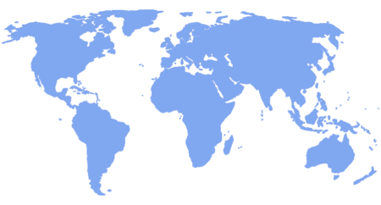
Truly Global Presence
155 Offices in 40 countries
85 Delivery Centres in 16 countries
Europe
18
2
UK & Ireland
N. America
7
1
50
4
India
47
65
APAC
ME & Africa
14
3
6
2
Iberoamerica
13
8
Sales Office
Delivery Centres
As on 1st October 2007

Slide 5
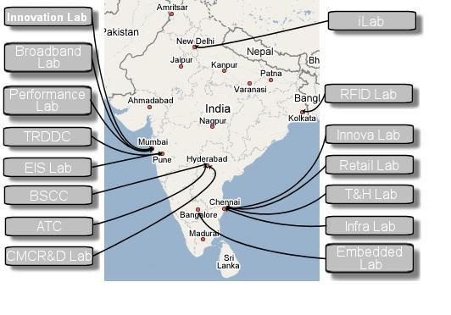
TCS Innovation Labs in INDIA

Slide 6
Overview
New Technologies
City
Related
Problems!
Awareness
Ease of Participation
Solve
Active Citizen Participation
Municipal Corporation

Slide 7
Citizen Participation: Multi mode complaint registration
Conventional
  Verbal complaints registered at Central Complaint Registration System (CCRS) counter
  Courier paper based complaints to CCRS, Municipal HO
  Complaints received at Ward Office by Complaint Officer
Phone, Fax
  24 hours call attendance with 10 phone lines on 1916
  Fax complaints to 2269 4719
Internet
  E-mail complaints to ccrs_ho@vsnl.net
  Hyperlink from MCGM website at www.mcgm.gov.in

Slide 8
Good Enough for Active Participation?
Conventional
  Time Consuming (need to go to ward office),
  Tedious (strict timings; you need to work too!)
Phone, Fax
  Phone (Acoustics Confusion; language)
  Fax (an expense; fax machine availability; write on a paper)
Internet
  Email (not accessible to many; need a computer on internet)
  Web - Need a computer on web (not accessible to many)
Several options available but …. far from eliciting citizen participation; can we do better?

Slide 9
A Look at Available Technologies
Mobile Communications
  Getting Cheaper
  Higher penetration and Growing
  Accessible across economic strata
Natural Language Processing Technology
  Subfield of AI and Computational Linguistics
  Addresses automated generation and understanding of natural human languages
  Makes man machine interaction easy
    Converts human language into formal representation that are easier for computers to manipulate
Can we blend these two technologies?

Slide 10
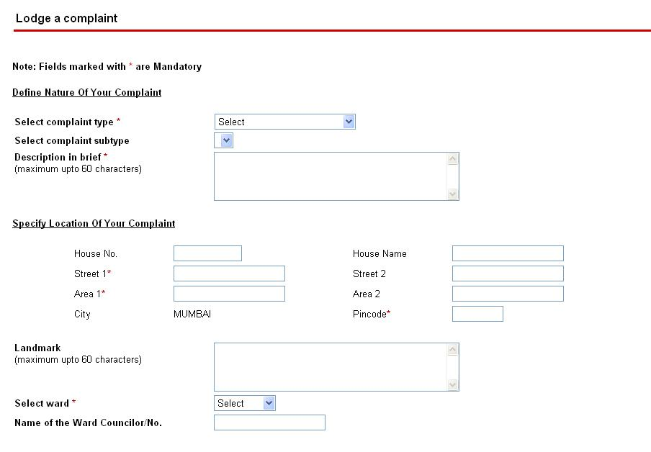
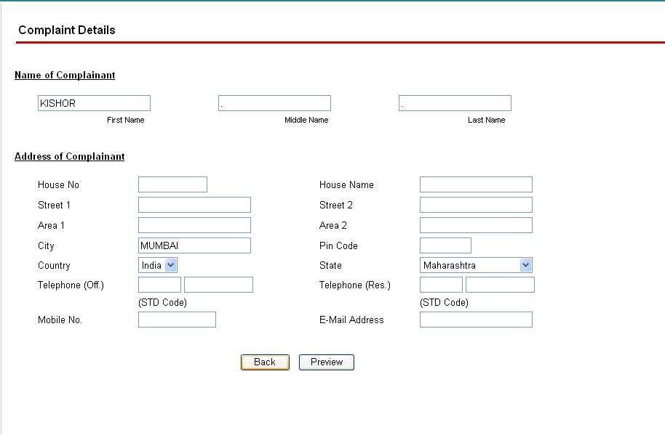
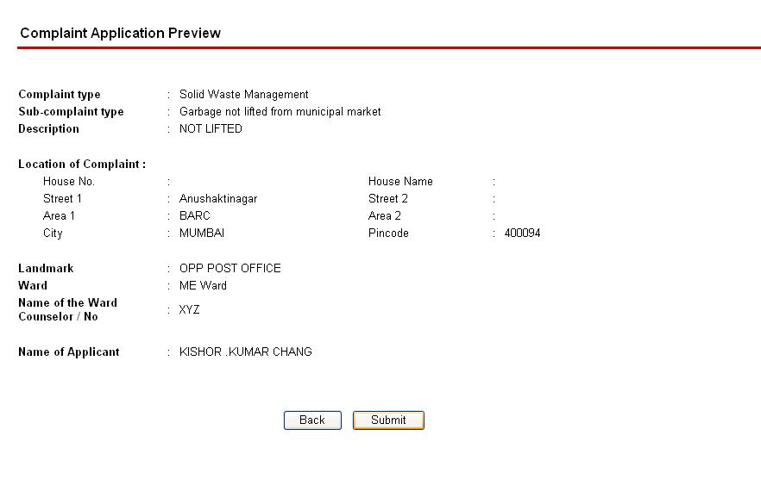
Complaint Registration on the Web: Today
Need to have access to networked computer
Aware of category and sub category of complaint
Need to aware of ward details
Several clicks and hyperlink traversals
Need to note the complaint number for future tracking

Slide 11
Complaint Registration on the Web: Summary
For complaint registration, fill following mandatory fields:
  Complaint Type
  Complaint Sub type
  Street
  Area
  Ward
  Pincode
On registration, a complaint ID is returned for following up.

Slide 12
Natural Language Mobile Interface:
What is it?
  SMS based interface to municipal corporation(MC)’s existing web based complaint registration system.
  Citizens can complain by sending a simple SMS in a format free language.
  System registers the complaint with the MC’s complaint registration web site.
How does it work?
  Using natural language processing techniques, system understands the complaint from SMS text .
  If SMS contains sufficient information, complaint is registered.

Slide 13
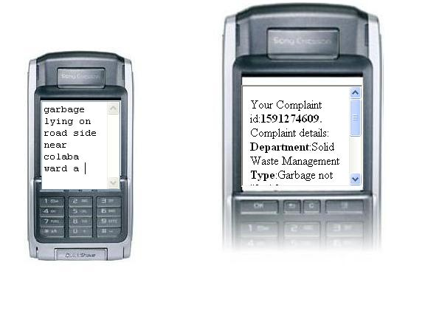
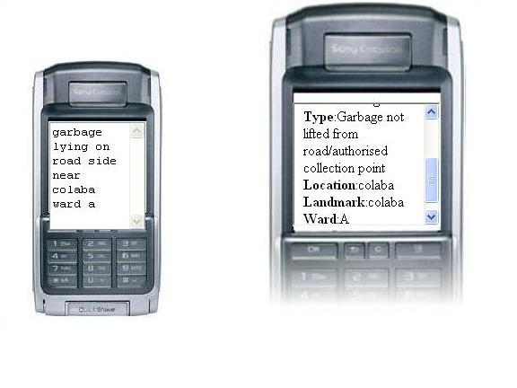
Natural Language Mobile Interface:

Slide 14
How?
User composes a SMS complaint (natural language; free of format;160 char) on his mobile device
Sends the SMS to a predefined short code
System interprets the intent of the complaint (NLP)
Insufficient information? Intelligently asks for missing information
Files the complaint on the MCGM portal (existing backend)
Retrieves the complaint number
Send the complaint number to the user as SMS (future reference)
Complaint filing made easy and simple

Slide 15
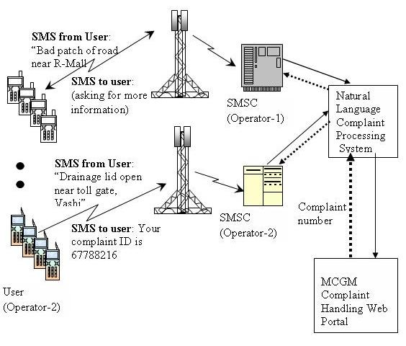
Natural Language Mobile Interface: Architecture

Slide 16
Active Citizen Participation: Why?
Ability to register their complaints
  “as they occur”
  Anytime; any where (24 x 7)
  using their hand-held device for a minimal cost (cost of a SMS)
Satisfying sense of participation
  Ease of use
    devoid of any specific format to register a complaint
    freedom to send a complaint in no format (in natural language),
    allows use of colloquial words in their complaints
  Tracking Complaint
    keep track of their complaint status 24x7 using their mobile device

Slide 17
Municipal corporation participation: Why?
Get to know about various complaints,
  Even those which they were unaware of because of lack of citizen participation
Get to appreciate
  sense of urgency

Slide 18
Conclusions
Enables and assists citizens to place a compliant
  through an SMS on their mobile phone
  around the clock; allows “complain as you see”
  easy to use (register complaints in natural language)
Economic Sense
  make use of the existing web portal infrastructure as the back-end (no additional cost to Municipal Corporation)
  Cheap (cost of an SMS – to user)
Social Relevance
  enables active citizen participation for upkeep of city
  solution to push socially relevant messages to citizens (Polio drop)

Slide 19
Thank You
Questions, Comments?
TCS Innovation Labs – Mumbai
Tata Consultancy Services
Yantra Park, Thane (West)
Maharastra 400 601
{sunilkumar.kopparapu, nirmal.j}@tcs.com

