Slide 1
A Novel Mobile Interface to Register Citizen Complaint
  Dr. Sunil Kopparapu
  TCS Innovation Lab – Mumbai,
  Tata Consultancy Services, Thane, Maharastra, India

Slide 2
Overview
New Technologies
City
Related
Problems!
Awareness
Ease of Participation
Solve
Active Citizen Participation
Municipal Corporation

Slide 3
Citizen Participation: Multi mode complaint registration
Conventional
  Verbal complaints registered at Central Complaint Registration System (CCRS) counter
  Courier paper based complaints to CCRS, Municipal HO
  Complaints received at Ward Office by Complaint Officer
Phone, Fax
  24 hours call attendance with 10 phone lines on 1916
  Fax complaints to 2269 4719
Internet
  E-mail complaints to ccrs_ho@vsnl.net
  Hyperlink from MCGM website at www.mcgm.gov.in

Slide 4
Good Enough for Active Participation?
Conventional
  Time Consuming (need to go to ward office),
  Tedious (strict timings; you need to work too!)
Phone, Fax
  Phone (Acoustics Confusion; language)
  Fax (an expense; fax machine availability; write on a paper)
Internet
  Email (not accessible to many; need a computer on internet)
  Web - Need a computer on web (not accessible to many)
Several options available but …. far from eliciting citizen participation; can we do better?

Slide 5
A Look at Available Technologies
Mobile Communications
  Getting Cheaper
  Higher penetration and Growing
  Accessible across economic strata
Natural Language Processing Technology
  Subfield of AI and Computational Linguistics
  Addresses automated generation and understanding of natural human languages
  Makes man machine interaction easy
    Converts human language into formal representation that are easier for computers to manipulate
Can we blend these two technologies?

Slide 6
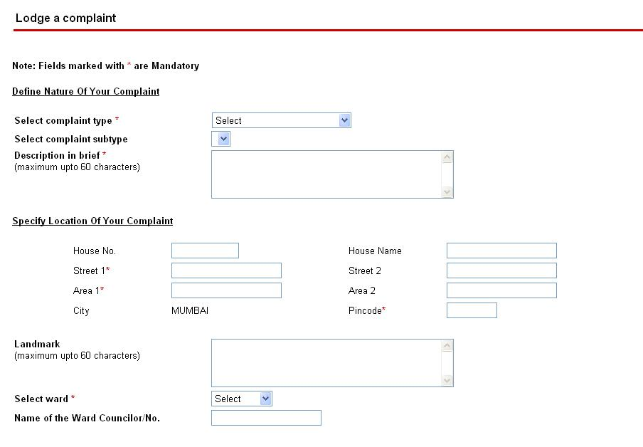
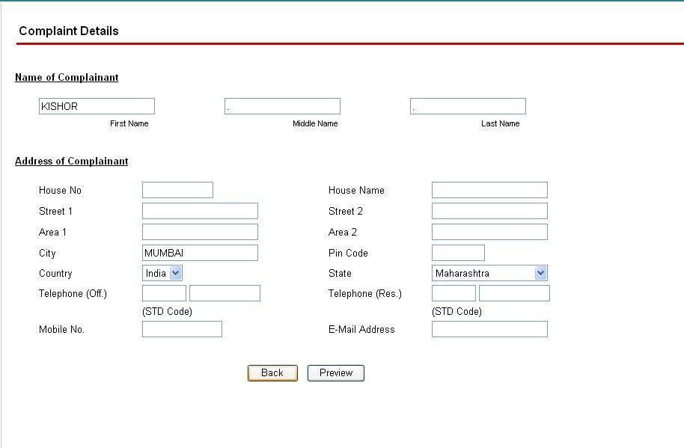
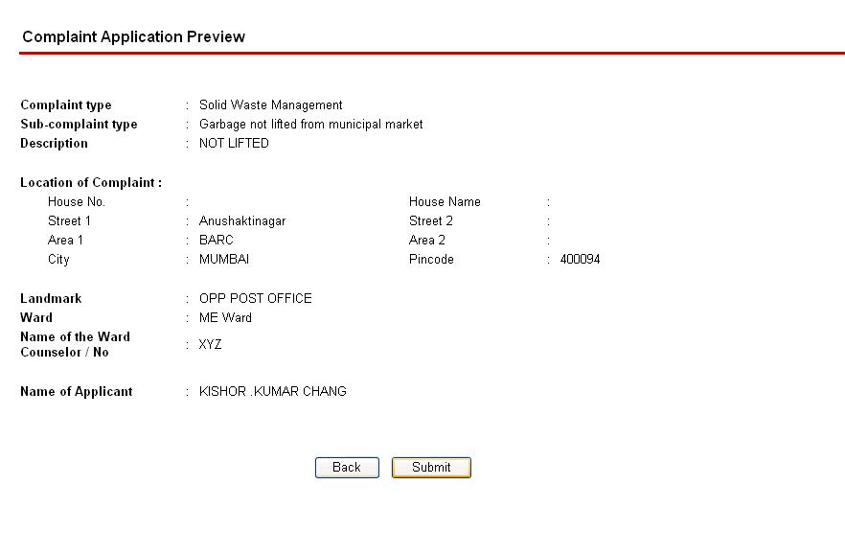
Complaint Registration on the Web: Today
Need to have access to networked computer
Aware of category and sub category of complaint
Need to aware of ward details
Several clicks and hyperlink traversals
Need to note the complaint number for future tracking
Difficult to upload images of complaint scenes

Slide 7
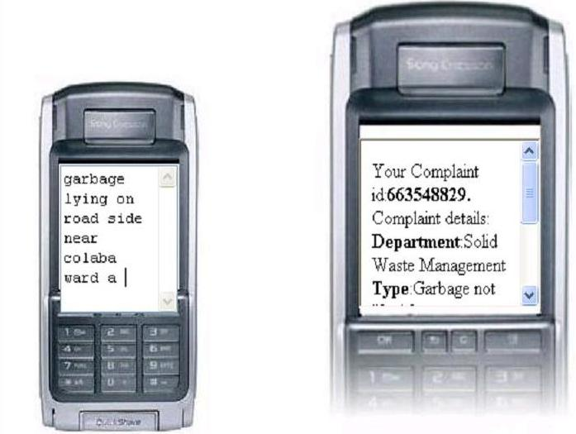
Natural Language Mobile Interface: Possible

Slide 8
How?
User composes a SMS complaint (natural language; free of format free;160 char) on his mobile device
Sends the SMS to a predefined short code
System interprets the intent of the complaint (NLP)
Insufficient information? Intelligently asks for missing information
Files the complaint on the MCGM portal (existing backend)
Retrieves the complaint number
Send the complaint number to the user as SMS (future reference)
Complaint filing made easy and simple

Slide 9
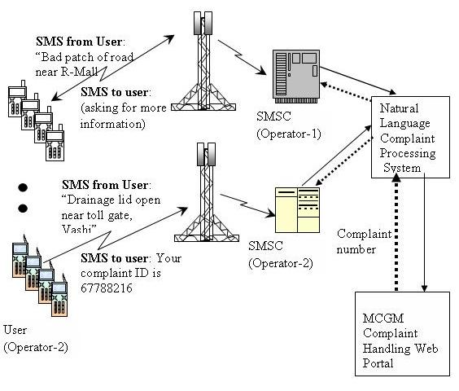
Natural Language Mobile Interface: Architecture

Slide 10
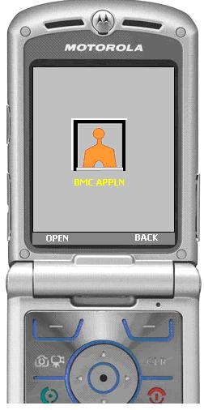
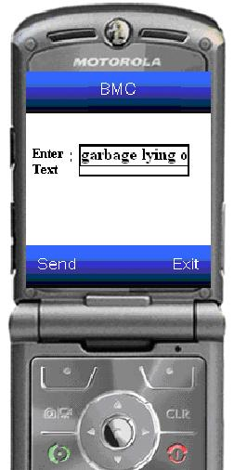
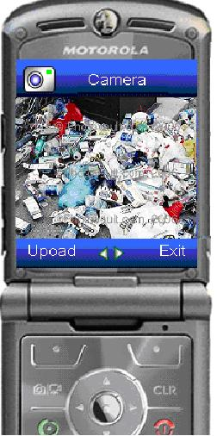
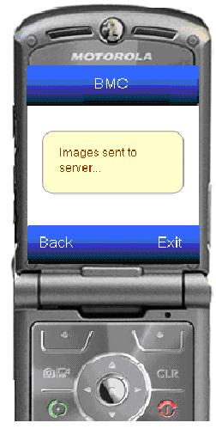
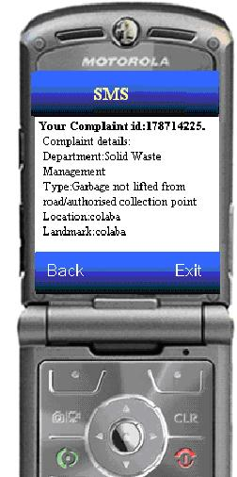
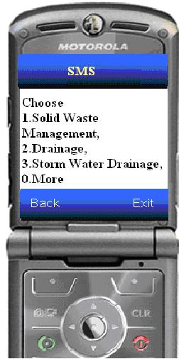
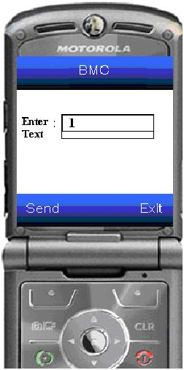
Mobile User Interface++: Usage Example

Slide 11
Active Citizen Participation: Why?
Ability to register their complaints
  “as they occur”
  Anytime; any where (24 x 7)
  using their hand-held device for a minimal cost (cost of a SMS)
Satisfying sense of participation
  Ease of use
    devoid of any specific format to register a complaint
    freedom to send a complaint in no format (in natural language),
    allows use of colloquial words in their complaints
  Tracking Complaint
    keep track of their complaint status 24x7 using their mobile device

Slide 12
Municipal corporation participation: Why?
Get to know about various complaints,
  Even those which they were unaware of because of lack of citizen participation
Get to appreciate
  sense of urgency
  genuineness of the complaint
  By looking at the “scene” of the complaint

Slide 13
Conclusions
Enables and assists citizens to place a compliant
  through an SMS on their mobile phone
  around the clock; allows “complain as you see”
  easy to use (register complaints in natural language)
  push scenes of complaint (add authenticity to complaint)
Economic Sense
  make use of the existing web portal infrastructure as the back-end (no additional cost to Municipal Corporation)
  Cheap (cost of an SMS – to user)
Social Relevance
  enables active citizen participation for upkeep of city
  solution to push socially relevant messages to citizens (Polio drop)

Slide 14
Thank You
Questions, Comments?
TCS Innovation Lab – Mumbai
Tata Consultancy Services
Yantra Park, Thane (West)
Maharastra 400 601
{sunilkumar.kopparapu, arun.pande}@tcs.com

