Slide 1
Knowledge Driven Off-line to On-line Script Conversion
Sunil Kopparapu, Devanuj, Akhilesh Srivastava, P.V.S. Rao
Cognitive Systems Research Laboratory
Tata Consultancy Services Limited
www.tcs.com

Slide 2
Presentation Outline
Off-line and on-line script
Off-line to on-line conversion problem
Advantage of using on-line data
Description off-line to on-line conversion
Knowledge used for conversion
Example
Conclusion

Slide 3
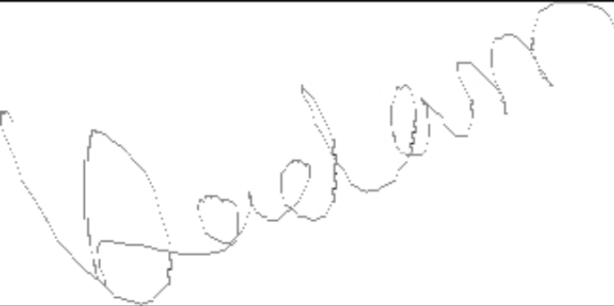
What is off-line script?
Represented as a bitmap image (.jpg, .gif, .pgm, .pnm)
There is no information (explicitly defined in the representation) on how the script was written
For example a scanned image of a signature

Slide 4
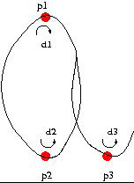
What is on-line script?
Represented as a set of time sequenced temporal (x(t), y(t)) coordinates
Representation captures the manner in which the signature was written (additionally pressure, number of pen lifts, etc may be also captured)
For example the output of a digitizing tablet (e-pen, IBM-Crosspad)

Slide 5
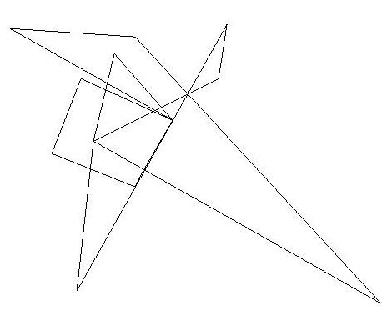
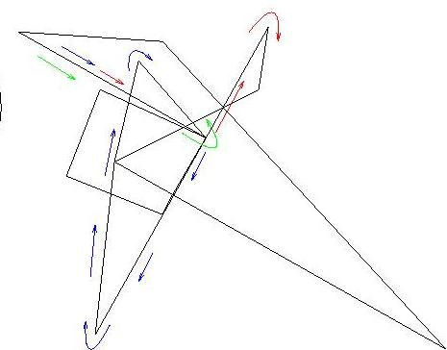
How was this written?
Several ways in which it could have been written, ill-posed problem

Slide 6

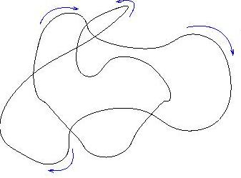
How was this written?
Can guess the way it could have been written

Slide 7
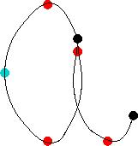

How was this written?
Can guess the way it could have been written

Slide 8
Why?
Knowledge of human minimum energy principle in writing script
  Continuity and
  Smoothness
Familiarity of the written script
  Direction of writing (left to right, top to bottom)
Knowledge of general ‘accepted’ way of writing

Slide 9
Why on-line script?
Better description of data.
Information present to exactly reconstruct the script exactly the way it was generated.
Position, orientation, size variations can be dealt with more easily
Robust parameter extraction possible
  Better pattern matching ability
  Better script recognition or verification

Slide 10
Conversion Procedure (1)
Input: Off-line bitmap image
Preprocessing and adaptive thresholding to binarize image
Identification of background and foreground of image
Foreground is the script (a path)
Identification of start point on the path
Construction of traversal element (a truck)
Positioning the truck on the path (use knowledge and heuristics)
Steer the truck to stay on the path (using knowledge and heuristics)
Output: Path traversed by truck is the on-line script

Slide 11
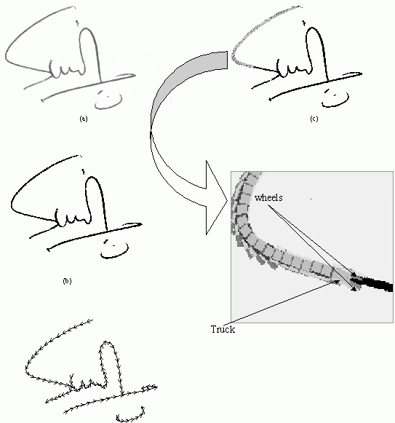
Conversion Procedure (2)

Slide 12
Knowledge Base
Script written from left to right
If more than one traversal path exist at a node – continue in the same direction as when approaching the node
Anticipate discontinuity in written script, variation in thickness, etc (due to binarization or pen pressure)
Script trajectory is continuous and smooth (human – optimization - minimum energy)

Slide 13


Example Traversal showing off-line to on-line conversion

Slide 14
Conclusions
Described a knowledge driven (using image processing techniques) process to extract on-line information from off-line script.
Conversion enables use of on-line parameters (size, orientation can be dealt more easily) for off-line script processing
Robustness in conversion can be achieved by guiding the conversion process using on-line information.
Among several applications, can be used for automated cheque signature verification or cheque processing

