Slide 1
Securing Mobile Devices Using Speech Biometrics
Anoop Bal and Sunil Kopparapu
TCS Innovations Lab, Advanced Technology Applications Group Tata Consultancy Services Limited
Thane – Maharashtra
anoop.bal@tcs.com
Notes:
If you are reading ,Please don’t explain.
Speak Slowly.
In agenda, Don't speak about Question Answer Session.

Slide 2
Agenda
Aim
Background
Need for secure mechanisms
About Biometrics and Speech as Biometric
Implementation and Results
Conclusions

Slide 3
Background
Twelve TCS Innovations Lab around the globe
Advanced Technology Application Group (ATAG) , located at Thane, Maharashtra is one among them
ATAG is involved in Research and Development activities on Speech, Script and Natural Language Processing technologies, with the aim of providing better human-machine interface

Slide 4
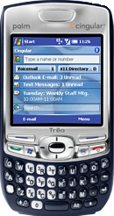
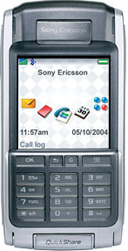
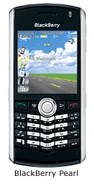

Aim
To secure mobile devices

Slide 5
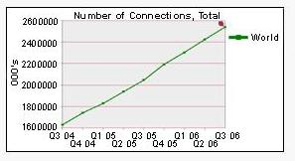
Growth of mobile phone market
Explosive growth in the usage of mobile phones
  Globally, 2.5 billion mobile subscribers on Dec’06
  [Q3 06]
  Projected to reach 3 billion subscribers by 2008

Slide 6
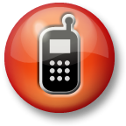
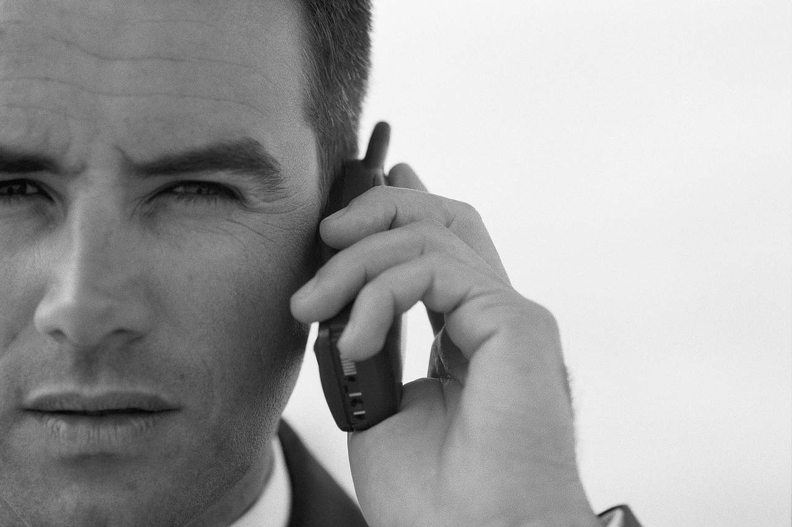
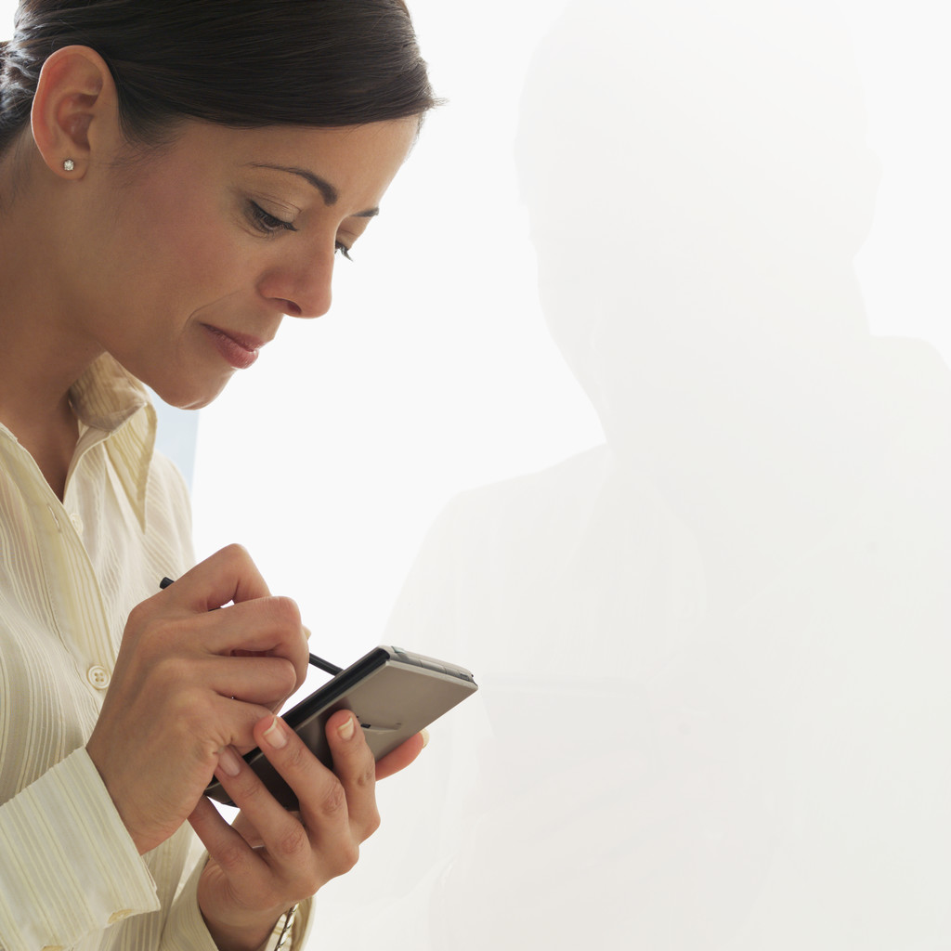
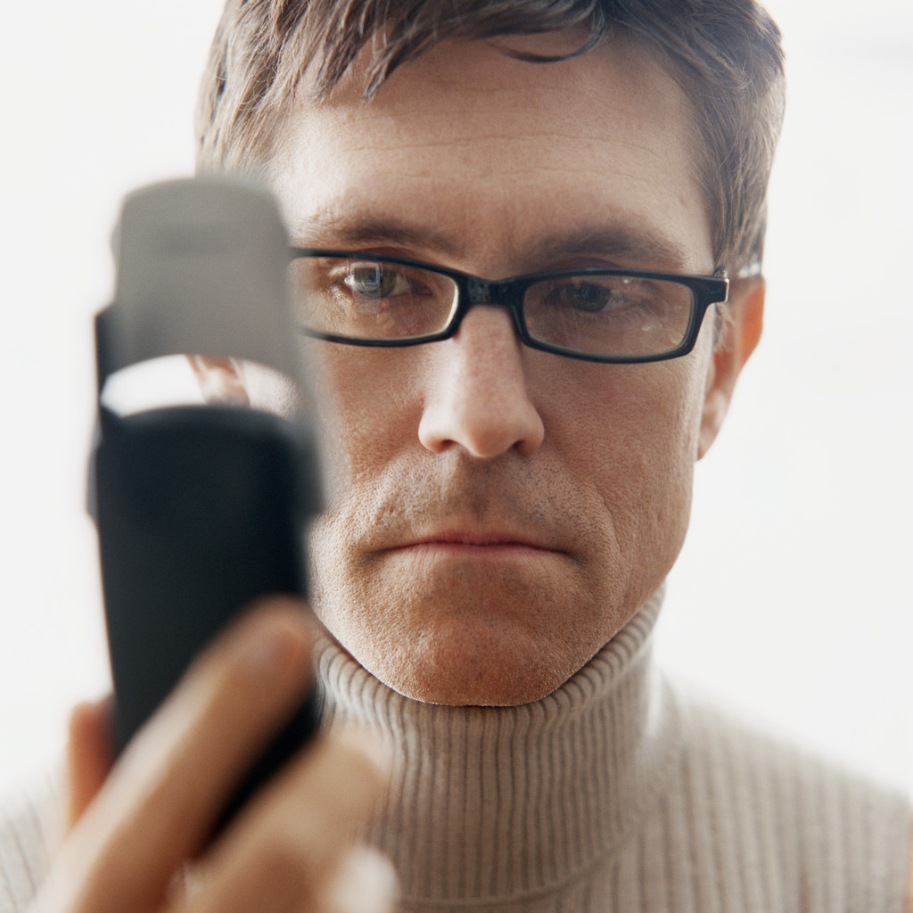
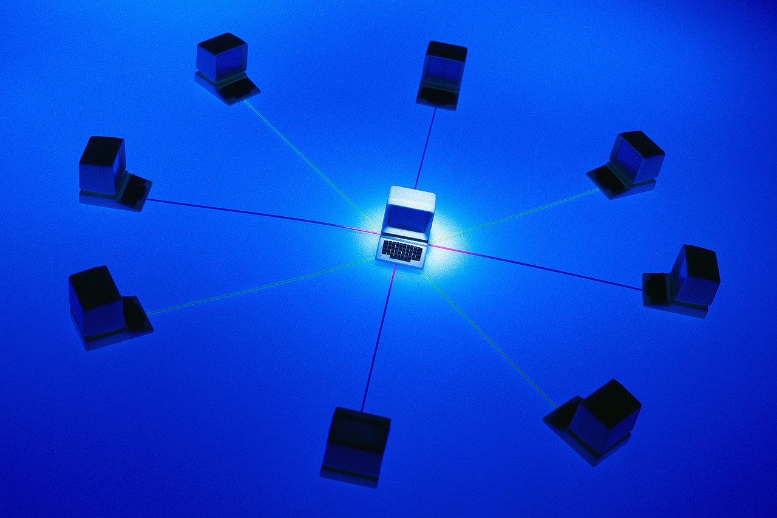
Evolution of Mobile Phones
Mobile phones have become
  Smaller, Sleeker and more Sophisticated
  Expensive
  Carry lots of Personal and Sensitive Corporate data

Slide 7
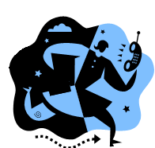
Why Secure Mobile Phone?
Mobile devices carry Personal and Sensitive Corporate data
As per estimates 7 Million mobile phones are lost every year

Slide 8

Is your mobile phone secure?
Phones provides Security mechanisms like Personal Identification Number (PIN) and Passwords
Reasons for failure
  Low user Acceptance
  Typically poor protection
  Cannot ensure that the user is who he claims to be
Notes:
Need to look into the heading…

Slide 9
Solution
Biometrics
Notes:
Need to look into the heading…

Slide 10
What is Biometrics?(1)
Biometrics is the science and technology of measuring and analyzing biological data

Slide 11
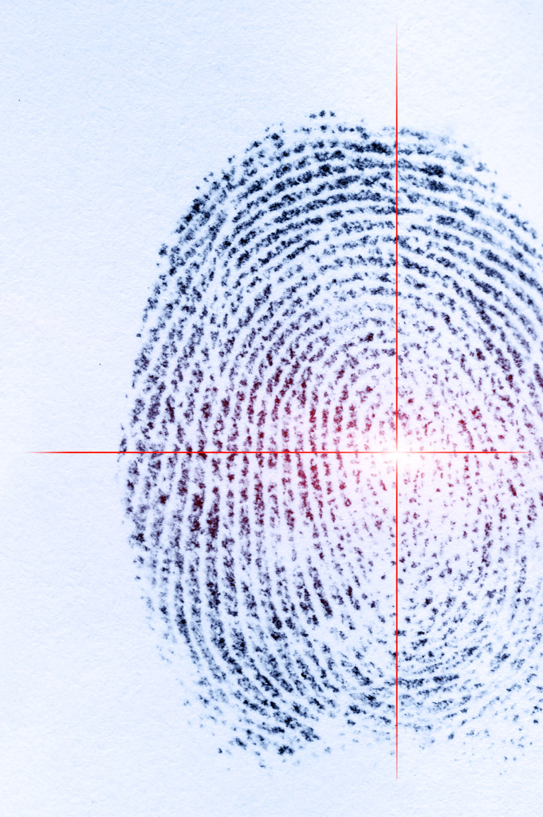
What is Biometrics?(2)
Biometrics refers to technologies that measure and analyze human body characteristics, such as fingerprints,

Slide 12
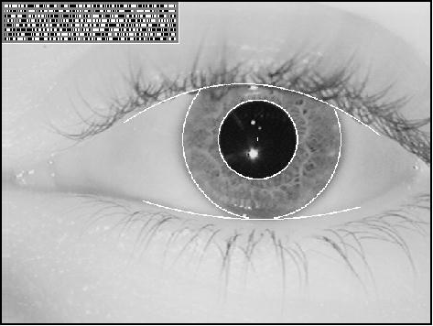
What is Biometrics?(2)
Biometrics refers to technologies that measure and analyze human body characteristics, such as fingerprints, eye retinas and irises,

Slide 13
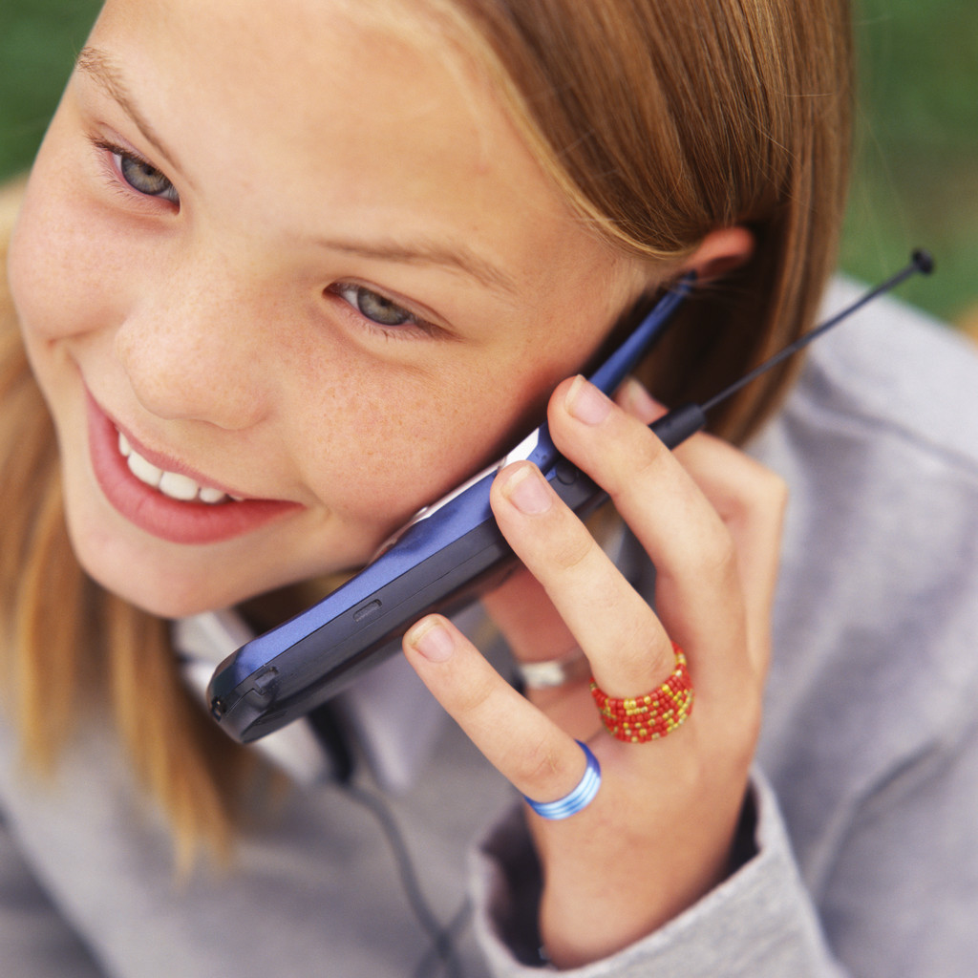
What is Biometrics?(2)
Biometrics refers to technologies that measure and analyze human body characteristics, such as fingerprints, eye retinas and irises, voice patterns,

Slide 14
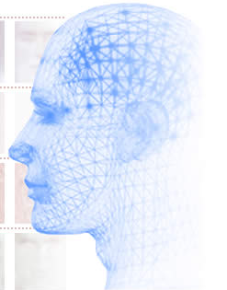
What is Biometrics?(2)
Biometrics refers to technologies that measure and analyze human body characteristics, such as fingerprints, eye retinas and irises, voice patterns, facial patterns

Slide 15
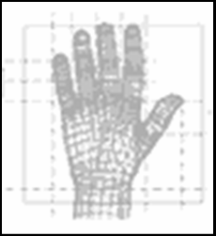
What is Biometrics?(2)
Biometrics refers to technologies that measure and analyze human body characteristics, such as fingerprints, eye retinas and irises, voice patterns, facial patterns and hand measurements, for authentication purposes.

Slide 16
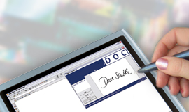
Advantages of using biometrics
Biometrics verifies the user by what he is rather than what he has or what he knows
High accuracy in identifying genuine users
Ease of usage

Slide 17

Why Speech as a biometric?
Non - intrusive – When compared to other biometric
methods like Iris scanning or Finger print recognition.
Cost effective – No additional hardware required.
User Friendly – Since speech comes naturally.

Slide 18
Speech Biometrics
Speech Biometrics can be broadly classified as
Speaker Recognition
Speaker recognition is the act of identifying one individual from a group, by comparing the voice pattern of something they have said with a database of many voice patterns.
Speaker Verification
Speaker verification is the process of authenticating
the claimed identity of a person based on users voice
characteristics.
Notes:
Need to change the heading….

Slide 19
Speaker Recognition and Verification
Recognition
Gallery Who Spoke?
/Edna/ /????/
/Sunil/
/Akhilesh/
/Anoop/
/Devanuj/
Response - Sunil
Verification
/????/ Is this Sunil?
/????/ Is this Sunil?
/????/ Is this Sunil?
Response – YES/NO

Slide 20
Types of Speaker Verification
Fixed Phrase – Pre-determined phrase used for verification
Fixed Vocabulary – verification more flexible and practical;
training and testing materials for a speaker are generated
based on words of a fixed vocabulary
Flexible Vocabulary – a general set of sub word phone models is created during speaker model training
Text-Independent – User is not constrained to say fixed or
prompted phrases
Both complexity and security increases as we
go from fixed phrase to text-independent.

Slide 21
Overview - Speaker Verification Systems
Speech Database
Date Time
User X
Training
Model
λ_{x}
Database
Threshold
User x λ_{x} T_{x}
Training Phase
λ_{x}
T_{x}
t
Testing
(t /λ_{x})
t_{x}
(t_{x} >T_{x}) (t_{x} <T_{x})
Testing Phase
Verification Success
Verification Failure

Slide 22
Speaker Verification - Training Phase
Test Input
Test Input
Test Input
Test Input
Signal Processing
Model Generation
Threshold Criteria
Notes:
Threshold Criteria???????? Here u need to speak about the relevance of the threshold Criteria.
Also speak about the best case scenario in recording input….
Add something about HMM

Slide 23
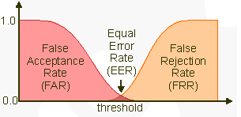
Measuring Performance of a Speaker Verification System
FAR - False Acceptance Ratio
The percentage of incorrect successful verifications
FRR - False Rejection Ratio
The percentage of incorrect failed verifications
EER - Equal Error Rate
The value at which FAR equals FRR

Slide 24
Speaker Verification - Testing Phase
Test Input
Signal Processing
Feature Extraction
Pattern Matching
Decision Logic
Accepted
Rejected

Slide 25

Implementation
In BREW 2.0 (Binary Runtime Environment for Wireless) Simulator
Text Dependent - Speaker Verification

Slide 26
Implementation
*Value below which authentication fails.
User speaks into handset
Voice is recorded and saved
Features from recorded
voice is extracted
These features are
compared with the voice
model of genuine user
(verification Score)>
(Threshold Value*)
No
Yes
Authentication:
Failure
Authentication:
Success
Notes:
Add feature extraction and also *

Slide 27
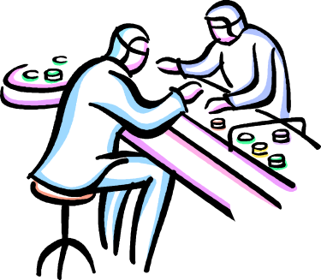
Experiment Details
Number of Users - 6
  Males - 4
  Females - 2
Speech Samples - 70
  Genuine User - 20 Samples
  Imposter (s) - 10 Samples/User
Test Environment - Personal Computer
- Using BREW Simulator
- Microphone
Notes:
Replace participants with a better word.

Slide 28
Results
Threshold (T1) Threshold (T2) Threshold (T3)
FAR 15 30 50
FRR 16 16 2
Note:
1. T1 – Low Threshold, T2 - Medium Threshold, T3 - High Threshold
2. Experiments carried over a set of 6 users. Imposters were aware of
Pass Phrase (i.e. Skilled Forgery)
3. Speaker Verification Software developed in-house

Slide 29
Conclusions
There is a need to provide more security for mobile devices.
Biometrics could provide better security than existing systems like PIN and Passwords
Voice biometrics could be used as an effective and efficient authentication mechanism
Experimental results show that the speaker verification system performs very well
Could be ported to J2ME (Java 2 Micro Edition), so that they could be used in GSM phones also

Slide 30
Questions?

Slide 31
Thank You!

