Slide 1
Speech Application Development
Presentation by ATAG @ TACTiCS 2006 in Hyderabad
Akhilesh Srivastava
ATAG – Speech, TCS Ltd
November 30, 2006

Slide 2
Speech Applications
Speech Applications – broad categorization
    Hosted applications
    Deployed in customer environment
Technologies used;
    Speech recognition and synthesis e.g.
      auto-helpdesk i.e. speech enabled IVR systems,
      public address systems,
      auto-attendant,
      voice enabled web access
      value added services (such as e-mail reading, voice to SMS, UMS), etc.
    Speaker identification e.g.
      speech biometrics based access control
    Others – speech processing for some other purposes, e.g.
      medical diagnosis,
      accent analysis,
      music recognition etc.

Slide 3
Choosing the IVR application to speechify
Look at
  Number of calls received
  Number of callers
  Call completion rate of the existing system (to understand current usage patterns)
Note:
In general, a low call completion rate with a highly used application might point to a good candidate for an upgrade to speech.
To begin with avoid choosing business critical applications for speech enabling
Applications such as entering credit card PIN numbers may be more suited for touch-tone implementation than speech enabled system

Slide 4
Speech Application Development
Steps
Select Your Speech Components
VUI Design
Design Application Prompts, Grammars, and Dialogues
Increase Application Success with Proper Error Handling
Tuning and Testing
Measure Application Success
Reference:
"http://www.microsoft.com/speech/community/newsletter/articles/0405article.mspx"

Slide 5
1. Select Your Speech Components
Select
    Speech Engine
    Development Standards
    Platform and OS

Slide 6
1. Select Your Speech Components
Select Speech Engine
    Demographics
        Language
        Local accents
        Language mix
        Culture
      of the target audience
    Environment
      Background noise
      Access mode
    Cost
      one is willing to pay
    Complexity
      Integration of SW, HW and third party components

Slide 7
1. Select Your Speech Components
Select Development Standards
  Open Standards
    VoiceXML
    SALT
  Proprietary platforms
      Locked-in with a few vendors
      Provide reduced customer flexibility

Slide 8
1. Select Your Speech Components
Select Development Standards
VoiceXML
Royalty free official W3C standard
Designed specifically for speech based dialogues in telephony based applications
May involve higher implementation cost due to
  Lack of integration - VoiceXML engines, tools, and libraries all come from different vendors
  Lack of industrial-strength programming and debugging tools
  Incomplete support for telephony, which initially led to many proprietary extensions

Slide 9
1. Select Your Speech Components
Select Development Standards
SALT (Speech Application Language Tags)
Royalty free standard submitted to W3C
Supports both telephony and multimodal applications (such as desktop, tablet PCs, cell phones)
Uses existing Web markup languages and standards for speech output, grammar formats, and semantic results
Reduced implementation costs due to available
      Automated speech recognition (ASR) and text-to-speech (TTS) engines
      Grammar editing tools
      Authoring and debugging programs

Slide 10
1. Select Your Speech Components
Select Platform and OS
VoiceXML platforms tend to be stronger on UNIX and Java, which might be a better fit if one doesn’t want to migrate to Windows.
SALT may be a better choice for .NET development framework. An application that uses Windows to build an enterprise application would make integration with business back-end servers much easier.
OS wise both UNIX and Windows are reliable enough.
More than OS one should choose proper development tools (programming languages, integrated development environment (IDE), and debugger) to achieve overall system stability.

Slide 11
2. VUI Design
For VUI design first find out whether
    the application be entirely speech-enabled?
    speech automation be restricted to a part of the interaction? or
    the application offer Touch-Tone fallback throughout?
    it requires barge-in feature (i.e. allows callers to speak while a prompt is playing)?
Good practices;
    Provide Touch-Tone fallback for certain inputs (e.g. times when a caller is having trouble with spoken input, is concerned about security (for example, saying a credit card number, PIN, or password in a public venue) or simply prefers to use Touch-Tone.
    Avoid/minimize nested menus
    Reduce the caller input steps (to increase customer satisfaction by decreasing call duration and cost)
    Allow barge-in and encourage callers to respond at any time

Slide 12
2. VUI Design
The design decisions made during VUI design will influence the level of complexity that the application developer will face.
  Present callers with a main menu list of keywords.
      limit the number of choices to fewer than five
      specify the accepted keywords in a spoken menu (to minimize the number of potential answers so that grammar development is manageable)
  Provide directed dialogue.
      design questions that are answered by Yes or No. (to limit the number of potential answers and simplify application design and reduce the complexity of speech recognition grammars)
  Interact with the caller through natural language.
      This is the most complex approach as it enables a caller to say almost anything in response to an open-ended question such as “What can I do for you?"
      Need a thorough analysis and understanding of caller interaction. The resulting grammar set is comprehensive, covers all potential caller utterances, and detects keywords in sentences.
  Aim modularizing the application - separate UI and business logic

Slide 13
3. Design Application Prompts, Grammars, and Dialogues
Prompts
    are the short audio files played to the caller to provide important navigation cues
    cause the caller to speak, or provide them with the acceptable commands at the specific point in the application.
    can be prerecorded or dynamically generated by using TTS technology.
    should be as short as possible
    should be clear and unambiguous
    may end with a tone to cause the caller to speak or allow for barge-in during playback
    can provide feedback to the caller (where possible, this feedback should embed confirmation of speech input)

Slide 14
3. Design Application Prompts, Grammars, and Dialogues
Grammars
    The application grammar defines which input utterances are acceptable to the application
    It contains a list of the exact words the caller might say and the order in which these words might be said
    Any caller utterance that is not contained in the grammar will not be recognized
    While selecting vocabulary, identify and possibly avoid the words and terms that might cause a problem for the speech recognition engine
    Most speech recognition engines provide pre-built grammars, that need to be tweaked while tuning and testing
    After defining the grammar, we need to build the word pronunciations.
    (While most speech engines supply a default pronunciation for each word in the vocabulary, it is often insufficient. Varying geographical, cultural, and gender accents and dialects require multiple pronunciations per word to account for the various ways in which a word will be spoken.)

Slide 15
3. Design Application Prompts, Grammars, and Dialogues
Dialogues
      After building the grammar, one has to record the new prompts.
        Grammar development is closely tied to the design of the call flow dialogues, which are the specific prompts or questions that the application will ask and the possible answers that the caller can say in response
      When choosing the speech application's voice (persona), seek a friendly, welcoming voice to record grammar prompts

Slide 16
4. Increase Application Success with Proper Error Handling
Prompt Escalation
      When input recognition fails (for example, due to low speech recognition engine confidence, words out of grammar, or no speech detected), the application should next time provide a different prompt that gives the caller more information to resolve the problem and to move the dialogue forward
      One might want to encourage callers to use Touch-Tone input when spoken entries have been recognized incorrectly (this will help reducing the user frustration)
Confidence Thresholds and Confirmation Interaction
      Rejection threshold: An utterance with a confidence below this value is rejected as NoReco (not recognized)
      Confirmation threshold: An utterance with a confidence above this value does not require confirmation. However, the system might provide an implied confirmation, such as "Connecting you to Sunil" This simple feedback reassures the caller.

Slide 17
5. Tuning and Testing
Tuning is an iterative process of analyzing system performance based on system logs and recorded user interactions
The tuning phase can take several months and might require an interdisciplinary team of professionals, including developers, testers, linguists, and psychologists
What should be analyzed and tuned?
  Prompts
  Dialogue
  Grammars
  Recognition
  Confidence thresholds
  Pronunciation

Slide 18
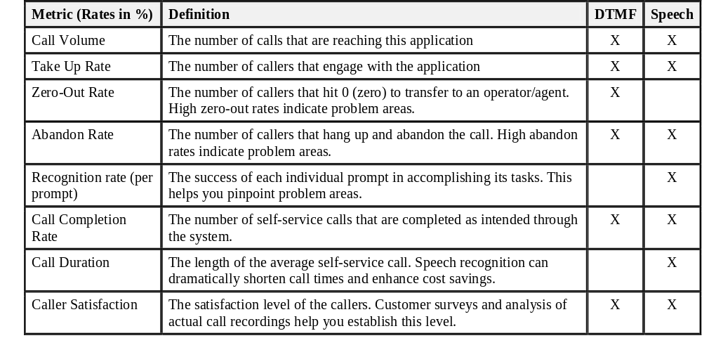
6. Measure Application Success
Whether the overall goal is to reduce operational costs or to increase customer satisfaction, the metrics below capture some of the key measurements

Slide 19
Thank You!

