Slide 1
Speech Enablement - the ‘Natural’ Value Add:
for Humans and Systems
Prof. P V S Rao
Adviser, Tata Consultancy Services Ltd.
TCS – Deccan Park
Hyderabad
November 30, 2006

Slide 2
“Speech is going to be a core technology
to be integrated.
The conventional method
(of keying in and having errors and corrections on your hands)
is going to change.”
… Mr. S Ramadorai
In reply to a question,
What will be the future technology milestones?
(Interview with T. M. A. Kumar and G. Ramamoorthy)

Slide 3
Objective
Give participants a feel for the science and technology of speech
Familiarize them with techniques currently in use
Update them regarding state-of-the-art
Provide an appreciation of the challenges and potential that the technology
holds for IT
Structure
Professor P V S Rao Speech Fundamentals
Dr. Sunilkumar Kopparapu Speech Fundamentals
Akhilesh Srivastava Speech Applications
Dr. Arun Pande Speech Business
Contents of Part 1
Human Interaction – ’Speech’ and ’Language’
Complex nature of speech signal – challenges for analysis
Current state-of-the-art and limitations
Future projections

Slide 4
Evolution of Speech
Communication necessitated by need for survival
Most species
Finding food: survival
Avoiding predators: survival
Finding a mate: reproduction, perpetuation of species
Higher species
Emotions
  Anger, love, concern etc.
Combination of sounds and body gestures
Human:
Sound and gesture based
Shift from
Conveyance of emotions to communication of concepts
Sound and gesture to predominantly sound
  Freed the limbs and body
  Line of sight communication not crucial
  Facilitated organization of group activity – hunting, fighting

Slide 5
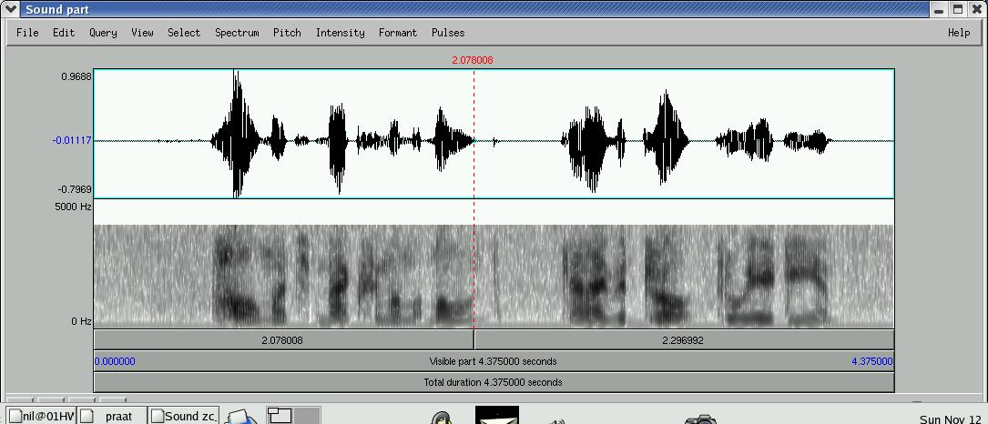

Information content in spoken and written text
Duration of sentence: 4.375 seconds, 8 kHZ, mono, 8 bit
Information Content: 16295 bytes,
Only Zero Crossings: 8536 bytes
Transcript: “How much maximum amount can I withdraw through ATM?”
Length of Transcript: 51 characters
Information Content in Transcript: 102 bytes

Slide 6
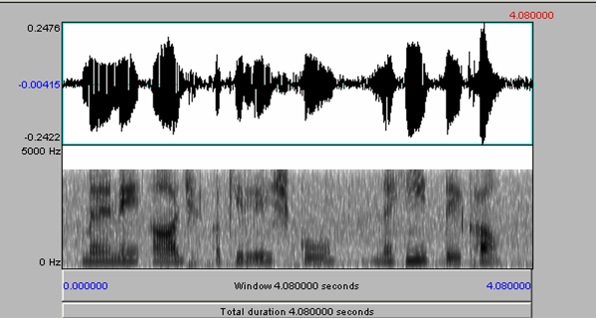
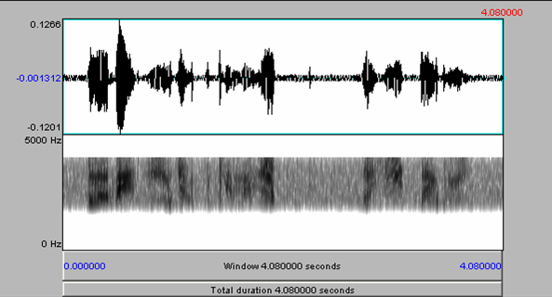
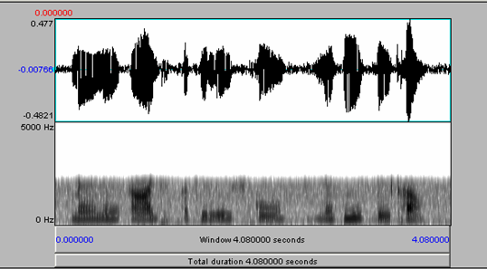
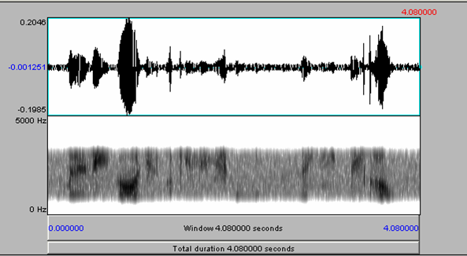
Speech in High, Low and Mid Frequency Ranges
Original Signal: Mono and sampling rate 8000 Hz (0-4000 Hz)
High pass filtered (only 2000-4000 Hz)
Low pass filtered (only 0 – 2000 Hz)
Mid frequency range (only 1000-3000 Hz)

Slide 7
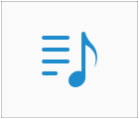
Speech Intelligibility in presence of Gaussian noise
Original speech
20% of signal
50% of signal
100% of signal
200% of signal
Noise Level

Slide 8
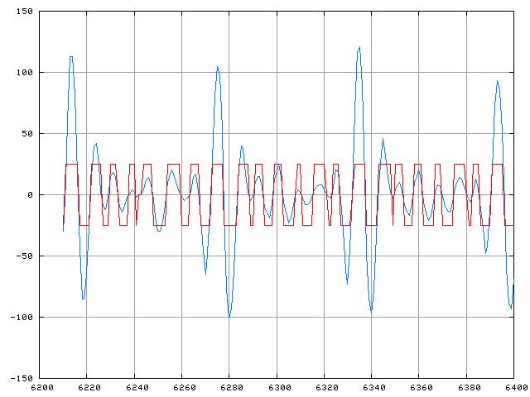
Infinite Amplification and Peak Clipping

Slide 9
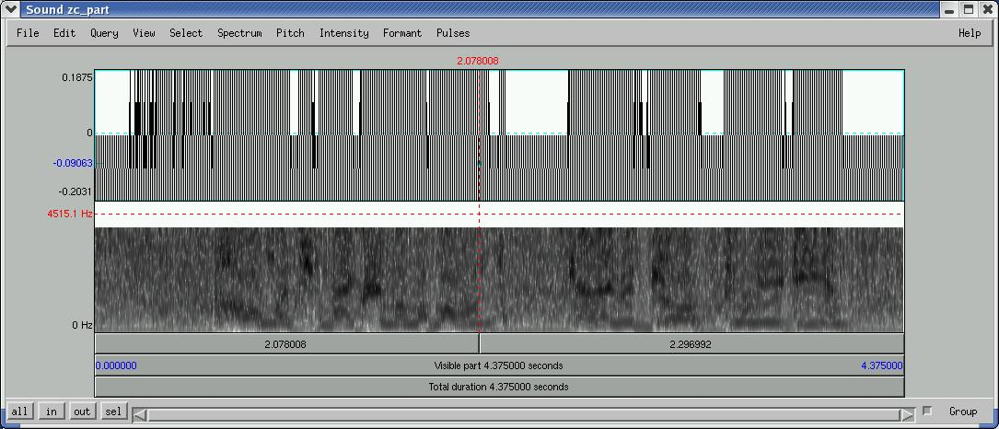
Zero Crossings: Infinite Amplification and Peak Clipping

Slide 10
Cocktail Party Effect
Cross talk with two speakers

Slide 11
Synthesis by Concatenation
Phoneme concatenation - single phonemes.
Phoneme concatenation - diphones
Pitch and Amplitude normalisation
Amplitude and Pitch normalisation, vowel smoothing

Slide 12
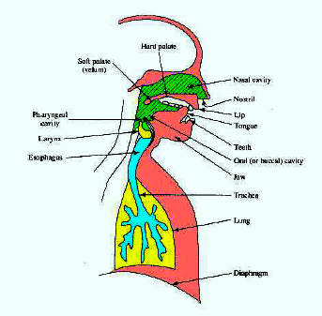
Hard Palate
Soft Palate
(velum)
Nasal Cavity
Nostril
Pharyngeal
Cavity
Lip
Tongue
Larynx
Teeth
Esophagus
Oral Cavity
Jaw
Trachea
Lung
Diaphragm
The Human Speech Production Mechanism

Slide 13
From Thought to Speech to Script – A Top Down Look
Intended message formed in brain
Pragmatics, Semantics , Syntax
Symbol String
Inertia anticipatory & co-articulation
Articulatory choreography
Speech Signal
Phonetic Symbol String
Spelling ambiguity (less for Indian languages)
Script Symbol String

Slide 14
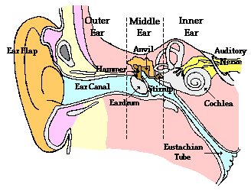

Slide 15
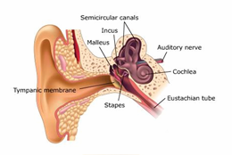

Slide 16
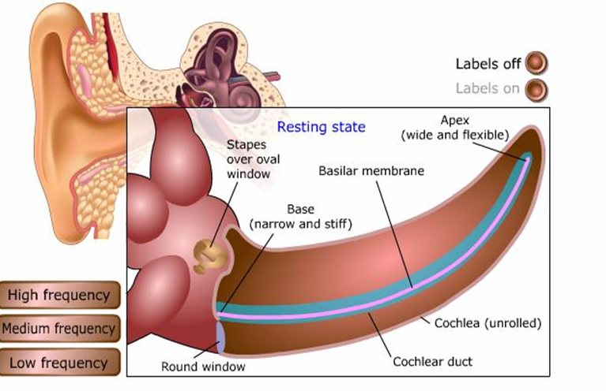

Slide 17
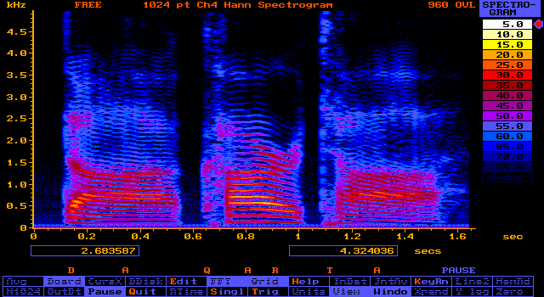
Spectrogram of /DAQARTA/

Slide 18
Recognition problems
Variability depending on context, mood, speaker
Systematic
Context effects
Phonetic, Syntactic, Semantic, Pragmatic
  Time constants of articulators
  Co-articulation
  Anticipatory articulation
  Effect of adjacent and non-adjacent
  phonemes
Non systematic
Laxity, sloppiness, speed, mood, well-being
Inter-speaker
Anatomical, dialectical, cultural etc.

Slide 19
Passenger to Booking Clerk:
“Would you condescend into doing me the favour of booking two tickets in the most luxurious class available, since, having come to know about illness in the family, I, accompanied by my spouse, intend to visit my relatives in the township of Gorakhpur, exactly a week from today?”
Response of Booking Clerk
“…… Eh!?”

Slide 20
Conclusions so far
Important for synthesis
  Replication of context effects
  Replication of intonation
  Requires parsing
Important for recognition
  Use of phoneme level context information
  Heavy dependence on phonetic, syntactic,
  semantic ‘grammars’
  Not deep level grammars for interactive
  transactions

Slide 21

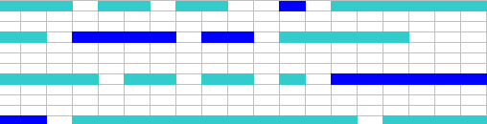
Dictation System Operation
Speech Signal
Step 1: Choose several alternatives for each phoneme
Step 2: Lexicon - choose appropriate phonemes to form words
Step 3: Grammar - choose word strings to form sentences
Good example: My key note millennium address at CSI (2000)
Bad example: Email to friend
Pitfalls: fails if grammar rules broken
e.g. “Hi Tom, saw this flick yesterday….”

Slide 22
  Interactive Systems: Directed Dialogue
  Present users with specific lists of available commands.
  Prompt them with questions to move them through a dialogue.
  (Capital letters are a cue to the voice actor to add subtle inflections that emphasize the commands)
SYSTEM: Say SCHEDULE AN APPOINTMENT
or LOOK UP MY APPOINTMENTS.
CALLER: Schedule an appointment
SYSTEM: Please pick a date for this appointment.
CALLER: Monday
SYSTEM: What time would you like to start?
CALLER: Ten A.M.
(Hardly any flexibility or freedom for the user!)

Slide 23
Interactive Systems: ‘Natural’ Dialogue
(Some flexibility provided for)
SYSTEM: Your first name please
USER: Akhilesh / I am Akhilesh / My name is Akhilesh
SYSTEM: Your last name?
USER: Srivastava is my last name / It is Srivastava / My last name is Srivastava
SYSTEM: Thank you. Now I need to verify your details. What is you date of birth?
USER: I was born on 25th January 1986 / 25-01-86 / My birth date is 25 Jan 1986
SYSTEM: We need to enter your marital status, Please say MARRIED if you are married. Say SINGLE if you are Un-Married
USER: Married / I am married
SYSTEM: Now, gender information. Please say MALE or FEMALE
USER: Uhmm... Male
SYSTEM: The type of policy you need. Please State SINGLE or JOINT POLICY
USER: Joint, of course / Joint please / I want a joint policy / I would like Joint
SYSTEM: And payment Method? Please specify CHEQUE or DIRECT DEBIT
USER: Cheque please / I’ll pay by cheque / Cheque payment
SYSTEM: Next, about payment frequency. Please say ANNUAL OR MONTHLY
USER: Monthly / Monthly payment / I prefer monthly
SYSTEM: Entering health status is mandatory. Have you ever tested positive for any of these - HIV, Hepatitis B or Hepatitis C? Please say YES or NO
USER: No / Never / Absolutely No / None of these
SYSTEM: Your Application Number is xxxxx, Thank you for using our system.

Slide 24
Akhilesh / I am Akhilesh / My name is Akhilesh
Null
My name is
Akhilesh
I am
Srivastava is my last name / It is Srivastava / My last name is Srivastava
It is
is my last name
Null
Srivastava
My last name is
Null
Joint, of course / Joint please / I want a joint policy / I would like Joint
Null
Please
I want a
Joint
I would like
Null

Slide 25
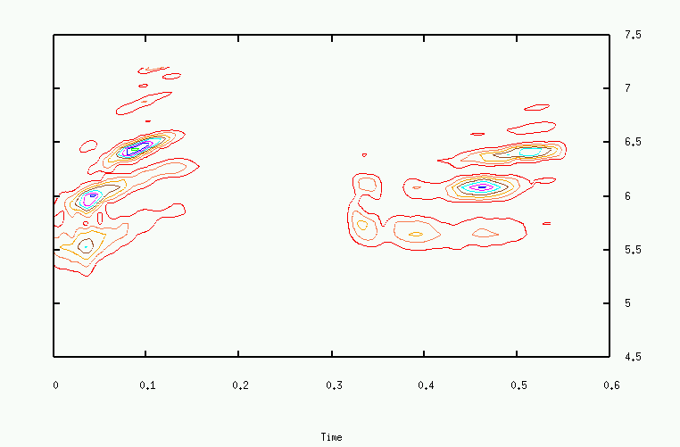
Speech Spectrogram for the utterance /Sunil Kopparapu/

Slide 26
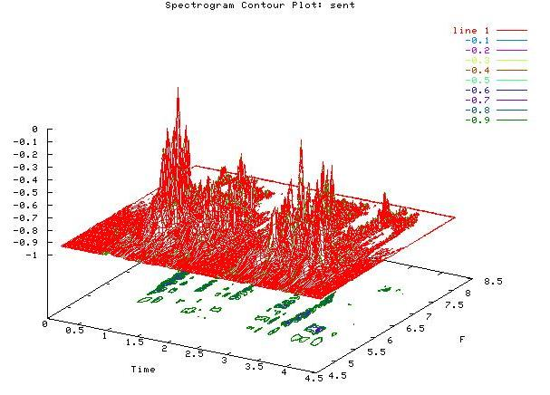
Energy
Frequency
Time

Slide 27
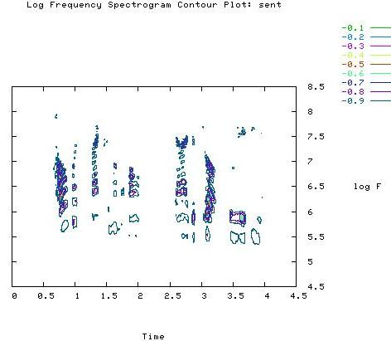
2D Spectrogram of Sentence “how much maximum amount can I withdraw through ATM”
Good 2D spectrogram, preferably same as Sunil’s contour map
Frequency
Time

Slide 28
Strategy
Get foothold in speech technology
Build up good references
Invest as needed
(initial phase, substantial business and profits not crucial)
Analogy – Career planning for young person
Option 1
Send him for an ‘ordinary’ job
Option 2
Send him for degree/special training
Improve his image and earning potential
Specialization implies investment
Then, job at nominal salary for some time
May continue to need financial support from parents
During this period, establish professional credibility
Will eventually earn substantial amounts
(Some risk, but worthwhile)

Slide 29
Speech Technology is here to stay
Speech capability
a differentiator in human evolution
(Singularly responsible for human progress)
Will be so in IT now
Survival without speech: possible
Many species still do
But…
To excel, speech is indispensable
It is the natural value add
Will facilitate moving up the value chain

Slide 30
 | Edna | Ambikesh
IBM ViaVoice Correct | 90.16% | 73.77%
Microsoft SAPI Correct | 78.68% | 66.39%
Both Engines Correct | 70.49% | 56.56%
Both Engines Wrong | 0.03% | 0.13%
Both Engines Wrong | 0.03% | 0.13%
At least One Engine Correct | 99.97% | 99.87%
Table 1: Performance of two dictation systems compared
Total sentences dictated 15 [a total of 122 words]

Slide 31
Two Systems Are Better Than One
 | THE FUND SHALL |  | CANCELLED |  | TICKET
HOW MUCH |  | I GET IN CASE I |  | MY BOOK
 | REFUND SHUT |  | CAN SIT IN |  | TO DICTATE
CAN |  |  |  | A |  | MOVE IT |  | TO NINE
 |  | WE GO FOR
THEN |  |  |  | THE |  | MOVIE |  | TONIGHT

Slide 32
Information content in spoken and written text
Spoken text:
8 bits per sample x 10 kHz sampling rate
= 80 kbits/sec
= 5000 kbits/min
A vector of size 6829 represents the signal and each vector is a 10 bit vector.
(6829*(10/8)) bytes. = 8536 bytes
Transcript of speech:
100 words/min x 6 characters/word
x 8 bits/character = 5 kbits/min
Reduction by factor of 1000 to 1

