Slide 1
Attention
황지은
TNT Vision
2024/03/19

Slide 2
Content
Seq2Seq
Attention mechanism
Transformer

Slide 3
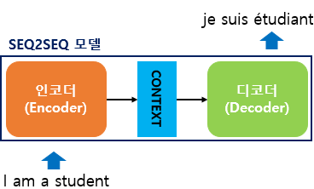
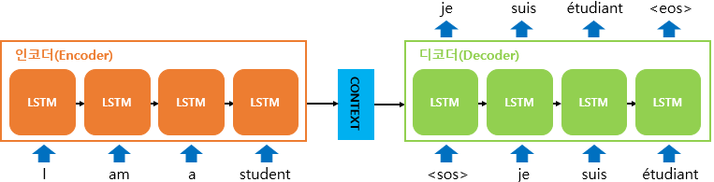
Sequence-to-Sequence(seq2seq)

Slide 4
Problem of Sequence-to-Sequence(seq2seq)
Vanishing Gradient caused by RNN
Information loss during context vector compression process (Bottleneck Problem)

Slide 5
Attention
Attention
Pay attention to encoder most associated with the decoder

Slide 6
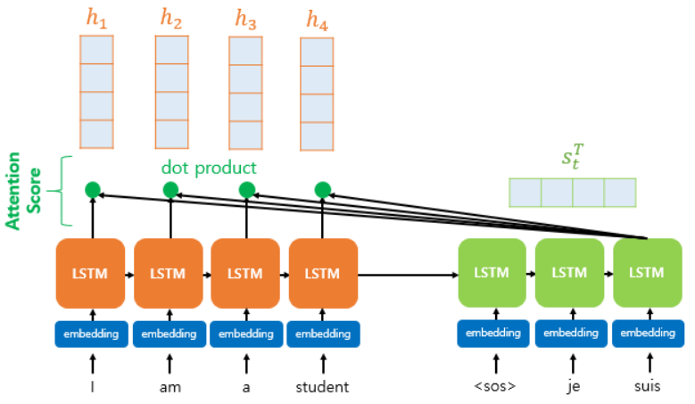
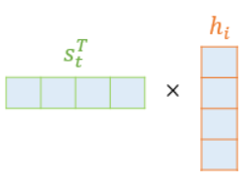


Attention score
Dot Product
Attention score

Slide 7
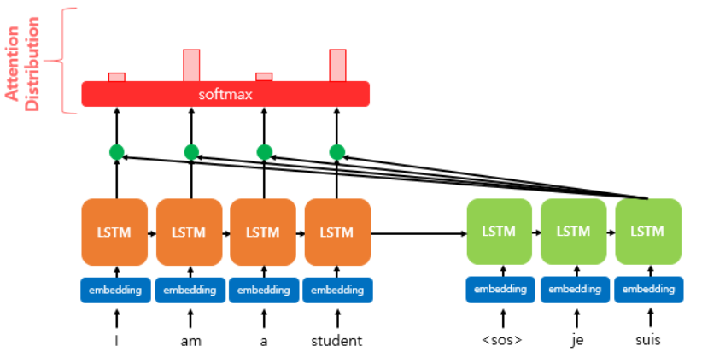

Attention Distribution
Sum: 1 (softmax)
Attention distribution

Slide 8
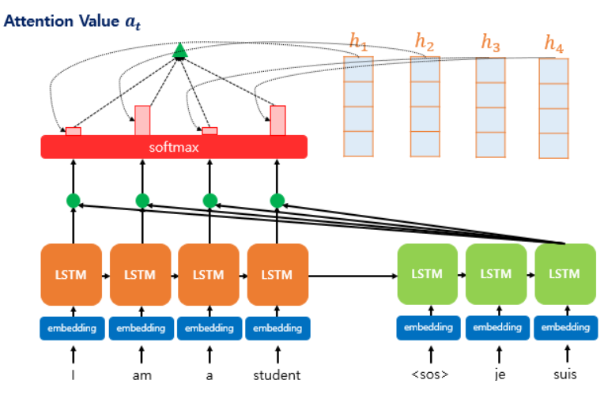

Attention Value
Attention weight * encoder’s hidden state
Attention value

Slide 9
Transformer
Problem of Attention Mechanism
Transformer
Impossible parallel processing
As the length of the sentence becomes longer, the amount of attention calculation increases.
<attention is all you need>

Slide 10
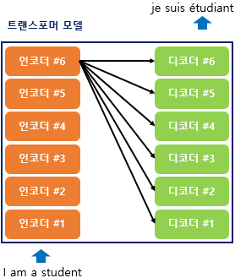
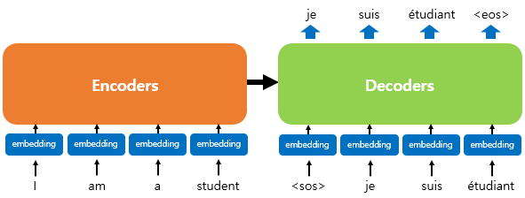
Transformer
Parallel Processing
(Not Sequential Processing)
Repetition of Encoder and Decoder

Slide 11
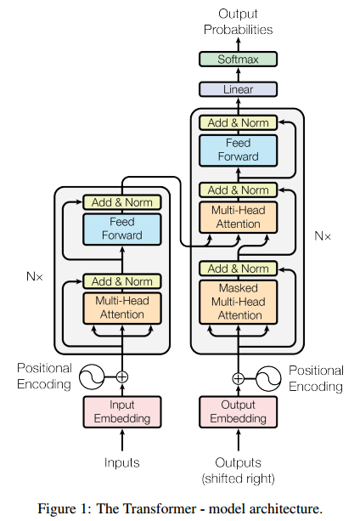
Transformer
Encoder
Decoder
Add & Norm
Position-wise Feed-Forward Networks
Encoder-Decoder Attention
Multi-Head Self Attention
Masked Multi-head Attention
Positional Encoding

Slide 12
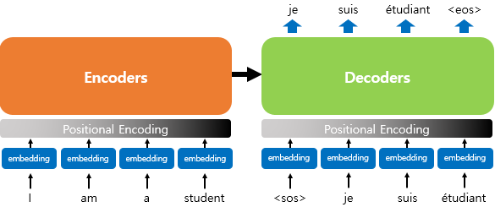
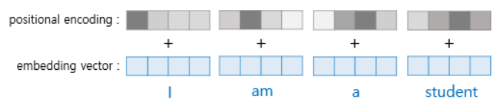
Positional Encoding
Reference of positional information

Slide 13
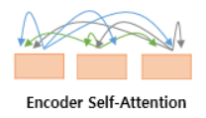

Encoder Self-Attention
Encoder Self-Attention
Similarity between encoders
Encoder-Decoder Attention
Similarity between encoder and decoder

Slide 14
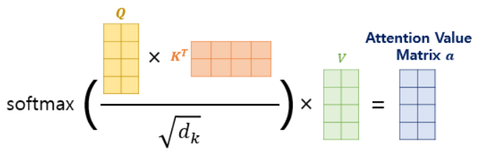

Scaled Dot-Product Attention
Dimension of K vector

Slide 15
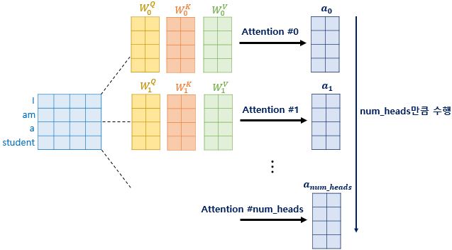

Multi-Head Attention

Slide 16
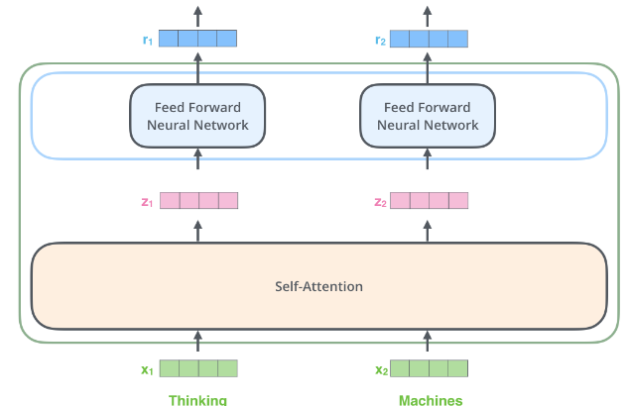
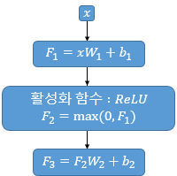
Position-wise Feed-Forward Networks

Slide 17
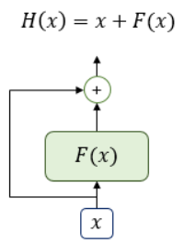
Add & Norm: Residual Connection & Layer Normalization
Residual Connection
Solution of Vanishing Gradient

Slide 18
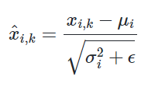
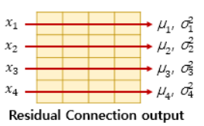


Add & Norm: Residual Connection & Layer Normalization
Layer Normalization
x_i from mean & variance
Normalization
Considering residual output

Slide 19
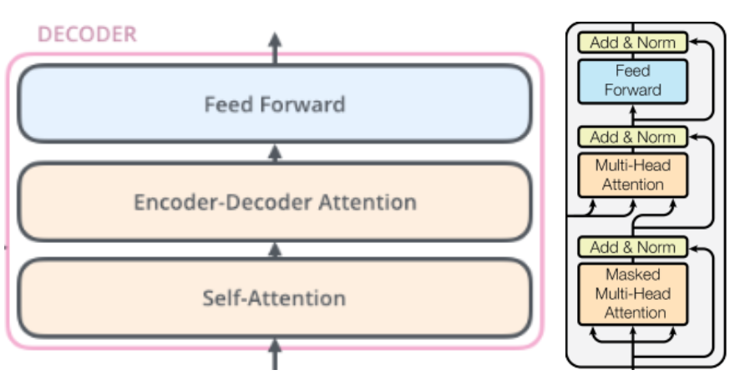
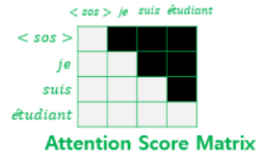
Masked Multi-head Attention
Masked Multi-head Attention

Slide 20
Encoder-Decoder Attention
Encoder-Decoder Attention

Slide 21
Feed-Forward Networks
Feed-Forward Networks

Slide 22
Transformer
Encoder
Decoder
Add & Norm
Position-wise Feed-Forward Networks
Encoder-Decoder Attention
Multi-Head Self Attention
Masked Multi-head Attention
Positional Encoding

Slide 23


