Slide 1

Learning Transferable Visual Models From Natural Language Supervision
CLIP: Contrastive Language–Image Pre-training
문학준
TNT Vision
2024/03/12

Slide 2
Summary
Large noisy web data(WIT) 구축 -> 기존의 NLP LLMs들이 주로 사용하던 대용량 데이터 셋을 활용한 representation learning 방법을 적용
Text embedding과 Image embedding을 연결하는 새로운 방법을 제시함으로써, Cross-modality의 가능성 제시
Zero Shot Natural Language Supervision 방식에서 이미지에 대한 좋은 성과

Slide 3
What is Multi-Modal learning?
Approach of designing models that can process and interpret information from multiple types of data or modalities simultaneously.

Slide 4
Natural Language Supervision
The process of using natural language data to guide or supervise the learning process of AI models (e.g. Image Classification)

Slide 5
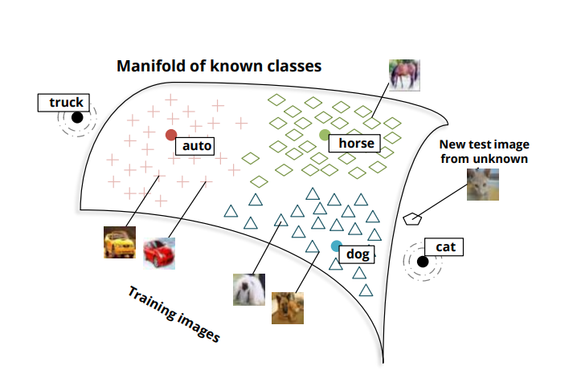
Zero-Shot Learning

Slide 6
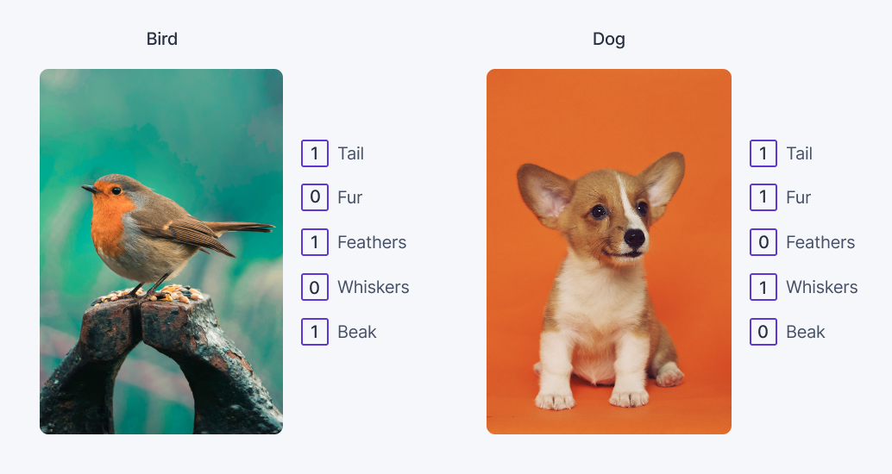
Zero-Shot Learning
Notes:
우선 Zero shot learning도 지도학습이다. 그러나 기존의 지도학습과는 다른 방법으로 예측하는데 바로 semantic information을 활용하는 것이다.
예를 들어 이러한 방식으로 각 이미지의 특징들을 embedding하는 것이다. 이러한 attributes는 Wikipedia or word corpus를 활용하는 방법들이 있다.
추가적으로 CNN이나 Transformer를 통해 이미지의 특징들을 추출해낼 수 있다.

Slide 7
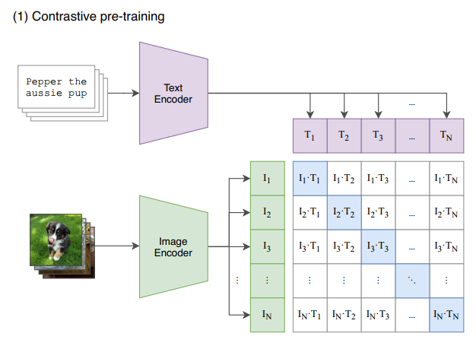
Contrastive pre-training

Slide 8
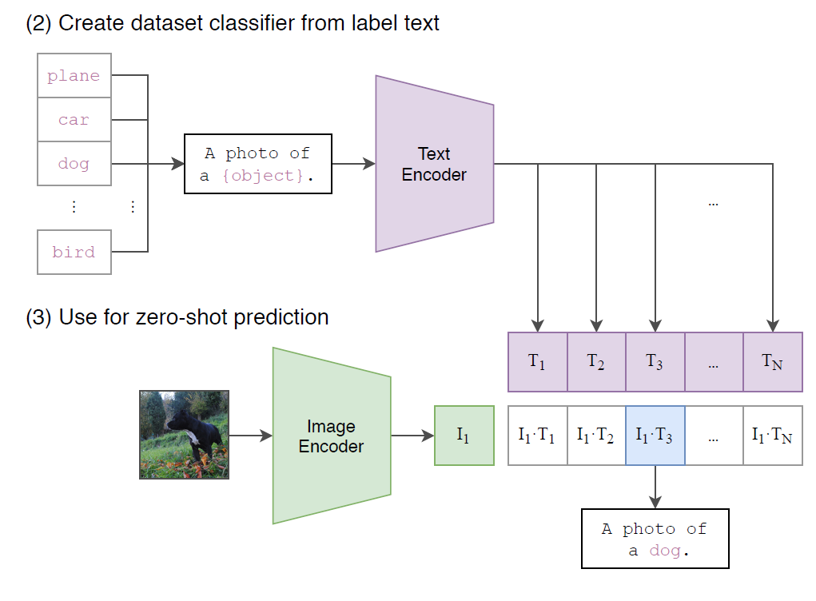
Contrastive pre-training

Slide 9
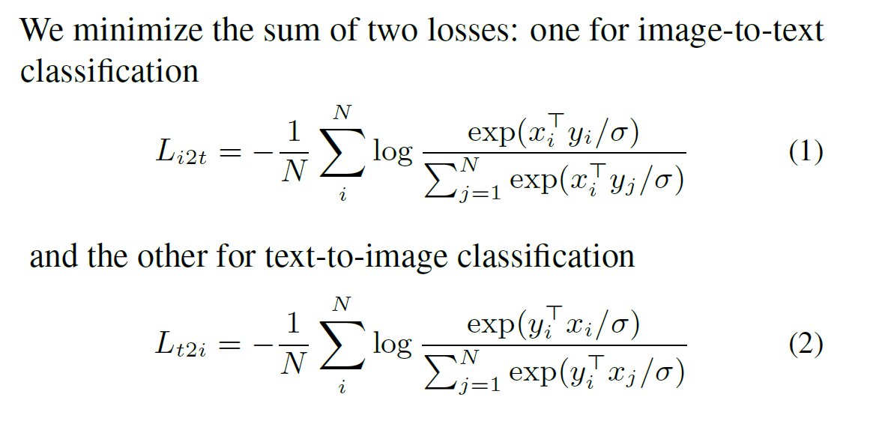
Contrastive pre-training
Positive: matched image-text pairs
Negative : all other random image-text pairs that can be formed
Positive pair에서의 cosine similarity는 최대화, Negative pair에서의 cosine similarity는 최소화

Slide 10
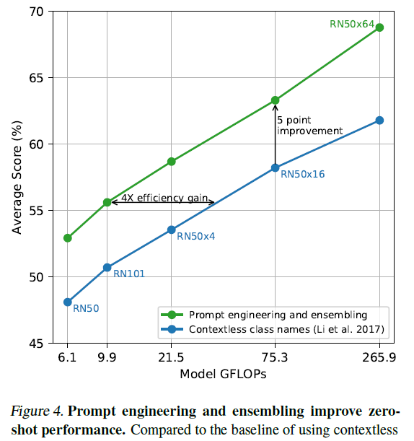
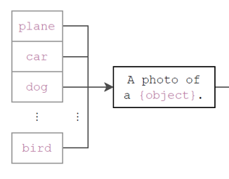
Prompt engineering and ensemble

Slide 11
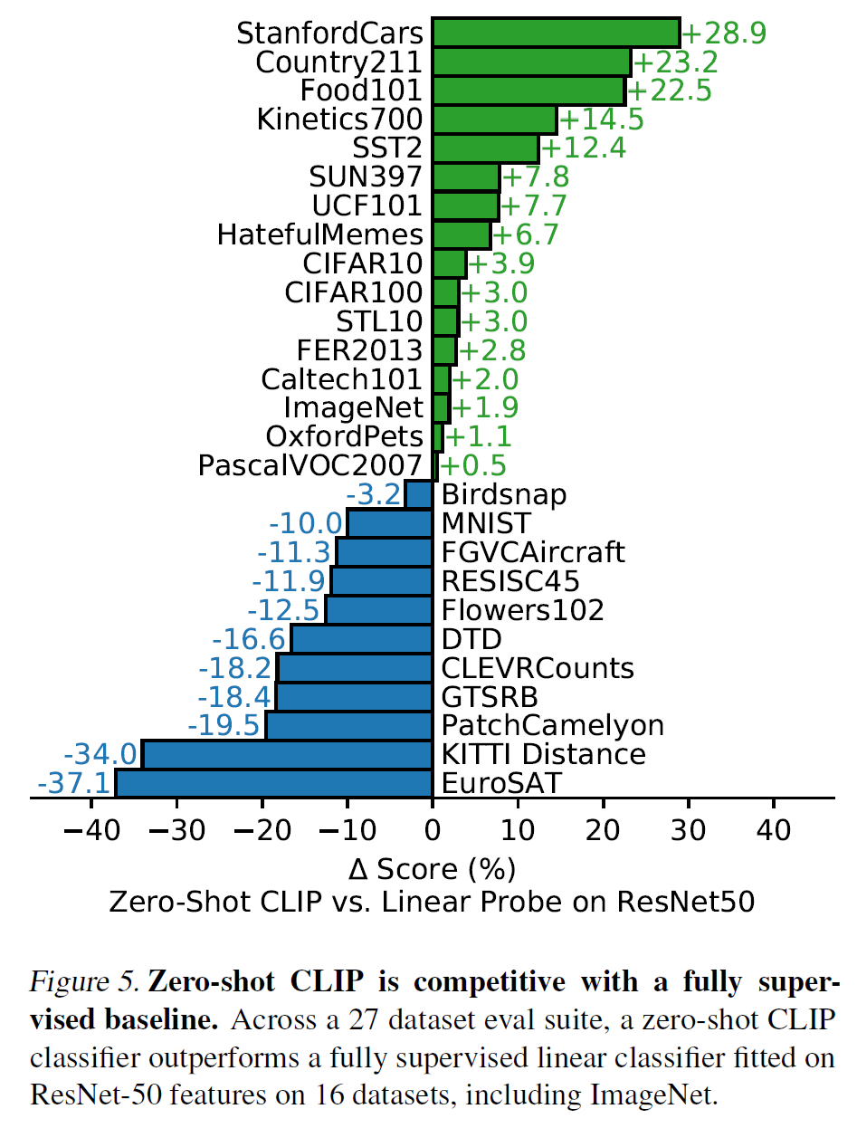
Analysis of zero-shot CLIP performance

Slide 12
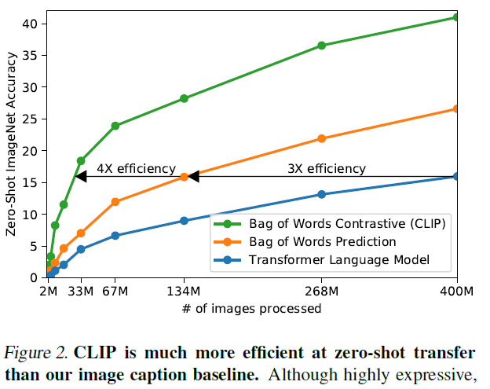
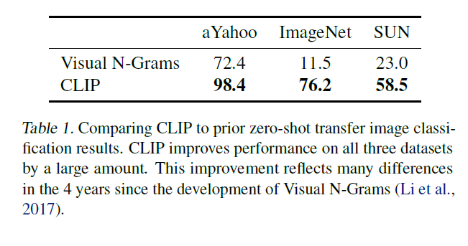
Analysis of zero-shot CLIP performance

Slide 13
Robustness to Natural Distribution Shift
In the case of machine learning models, there is always a risk of overfitting and a possibility of failing to generalize (or low generalization performance).
This is partly because it is based on the assumption that the distribution of the training set and test set will be the same. This difference is referred to as a distribution shift.

Slide 14
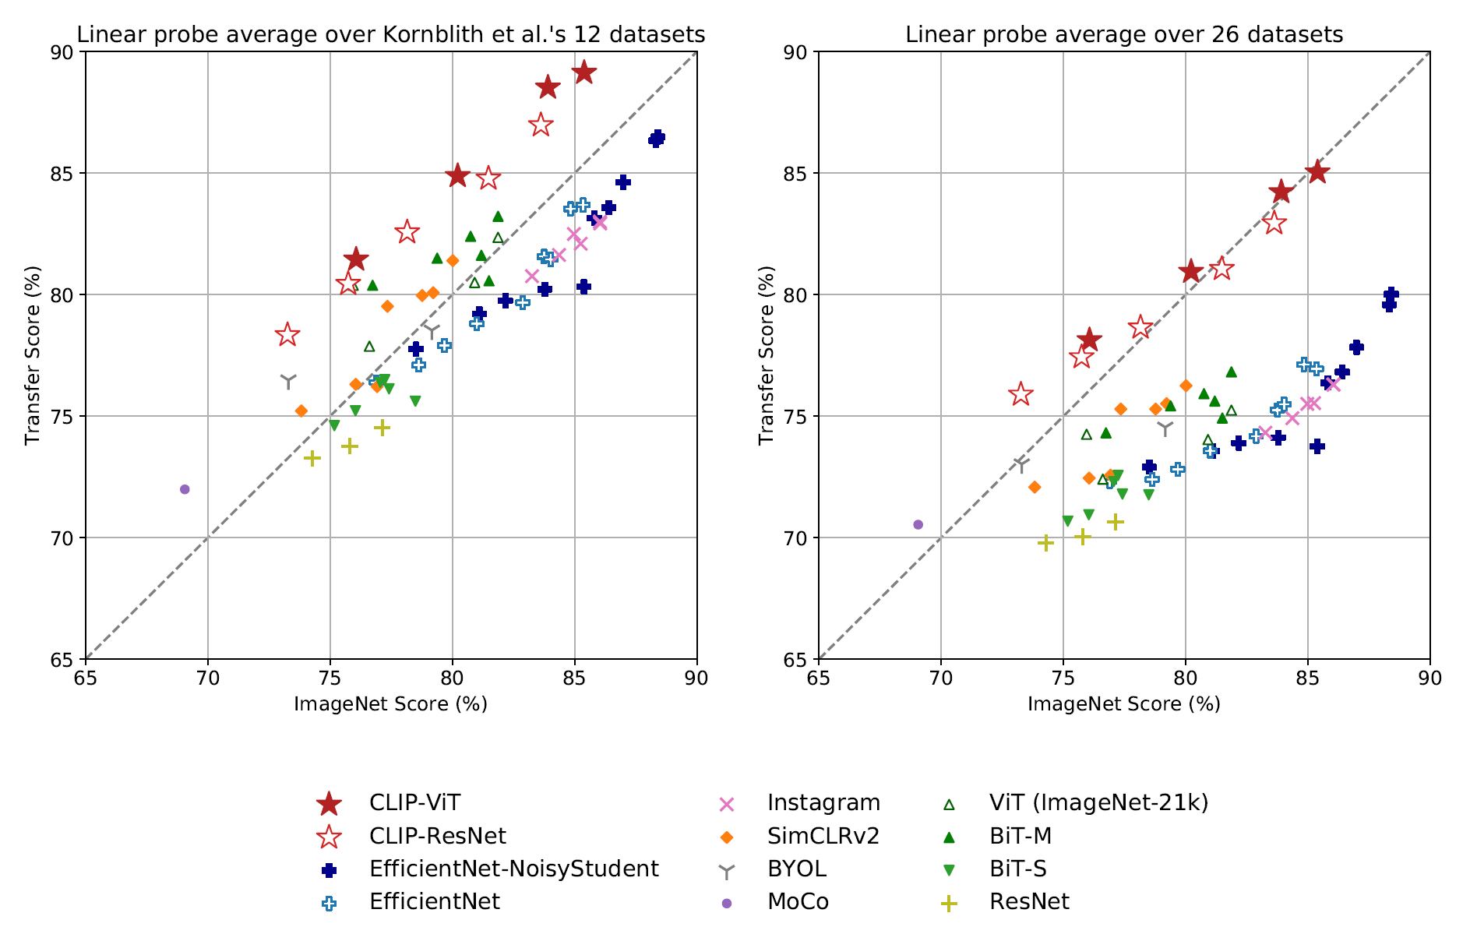
Robustness to Natural Distribution Shift

Slide 15
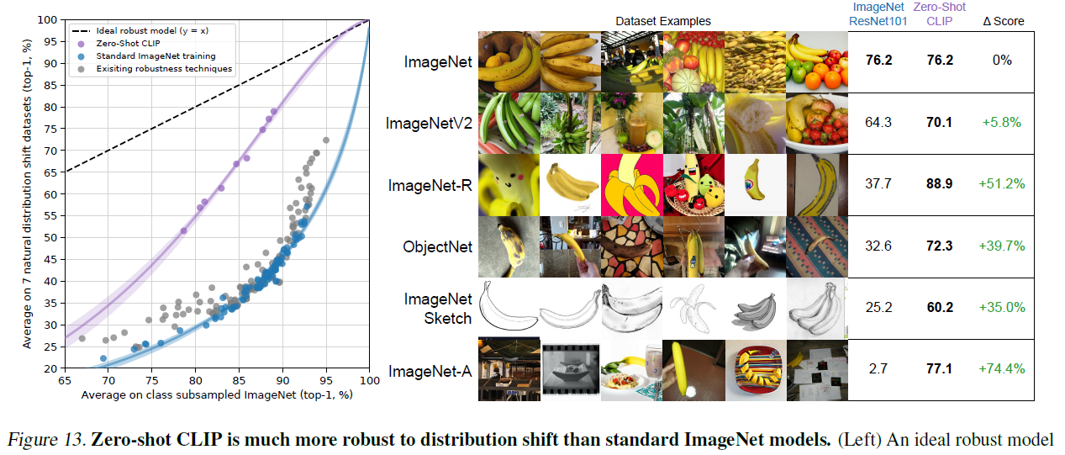
Robustness to Natural Distribution Shift

Slide 16
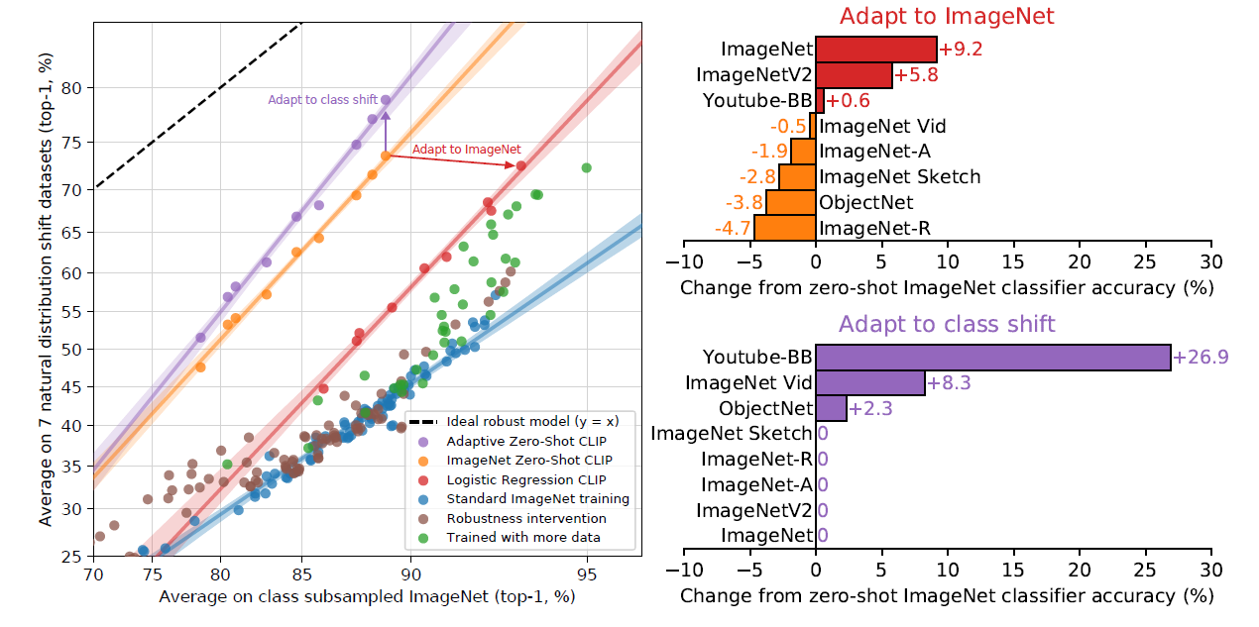
Supervised adaptation to ImageNet reduces avg robustness

Slide 17
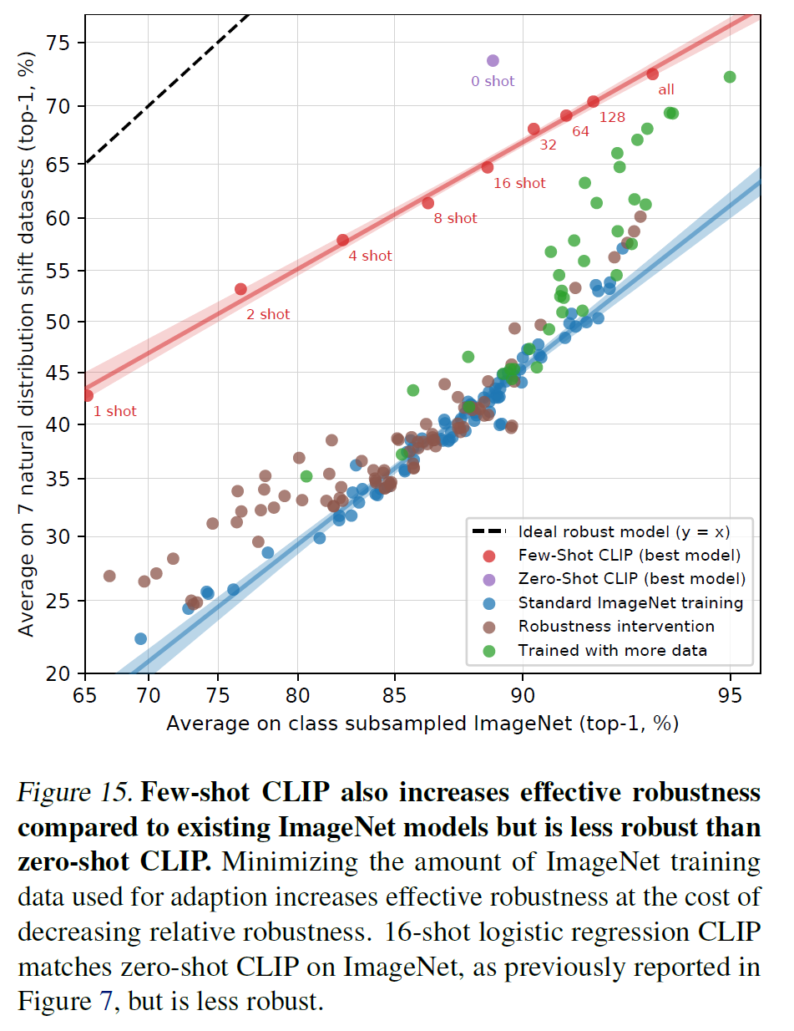
Few-shot CLIP

Slide 18
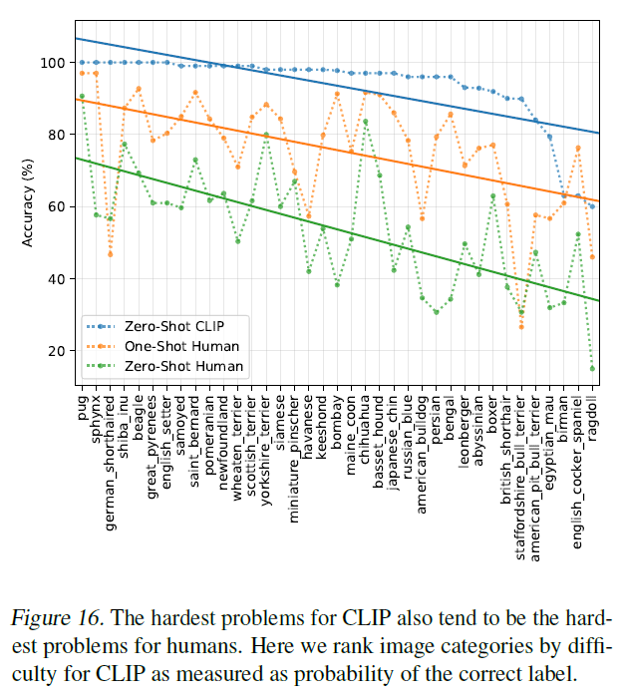
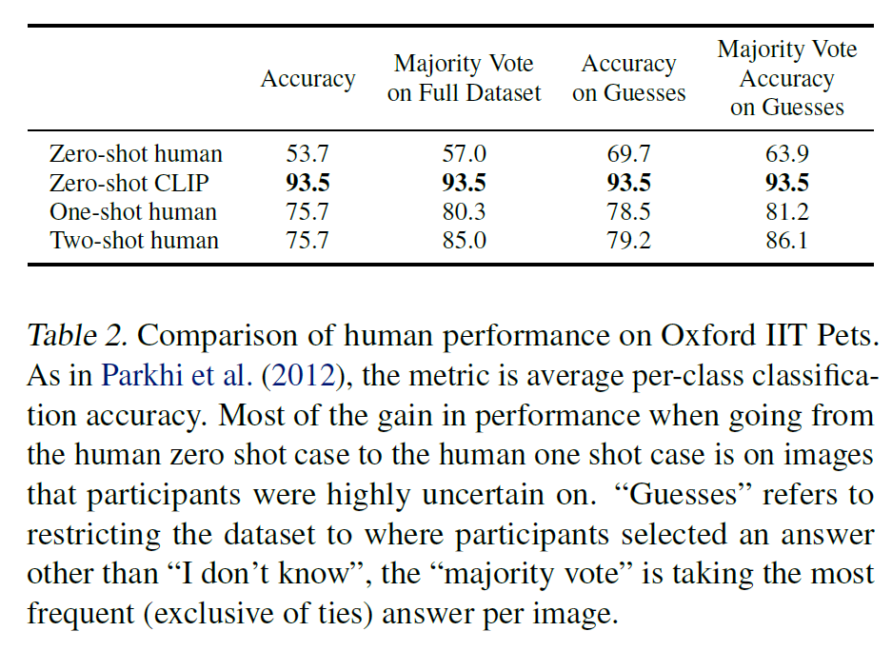
Comparison to Human Performance

Slide 19
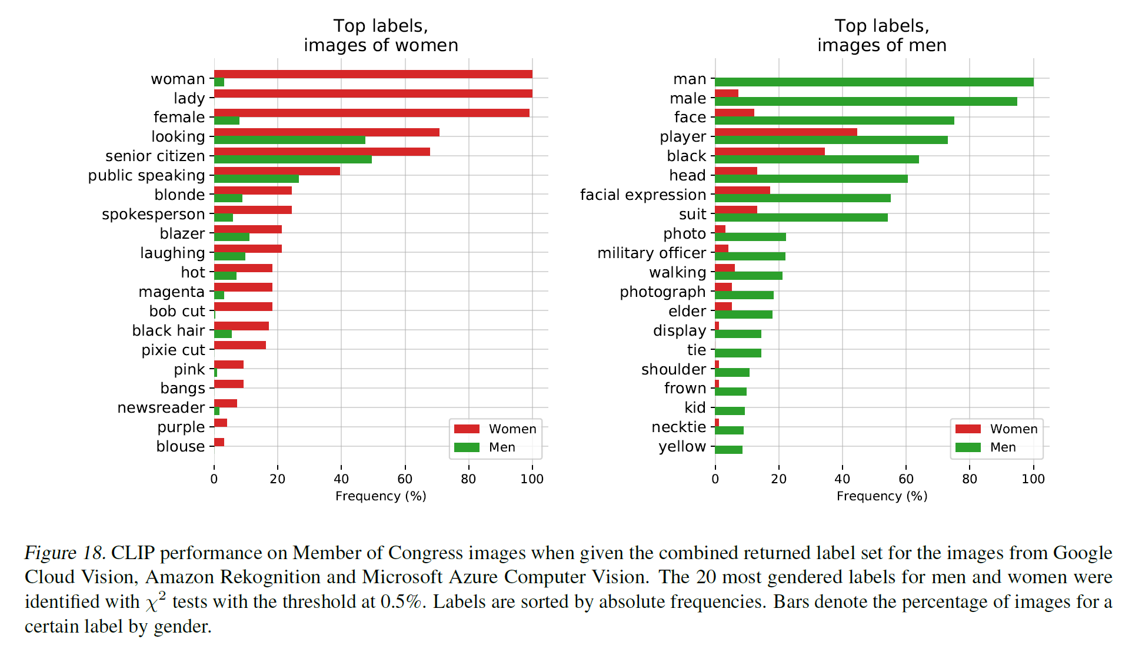
Biases

Slide 20
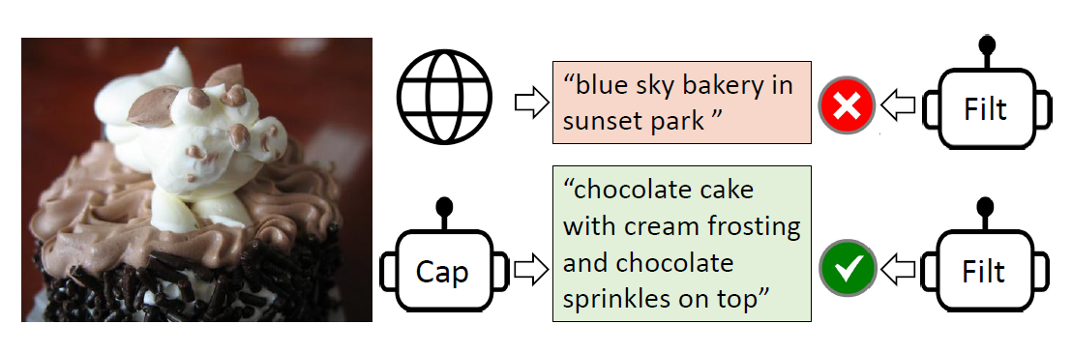
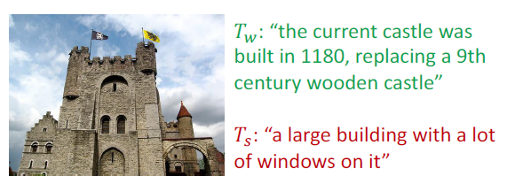
CLIP vs Align vs BLIP
“A photo of a {label}.”
“A photo of a {label}, a type of pet.”
CLIP: Idea of Prompt Engineering
#Dataset : 400 million
BLIP: Idea of “CapFilt” (Caption and Filtering)
#Dataset : 14 million

Slide 21

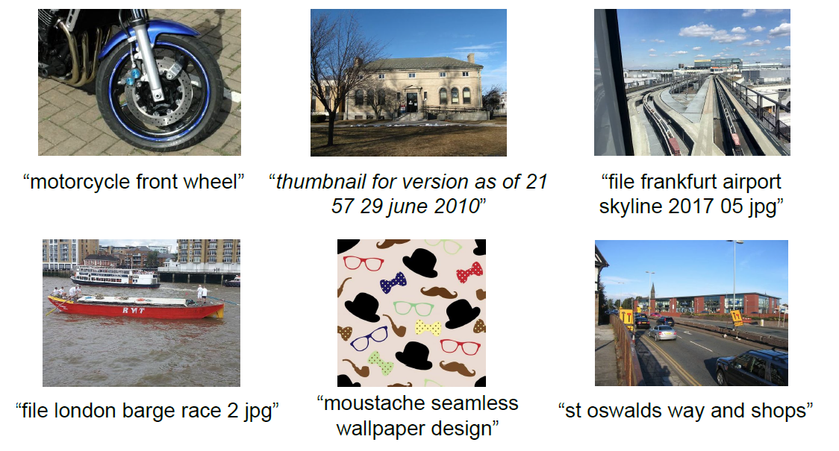
Align(A Large-Scale Noisy Image-Text Dataset)
# 1.8 billion image-text pairs (with noise)

Slide 22


