Slide 1
Live commerce(AliExpress LIVE)
Presentation of requirement specification
2018/11/1
SE Team 3
Yazhini Venugopal, Daegeun Choi
{Yazhini.yazhl93, asdf123ggg}@gmail.com

Slide 2
Table of Contents
1. Overview of target system
- 1) Objectives
- 2) Main features
- 3) Context modeling
2. System architecture
3. System functionalities
- 1) User Scenarios
- 2) Actor Extraction
- 3) Use cases Diagrams
- 4) Function Descriptions
4. System behavior
- 1) Sequence diagram
5. Quality attributes scenarios
6. System constraints
7. Future Works

Slide 3
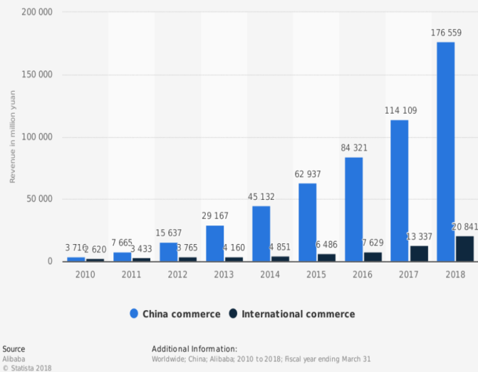
1. Overview of target system
1) Objectives
Annual e-commerce revenue of Alibaba from 2010 to 2018
(in million yuan)

Slide 4
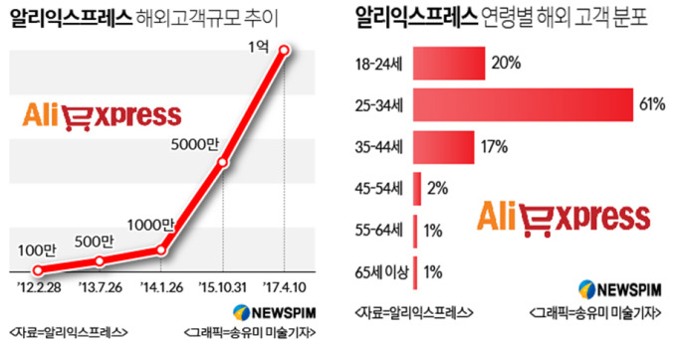
1. Overview of target system
1) Objectives
Distributions of number of customers of AliExpress

Slide 5

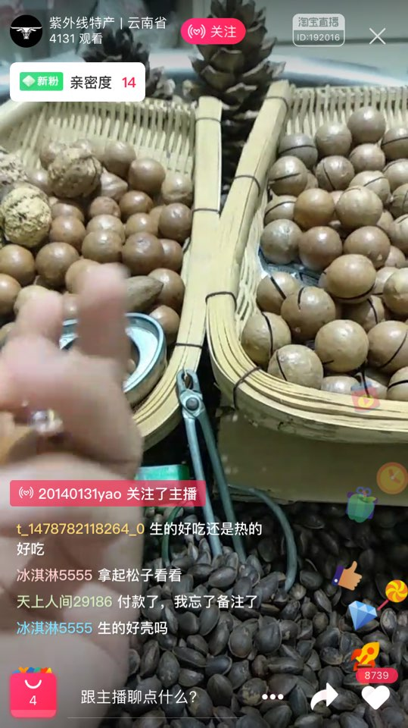
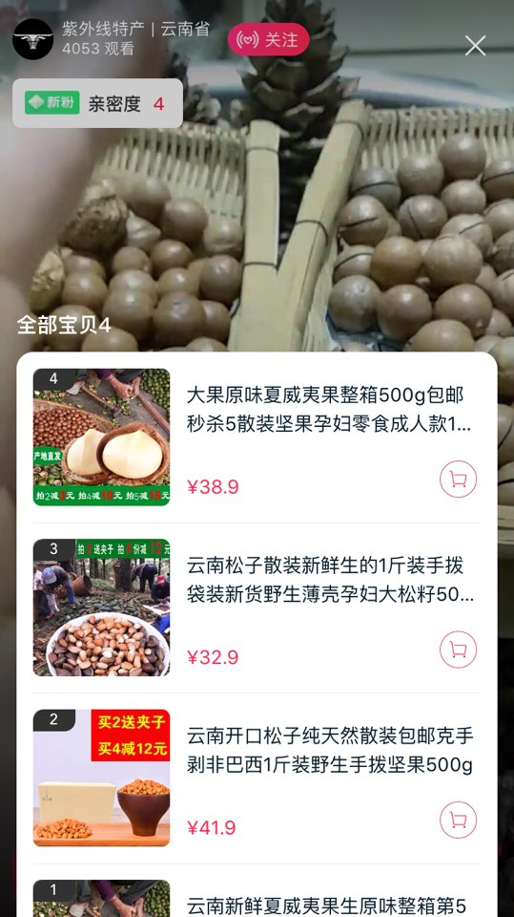
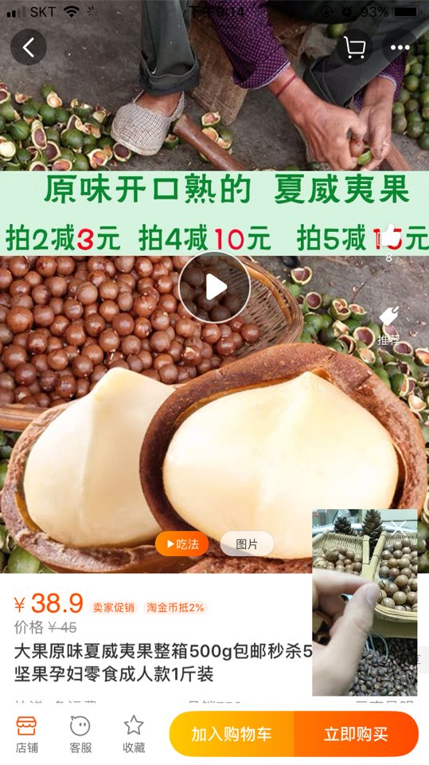
1. Overview of target system
2) Main features
Live Video Streaming
Online Shopping System

Slide 6
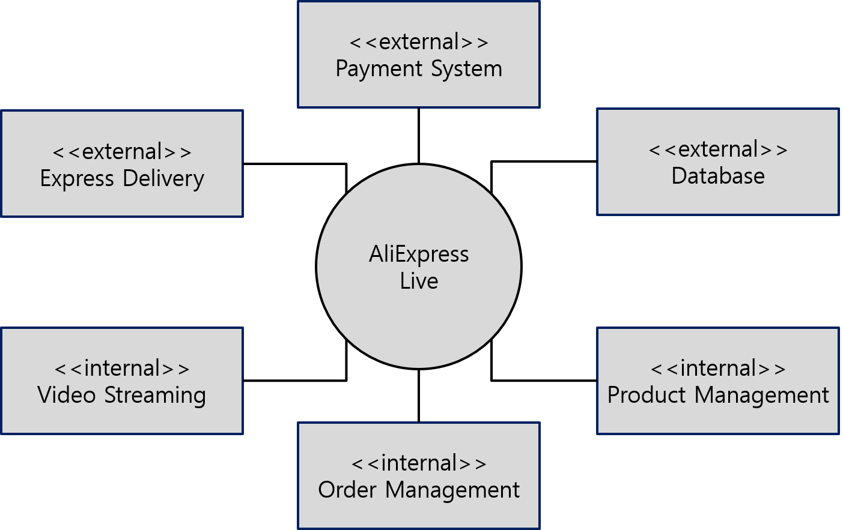
1. Overview of target system
3) Context modeling

Slide 7
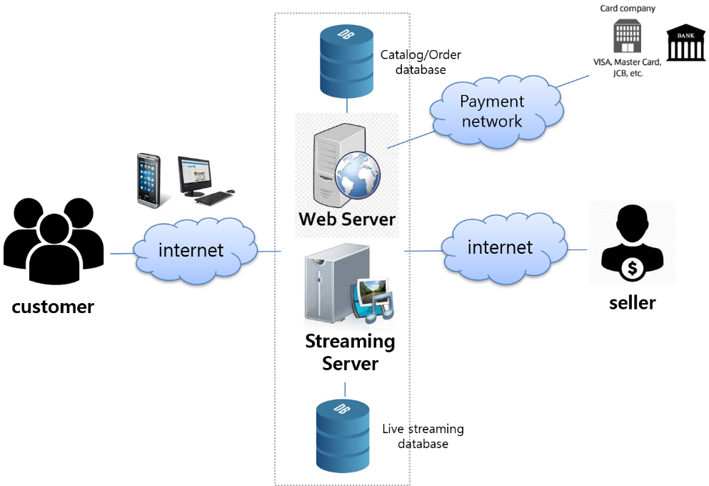
2. System architecture
1) AliExpress system architecture

Slide 8
3. System functionalities
1) User Scenarios
Examples of User Scenario
User Scenario #5
When the customer clicks on the Live store, it will go to the broadcast webpage. The video window is put at the top of the broadcast page;
User Scenario #7-D
Customer selects the quantity of the product, puts the product into the shopping cart or makes payment immediately.

Slide 9
User Scenario 목록 등을 좀 보여줄 필요가 있다
( APPENDIX )

Slide 10
3. System functionalities
2) Actor Extraction
Actor | Description
Customer | A user of system who purchases products.
Seller | A user of system who sells products.
Payment System | An external system which handles payment.

Slide 11
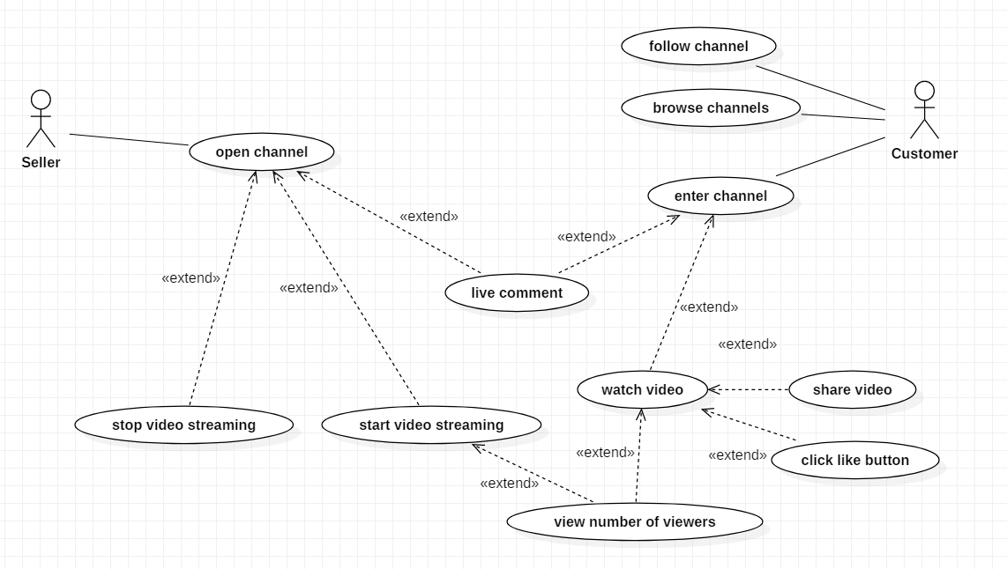
3. System functionalities
3) Use cases Diagrams
Watch / browse live channels

Slide 12
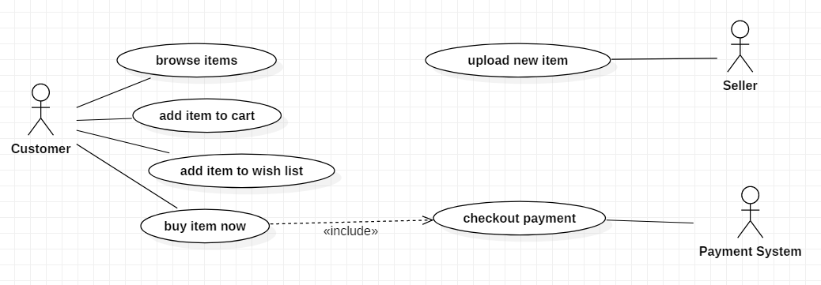
3. System functionalities
3) Use cases Diagrams
Order products

Slide 13
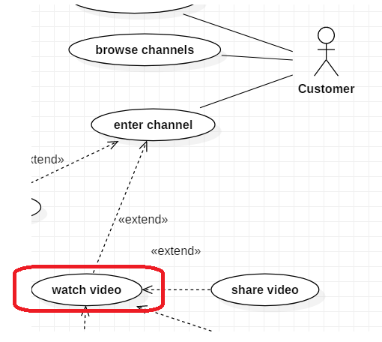
3. System functionalities
4) Function Descriptions
User Scenario #5
When the customer clicks on the Live store, it will go to the broadcast webpage. The video window is put at the top of the broadcast page;

Slide 14
3. System functionalities
4) Function Descriptions
Function Name | 1. Watch video
Definition | Customers open any channel to watch live streaming. If the channel has ongoing live video, it will be displayed to the customer. Customer can click on the video to watch it
Input | Customer opens a channel and click on the video to watch it
Output | Any ongoing to live available in the store channel will be displayed on top and customer can watch it.
Process | Login to the website and open the ongoing live stream to watch. If there is any live available, it will be displayed.
Conditions | 1. Store must have ongoing or already ended video.

Slide 15
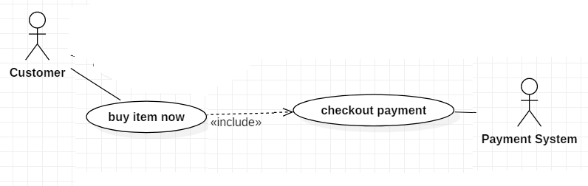
3. System functionalities
4) Function Descriptions
User Scenario #7-D
Customer selects the quantity of the product, puts the product into the shopping cart or makes payment immediately.

Slide 16
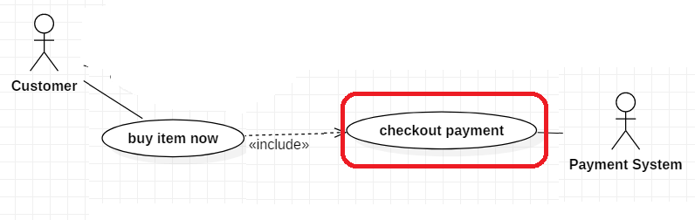
3. System functionalities
4) Function Descriptions
Function Name | 14. Checkout payment
Definition | Customer can make order and pay the price finally through checkout payment.
Input | Customer enters his or her private information like card holder information, bank information.
Output | Send it to the payment system to approve payment.
Process | Customer enters his or her payment information and then click “Place Order” button. Payment information will send to the payment system to approve/reject payment.
Conditions | 1. Customer should be in order page. 2. Customer should have his or her own payment information.

Slide 17
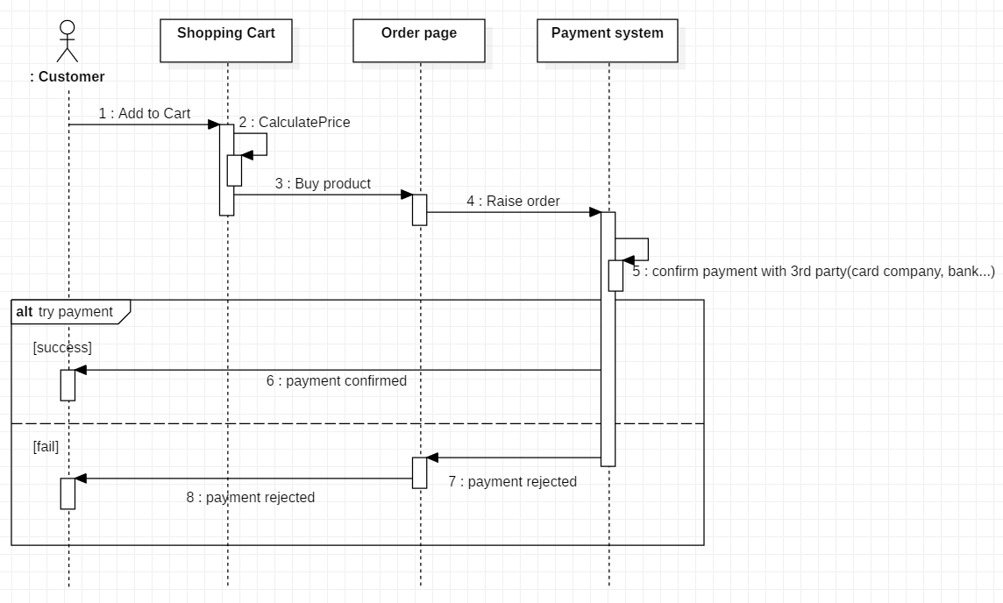
4. System behavior
1) Sequence diagram
Purchase Procedure

Slide 18
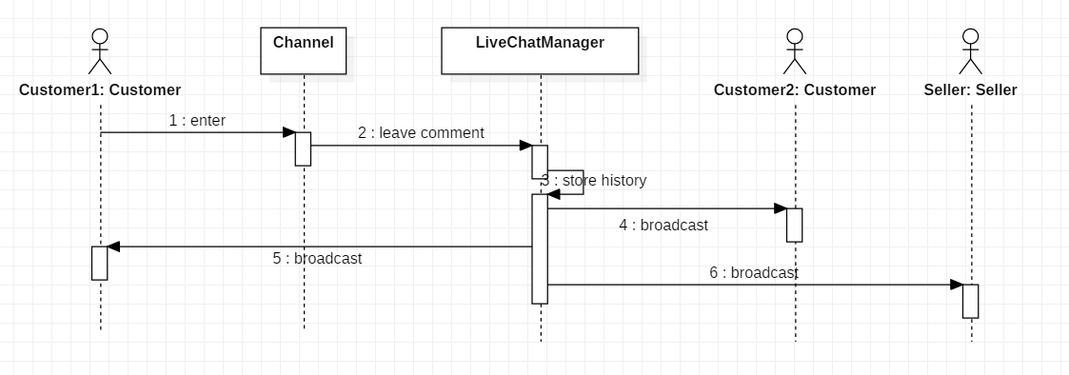
4. System behavior
1) Sequence diagram
Live Comment Broadcasting

Slide 19
5. Quality attributes scenarios
1) Nonfunctional requirements
NFRs | Definitions
Performance | How well does it function? (Response time, Data throughput, etc.)
Safety | How safe does it function? (Data backup/storage method, Server stability)
Security | How secure does it function? (Encryption level, Probability/time/resources to detect an attack, etc.)
Usability | How easy does it function? (Efficiency, Function ease, etc.)

Slide 20
5. Quality attributes scenarios
1) Nonfunctional requirements
Security
Source | Individual or system that is correctly identified or unknown identity
Stimulus | Tries to access to user information or payment information
Artifact | Data within system
Environment | System is online
Response | Hides identity of the user except identified user’s own information
Response Measure | Probability of detecting attack.

Slide 21
5. Quality attributes scenarios
1) Nonfunctional requirements
Performance
Source | Users
Stimulus | Requests video stream
Artifact | System
Environment | Under normal/overload mode
Response | Returns video stream
Response Measure | Latency and throughput

Slide 22
5. Quality attributes scenarios
1) Nonfunctional requirements
Safety
Source | Users
Stimulus | Requests to pay
Artifact | System
Environment | Payment system is online or offline
Response | Proceeds the payment or rollback when it is not available
Response Measure | Probability of incorrect payment

Slide 23
5. Quality attributes scenarios
1) Nonfunctional requirements
Usability
Source | Users
Stimulus | Tries to connect to system with PC or mobile devices.
Artifact | System
Environment | At runtime
Response | Shows different GUI for each devices
Response Measure | User satisfaction

Slide 24
5. Quality attributes scenarios
2) Priority of Each Non-Functional Requirements
Utility
Security
(M, M)
Performance
(M, H)
Safety
(H, M)
Usability
(L, L)
User's information should be kept securely
Users should be able to watch video with good quality
Payment should be proceed without any error and when it should be rollback when it is not available
Users should be able to use system with various type of devices

Slide 25
6. System constraints
1) System constraints
Technical constraints
The system should not use Active X and support payment on all kind of web browsers.
The system should work on IOS, Android and Windows.
Business constrains
The system should be ready to demo until August 2019
The system should spend less than 1 billion dollars

Slide 26
7. Future works
1) Architecture design

Slide 27
Q&A
Thanks

Slide 28
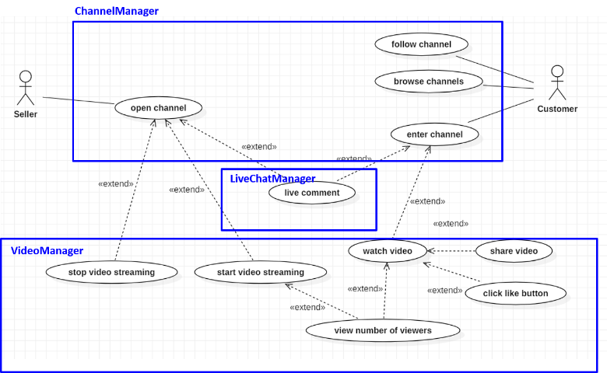
Appendix
Relationship Among Components

Slide 29
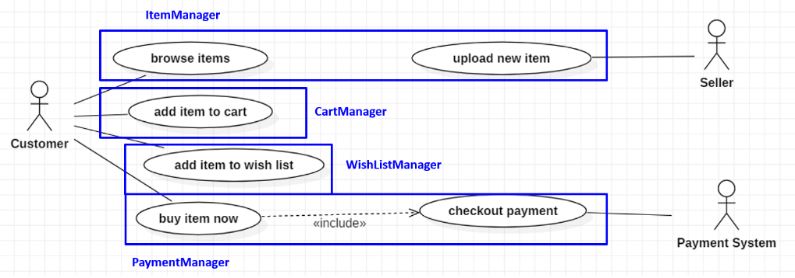
Appendix
Relationship Among Components

Slide 30
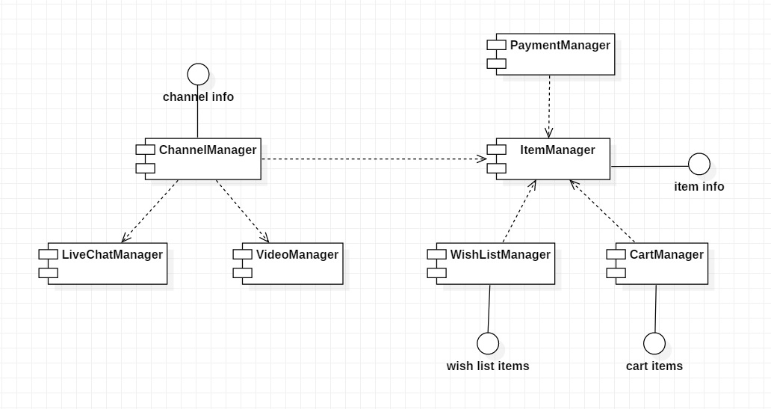
Appendix
Component Diagram

