Slide 1
LiveShop
Team #1
Pham Cong Vinh Hyung-Joon Jeon Taekwon Ka
Vo Van Vi Mwasinga Lusungu

Slide 2
Contents
System Overview
01
Architecture Design
02
Conclusion
03

Slide 3
System Overview

Slide 4



System Overview
live streaming
online chat
online purchasing system
Live Shop
LiveShop
LiveShop
Design Concept of LiveShop

Slide 5
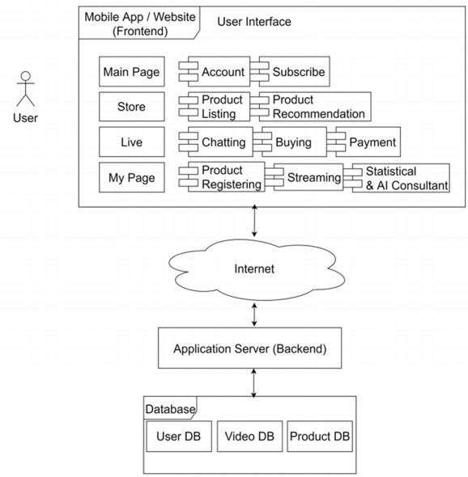
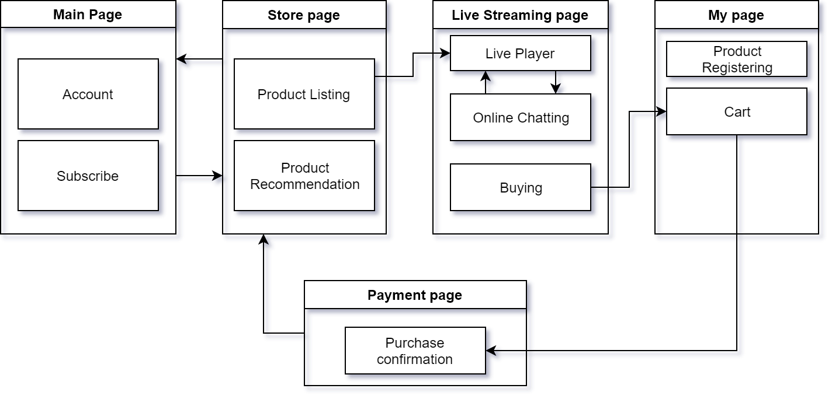
System Overview
Overall system of LiveShop

Slide 6
Architecture Design

Slide 7
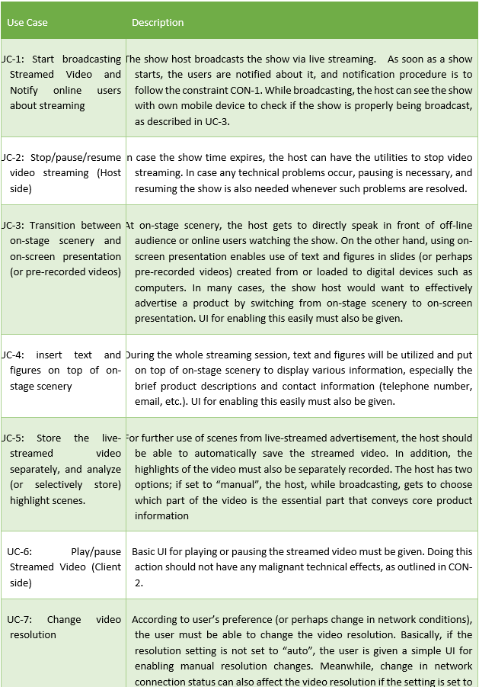
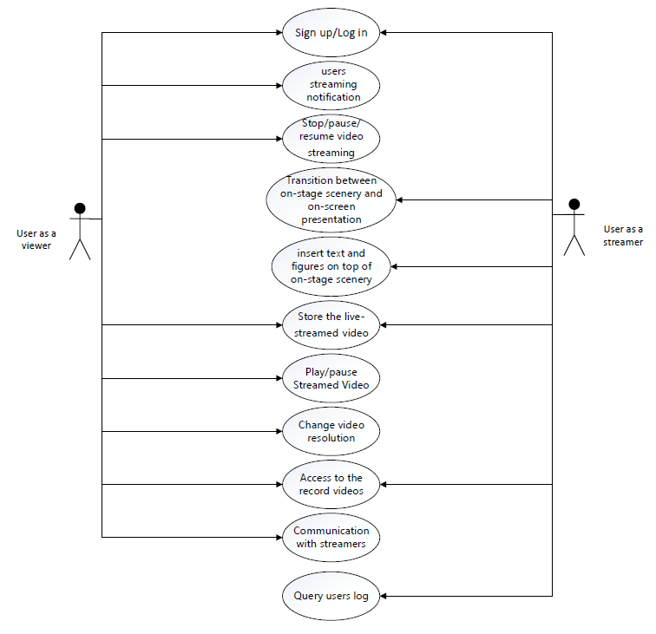
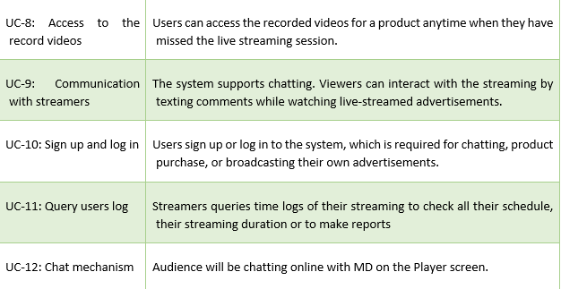
Architecture Design
System Requirement : Use Case

Slide 8
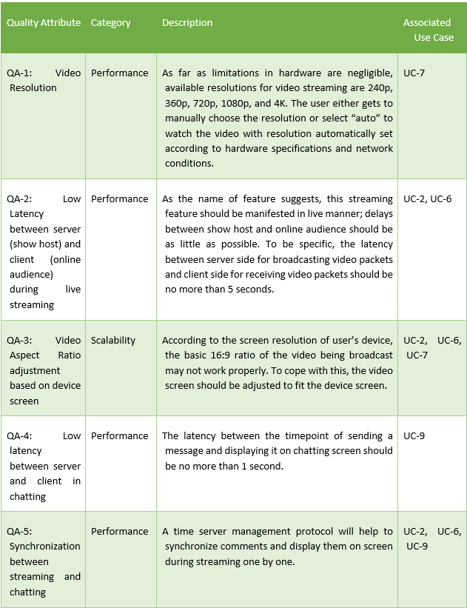


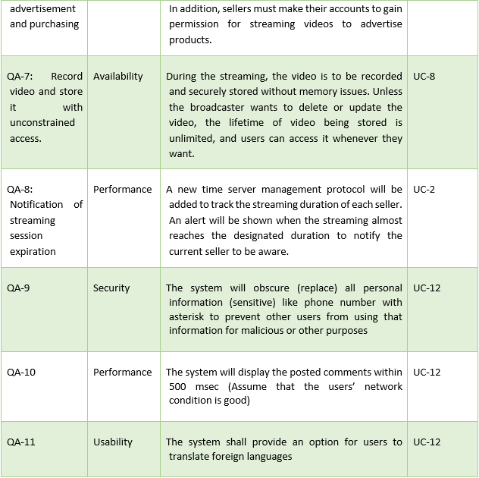
Architecture Design
System Requirement : Quality Attribute Scenario

Slide 9
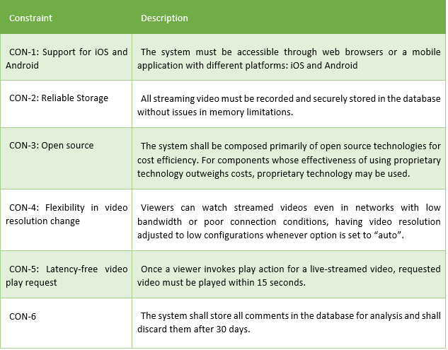
Architecture Design
System Requirement : Constraints

Slide 10
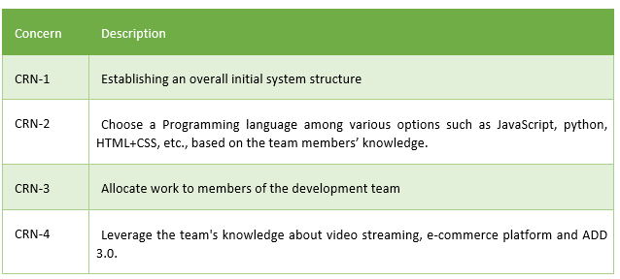
Architecture Design
System Requirement : Architectural Concern

Slide 11
Architecture Design
ADD Process
Start from a greenfield system in mature domain
Iteration 1 : System Architecture
Goal : To establish an overall system architecture
Iteration 2 : Selection of Technologies
Goal : To establish an overall initial system structure while leveraging the team's knowledge.
Iteration 3 : Refining elements for Video Streaming functionality
Goal : To decide design concepts from existing software solutions related to video streaming
Iteration 4 : Commenting
Goal : To add the commenting feature to the system

Slide 12
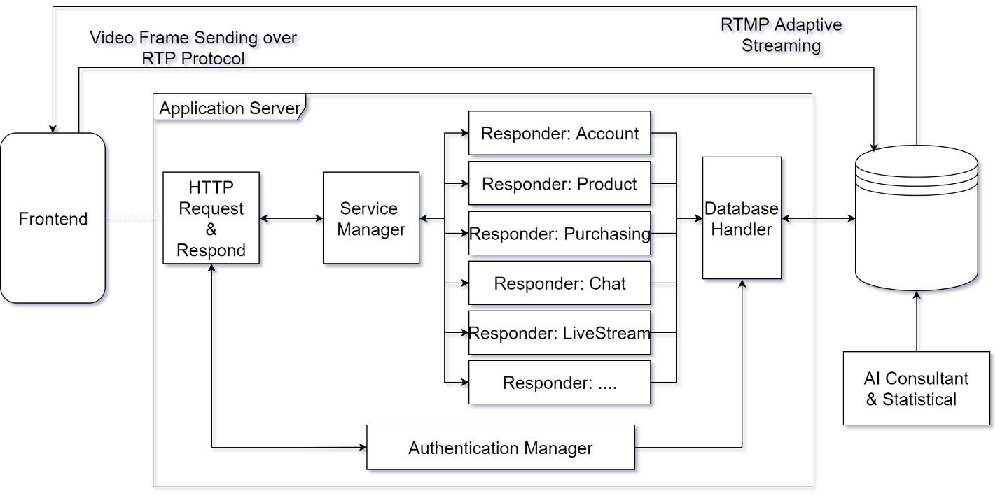
Architecture Design
Sketch view of Iteration 1 : System Architecture
Sketch view of Action-Domain-Responder

Slide 13
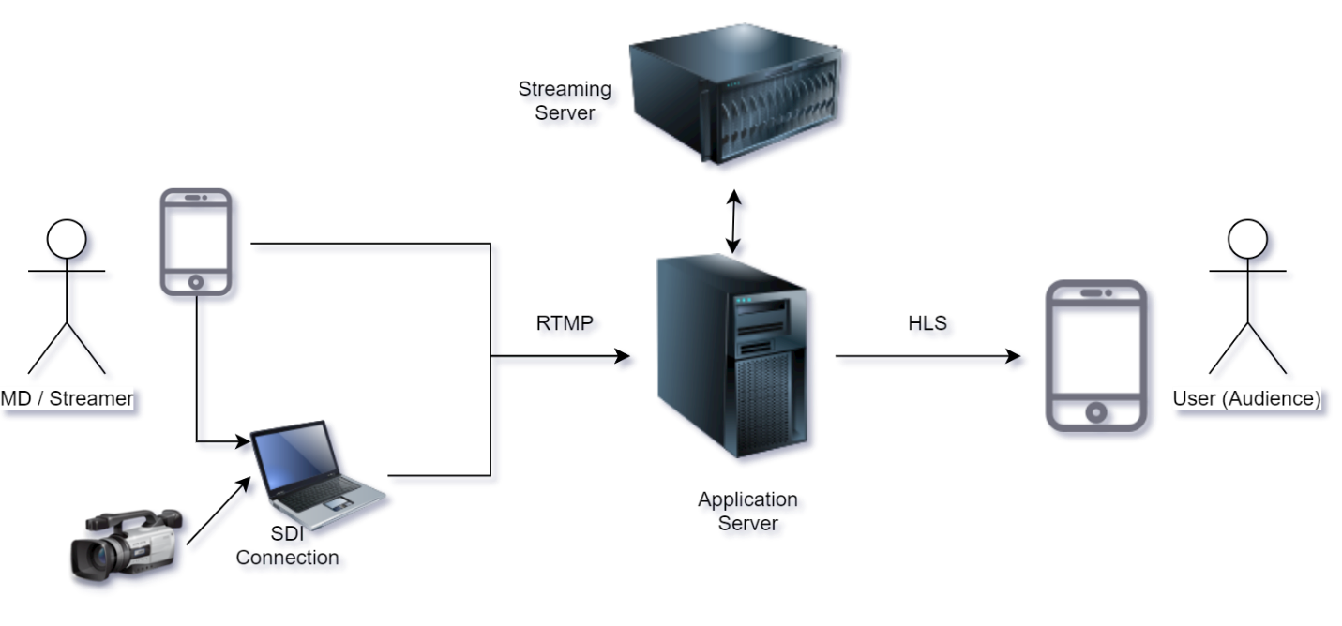
Architecture Design
Sketch view of Iteration 2 : Selection of Technologies
Sketch view of streaming server

Slide 14
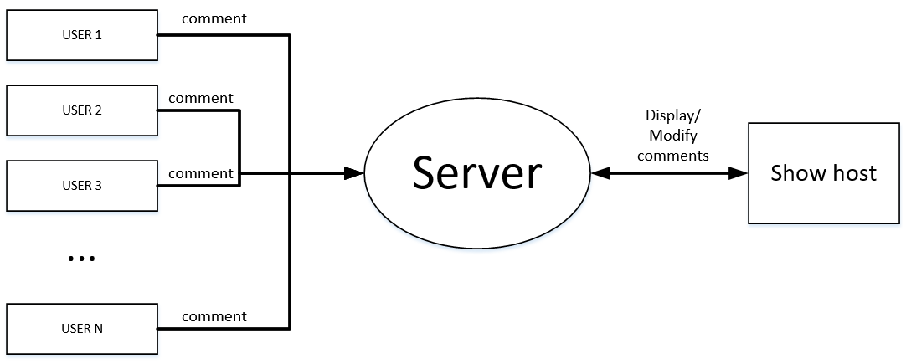
Architecture Design
Sketch view of Iteration 4 : Commenting
Sketch view of commenting feature

Slide 15
Conclusion

Slide 16
Conclusion
The overall architecture design is based on the principle of Action Domain Responder architecture. The decision to adopt this design principle was necessitated by the need to separate components in order to eliminate the possibility of single point of failure instances.
In our initial architectural design, we adopted a very simple model which comprised a single apache2 server on which all services such as the video streaming RTMP. This architecture had various drawbacks including the issue of a single point of failure. Applying ADD principles in design the architecture helped us to come up with a better architectural design.
Rather than the requirement specification through reverse engineering, more detatiled and diverse system architectures were obtained when we focus on quality attributes and design the architecture by ADD process.

Slide 17
Thank you!
Team #1
Pham Cong Vinh Hyung-Joon Jeon Taekwon Ka
Vo Van Vi Mwasinga Lusungu

