Slide 1
ADD for LiveShop: Document of Architectural Drivers
Team 1
Hyung-Joon Jeon 2019712410
PHAM CONG VINH 2019711010
MWASINGA LUSUNGU 2019711011
VO VAN VI 2018711276
Taekwon Ka 2013314340

Slide 2
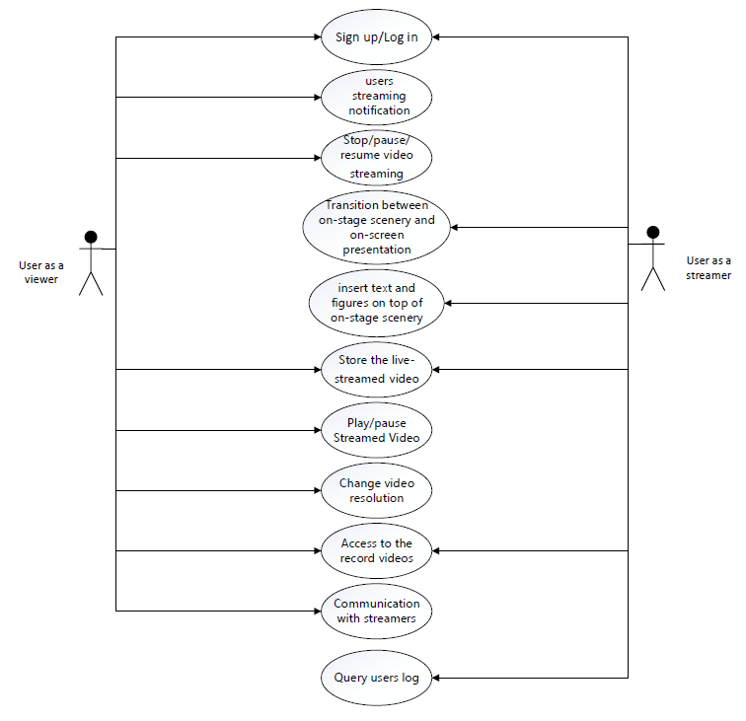
Use Case Diagram

Slide 3
Use cases
Use Case | Description
UC-1: Start broadcasting Streamed Video and Notify online users about streaming | The show host broadcasts the show via live streaming. As soon as a show starts, the users are notified about it, and notification procedure is to follow the constraint CON-1. While broadcasting, the host can see the show with own mobile device to check if the show is properly being broadcast, as described in UC-3.
UC-2: Stop/pause/resume video streaming (Host side) | In case the show time expires, the host can have the utilities to stop video streaming. In case any technical problems occur, pausing is necessary, and resuming the show is also needed whenever such problems are resolved.
UC-3: Transition between on-stage scenery and on-screen presentation (or pre-recorded videos) | At on-stage scenery, the host gets to directly speak in front of off-line audience or online users watching the show. On the other hand, using on-screen presentation enables use of text and figures in slides (or perhaps pre-recorded videos) created from or loaded to digital devices such as computers. In many cases, the show host would want to effectively advertise a product by switching from on-stage scenery to on-screen presentation. UI for enabling this easily must also be given.
UC-4: insert text and figures on top of on-stage scenery | During the whole streaming session, text and figures will be utilized and put on top of on-stage scenery to display various information, especially the brief product descriptions and contact information (telephone number, email, etc.). UI for enabling this easily must also be given.
UC-5: Store the live-streamed video separately, and analyze (or selectively store) highlight scenes. | For further use of scenes from live-streamed advertisement, the host should be able to automatically save the streamed video. In addition, the highlights of the video must also be separately recorded. The host has two options; if set to “manual”, the host, while broadcasting, gets to choose which part of the video is the essential part that conveys core product information

Slide 4
Use cases
Use Case | Description
UC-6: Play/pause Streamed Video (Client side) | Basic UI for playing or pausing the streamed video must be given. Doing this action should not have any malignant technical effects, as outlined in CON-2.
UC-7: Change video resolution | According to user’s preference (or perhaps change in network conditions), the user must be able to change the video resolution. Basically, if the resolution setting is not set to “auto”, the user is given a simple UI for enabling manual resolution changes. Meanwhile, change in network connection status can also affect the video resolution if the setting is set to “auto”. Details on how video resolution is automatically changed is described in QA-1.
UC-8: Access to the record videos | Users can access the recorded videos for a product anytime when they have missed the live streaming session.
UC-9: Communication with streamers | The system supports chatting. Viewers can interact with the streaming by texting comments while watching live-streamed advertisements.
UC-10: Sign up and log in | Users sign up or log in to the system, which is required for chatting, product purchase, or broadcasting their own advertisements.
UC-11: Query users log | Streamers queries time logs of their streaming to check all their schedule, their streaming duration or to make reports

Slide 5
Quality Attributes
Quality Attribute | Category | Description | Associated Use Case
QA-1: Video Resolution | Performance | As far as limitations in hardware are negligible, available resolutions for video streaming are 240p, 360p, 720p, 1080p, and 4K. The user either gets to manually choose the resolution or select “auto” to watch the video with resolution automatically set according to hardware specifications and network conditions. | UC-7
QA-2: Low Latency between server (show host) and client (online audience) during live streaming | Performance | As the name of feature suggests, this streaming feature should be manifested in live manner; delays between show host and online audience should be as little as possible. To be specific, the latency between server side for broadcasting video packets and client side for receiving video packets should be no more than 5 seconds. | UC-2, UC-6
QA-3: Video Aspect Ratio adjustment based on device screen | Scalability | According to the screen resolution of user’s device, the basic 16:9 ratio of the video being broadcast may not work properly. To cope with this, the video screen should be adjusted to fit the device screen. | UC-2, UC-6, UC-7
QA-4: Low latency between server and client in chatting | Performance | The latency between the timepoint of sending a message and displaying it on chatting screen should be no more than 1 second. | UC-9

Slide 6
Quality Attributes
Quality Attribute | Category | Description | Associated Use Case
QA-5: Synchronization between streaming and chatting | Performance | A time server management protocol will help to synchronize comments and display them on screen during streaming one by one. | UC-2, UC-6, UC-9
QA-6: Account management for advertisement and purchasing | Security | Although any users (even unregistered users) can view the products and their associated streamed videos, they must sign up / log in to purchase them. In addition, sellers must make their accounts to gain permission for streaming videos to advertise products. | UC-10
QA-7: Record video and store it with unconstrained access. | Availability | During the streaming, the video is to be recorded and securely stored without memory issues. Unless the broadcaster wants to delete or update the video, the lifetime of video being stored is unlimited, and users can access it whenever they want. | UC-8
QA-8: Notification of streaming session expiration | Performance | A new time server management protocol will be added to track the streaming duration of each seller. An alert will be shown when the streaming almost reaches the designated duration to notify the current seller to be aware. | UC-2

Slide 7
Constraints
Constraint | Description
CON-1: Support for iOS and Android | The system must be accessible through web browsers or a mobile applications with different platforms: iOS and Android
CON-2: Reliable Storage | All streaming video must be recorded and securely stored in the database without issues in memory limitations.
CON-3: Open source | The system shall be composed primarily of open source technologies for cost efficiency. For components whose effectiveness of using proprietary technology outweighs costs, proprietary technology may be used.
CON-4: Flexibility in video resolution change | Viewers can watch streamed videos even in networks with low bandwidth or poor connection conditions, having video resolution adjusted to low configurations whenever option is set to “auto”.
CON-5: Latency-free video play request | Once a viewer invokes play action for a live-streamed video, requested video must be played within 15 seconds.

Slide 8
Concerns
Concern | Description
CRN-1 | Establishing an overall initial system structure
CRN-2 | Choose a Programming language among various options such as Javascript, python, HTML+CSS, etc., based on the team members’ knowledge.
CRN-3 | Allocate work to members of the development team
CRN-4 | Leverage the team's knowledge about video streaming, e-commerce platform and ADD 3.0.

