Slide 1
Fitts: Recommendation System
with ADD
https://github.com/skkuse-adv/2019Fall_team2
Team Name: Team2
Members: 빙 (2019711305),
임근식(2019711699),
하지크 (2019711435)

Slide 2
Presentation Outline
Project management
System overview
Architecture design
Conclusion

Slide 3
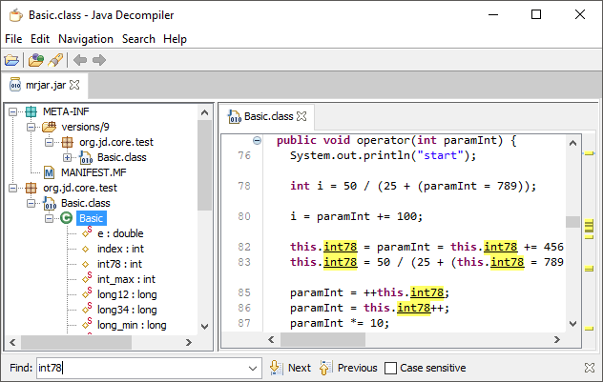

Project management (1/7)
Analyze the target system with open-source software
Utilize reverse-engineering tool, Java Decompiler

Slide 4
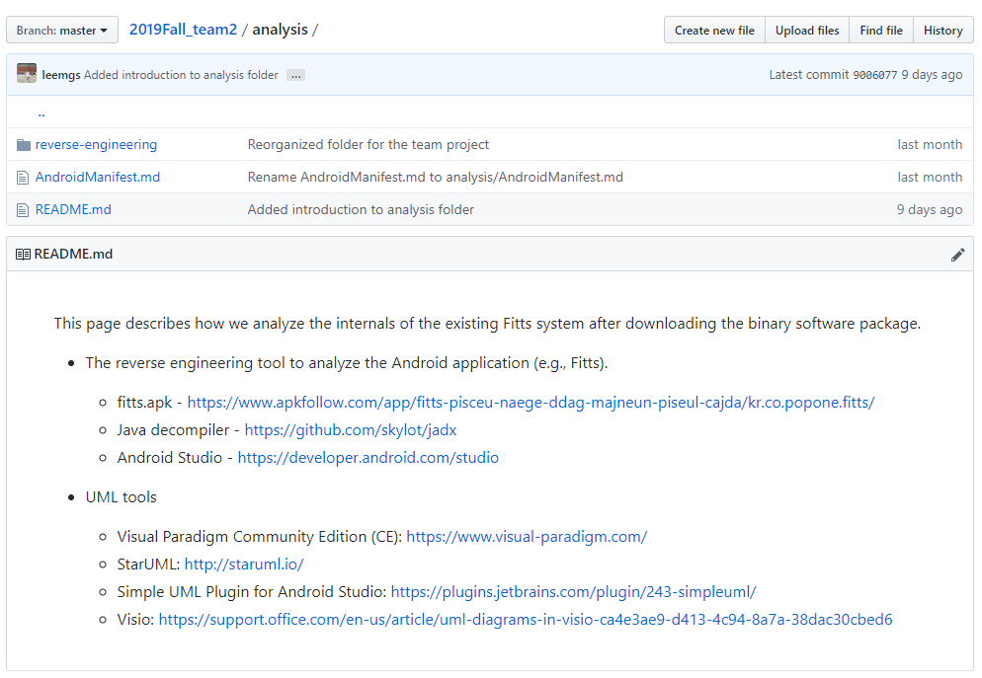

Project management (2/7)
Summarize the internals of the target system with Git/GitHub

Slide 5
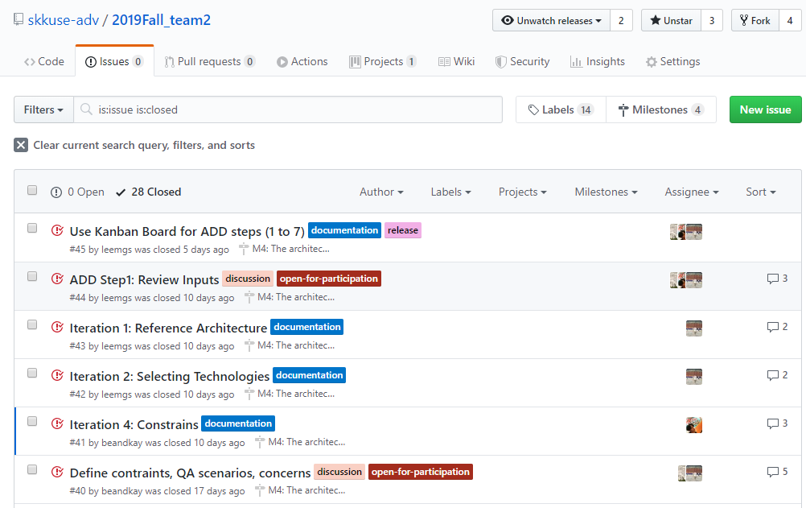
Project management (3/7)
Discuss new idea & topic with GitHub Issue

Slide 6
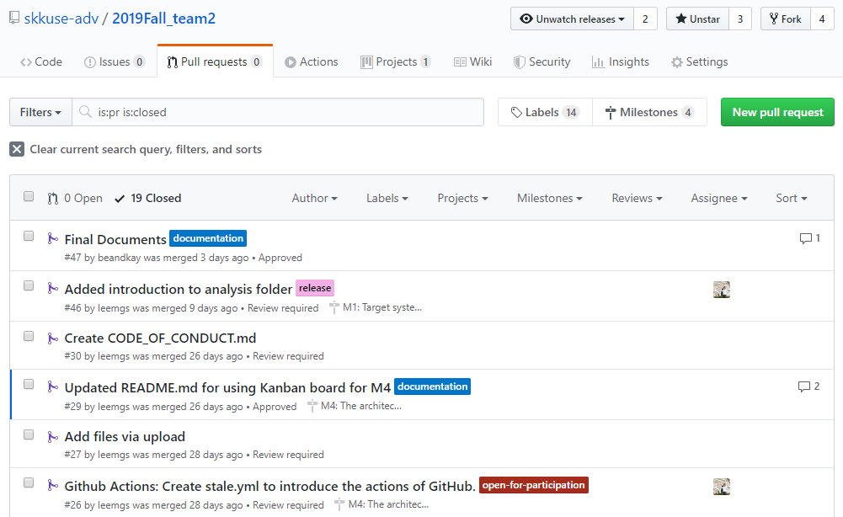
Project management (4/7)
Review and merge tasks among members with Pull Request (PR)

Slide 7
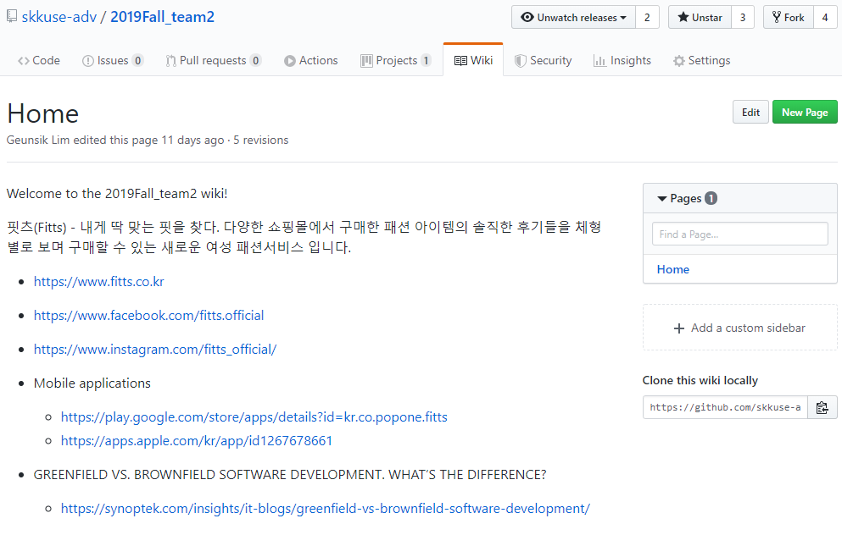
Project management (5/7)
Share the survey and study with Wiki

Slide 8
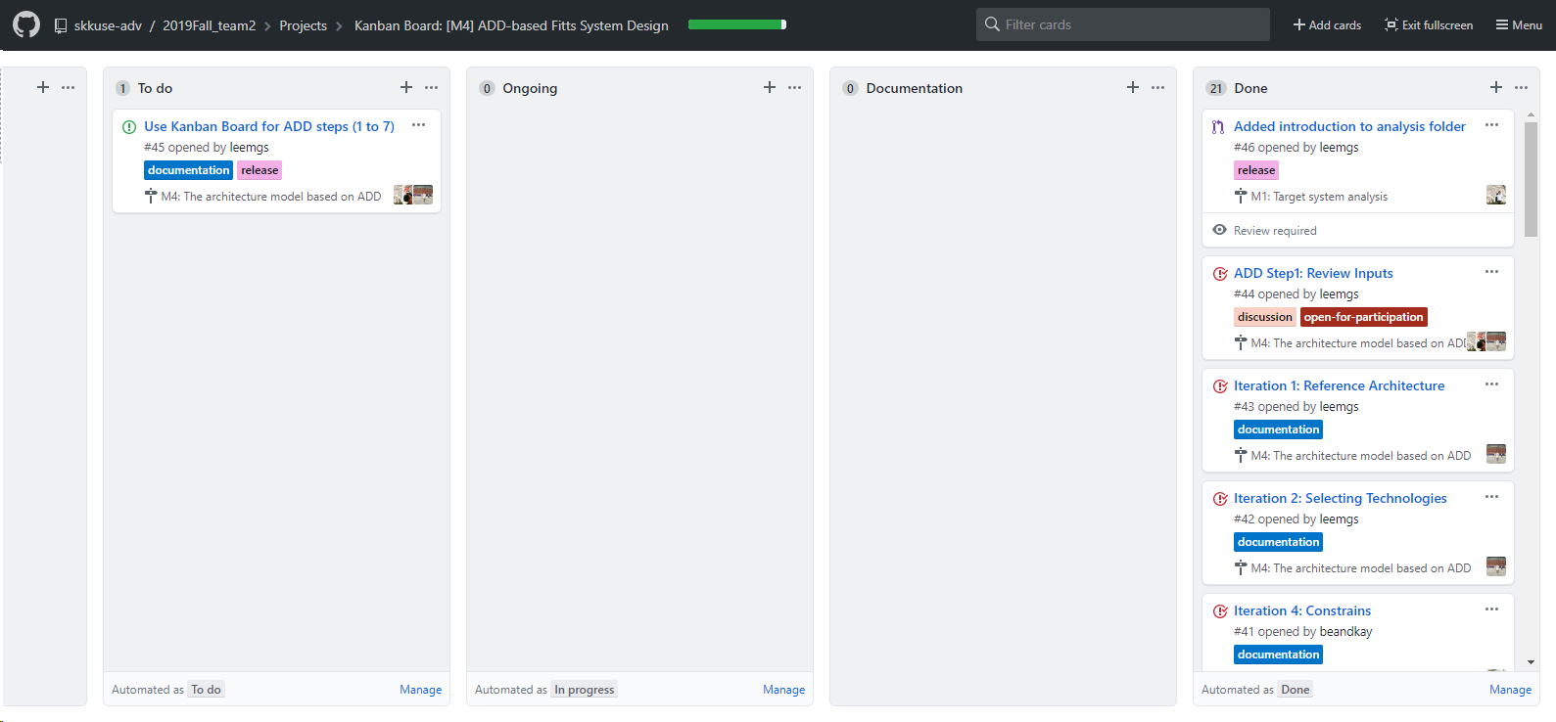
Project management (6/7)
Manage the work status of items with Kanban board of GitHub

Slide 9
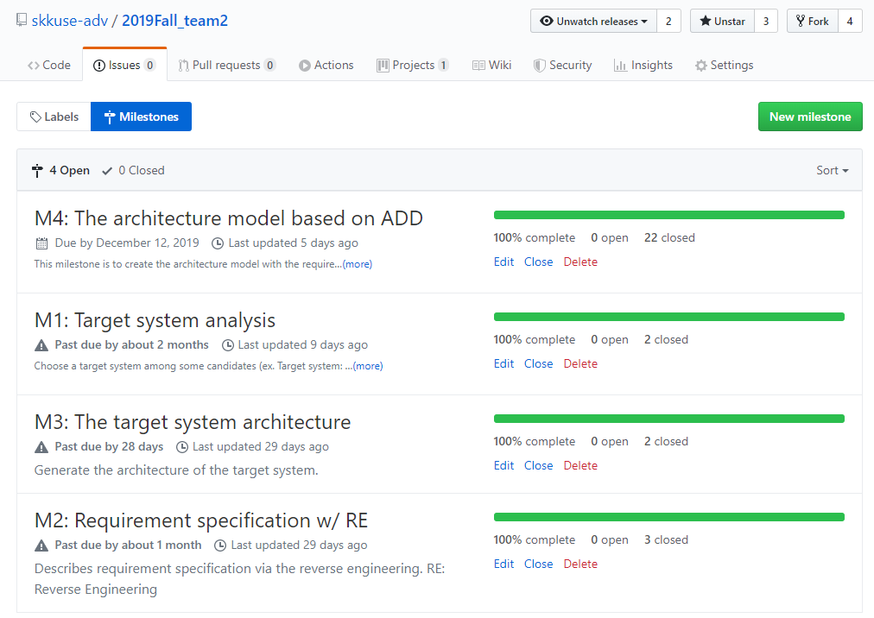
Project management (7/7)
Manage the schedule of the each step with Milestone

Slide 10
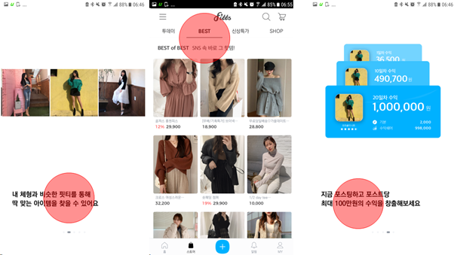
System overview (1/2)
Figure 1. Major functions of the Fitts system

Slide 11
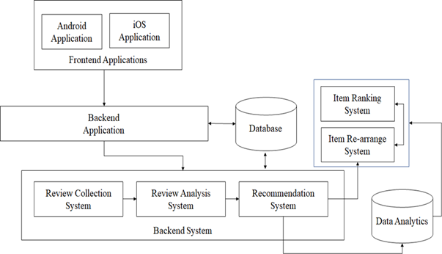
System overview (2/2)
Figure 2. Overall system architecture

Slide 12
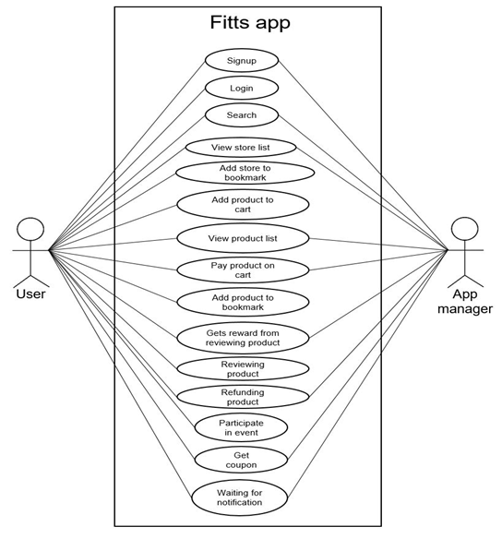
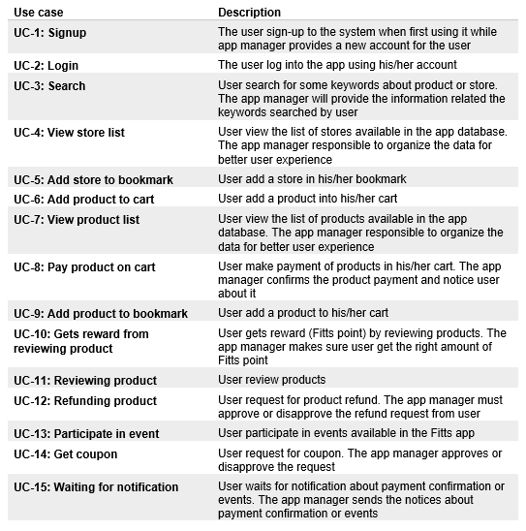
Architectural Design (1/5)
Review input: Use case

Slide 13
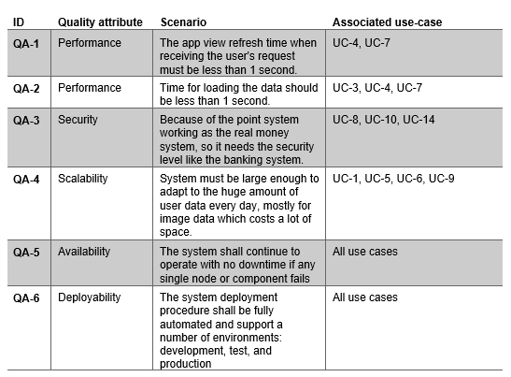
Architectural Design (2/5)
Review input: Quality Attribute Scenario

Slide 14
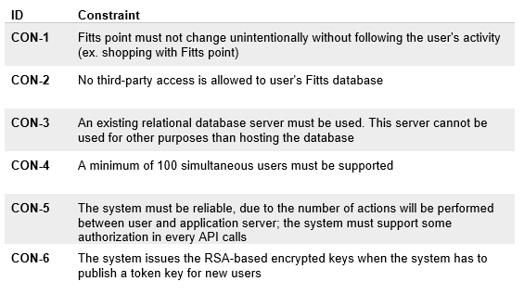
Architectural Design (3/5)
Review input: Constraints

Slide 15
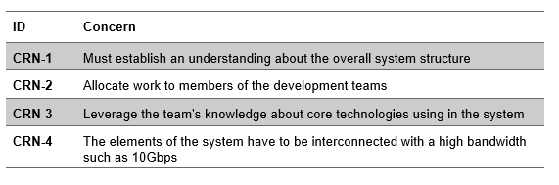
Architectural Design (4/5)
Review input: Architectural Concern

Slide 16
Architectural Design (5/5)
Summary of ADD
Start from a greenfield system
Iteration 1: System architecture
Goal: Depict the reference architecture and overall system structure
Iteration 2: Selecting technologies
Goal: Select technologies in order to enhance the existing recommendation system
Iteration 3: Quality Attribute Scenario driver
Goal: Review QAS driver is because we decided to integrate a recommendation system with the existing Fitts system architecture
Iteration 4: Constraints driver
Goal: Review constraints driver
Iteration 5: Architectural concern driver
Goal: Review architectural concern driver

Slide 17
Conclusion
We added a "Recommendation System" to the existing Fitts application
The way we integrate the "Recommendation System" is done by iteration of ADD
Our "Recommendation System" employs the state of the art AI-technology in order to give Fitts customer a better shopping experience compare to other personalization apps

Slide 18
Thank you

