Slide 1
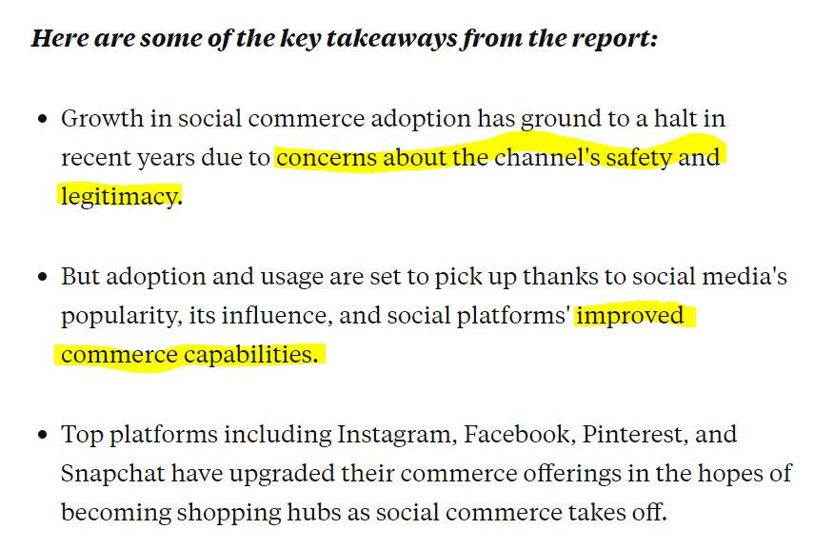
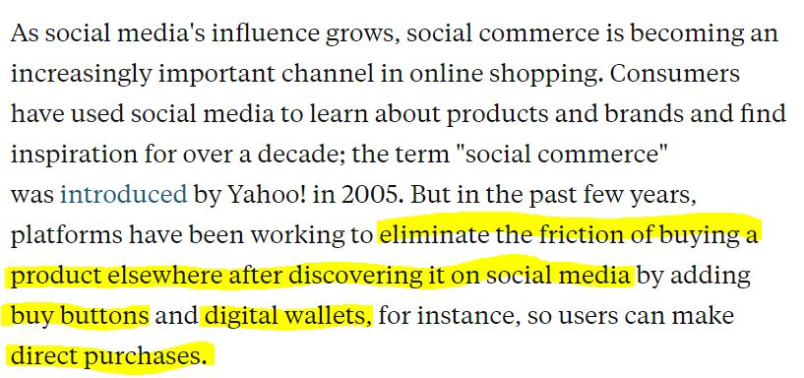
Social Commerce Market Report: How social media is driving ecommerce sales in 2020
->Business Insider

Slide 2
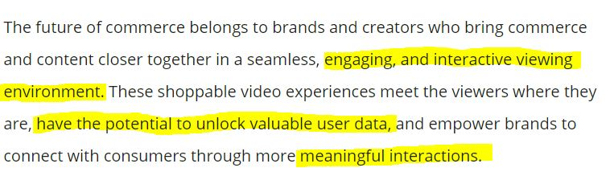
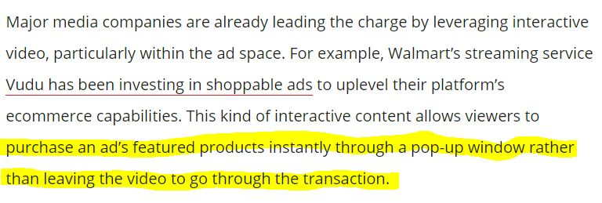
The Future of Commerce is a Shoppable Video
->VB

Slide 3
내용 구상
어떠한 형태의 서비스를 만드는건지,, 우리가 브랜드를 론칭하는 건가? 아님 브랜드-소셜 미디어의 매개체 역할로써 어떻게 플랫폼 마케팅을 할 수 있는지 아이디어 주는 거? 아님 소셜 미디어의 담당자로써 어떻게 우리 플랫폼 내 해당 서비스를 실현시킬지에 대한 프로젝트?
->어떤 상황이냐에 따라 주체 (entity), user story가 달라질 것 같은데.
(참고)
https://topdigital.agency/trends-in-e-commerce-software-development-you-should-consider/

Slide 4
Chatbots interacting with customers
-assist customers in dealing with issues, answer their questions, and suggest what products customers need
Ex) H&M Kik messengers
2) More storefront apps
-shopping mobile
-send promotional notifications and targeted recommendations to customers
-enable convenient product search with a variety of filters
-fast and secure payments
3) Predictive Pricing (data-driven decision making)
-can be done by machine learning and big data
-flexible and offer the best price for a product like how hotels and accommodation places do
4) Augmented Reality (AR)
-visualization, and making the purchase decision faster (just like test drives)
Ex) IKEA’s IKEA Place
-personalizing the shopping experience, increasing customer engagement
5) Smart search and voice search
-can enable with elements of artificial intelligence
-avoid customers going to other shops when they can’t find what they want
-understanding customers, getting insights into customer needs &shopping habits
6) Security issues
-must prevent credit card data being stolen and being used by fraudsters
-high level of information security and customer data protection needed
-the use of specific financial software

