Slide 1
오늘도 거래완료
어플리케이션 제안서 10조

Slide 2
팀명을 입력하세요
오늘도 거래완료
1. Background
2. Overview
3. Design concept
4. Development
5. Features
6. Reference

Slide 3
Background

Slide 4

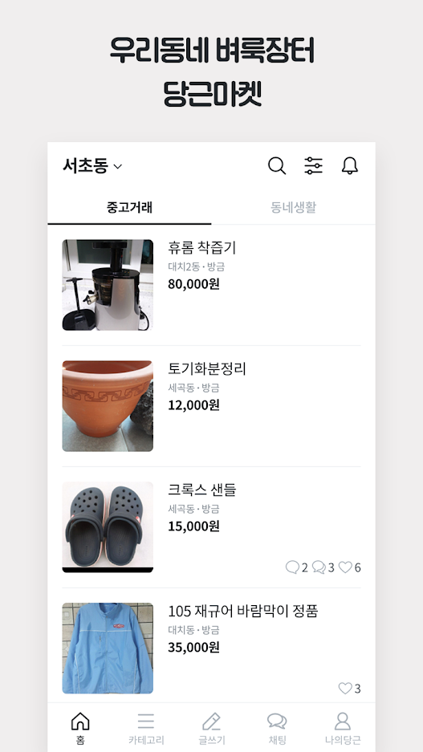
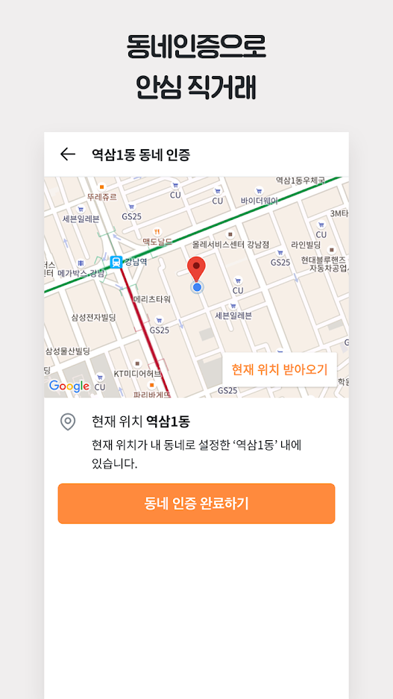
팀명을 입력하세요
오늘도 거래완료
1. Background
Application for safe used transactions

Slide 5
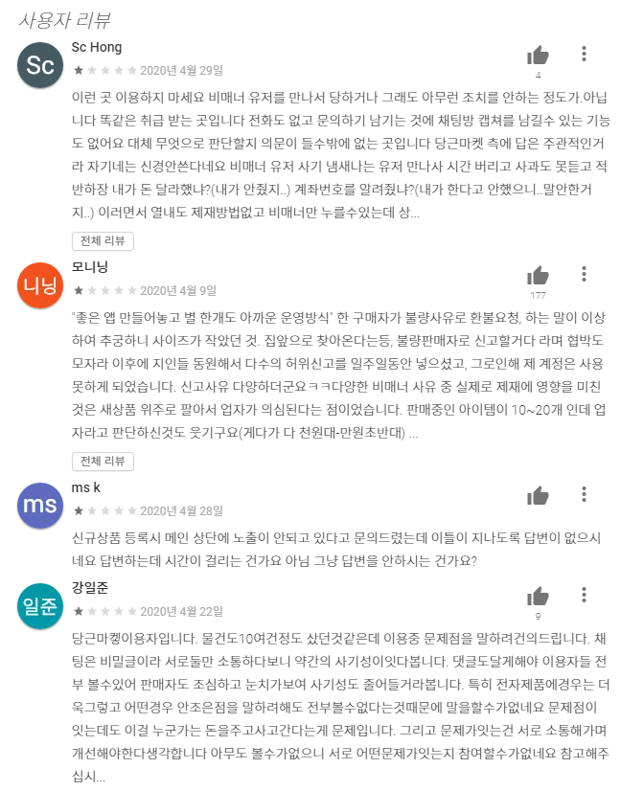
팀명을 입력하세요
오늘도 거래완료
1. Background
However…
1) Buyer oriented policy

Slide 6
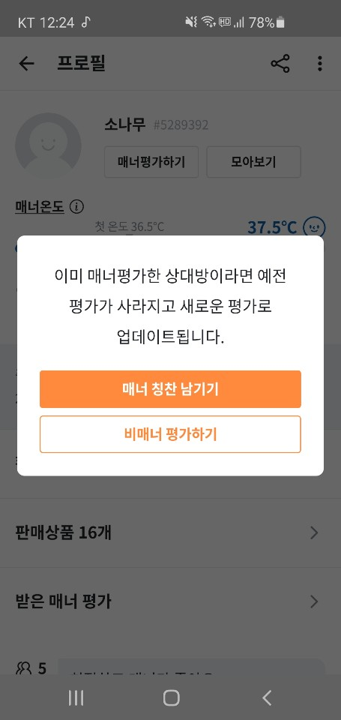
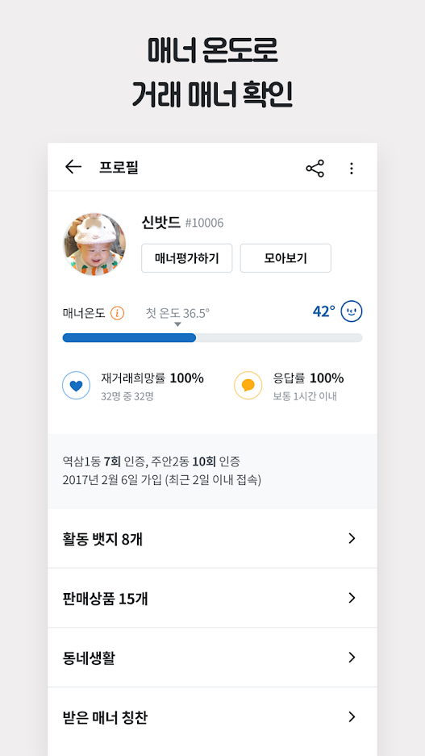
팀명을 입력하세요
1. Background
However…
2) Meaningless manner temperature
User can evaluate without any communication

Slide 7
Overview

Slide 8
Design Concept

Slide 9
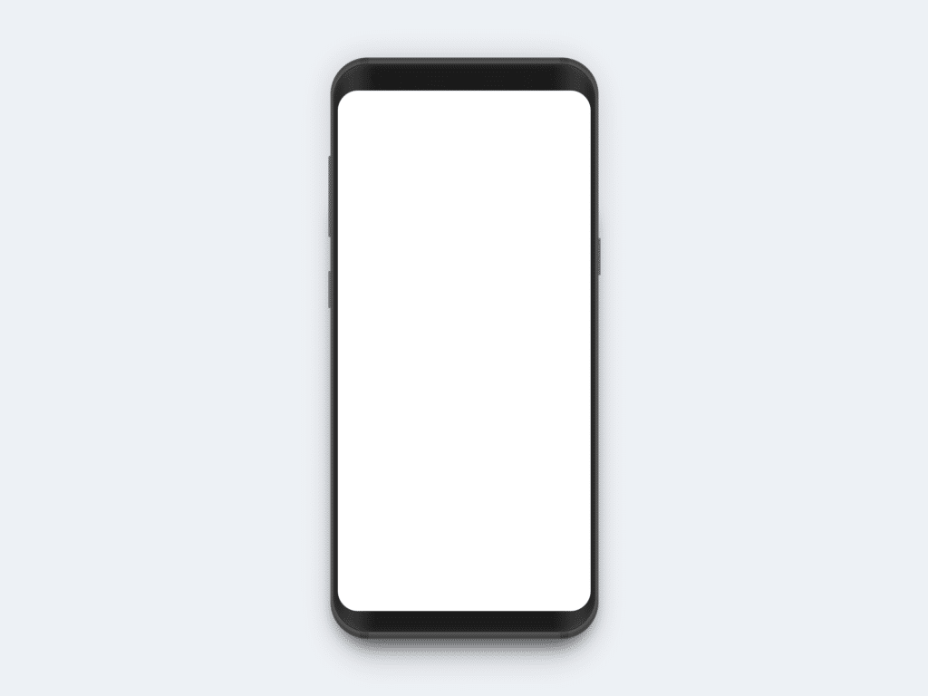





Design Concept:
Chatting board
Sungkyunkwan
Software Book
Transaction completed
Post Review
click to post review about sellers
communicate with Buyer & Seller

Slide 10

Design Concept:
Goods rating system
Praise
Sungkyunkwan
Suwon
4.2
Represent the average rate about goods
rate about goods
Choose rate and upload screenshot.
Upload
Screenshot
upload screenshot
Screenshot.pdf
2020/05/03
Cancel
Rating submitted

Slide 11
Development

Slide 12
팀명을 입력하세요
4. Development
1. System Architecture
Frontend
Backend
Web Browser
Web Application Server
Data Base
Web Server
Web Application
Chatting
System
Seller / Customer
Grading System

Slide 13




팀명을 입력하세요
4. Development
Frontend
Backend
Web Site
Web Application Server
Database
Seller / Customer
Grading System(with NLP)

Slide 14
Features

Slide 15
팀명을 입력하세요
5. Feature
Increased reliability of rate
It can only rating after chatting on the chat screen
Easy to review the report
It can upload chat history

Slide 16
Reference

Slide 17
팀명을 입력하세요

Slide 18
팀명을 입력하세요
설명 1
설명 2
나눔바른고딕
HY견고딕

Slide 19
팀명을 입력하세요

Slide 20
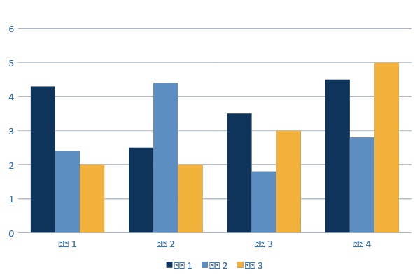
팀명을 입력하세요

